Slide 1
Presentation Title | Priorities of IEC
Presenter | Frans Vreeswijk, General Secretary & CEO
Session | Session #4: GSC Member Presentations
Document Name/Version | GSC20_Session#4_Prioirities_Frans_IEC Rev 0 Submission/Revision date: 21 April 2016
Notes:
1

Slide 2
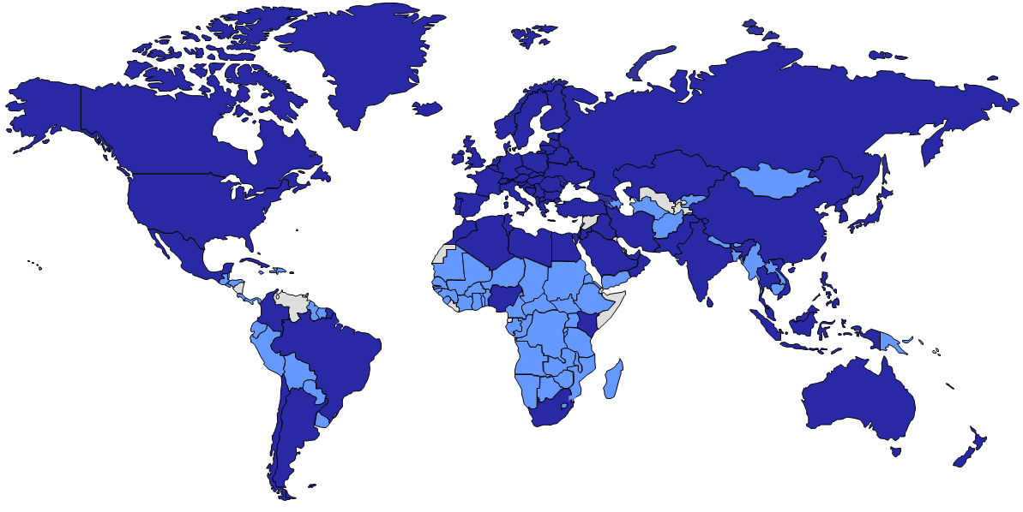
IEC IN FIGURES (2016)
World’s leading provider of International Standards and Conformity Assessment Systems in Electrotechnology
83 Members + 84 Affiliates
212 Technical Committees
> 1 450 Working Groups
> 20 000 Experts
> 9 000 International Standards
4 Conformity Assessment Systems
> 1M Certificates issued
Geneva
Boston
Nairobi
Sao Paulo
Singapore
Sidney
Notes:
2

Slide 3
MOVING FROM COMPONENTS TO SYSTEMS
3 Systems Committees (SyCs)
Active Assisted Living
Smart Energy
Electrotechnical Aspects of Smart Cities
Addressing the increasing complexity of technologies and the need for interoperability
Engaging Technical Committees (TCs), not directing them
Complementary to existing TCs, not competing with them
Breaking silos between technical areas
SyCs publish International Standards, Use Cases, Reference Architectures …
Notes:
3

Slide 4
DEFINING STRATEGIC AREAS
SG 9 – COMMUNICATION TECHNOLOGIES
SG 10 – WEARABLE SMART DEVICES
SG 8 – INDUSTRY 4.0
Develop strategy and roadmap for Smart Manufacturing
Develop common industrial terminology database
Recommend specific radio spectrum for critical applications
Identify technologies and trends that will impact IEC
Gather common requirements and identify gaps within IEC
Develop landscape of existing SDOs and consortia
Develop strategy and roadmap for Wearable Smart Devices
Develop unified terminology and definitions
Inventorize existing activities within and outside IEC
Notes:
4

Slide 5
FOSTERING INCREASED COLLABORATION
Notes:
5

