Slide 1

Presentation Title | Priorities of ARIB
Presenter | Kohei SATOH
Session | 4.1.1 Priorities of SDOs: ARIB
Document Name/Version | GSC20_Session#4_Priorities_ARIB Rev 0 Submission/Revision date: 20 April 2016
Notes:
1

Slide 2
Priorities (1)
- Strategic approach for global standardization -
Big three issues
5G : Collaborate worldwide through 5GMF (see attachment)
UHDTV & HDR : Promote the system worldwide
ITS : Promote the use of 700MHz
Close cooperation with Fora / Consortia
- draft STD with complete specification
- full IPR submission
・ gathering and analyzing information on IPR policy
- English Version of ARIB Standards

Slide 3
Priorities (2)
- Stop decreasing ARIB membership -
Less Privileges for Members
To decrease membership
ex)
・Free Download of ARIB Standards for non-members
・Free Attendance of ARIB Seminars for non-members
New Study / R&D Items
To increase membership
ex)
  ・Advanced private wireless communication systems

Slide 4
Challenges
Find new Study / R&D items to meet market needs
⇒ invite new members
Provide steady support to members
⇒ keep existing members
Accurate and rapid consultation on radio wave use
⇒ keep stable revenue

Slide 5
Next Steps (1)
International collaboration
and Standardization
Innovation by R&D
of industry, academia, government
５ＧＭＦ leads the discussion
Secretariat: ARIB/TTC

Slide 6
Next Steps (2)
Roadmap for 4K/8K proposed by MIC
Start of
4K・8K practical broadcasting
８Ｋ
UHDTV
(4K and 8K)
４Ｋ
Start of
8K test broadcasting
Start of
4K test broadcasting
Ｓａｔｅｌｌｉｔｅ
Ｂｒｏａｄｃａｓｔｉｎｇ
2 June, 2014
Smart TV
• Brazil World Cup
•Rio Olympics
•Tokyo Olympics
2Ｋ
The Shift to Digitization of Terrestrial Broadcasting
completed
Terrestrial Broadcasting
2011 2012 2013 2014 2016 2018 2020
6

Slide 7
Next Steps (3)
2016
202X
ITS
Connected Vehicle
Cooperative ITS
Automated
Driving
Many of frequency resources
Hybrid network
Commercial services
Dedicated system
Dedicated system
Safe driving support
Safe driving support
３D Map
（Real time Map）
Saving people
Big Data
Elderly driver assistance
…
Comfortable
Comfortable
Comfortable

Slide 8
Thank you
Merci beaucoup
谢 谢
감사합니다
ありがとう

Slide 9
<Attachment>
The Fifth Generation Mobile Communications Promotion Forum (5GMF)
1. Organization
2. Objectives
3. Activities
4. Worldwide Collaboration
5. Target

Slide 10
1. Organization
Establishment : 30 September 2014
Chairman : YOSHIDA, Susumu (Professor emeritus of Kyoto University)
Vice-Chair： SAKAUCHI, Masao (NICT),
Vice-Chair： SHINOHARA, Hiromichi (NTT)
Members : 91 (as of 1 April 2016)
Corporate body: 74, Academia individuals: 14
Special member: 3 (MIC, ARIB, TTC)
Secretary : Association of Radio Industries and Businesses(ARIB)
Telecommunications Technology Committee(TTC)
Web site : http://5gmf.jp/

Slide 11
Organizational Structure of the 5GMF

Slide 12
2. Objectives
Major objectives of 5GMF:
  To conduct R&D concerning 5G mobile and research and study on 5G standardization
  To collect information relating to 5G mobile and exchange thereof with other organizations
  To correspond and coordinate with related organization concerning 5G mobile
  To conduct dissemination and enlightenment pertaining to 5G mobile
  5G mobile = 5th generation mobile communications system

Slide 13
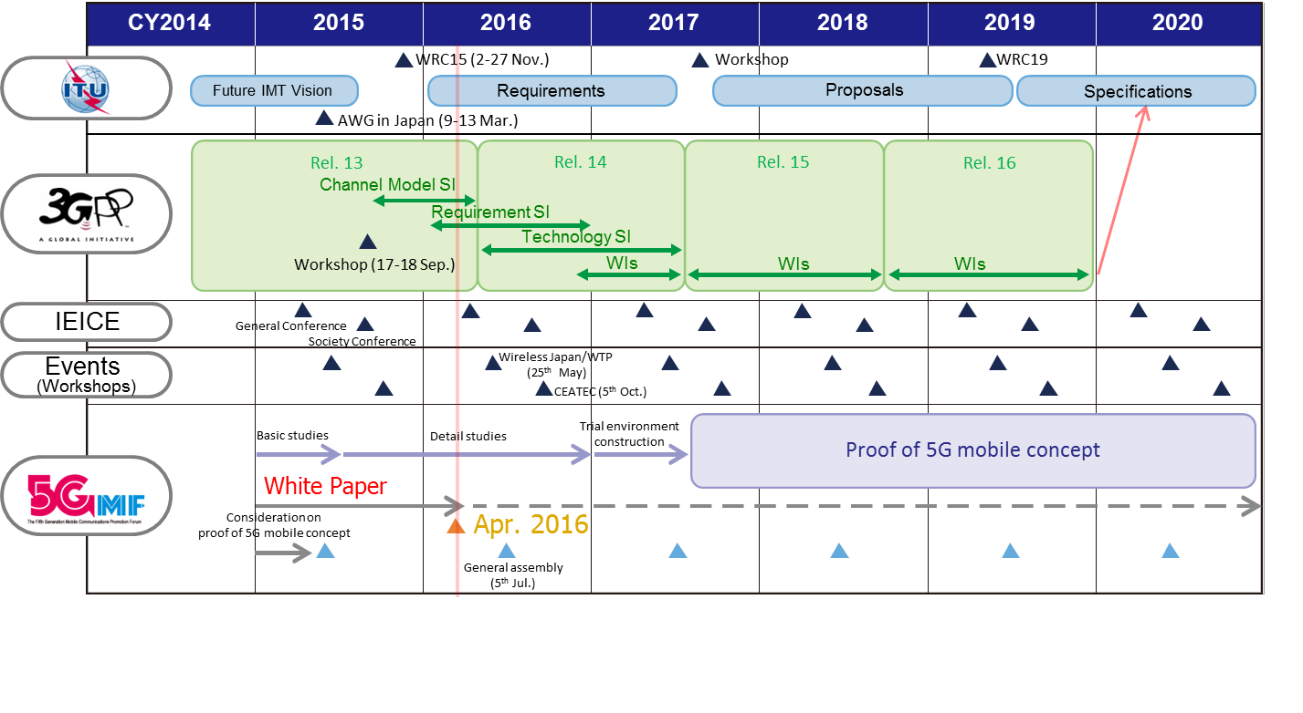
3. Activities plan of 5GMF
Action plan (mid-term) of 5GMF

Slide 14
Proof of the 5G system concept (1)
Objectives：
  Estimation of research and development result in 5GMF activities
  Estimation of the operation of an overall 5G mobile
  Demonstration of outputs on 5GMF to domestic and international organizations
  Promotion for practical use of 5G mobile

Slide 15
Proof of the 5G system concept (2)
● Verification to commence from FY2017 ●
5G commercialization
Lower frequency bands
5G commercialization
Higher frequency bands
Survey on user needs,
studies on applications / services
Integrated Verification Trial services / functions
- radio + network + applications -
Verification Trial
- Integration of radio+ network -
Detail studies
(Venue, frequency band, budget,
participating organizations /
soliciting enterprises, etc.)
Trial
environment
construction
Verification Trial
- Basic
technologies -
Basic
studies
FY2015
2016
2017
2018
2019
2020
2021
2022
Rugby
World Cup
Tokyo Olympic/
Paralympic Games

Slide 16




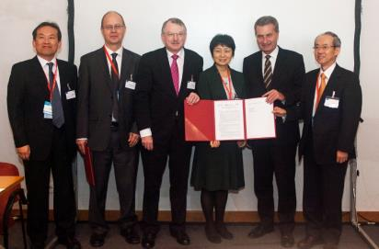
4. Worldwide Collaboration(1)
Collaborate multilaterally with other organizations
  Multilateral MOU for “Global 5G Event”
    Among 5G PPP, IMT-2020 PG, 5GMF, 5G Forum and 4G Americas
    MOU agreed, Lisbon, Portugal, 20 October 2015
Snapshot after the multilateral MOU agreement

Slide 17


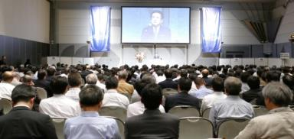
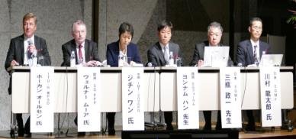
4. Worldwide Collaboration(2)
Hold workshops on 5G related issues
  CEATEC-Japan, Chiba, 8 October 2014
  18th Meeting of the APT Wireless Group, Kyoto, 9 March 2015
  Wireless Technology Park, Tokyo, 28 May 2015
  CEATEC-Japan, Chiba, 8 October 2015
Snapshot of workshop
Snapshot of panel discussion

Slide 18




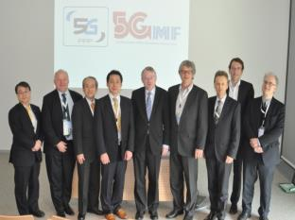
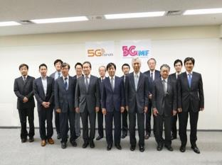
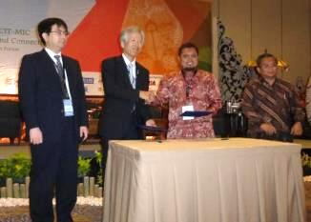
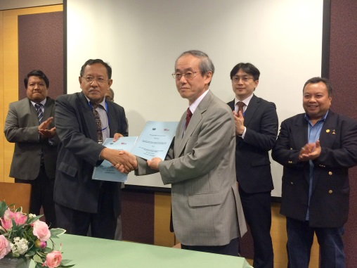
4. Worldwide Collaboration(3)
MOU exchange ceremonies with 5G associations worldwide
  5G Infrastructure Association ： 25 March 2015
  Korea 5G Forum ： 6 April 2015
  Wireless World Research Forum(WWRF)：
  21 August 2015 (e-mail)
  Indonesia 5G Forum ： 21 September 2015
  Malaysia IMT WG, MTSFB: 6 April 2016

Slide 19
5. Target of 5GMF (1)
Lead R&D and International standardization to implement 5G mobile for 2020 and beyond
  Publish White Paper and Implementation roadmap
Demonstrate verification tests on Proof of Concept
  After basic studies, detail studies and trial environment construction, perform verification tests (mobile network + wired network + mobile application) from FY 2017
Contribute actively internationally through collaboration with international organizations
  Promote the sharing information and vision for 5G mobile with overseas organizations
  in Europe (5G-PPP), Korea (5G Forum), China (IMT-2020 PG, FuTURE Forum), etc.
To play a major role of 5G mobile implementation

Slide 20
5. Target of 5GMF (2)
International collaboration
and Standardization
Innovation by R&D
of industry, academia, government
５ＧＭＦ leads the discussion

Slide 21
Supplementary Slides
ARIB

Slide 22
ARIB in Summary [ as of April 1, 2016 (April 1, 2015 ) ]
Membership Full Member : 188 (200)
Supporting Member : 4 ( 4)
Standardization Standard (STD) : 166 (159)
Technical Report (TR): 66 ( 63)
Technical Committee Study Group : 1 ( 4)
R&D Group : 4 ( 4)
Advanced Wireless Communications Study Committee (ADWICS)
Subcommittee : 4 ( 4)
Promotion Strategy Committee Subcommittee : 1 ( 1)
ISDB-T : 18 countries ( 17)
(new : Nicaragua, August 2015)
Electromagnetic Environment Committee
Subcommittee : 2 ( 2)

Slide 23
ARIB Activity - Work Contents -
Study/R&D - Standardization
- work on telecom (Radio) & broadcasting fields
- develop Standard by consensus
Promotion of Radio Industry
- hold special seminars, monthly seminars
- issue yearbook, quarterly bulletin, weekly news
Consultation on Radio Wave Use
- design radio links / select best available frequency
for microwave and satellite links
Cooperation with SDOs
- Signing of MoU with MTSFB (Malaysia) on April 2016

Slide 24
ARIB Activity - Statistics -
(FY) 2012 2013 2014 2015
Member 219 212 204 192
Income (100M\)
member fee 2.6 2.4 2.4 2.4
Business 6.2 7.1 6.4 6.7
consultation 2.8 3.0 2.4 2.5
others 3.4 4.1 4.0 4.2
Standard
STD 152 155 159 166
TR 64 64 63 66

Slide 25
Current Activities (Telecommunications) (1/3)
Mobile Communications
  International Mobile Telecommunication (IMT)
    Total number of Subscribers : 152.9 million (as of Sep. 2015)
    LTE : 79.0 million (as of Sep. 2015)
    LTE Advanced(4G) launched on March 2015
    2020 and beyond AdHoc Group published White Paper “Mobile Communications Systems for 2020 and beyond” on 8 Oct. 2014
    The Fifth Generation Mobile Communications Promotion Forum (5GMF) was established on 30 Sep. 2014
    5GMF and 5G Forum (Korea) signed MoU on 6 April 2015
  Broadband Wireless Access (BWA)
    Mobile WiMAX (UQ Communications Inc.) : 50MHz BW
    13.1 million Subscribers (as of Sep. 2015)
    Advanced XGP (Wireless City Planning) : 30MHz BW
    13.1 million Subscribers (as of Sep. 2015)
    Fixed Wireless Access ： 10MHz BW
    45 operators / 47 Region licensed (as of Feb. 2015)

Slide 26



Current Activities (Telecommunications) (2/3)
Standardized 700 MHz band ITS network of Japan
ITS Group, Research & Development, ARIB
Mr. Segawa Director of ITS Group
Mr. Oyama Senior Researcher
(As of April, 2016)
200 people
30 people
700MHz BAND ITS implementation Committee
Operations Support TG
ITS FORUM
RC 009
Chairman : Mr. Sueki (Toyota motor corporation)
Reader : Mr. Takenaka
(Mitsubishi Electric corporation)
700MHz帯 ITS実用化専門委員会
46 people
Standard Promotion TG
ITU-R M.2084
（ARIB STD-T109）
Secretariat
ITS Group, ARIB
42people
Reader : Mr. Sawada
(DENSO CORPORATION)
International Relations Committee
Chairman : Mr. Yamamoto
(NEC Corporation)
国際対応専門委員会
30 people
ITS FORUM
RC 011
support
Interconnection TG
90 people
Reader : Mr. Nanba
(DENSO CORPORATION)
Advanced Info-communication Systems Committee
22 people
Chairman : Ph.D. Obana
(The University of Electro-Communications)
Vehicle to Vehicle communication TG
ITS FORUM
RC 013
高度化専門委員会
Reader : Mr. Shibasaki
(PIONEER CORPORATION)
Other Committee or TG
（DSRC 5.8GHz. 79GHz radar etc.）
97 people

Slide 27
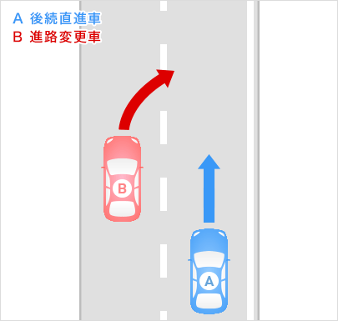
Current Activities (Telecommunications) (3/3)
Radio waves example of the use of Automated driving
◆ Cooperation with JAMA* considering the communication specifications from last year of May
Rapid determination, improve the certainty
◆ Communication system as a model
ITU-R M.2084-0（ARIB STD-T109, IEEE 802.11） and ITS Info-com Forum RC006
◆ In the current standard ◎ Connected Vehicle △ Automated driving
JAMA：Japan Automobile Manufacturers Association, Inc.
Support at the time of
the merging and lane change(UC1)
Delivery of the incident(UC2)
A:lane change vehicle
B:following vehicle
A:Emergency avoidance
vehicle
B:following vehicle
① A→B（and other）
lane change request
<<broadcast>>
② B → A
Accept the request
<<Unicast>>
★Low latency and
certainty is necessary

Slide 28
Current Activities (Broadcasting) (1/3)
UHDTV (4K/8K)
  Broadcasting
    Road Map
      2014 : Test broadcast (4K) using CS (Communication Satellite)
      2015 : Practical broadcast (4K)
      2016 : Test broadcast (8K) using BS (Broadcasting Satellite)
      2018 : Practical broadcast (4K/8K)
  Standard
    Program Production Video: ARIB STD-B56 (Ver.1.1 : Mar. 2014)
    ARIB STD-B67 (Ver.1.0 : July. 2015)
    Audio: ARIB STD-B59 (Ver.1.0 : Mar. 2014)
    Interface: ARIB STD-B58 (Ver.1.1 : Mar. 2015)
    Transmission Satellite ARIB STD-B44 (Ver.2.1 : Mar. 2016)
    Receiver ARIB STD-B63 (Ver.1.5 : Mar. 2016)

Slide 29
Current Activities (Broadcasting) (2/3)
Hybridcast
  Synchronized presentation of main program and Internet content
  NHK : Launched in Sep. 2013
  Service expands to various programs
  Commercial TVs : TBS launched in Oct. 2014, others follow
Multimedia Broadcasting
  V-low (99~108MHz)
    ISDB-TSB , Regional Service
    Service was started in March,2016 in Tokyo, Osaka and Fukuoka.
    The broadcast area in going to be enlarged sequentially
  V-high (207.5~222MHz)
    ISDB-Tmm , Nation Wide Service
    mmbi launched 2 channel services in April 2012 (fee:\432/month)
    1.7 million subscribers (as of Dec. 2014)
    mmbi launched 8 channel services in 1st April 2015 (fee:\685/month)
    mmbi will terminate NOTTV service on 30 June, 2016

Slide 30
Current Activities (Broadcasting) (3/3)
ISDB-T International Promotion
  DiBEG (Digital Broadcasting Experts Group; Internal Group of ARIB) has done
  activities for ISDB-T international promotion.
  As a result, 18 countries including Japan have adopted ISDB-T.
  DiBEG mainly does two types of activities; Information Sharing and Technical
  Support.
  As information sharing activities, DiBEG has held seminars in ISDB-T adopting
  countries.
  As technical support activities, DiBEG has supported the development of the Basic
  Standards in ISDB-T adopting countries.

Slide 31
Global Standardization
  Closer collaboration among SDOs towards Global Standards
  Active exchange of information and views with other SDOs at meetings such as CJK, ITU-R WPs, APT Wireless Group and GSC.

Slide 32
Annex Slides
ARIB

Slide 33
Secretariat
Managing Director / Secretary General: Mr. Fusaki MATSUI
Executive Director: Mr. Yoshihide ISHIDA
Executive Director: Mr. Shigeki MORIYAMA
Administration Department
・General Affairs
・Personal Affairs
・Accounts
R&D Headquarters
Development Center
・Investigation and R&D
・Development of Technical Standards
9 Groups
Radio Utilization Consulting Department
・Consultation and Information Services for Spectrum Utilization
Planning and International Affairs Department
・Administrative work related to “ARIB Standards”
・Education and Popularization
・Correspondence with other national/international standards organizations

Slide 34
Technical Committee
Telecommunication
  Study Group
    Broadband Mobile Communications System for Public/Private Use
    (1st April 2015～)
  R&D Group
    Wireless LAN System (1st April, 2013～)
Broadcasting
  R&D Group
    Digital Broadcasting Systems
    Program Production Systems ( including UHDTV: 1st April 2015～)
    Transmission of Television Program Contribution

Slide 35
Advanced Wireless Communications
Study Committee (ADWICS)
  2020 and beyond AdHoc （Oct. 2013~)
Mobile Partnership Sub-Committee
  3GPP / 3GPP2
  oneM2M
Standardize Sub-Committee
  WP5D, AWG
  Future IMT
Broadband Wireless Access (BWA) Sub-Committee
  WiMAX
  XGP / AXGP
Mobile Commerce Sub-Committee
  Mobile PKI (Public Key Infrastructure)

Slide 36
Frequency Reallocation (1/3) (Digital TV Switchover)
VHF:76～108 (Low)/170～222MHz (High)
FM
Analog TV
1-3ch
Analog TV
TV 4-12ch
76MHz
90MHz
108MHz
170MHz
222MHz
FM
FM*
G
B
Mobile Multimedia
Broadcasting **
Broadband Mobile
Communications System
for public use
G
B
Mobile Multimedia
Broadcasting
76
MHz
90
MHz
95
MHz
99
MHz
108
MHz
170
MHz
202.5
MHz
207.5
MHz
222
MHz
* 90-95MHz
For FM stations to
Complement AM Radios
(on the air : Fall 2014～)
** 99-108MHz
For V-Low Multimedia
Broadcasting
(on the air : March 2016～)
13 Segs
13 Segs
7 Segs
mmbi
Max 13 broadcasters
7 broadcasters
207.5MHz
222MHz

Slide 37
Frequency Reallocation (2/3) (Digital TV Switchover)
UHF:470～810MHz
Analog
TV 13-62ch
FPU/Radio
Microphone
Wireless
MIC
470MHz
770MHz
806 810MHz
Digital TV Broadcasting
13～52ch
R-MIC
GB
Mobile
GB
ITS
GB
Mobile
GB
Wireless
MIC
White Space
470MHz
710
714
718
748
755
765
773
803
806
810MHz
        FPU/Radio Microphone : Move to another band by March 2019
        - FPU : Move to 1.2GHz / 2.4GHz
        - Radio Microphone : Move to 1.2GHz / 710-714MHz / UHF TV White Space

Slide 38
Frequency Reallocation (3/3) (Telecommunication)
890MHｚ～960MHz
Mobile
(2)
MCA
Mobile
RFID
(3)
890-903MHz
905-915MHz
915-950MHz
950-958MHz
890-900MHz
900-915MHz
915-928MHz
930-940MHz
945-960MHz
2016~
GB
(1) IMT
RFID
GB
MCA
GB
(1) IMT
10MHz
15MHz
13MHz
10MHz
5MHz
15MHz
(1) Assigned to SOFTBANK MOBILE (SBM) in March 2012
SBM Started 5MHzx2 service from July 2012
Reallocation cost for MCA / RFID to be born by SBM
(2) Personal Radio : Terminated by 2015
(3) STL/TTL : Reallocate to another band by Nov. 2015

Slide 39
1.7GHz IMT Band Expansion
35MHz×2 in 1.7GHz band has been allocated to IMT/public use since 2005.
The technical legislation of the adjacent 5MHz×2 band was set in December 2012 for future use by IMT
  Not yet assigned
  LTE trial using 1744.9-1764.9 / 1839.9-1859.9 was done by e-Access (Aug. ~ Sep. 2013)
5MHz
5MHz
e-Access
(15MHz)
NTT DoCoMo*
(20MHz)
NTT DoCoMo*
(20MHz)
* : Tokyo, Nagoya, Osaka
e-Access
(15MHz)
Public Use
Public Use
1744.9 1749.9
1764.9
1784.9
1839.9 1844.9
1859.9
1879.9 MHz
Additional Frequency Bands
Notes:
13 July 2009
GSC14-PLEN-xx 4.1 ARIB Report
39

Slide 40
2.5 GHz-band Channel Plan for BWA
AXGP
Mobile Communications
(For Nation-wide deployment)
Fixed Wireless Access (FWA)
(For Regional deployment)
Mobile WiMAX
Mobile Communications
(For Nation-wide deployment)
N-STAR
Wireless City
Planning
(30MHz)
45*
Operators
(*As of
Feb 2015)
(Reserved)
N-STAR
Guard Band
UQ Communications
(50MHz)
Guard Band
Guard Band
Guard Band
2535
MHz
2545
MHz
2575 2582
MHz MHz
2592 2595
MHz MHz
2645
MHz
2655
MHz
2660
MHz
Notes:
13 July 2009
GSC14-PLEN-xx 4.1 ARIB Report
40

Slide 41
ISDB-T in the world
ISDB-T International Promotion Activities (1/2)
Guatemala
(Adopted in May. 2013)
Honduras
(Adopted in Sep. 2013)
(Trial in Mar. 2014)
Nicaragua
(Adopted in Aug. 2015)
Japan
(Launched in Dec. 2003)
(ASO in Jul. 2011)
Costa Rica
(Adopted in May. 2010)
(Launched in May. 2014)
Philippines
(Adopted in Jun. 2010)
(Launched in Feb. 2015)
Ecuador
(Adopted in Mar. 2010)
(Trial in Mar. 2010 )
Venezuela
(Adopted in Oct. 2009)
(Launched in Jun. 2011)
Brazil
(Adopted in Jun. 2006)
(Launched in Dec. 2007)
Sri Lanka
(Adopted in 2014)
Peru
(Adopted in Apr. 2009)
(Launched in Mar. 2010)
Botswana
(Adopted in Feb. 2013)
(Launched in Jul. 2013)
Chile
(Adopted in Sep. 2009)
(Trial in Mar. 2012 )
Maldives
(Adopted in Apr. 2014)
Paraguay
(Adopted in Jun. 2010)
(Launched in Aug. 2011)
Bolivia
(Adopted in Jul. 2010)
(Launched in Sep. 2011)
ISDB-T 18 countries (including Japan)
(Integrated Services Digital Broadcasting - Terrestrial)
Argentina
(Adopted in Aug. 2009)
(Launched in Apr. 2010)
Uruguay
(Adopted in Dec. 2010)
(Trial in Jul. 2012)
１８ countries
As of April. 2016
Notes:
ISDB-T方式は、現在日本を含めて１７の国で採用されています。
フィリピン、スリランカ、モルディブ、ボツワナなどアジア、アフリカの国でも採用されています。
もちろんご存知のように中南米の多くの国がISDB-T方式を採用しています。

Slide 42
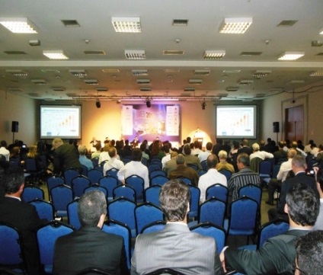
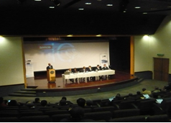
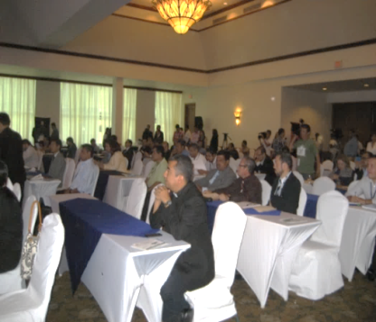
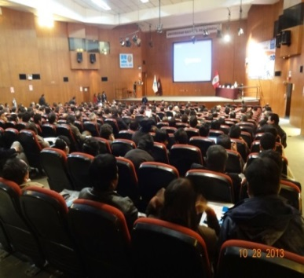
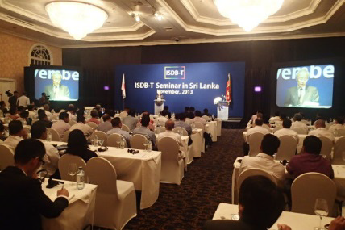
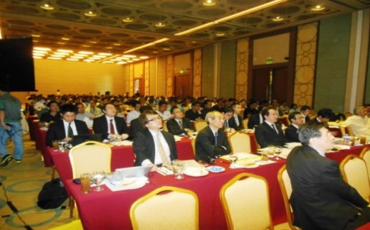
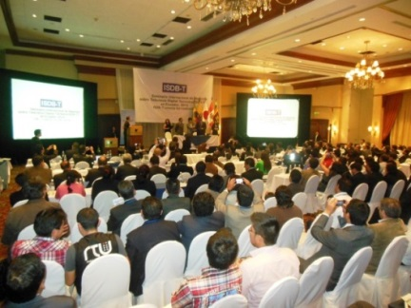
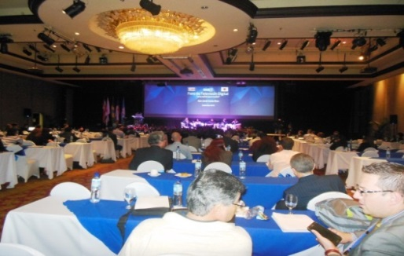
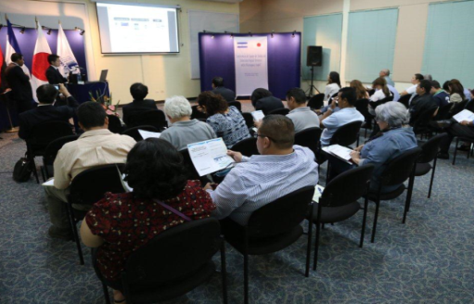
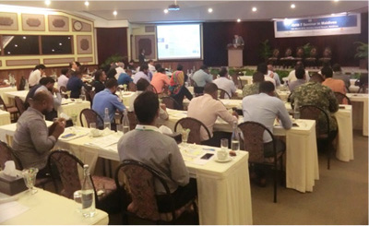
Information Sharing Activities
ISDB-T International Promotion Activities (2/2)
Brasil
Aug. 2012/2013/2014/2015
Botswana
Jul. 2013
Honduras
Aug. 2013
Peru
Oct. 2013/Jan. 2016
Sri Lanka
Nov. 2013
The Filipinas
Jan./Mar. 2014, Jan. 2015
Ecuador
Apr. 2014/Nov. 2015
Costa Rica
Sep. 2014
Nicaragua
Nov. 2015
Maldives
Mar. 2016
Information sharing about broadcasting technologies and Japanese experience
ISDB-T technologies/new services/social effects,
ASO, Japanese Broadcasters’ experience,
New radio systems introduced after ASO,
Further advancement of broadcasting
42
Notes:
情報提供の活動の例です。
総務省さんが主催するセミナーあるいはDiBEG自身で開催するセミナーに専門家を派遣して、ISDB-Tに関する技術等について講演を行うなどの活動をしています。
ブラジルのSETでは定期的に講演を行っています。
2013年にはボツワナ、ホンジュラス、ペルー、スリランカで行いました。
2014年はエクアドルやコスタリカ、2015年はニカラグアで行いました。
また、配備が進んでいるフィリピンでは頻繁に行っています。
内容としては、ITDB-T技術や新サービスやその社会的影響、アナログ停止に至るまでの日本の経験、アナログ停止後の新たな無線システム、最先端のの放送技術などです。

Slide 43
Standardization Activities (1/2)
Outcome from Standard Assembly
ARIB Standard (STD)
  Technical requirement for radio systems
ARIB Technical Report (TR)
  Operational guidelines for radio systems
Number of STD and TR * (As of March 25, 2016)
 | STD | TR
Telecommunications | 93 | 23
Broadcasting | 73 | 42
General | 0 | 1
* Not including suppressed STD/TR
Free Download
  http://www.arib.or.jp/english/html/overview/index.html
Notes:
13 July 2009
GSC14-PLEN-xx 4.1 ARIB Report
43
13 July 2009
Activities of ARIB
43

Slide 44
Standardization Activities (2/2)
List of New ARIB Standards (April 2015 – March 2016)
Telecommunications
  ARIB STD-T113 ： WIRELESS POWER TRANSMISSION SYSTEMS <Ver.1.0 : July. 2015, Ver.1.1 : Dec. 2015 >
  ARIB STD-T115 ： REGIONAL DIGITAL SIMULTANEOUS COMMUNICATION SYSTEM TYPE2 <Ver.1.0 : Sep. 2015>
  ARIB STD-T116 ： DIGITAL MOBILE TELECOMMUNICATION SYSTEM FOR LOCAL GOVERNMENT (SCPC/4FSK)
  <Ver.1.0 : Dec. 2015 >
Broadcasting
  ARIB STD-B66 : UHDTV MULTIFORMAT COLOR BAR <Ver.1.0 : July. 2015, Ver.1.1 : Dec. 2015 >
  ARIB STD-B67 : ESSENTIAL PARAMETER VALUES FOR THE EXTENDED IMAGE DYNAMIC RANGE TELEVISION
  (EIDRTV) SYSTEM FOR PROGRAMME PRODUCTION <Ver.1.0 : July. 2015 >
  ARIB STD-B68 : TIME CODE FORMAT IN THE INTERFACE FOR UHDTV PRODUCTION SYSTEMS
  <Ver.1.0 : Dec. 2015 >
  ARIB STD-B69 : EXCHANGE FORMAT OF THE DIGITAL CLOSED CAPTION FILE FOR DIGITAL TELEVISION
  BROADCASTING SYSTEM (SECOND GENERATION) <Ver.1.0 : Mar 2016 >

