Slide 1
Alliance for Telecommunications Industry Solutions (ATIS) Update
Document No: | GSC17-PLEN-79
Source: | ATIS
Contact: | Susan Miller, smiller@atis.org
GSC Session: | PLEN
Agenda Item: | 4.2
Thomas Goode
General Counsel
ATIS

Slide 2
Highlight of ATIS Activities
As a leading ICT organization, ATIS’ mission is to define, address, and advance technology solutions and standards to support the timely roll-out of new products and services
The diverse membership includes wireline and wireless service providers, broadband providers, equipment manufacturers, software developers, consumer electronics companies, internet service providers, cable companies, digital rights management firms, government and public safety agencies.

Slide 3
Highlight of ATIS Activities
ATIS places an emphasis on its members’ market-driven priorities – at the intersection of business and technology.
ATIS’ C-level Board of Directors, its Technology and Operations (TOPS) Council, and its CIO Council define the strategic vision and technology priorities to advance members’ business needs.
Business opportunities to be realized and business challenges to be solved sets the priority agenda.
Fast-tracked solutions and standards development covers the technology development lifecycle – from innovation and solution design, to business use case formulation, to requirements, specifications, standards, interoperability testing, software tool kits, best practices, data collections, user guidelines and more.

Slide 4
Highlight of ATIS Activities
ATIS’ approach has evolved – delivering output in concert with business needs for priority work.
Smaller development groups with greater range of expertise – network, IT/software, product development, marketing, etc.;
Tight time frames with parallel interoperability needs addressed – fast tracking more the norm;
Engagement of business organizations with more emphasis on business value; and
Landscape Teams (quick study) -- to Focus Groups (business use case/issue analysis) -- to Solutions and Standards Development

Slide 5
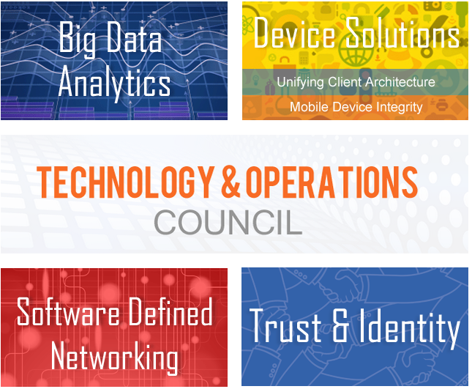
Highlight of ATIS Activities

Slide 6
Highlight of ATIS Activities
Big Data Analytics Focus Group
Exploring potential for a federated, large-scale approach for operators to leverage the information in their networks
Developing an analytics metadata framework
Determining applicability of existing data exchange mechanisms to Big Data Analytics
Launched and will complete in three months

Slide 7
Highlight of ATIS Activities
Goal
Connect network services to third-party applications and end users
Execution
Develop JavaScript libraries to integrate enhanced network services with edge devices – e.g., orca.js: Open Real-time Communications API
Promotion
Demonstrate capabilities for service providers to transform their network into a commercial transaction platform
Device Solutions

Slide 8
Highlight of ATIS Activities
Open source project under the sponsorship of ATIS
Simplifies call control for real-time web applications
Offers IMS network services to application developers
Provides web developers with APIs that are consistent across service providers

Slide 9
Highlight of ATIS Activities
Mobile Device Integrity Landscape Team
Mobile Device Integrity Panel (established by the U.S. government) published Guidelines defining security requirements for BYOD; recommended hardware-rooted security (Roots of Trust, or RoTs).
ATIS was asked to provide feedback:
Emphasized that the document should list the desired security features without supporting any specific implementation.
Concluded that most vendors have the hardware capabilities to support the RoTs laid out in the NIST document. NIST should not favor particular implementations.

Slide 10
Highlight of ATIS Activities
Software-Defined Networking Focus Group
Addressing how SDN can be applied in a federated environment.
Determining the operational issues and opportunities from increasing the programmability of the network:
OSS/BSS impacts
Reliability/fault detection
Administration and maintenance issues over the network element
Service life cycles of IP-infrastructure-based network elements and services

Slide 11
Highlight of ATIS Activities
Trust and Identity Focus Group
ATIS is framing a trust and identity solution that will:
Provide global interoperability between service providers like the PSTN;
Support a diverse set of services (e.g., the web); and
Maintain a higher level of trust than what exists today.
Focus Group is currently assessing trust and identity management models in support of the communications industry’s service offerings.

Slide 12
Highlight of ATIS Activities
Cybersecurity Focus Group (complete)
Developed a foundation for E2E analysis of vulnerabilities in devices, networks, and computing infrastructures.
ATIS launched subcommittee to focus on cybersecurity issues.
Workshop being held June 18-19, 2013 to bring together CIOs, CTOs and CSOs in both government and industry. Focus on improvements to the security of infrastructure and communications.

Slide 13
Highlight of ATIS Activities
M2M Focus Group (complete)
Smart Grid assessment
Connected Vehicle assessment
eHealth assessment
The M2M FG identified numerous common service layer characteristics and functions.
M2M Committee was launched in July 2012, and is utilizing the work of the Focus Group as its foundation.

Slide 14
Highlight of ATIS Activities
PSTN Transition Focus Group Report (complete)
Evaluated the network’s current state and identified capabilities that the successor networks will deliver.
Assessed key issues in the transition across four areas of network evolution: application services, access, numbering, and transport.
Focus Group made recommendations to FCC Technical Advisory Council (PSTN Successor Infrastructure Work Group).

Slide 15
Observations and Direction
The pace of innovation, the need for business relevance, the speed of the output’s delivery is more important than ever to ATIS members.
Fundamental shifts – e.g., all IP networks, Software Defined Networking, M2M, etc. are changing the industry and the role of standards.
The integration of network and IT are happening and will enable companies to provide services with an interoperable, media-rich, service-oriented network.
Continual re-invention of how we develop solutions and standards will be essential.

