Slide 1
Recent Standardization Activities on E-waste
Document No: | GSC17-PLEN-66r1
Source: | TTA
Contact: | Samyoung CHUNG (sychung@msip.go.kr)
GSC Session: | PLEN
Agenda Item: | 6.6
Samyoung CHUNG, RRA
TaekSoo KIM, KITEC
Kishik PARK, Green ICT Forum

Slide 2
ITU Activities on e-waste
WTSA-12: Res. 79 (Dubai,2012)
The role of telecommunications/ICTs in handling and controlling e-waste
from telecommunication and information technology equipment and
methods of treating it
resolves to organize seminars and workshop to enhance awareness of
the hazards of e-waste and the methods of treating it
instructs ITU-T SG5 to develop and document examples of best practice
for handling and controlling e-waste for dissemination
to develop Recommendations, methodologies relating to handling e-waste
to foster awareness of the hazards of e-waste
to study the impact of used ICT products brought into developing countries
and give appropriate guidance
ITU WCIT-12: Final Acts (Dubai, 2012)
ARTICLE 8A Energy efficiency/e-waste
8.2 Member States are encouraged to adopt energy-efficiency and
e-waste best practices taking into account the relevant
ITU-T Recommendations

Slide 3
ITU Activities on e-waste
ICT and Climate Change
Assessment methodology
Guideline for ICT enabling effect
Question 13
Environmental impact reduction including e-waste
Question 16
Eco-specifications and rating criteria
for mobile phones eco-rating programs
eco-rating and spec. criteria
categories :
hazardous substances
energy efficiency
end of life
Rare metal recycle
L-C management
Battery

Slide 4
Q.13 & 16 of ITU-T SG5
L.rare Metals
Updated a draft Recommendation L.rareMetals_measurement containing two
measurement methods to characterize rare metals in ICT goods
Life Cycle management of ICT equipment
UNEP proposed to develop a technical paper on life-cycle management of
ICT equipment and approved in Feb. 2013 to
This Technical paper aims to provide guidance on;
Substitution of harmful substances, disposal of used and end-of-life equipment
Environmentally sound management of used and end-of-life equip.
Avoidance or minimization of e-waste
Mobile phone Eco-rating
Recommendation for eco-specifications and rating criteria for mobile phone
The objective is to define a eco-specification criteria and rating criteria
Specific criteria for hazardous substances, energy efficiency, end of life…

Slide 5
ASTAP Activities on e-waste
ASTAP(APT Standardization Program)
The objective of ASTAP is to establish regional cooperation on
standardization and to contribute to global standardization activities
ASTAP21, Board Committee chose e-waste issue as an important topic
E-waste and rare metal issue was considered as a candidate topic for
ASTAP 23 industry workshop
ASTAP21 published ‘Guidance for Green ICT standards’ including
rare metal standardization activities
ASTAP21 approved New work item to publish an e-waste status report
ASTAP21 approved a Questionnaire on e-waste status and related policies
To collect data on e-waste management system, policies, regulations
E-waste status, hazardous degree anticipation and possible solutions

Slide 6
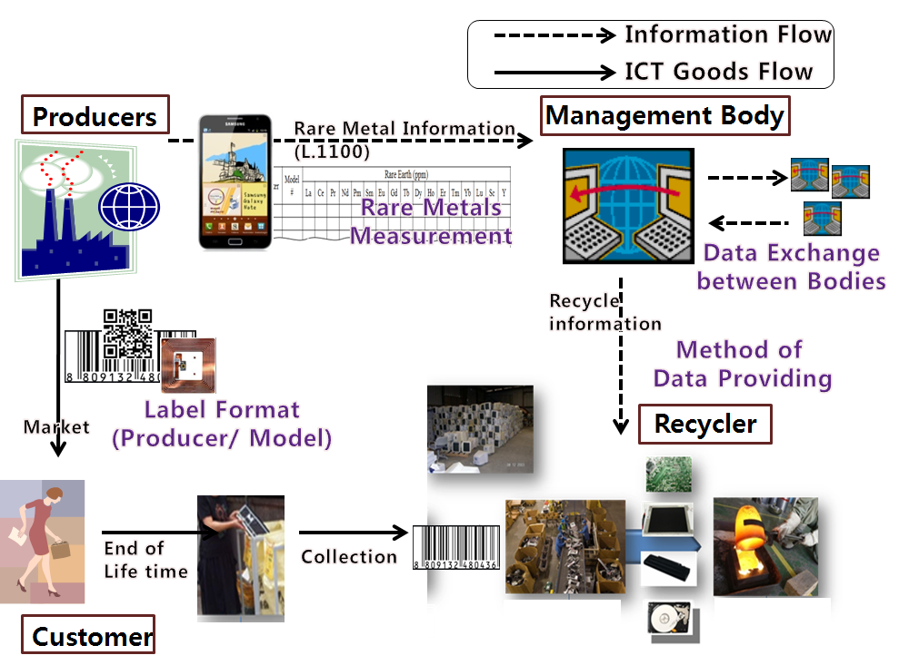
TTA, ICT&CC SPC (2008~)
Road Map for standardization of rare metal recycling from ICT products
(2013. 1. TTA.IT-L.1100) A method to provide recycling information of rare metals in ICT goods
(L.rareMetal-measurement, 2013~2014)
Measurement methods to characterize rare metals
(2014~2015) Label format of rare metals information for ICT goods
(2015~2016) Data Exchange format for rare metals information between “Management Bodies”
(2016~2017) Application interface to get rare metals information from a management body

Slide 7
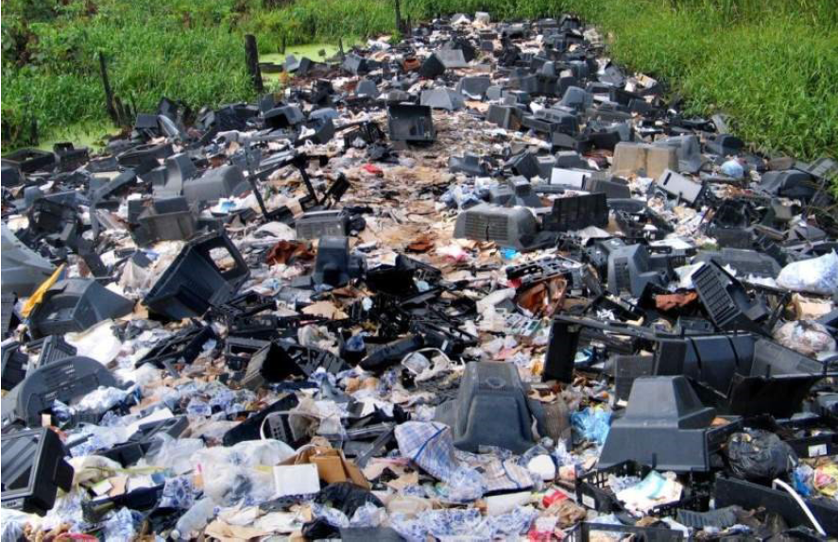
Challenges
Job Creation
e-waste
e-challenge
Standardization
and Regulation
e-waste
e-opportunity
Rare metal Recycling
Environment protection
GHG Reduction

Slide 8
Proposed Resolution (update)
Update the Resolution GSC-16/08 ICT and the Environment
Considering(insert after current d): that the World Telecommunication Standardization Assembly created Resolution 79(Dubai, 2012) entitled “The role of telecommunications/information and communication technologies in handling and controlling e-waste from telecommunication and information technology equipment and methods of treating it” and ITU WCIT-12: Final Acts (Dubai, 2012) Article 8A entitled “Energy efficiency/e-waste” which emphasized the need to address the handling and controlling of e-waste and to contribute to global efforts in dealing with e-waste;
Resolves (change of final bullet point under 4 ) the study of e-waste including environmentally safe disposal and recycling of discarded ICT equipment.

