Slide 1
ATIS’ ICT Accessibility Activity
Document No: | GSC17-PLEN-65
Source: | ATIS
Contact: | Farrokh Khatibi (fkhatibi@qti.qualcomm.com)
GSC Session: | PLEN
Agenda Item: | 6.12
Dr. Farrokh Khatibi
Director of Engineering
Qualcomm

Slide 2
SMS to Emergency Services
ATIS led a joint effort with TIA to develop a new standard on text messaging to 9-1-1 Emergency Services (ES) for wireless operator native Short Message Service (SMS) capabilities.
The project was approved in April 2012.
The standard (J-STD-110) was published in March 2013.
Further work has started on implementation guidelines to enable a fast and smooth deployment.

Slide 3
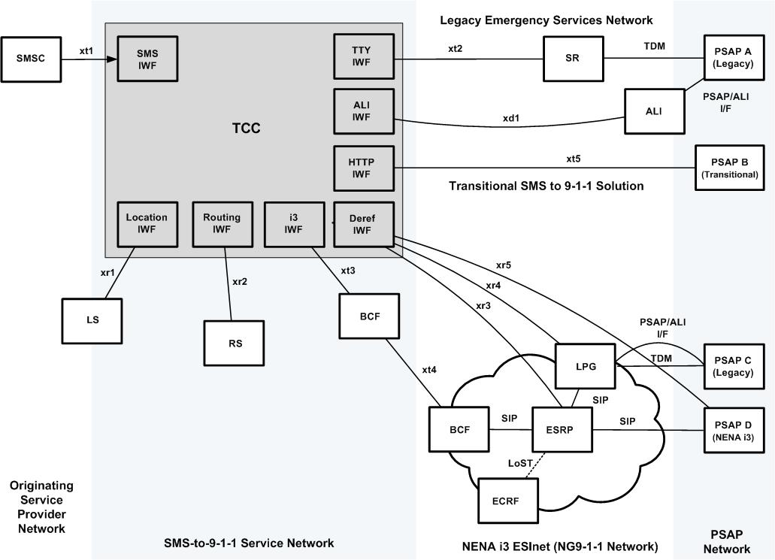
SMS to Emergency Services High Level Functional Architecture
ALI Automatic Location Identification
BCF Border Control Function
ECRF Emergency Call Routing Function
ESRP Emergency Services Routing Proxy
IWF InterWorking Function
LPG Legacy PSAP Gateway
LS Location Server
PSAP Public Safety Answering Point
RS Routing Server
SMSC Short Message Center
SR Selective Router
TCC Text Control Center

Slide 4
CMAS
In addition to Citizen-to-Authority work, ATIS is working on improving Authority-to-Citizen enhancements:
The Commercial Mobile Alert System (CMAS) is the system interface to the Wireless Emergency Alerts (WEA) service that wireless carriers have been rolling out across the U.S. since 2012.
It provides geographically targeted, timely, and effective emergency alert messages to mobile devices using mobile broadcast technology.
Completed Standards:
J-STD-100, J-STD-101 (and -101.a), J-STD-102, ATIS-0700006, ATIS-0700007, ATIS-0700008, ATIS-0700009, ATIS-0700010, ATIS-0700012, ATIS-0700013, ATIS-0700014

Slide 5
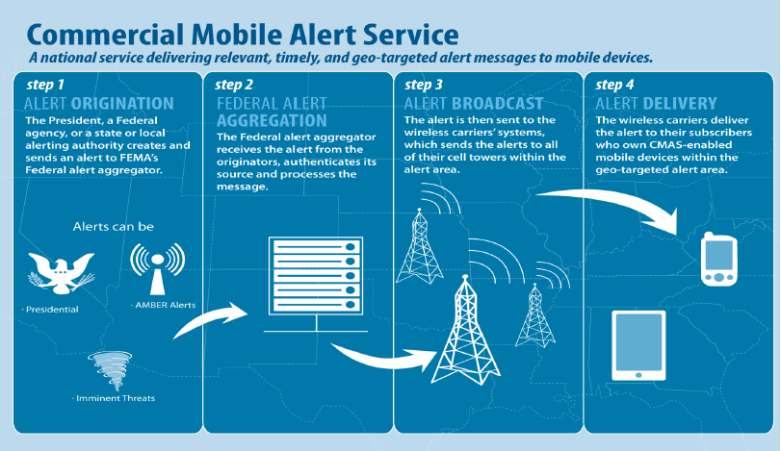
CMAS

Slide 6
Enhancing CMAS
Work is underway in ATIS for enhancements to CMAS:
Canadian CMAS.
CMAS International Roaming.
Enhancements to Public Warning System (PWS) 3GPP to enable efficiency of CMAS.

Slide 7
Strategic Direction
The need for ICT accessibility is a global one:
Standards developed in the U.S. can be adapted around the world.
Deployment lessons learned in the U.S. can be shared with interested entities.
A common technical approach to ICT accessibility can enable faster worldwide deployment as well as enhanced international roaming security, safety, and experience.

Slide 8
Challenges
Regulatory requirements may not be the same in different regions.
Service level requirements may also be different across regions.
For example, Tsunami warnings may have less delay tolerance than weather related warnings.

Slide 9
Next Steps/Actions
Continue the development of ICT accessibility standards to meet the U.S. regulatory requirements to enable the safety and security of the users.
Cooperate with other regions in order to exchange experiences and drive towards common world-wide standards, to the extent possible.

Slide 10
Proposed Resolution
ATIS supports the reaffirmation of the Resolution (GSC-16/27) on ICT Accessibility.

