Slide 1
ATIS and the Smart Grid
Document No: | GSC17-PLEN-63
Source: | ATIS
Contact: | Farrokh Khatibi (fkhatibi@qti.qualcomm.com)
GSC Session: | PLEN
Agenda Item: | 6.9
Dr. Farrokh Khatibi
Director of Engineering
Qualcomm

Slide 2
Highlight of Current Activities
Under the United States’ Energy Independence and Security Act (EISA) of 2007, the National Institute of Standards and Technology (NIST) was given "primary responsibility to coordinate development of a framework that includes protocols and model standards for information management to achieve interoperability of smart grid devices and systems.”
ATIS has been involved in NIST’s Smart Grid Interoperability Panel (SGIP) since 2009 (and has identified several areas of ICT standards involvement in SGIP’s Priority Actions Plans (PAPs)).

Slide 3
Highlight of Current Activities
ATIS Wireless Technologies and System Committee (WTSC) has developed input to SGIP PAP02 (Wireless Communications for the Smart Grid) on the characteristics of four 3GPP technologies (EDGE, UMTS, HSPA+, and LTE) for inclusion as potential technologies to be used by Smart Grid.
WTSC continues to work on evaluating the aforementioned 3GPP technologies against the Smart Grid requirements to assess the suitability of these technologies for meeting the Smart Grid requirements.

Slide 4
Highlight of Current Activities
ATIS Machine-to-Machine Committee (M2MC) is currently reviewing use cases and requirements for the Smart Grid (SG) with the goal of facilitating input to oneM2M.
ATIS’ objective is to ensure the best technical solution that fulfills U.S. requirements, while providing a harmonized and global SG framework.

Slide 5
Strategic Direction
The ICT sector is uniquely well-positioned to leverage its networks and experience to enable interoperability between the Smart Grid’s intricate, multifaceted architectures and infrastructures; specifically:
  Access/Transport/Delivery of Data and Services
  Security and Conditional Access
  Service Management
Many SG flows are currently through the SG Advanced Metering Infrastructure (AMI) Network and Distribution domain
  Alternate/Future flows would be through the Home Area Network (HAN) to a Gateway with Energy System Interface (ESI) function embedded, and then into the carrier Access-IP Core to centralized applications, or back to Utility Operations
    Local applications (e.g., in gateways in the consumer domain) must also be addressed
Pursue commonalities that enable converging of platforms.

Slide 6
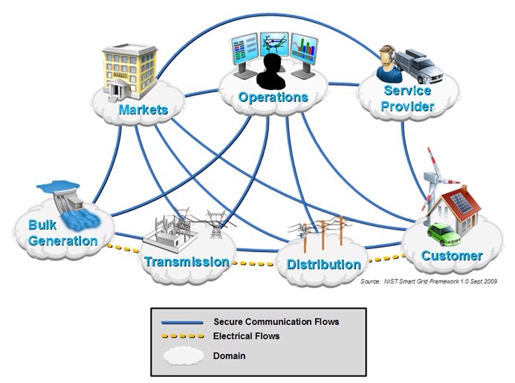
ICT’s Critical Role in SG
ICT is a key element of SG

Slide 7
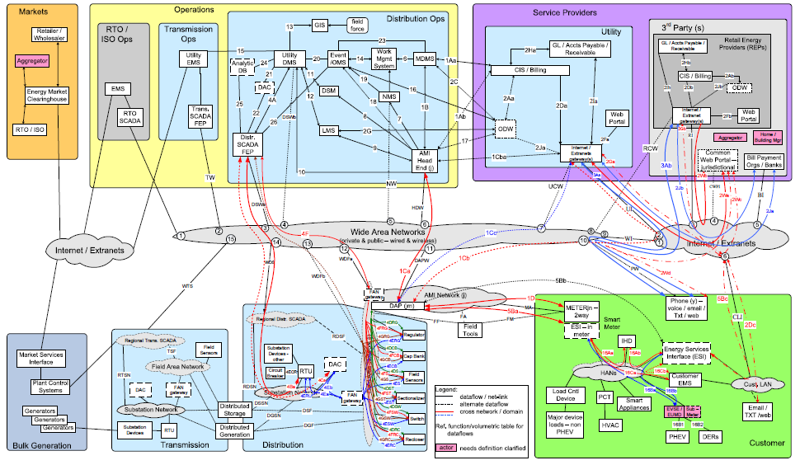
A Global Approach
North America’s Reference
Model:
ITU’s Reference
Model:
There is a desire for a common
and global approach to SG.

Slide 8
Challenges
Regulatory considerations that could be regional specific:
Consumer Privacy
  3rd party access to usage, billing, and pricing data
  Municipal and local requirements to
Critical Infrastructure Protection
  Cyber-security
  Cyber asset management
Consumer Pricing Notification
  State requirements associated with delivery of price signals and other consumer demand information
Net Energy Metering
  Settlement rules associated with micro/distributed generation
Renewable Energy Generation Mandates
Wireless Spectrum Allocation

Slide 9
Next Steps/Actions
Efforts in the U.S. to enable a Smart Grid are well underway.
  These efforts are well populated by the relevant stakeholders including ICT, power/utility companies, and international Standards Development Organizations (SDOs)
  Leverage the work done in the U.S. and other regions to enable a global set of standards
  Leverage Use Case assessment(s) to precipitate common requirements and specifications with other M2M verticals

Slide 10
Proposed Resolution
ATIS supports the reaffirmation of the Resolution (GSC-16/29) on Smart Grid.

