Slide 1
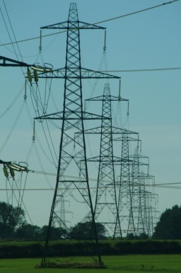
Telecommunications Standards for Smart Grids
Document No: | GSC17-PLEN-50
Source: | TIA
Contact: | David Su
GSC Session: | Plenary
Agenda Item: | 6.9
David Su
National Institute of Standards and Technology

Slide 2
TIA TR-51 Smart Utility Networks
TR-51 has completed work on the multi-part standard ANSI/TIA-4957, Standard Specification for the Smart Utility Network
The standard defines the Physical, Data Link, Network and Transport communication protocol layers required to support a range of Smart Utility Networks (SUN) for applications such as Home Area Networks (HAN), Advancement Meeting Infrastructure (AMI) and Distribution Automation (DA) networks
Multi-part standard includes:
ANSI/TIA-4957.000 Overview and Architecture
ANSI/TIA-4957.100 Layer 1 Standard Specification for the Smart Utility Network
ANSI/TIA-4957.200 Layer 2 Standard Specification for the Smart Utility Network
ANSI/TIA-4957.210 Multi-Hop Delivery Specification for the Smart Utility Network
ANSI/TIA-4957.300 Layer 3 Standard Specification for the Smart Utility Network
ANSI/TIA-4957.400 Layer 4 Standard Specification for the Smart Utility Network

Slide 3
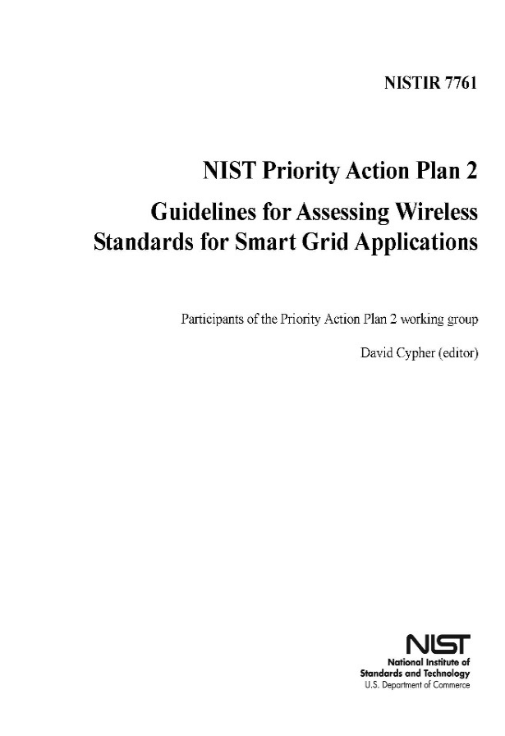
TIA Smart Grid Activities TR45.5 WIDEBAND SPREAD SPECTRUM DIGITAL TECHNOLOGIES STANDARDS
Focus: How to use existing telecom standards effectively for smart grids
TR-45 has been participating in the activities of the Smart Grid Interoperability Panel Priority Action Group on wireless protocols (PAP02) to develop Version 2 of Guideline for Assessing Wireless Standards for Smart Grid Applications
TR-45 completed the Wireless Functionality and Characteristics Matrix for the Identification of Smart Grid Domain Application in support of core CDMA technologies:
cdma2000 1x
cdma2000 EV-DO
xHRPD
TR-45 participated in evaluating the result of modelling and simulation on network performance under various network architecture and communication protocols, and realistic environments for smart grid applications,
http://members.sgip.org/apps/org/workgroup/sgip-pap02wg/documents.php
http://collaborate.nist.gov/twiki-sggrid/bin/view/SmartGrid/PAP02Wireless

Slide 4
TIA Smart Grid Activities TR-41 Telecommunications Requirements
TR-41 published TIA-1194 Surge Resistibility of Smart Grid Equipment Connected to either DC or 120/240 V Single Phase AC and Metallic Communication Lines
It applies to premises equipment that is connected to:
one or more metallic conductive communication line(s)
a DC power source, or a 120/240 V single phase AC power service with the neutral grounded at the service entrance
It specifies
Test procedures and resistibility requirements for in premises smart grid equipment
that the communications ports shall continue to demonstrate basic functionality when subject to overvoltage or overcurrent

Slide 5
TIA Smart Grid Activities TR50-Smart Device Communications
TR-50 has completed work on a M2M reference architecture. The architecture is designed to be applicable to multiple industry applications, including smart grid, home energy management and distribution automation to name a few.

Slide 6
Smart Grid Interoperability Panel SGIP 2.0
The Smart Grid Interoperability Panel created by NIST became a non-profit organization in January, 2013 (http://sgip.org/)
Supported by membership fees
As of mid-April, there are 171 due paying member organizations from utilities, product vendors, R&Ds, industrial alliances
International members include organizations and governments from Canada, Columbia, Ecuador, EU, India, Japan, the Netherlands, Taiwan (China)
New WGs & PAPs: Electro Magnetic Interoperability, Gas Technologies, Wholesale Demand Response, Green Button, Weather Information
SGIP 2.0 continues to work with SDOs, including national and international bodies.
Works with EU Smart Grid Coordination Group to harmonize architectural views
TIA is a member of SGIP 2.0

Slide 7
Proposed Resolution
TIA proposes that Resolution GSC-16/29 on Smart Grid be accepted as a GSC-17 resolution so that the spirit of cooperation and collaboration among PSOs and SDOs on standardization of standards for smart grid applications be continued.
TIA proposes revisions to the Resolution

