Slide 1
TTC Activity Report
Document No: | GSC17-PLEN-03
Source: | TTC
Contact: | Yoichi MAEDA
GSC Session: | PLEN
Agenda Item: | 4.9
Yoichi Maeda,
CEO & S.V.P TTC

Slide 2
TTC Strategy in 2013
Expansion of business in order to promote inter-industry innovation and develop new strategies of ICTs.
Promotion of strategic standardization activities through technical working groups and advisory groups in TTC
Global collaboration with the related standardization organizations including CJK, GSC, APT and ITU-T
Promotion of TTC standards and publicity activities
Focus on the hot standardization topics

Slide 3
High Interest Subjects in 2013
Disaster relief/emergency communications
M2M and IoT including e-health
Cloud computing and SDN (New)
Security
Smart grid and next generation HN (New)
ITS (Intelligent Transport Systems)
Conformance & Interoperability Testing
ICT & Environment
New Generation Networks and Photonic based Infrastructure (New)

Slide 4
ITU-T Review Committee: WTSA-12
RevCom was established in WTSA-12 in order to review ITU-T strategic plan and the existing ITU-T SG structure and prepare a strategic restructuring proposal to WTSA-2016
Since ITU-T SG restructuring will impact the future TTC standardization activities, TTC plans to contribute to ITU-T RevCom discussion by expanding mandates of the existing Global Collaboration AG (GCAG)
contribution to ITU-T TSAG and RevCom
global collaboration with CJK, APT ASTAP, GSC, ITU-T etc.

Slide 5
TTC Organization Chart
General Assembly
Administration
Strategy
Inter-Industry
Innovation Center（I3C）
Councilor's
Meeting
Standards
development
Board of Directors
Award Committee
IPR Committee
Promotion
Promotion Committee
Technical Assembly
Strategy Committee
Management Committee
18 Working Groups
6 Advisory Groups
Projects
Notes:
5

Slide 6
Officers
Chairman of the Board: Prof. Mitsutoshi HATORI
CEO & Senior Vice President: Mr. Yoichi MAEDA
also serves as Chairman of ITU-T RevCom
Secretary General: Mr. Noriyuki SHIGETA
Director General of I3C: Mr. Yukio Yamanaka
Notes:
6

Slide 7
Inter-Industry Innovation Center
Step forward of ICT global standardization from intra-industry innovation to inter-industry innovation such as Cloud Computing, M2M/IoT, ITS (Smart Car), Smart Grid (Smart Energy), and Disaster relief and emergency communications, etc.
TTC has established, in April 2011, "Inter-Industry Innovation Center (I3C)“, which surveys the trends of the inter-industry collaboration, identifies the areas where TTC should play an active role of innovation and develops new strategies of ICTs.

Slide 8
TTC Membership (as of Mar. 2013)
Category | No.
Vendors | 42
NW operators | 16
Broadcasters | 1
CATV Operators | 1
Others | 19
Total | 79
Notes:
8

Slide 9
TTC Standards development
ITU-T
ITU-T Recs
Upstream activities
Downstream activities
MiC
ICT Council ITU Sectional Meeting
participation/proposals
TTC Stds
TTC
TTC Working Groups
participation/proposals
NW operators, broadcasters,
venders, user groups, etc.
Notes:
5

Slide 10
Categories of TTC Standards
Category | Description | Relationship
JT | TTC Stds based on ITU-T Recommendations | ITU-T
JP | TTC Stds based on the de-jure recommendations/stds/deliverables developed by regional SDOs or partnership projects | 3GPPs
JF | TTC Stds based on the de-facto recommendations/stds/deliverables developed by organizations such as fora and consortia excluding ITU-T, ISO and regional SDOs | IETF, etc.
JJ | TTC Stds developed originally by Japan/TTC | TTC original
JS | TTC Stds based on ISO Stds | ISO

Slide 11
Categories and no. of TTC standards (as of February 2013)
Category | No.
JT | 409
JP | 173
JF | 143
JJ | 54
JS | 38
Total | 817

Slide 12
No. of TTC Standards in each year
Notes:
12

Slide 13
Working Groups (WGs)
NGN & FN (Future Network) WG
Optical transport networks and EMC WG
DSL WG
Network Management WG
IPTV WG
ICT & Climate Change WG
Signaling WG
Next-generation HN System WG
Optical Fiber Transmission WG
Numbering Plan WG
Security WG
Bridging Standardization Gap (BSG) WG (New)
oneM2M WG (New)
3GPP and 3GPP2 WGs, etc.
Notes:
13

Slide 14
TTC oneM2M WG (New)
Chairman : Nick YAMASAKI (KDDI)
Vice Chair : Akihiro TSUTSUI (NTT)
Members : 12 companies as of March. 2013
(including 6 oneM2M member companies)
ToR
oneM2M Steering Committee issues
Information/opinion exchange for oneM2M Technical Plenary & WGs
Information sharing of new movements in other organizations relating to M2M
Downstream activities of Technical Specification and Reports agreed at oneM2M
Promotion activities
Notes:
14

Slide 15
oneM2M in Japan
oneM2M
M2M Service Layer
Specifications
International
Responsible for wireless access
Responsible for
other network and service aspects
National
ARIB
IMT Partnership / oneM2M WG
TTC
oneM2M WG
Joint Meeting
Notes:
15

Slide 16
Advisory Groups (AGs)
Technology Research AG
Global Collaboration AG
Interoperability AG
Cloud computing AG
Multimedia AG
Smart CommunicationAG(restructured)
Smart Grid WP
Smart Car WP
Disaster relief/Emergency Comms WP
E-health, etc.
Notes:
16

Slide 17
IPR Committee
develops and updates "Fundamental and Operational Procedures on TTC IPR Policies" so that they are consistent with a) relevant lawful regulations in Japan, such as Patent Act, Copyright Act and Anti-trust Law; and, b) ITU/ ISO/IEC Common Patent Policy and guidelines for its implementation
develops and updates "Operational Treatment of Copyright for TTC Deliverables“. For more details, see http://www.ttc.or.jp/e/index.htlm

Slide 18
Inter/intra-regional collaboration
ITU-T
ICU (Russia)
ISACC
(Canada)
ETSI
(Europe)
TTA
(Korea)
ARIB
(Japan)
IEEE (USA)
CCSA
(China)
TTC
(Japan)
TIA
(USA)
ATIS
(USA)
3GPPs
GISFI (India)
APT
MSTFB (Malaysia)
Forms of collaboration | Examples
Participation | APT/ASTAP
Core member | CJK(ARIB, CCSA, TTA), GSC, 3GPP/3GPP2
MoU/LoI | ITU, ETSI, IEEE, GISFI, MSTFB, ICU, ZigBee Alliance (New), Wi-SUN Alliance (New) etc

Slide 19
MoU & LoI
 | Organizations
MoU | ITU&CJK, IEEE, ETSI, ATIS, TIA, ICU, MSTFB, ZigBee Alliance*, Wi-SUN Alliance*, etc.
LoI | GISFI
*Agreements in 2013

Slide 20
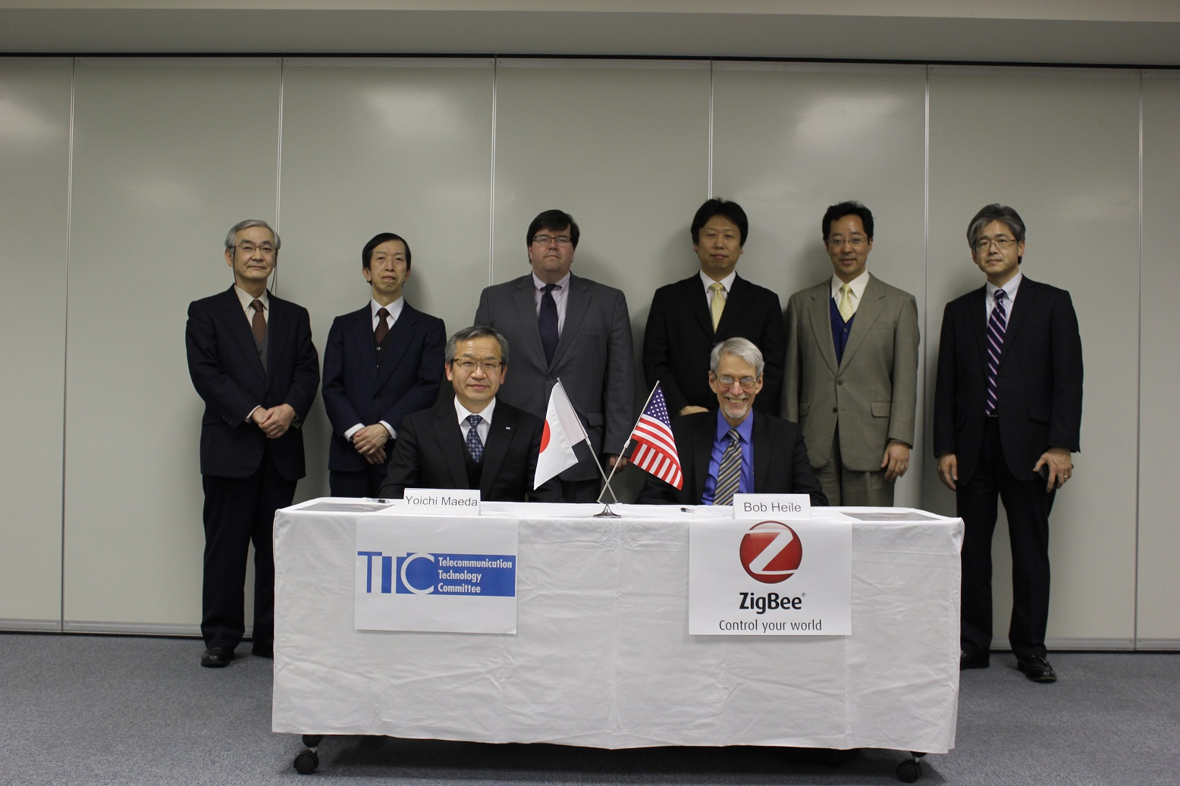
MoU with ZigBee Alliance
TR-1043 Implementation guidelines of Home network communication interface
JJ-300.10 Home network communication Interface for ECHONET Lite
Feb-21, 2013

Slide 21
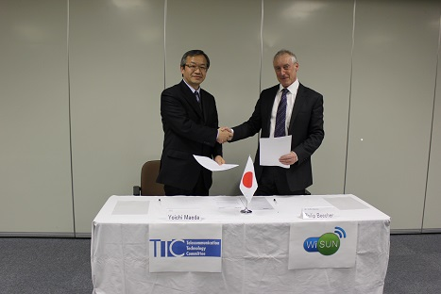
MoU with Wi-SUN Alliance
TR-1043 Implementation guidelines of Home network communication interface
JJ-300.10 Home network communication Interface for ECHONET Lite
Mar-5, 2013

