Slide 1
GSC-16 Closing Plenary
Summary Report
Document No: | GSC16-CL-39r1
Source: | GSC-16 Chair, GSC-16 Rapporteur
Contact: | Jim MacFie, jimacfie@microsoft.com
GSC Session: | Closing Plenary
Agenda Item: | 2.1
Jim MacFie, Chair
Ed Juskevicius, Rapporteur

Slide 2
Contents
  GSC-16:
    Schedule
    Attendance
    Contributions and Other Documents
    Meeting Reports
    Plenary Task Force Reports
    Output Resolutions
    GSC-16 Communiqué
  GSC-17 and Beyond:
    Potential Topics for the Opening Plenary of GSC-17, GTSC-10, and GRSC-10
2

Slide 3
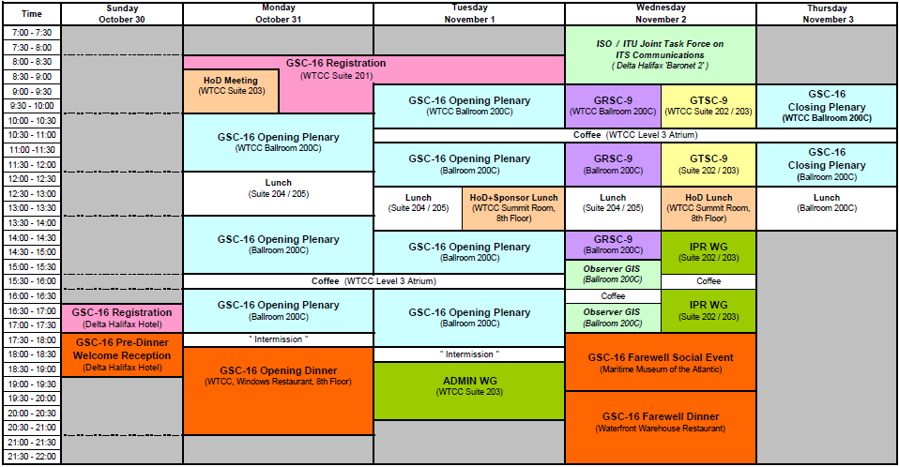

GSC-16 Schedule
http://www.gsc16.ca/english/meetingschedule.html
3

Slide 4
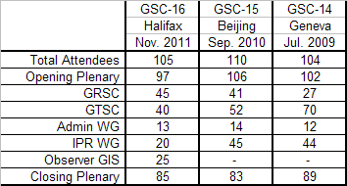
GSC-16 Attendance (1)
Total of 105 people attended GSC-16 including Members, Observers, Exhibitors and Sponsors:
The final list of GSC-16 participants is in GSC16-PLEN-02

Slide 5
GSC-16 Attendance (2)
Members (92 Delegates):
  3 from ARIB (vs. 5 at GSC-15, 5 at GSC-14)
  12 from ATIS (vs. 10 at GSC-15, 13 at GSC-14)
  9 from CCSA (vs. 16 at GSC-15, 11 at GSC-14)
  11 from ETSI (vs. 11 at GSC-15, 10 at GSC-14)
  16 from ISACC (vs. 6 at GSC-15, 6 at GSC-14)
  9 from ITU (vs. 14 at GSC-15, 15 at GSC-14)
  12 from TIA (vs. 11 at GSC-15, 11 at GSC-14)
  12 from TTA (vs. 10 at GSC-15, 8 at GSC-14)
  8 from TTC (vs. 10 at GSC-15, 12 at GSC-14)
Task Force Chairs (2, included above)
Observers (8 representatives, one of which was also on a PSO delegation)
Exhibitors (2), Sponsors (2), Secretariat (2)
The final list of GSC-16 participants is in GSC16-PLEN-02

Slide 6
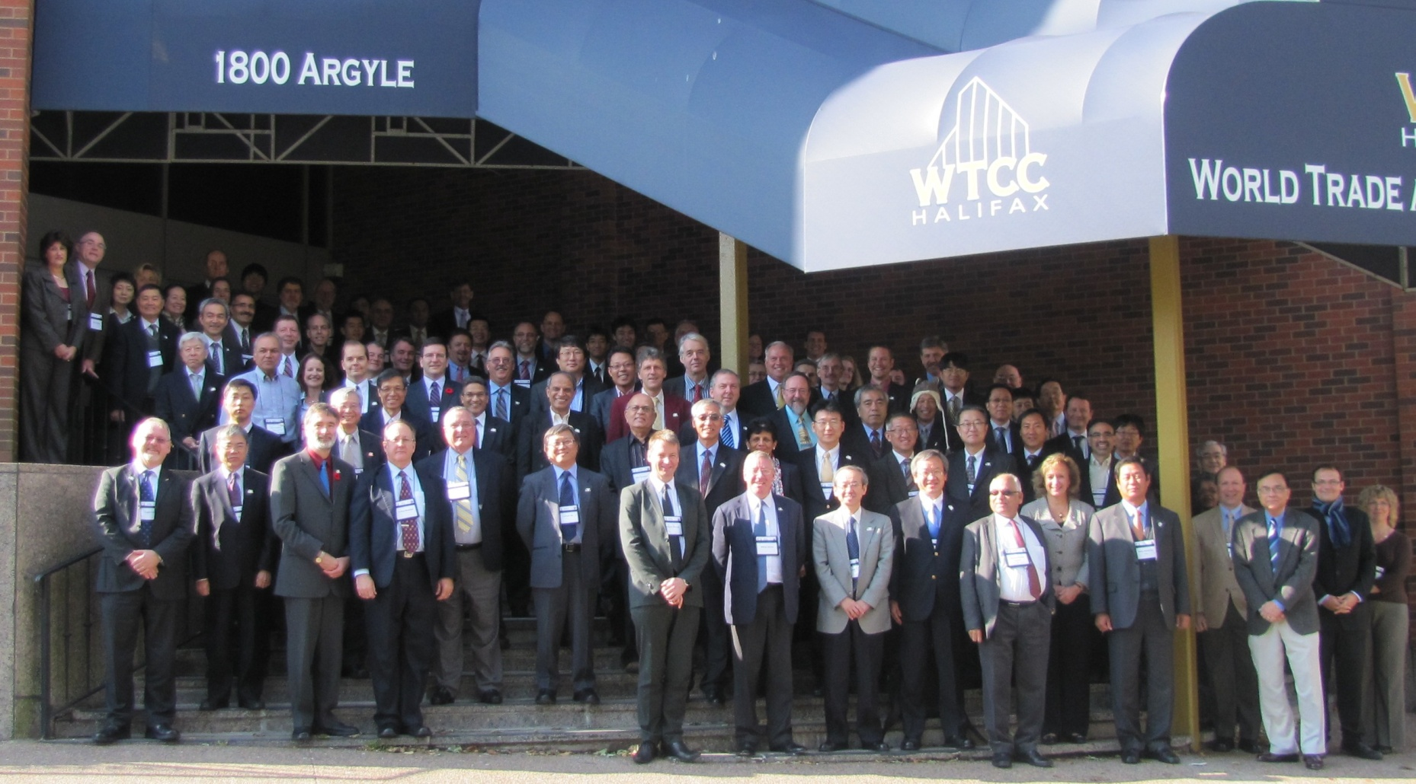
GSC-16 Attendance (3)
6

Slide 7
Meeting Documents http://www.gsc16.ca/english/documents.html
7

Slide 8
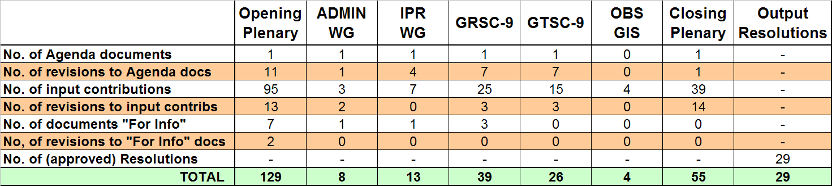
Quantity of Contributions and Other Documents
Note: ‘OBS GIS’ documents were presented by Observer organizations during a special general information session on November 2nd
http://www.gsc16.ca/english/documents.html
8

Slide 9
Meeting Reports (1)
GSC-16 Opening Plenary (GSC16-CL-02)
  This report was presented and approved in draft form at the GSC-16 Closing Plenary; summaries of some HIS panels were not yet ready and will be published once available in GSC16-CL-02r1
GRSC-9 (GSC16-CL-03)
  This report was presented and approved at the GSC-16 Closing Plenary
GTSC-9 (GSC16-CL-04)
  This report was presented and approved at the GSC-16 Closing Plenary
9

Slide 10
Meeting Reports (2)
ADMIN WG (GSC16-CL-05)
  This report was presented and approved at the GSC-16 Closing Plenary
IPR WG (GSC16-CL-06)
  This report was presented and approved at the GSC-16 Closing Plenary
10

Slide 11
Plenary Task Force Reports
Intelligent Transportation Systems (GSC16-PLEN-63)
  Standardization of cooperative ITS progressing in most PSOs
  Preliminary ITU-R report on advanced ITS radiocommunications developed in SG5 WP5A via cooperation of TTA, ETSI and ARIB
  New collaboration on “ITS Communications Standards” proposed
  Task Force will continue to exchange ITS information and facilitate cooperative activities among GSC Members
M2M Standardization (GSC16-PLEN-42)
  GSC M2M Standardization Task Force (MSTF) was established after GSC-15 per Resolution GSC-15/30.
  Activity map listing current M2M standardization activities worldwide produced in GSC16-PLEN-42a1r2
  MSTF will continue to encourage PSOs to review their M2M activities and to report progress to the Task Force and to GSC-17
11

Slide 12
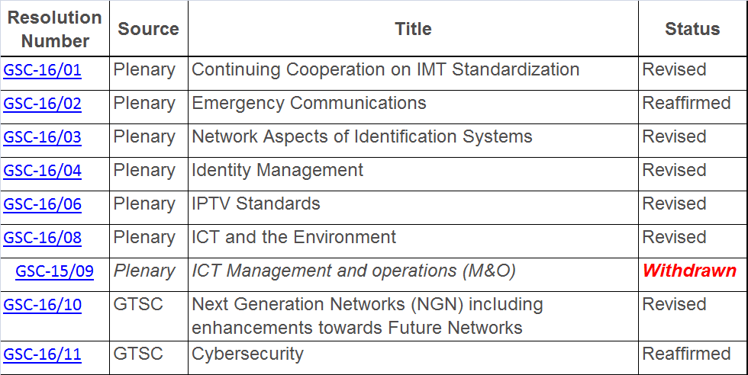
Output Resolutions (1)
http://www.gsc16.ca/english/gsc16-resolution.html

Slide 13
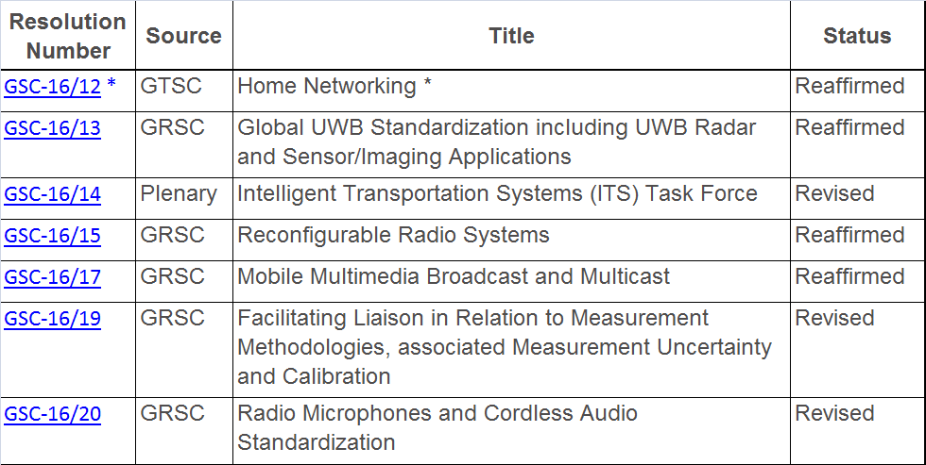
Output Resolutions (2)
* Note: GTSC-9 asked the HoDs to consider ‘promoting’ Resolution 12 on Home Networking to become a Plenary resolution before GSC-17.

Slide 14
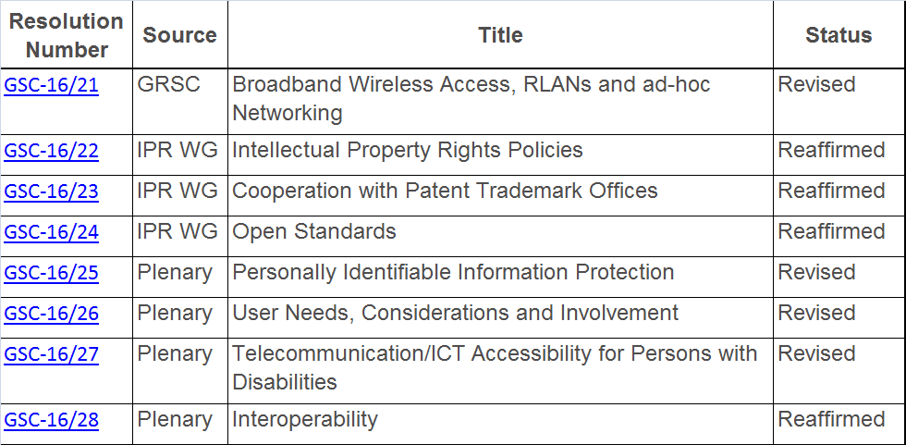
Output Resolutions (3)
http://www.gsc16.ca/english/gsc16-resolution.html

Slide 15
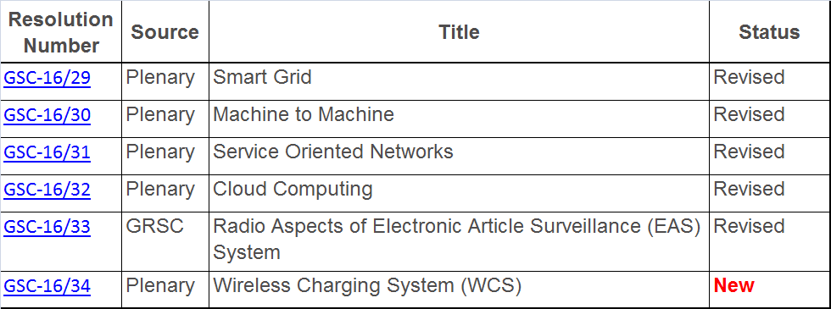
Output Resolutions (4)
http://www.gsc16.ca/english/gsc16-resolution.html

Slide 16
GSC-16 Communiqué
Communiqué published in GSC16-CL-38r2

Slide 17
Potential Topics for the
Opening Plenary of GSC-17
High Interest Subject Panel Sessions:
  Continuing Cooperation on IMT Standardization (Lead = ARIB)
  Emergency Communications (TIA)
  Security and Lawful Interception (TIA)
  Identity Management and Identification Systems (ITU)
  IPTV (ATIS)
  Intelligent Transportation Systems (TIA)
  ICT and the Environment (TTC)
  Interoperability (TTC)
  Machine to Machine Communications (ETSI)
  Smart Grid (TIA)
  Cloud Services (ATIS)
  ICT Accessibility (TIA)
  Wireless Mobile Charging (TTA)

Slide 18
Potential GTSC-10 Topics
High Interest Subject Panel Sessions:
  NGN evolving to Future Networks (ETSI)
  Cybersecurity (ATIS)
  Home Networking (ITU) *
* Note: GTSC-9 asked the HoDs to consider ‘promoting’ Resolution 12 on Home Networking to become a Plenary resolution before GSC-17.

Slide 19
Potential GRSC-10 Topics
High Interest Subject Panel Sessions:
  Broadband wireless access, RLANs and ad-hoc Networking (ISACC)
  Mobile Multimedia Broadcast and Multicast (TIA)
  Reconfigurable Radio Systems (TIA)

Slide 20
GSC-17 and Beyond
  The currently agreed sequence of hosts and locations for future GSC meetings is described in Section 10 of GSC16-ADMIN-02r1
  The next six meetings are planned to be:
    GSC-17, hosted by TTA, May 2013, Jeju Island
    GSC-18, hosted by ITU
    GSC-19, hosted by ETSI
    GSC-20, hosted by ATIS/TIA
    GSC-21, hosted by CCSA
    GSC-22, hosted by ARIB/TTC

Slide 21
Summary
Many HIS areas progressed since GSC-15
Substantial increase in activity and interest on M2M Communications, Smart Grid, ICT and the Environment, ICT Accessibility, Cloud Services
HIS panels (with PPSOs leading the discussions and controlling time) were effective
The participants were commended for their commitment to work on global standards
The ISACC Secretariat was commended for the efficient way in which GSC-16 was organized and facilitated throughout the week in Halifax.
21

