Slide 1
GTSC-10 Summary
Document No: | GSC17-CL-04r1
Source: | GTSC-10
Contact: | TTA: Dr. Kishik Park
GSC Session: | Closing Plenary
Agenda Item: | 2
Kishik Park, Ph.D.
GTSC-10 Chair, TTA

Slide 2
Meeting Overview
Up to 34 attendees
Met on the morning of Wed. May 15
8 input documents
GTSC-9 (ISACC) meeting report presented
Two High Interest Subjects with discussion and consideration of their respective resolutions
Presentation of current activities
NGN : ETSI, ITU, TTA
Cybersecurity : ATIS, ETSI, TIA
Proposed revision of Resolution
NGN : TTA, Future Networks including enhancements of Next Generation Networks (NGN)
Proposed reaffirmation of remaining Resolution
Cybersecurity : ATIS

Slide 3
Next Generation Networks (NGN) HIS Summary
Contributions from ETSI, ITU and TTA.
Highlights include the following topics
NGN is leaving its place to Future networks
ETSI, ITU and TTA starting work on this area
Key topics being addressed
Network Functions Virtualisation
Software Defined Networking
Smart Ubiquitous Networks
Some challenges
Readiness of industry to start work
Involving the user to get requirements
From research to standardisation
Migration from current to Future Networks
Recommendation(s)
Intensify relationship with research community
Develop roadmap for potential future collaboration at GSC
Agree revised resolution of NGN – and change title to FN

Slide 4
Cybersecurity
Presentations
Contributions from ETSI (-03), TIA (-07), and ATIS (-08)
Highlights/Summary
ETSI provides sup
port to ENISA (European Network and Information Security Agency) and develops relevant security standards for NGN, Mobile/Wireless, Electronic Signatures, Smart Cards, RFID/IOT/M2M, and Intelligent Transport, among others.
TIA TR-50 (Smart Device Communications) is working to ensure that architectures, protocols, and specifications meet requirements for secure solutions – including studies of Data-in-Transit Use Cases, M2M Threat Analysis.
ATIS recently developed end-to-end network topology and security zones to be used as foundation for comprehensively addressing cyber-related design and implementation vulnerabilities in devices, networks and computing infrastructures.
Workshops will continue to be hosted in Europe and North America to progress and discuss Cybersecurity issues and standardization.
Collaboration with government organizations, support of related initiatives, and the development of educational white papers continue to attempt to provide a common understanding of Cybersecurity issues.
Next Steps
Cloud computing/M2M/IoT will pose significant Cybersecurity issues that will need to be addressed.
Country-specific cybersecurity issues need to be considered relative to worldwide cybersecurity solutions
Continued domestic and worldwide collaboration is imperative.
Recommendation
Propose reaffirmation of Resolution GSC-16/11 on Cybersecurity.

Slide 5
Other Business
GTSC-10 has discussed the management of a few HISs currently assigned to GTSC
- The meeting see no reason why GTSC-10 HIS topics
could not be dealt with in the GSC Plenary
- This is also in line with discussion in GSC -17 Admin working group meeting

Slide 6
Thanks
Vice Chairs: Mr. Glenn Parsons , Mr. Jørgen Friis
PPSO’s leads: Mr. Gale Lightfoot, Mr. Luis Jorge Romero Saro
Presenters: Mr. Chae Sub LEE, Mr. Eric Barnhart,
Mr. Gale Lightfoot, Mr. Luis Jorge Romero Saro
Rapporteur: Ms. Minah Lee
Participants

Slide 7
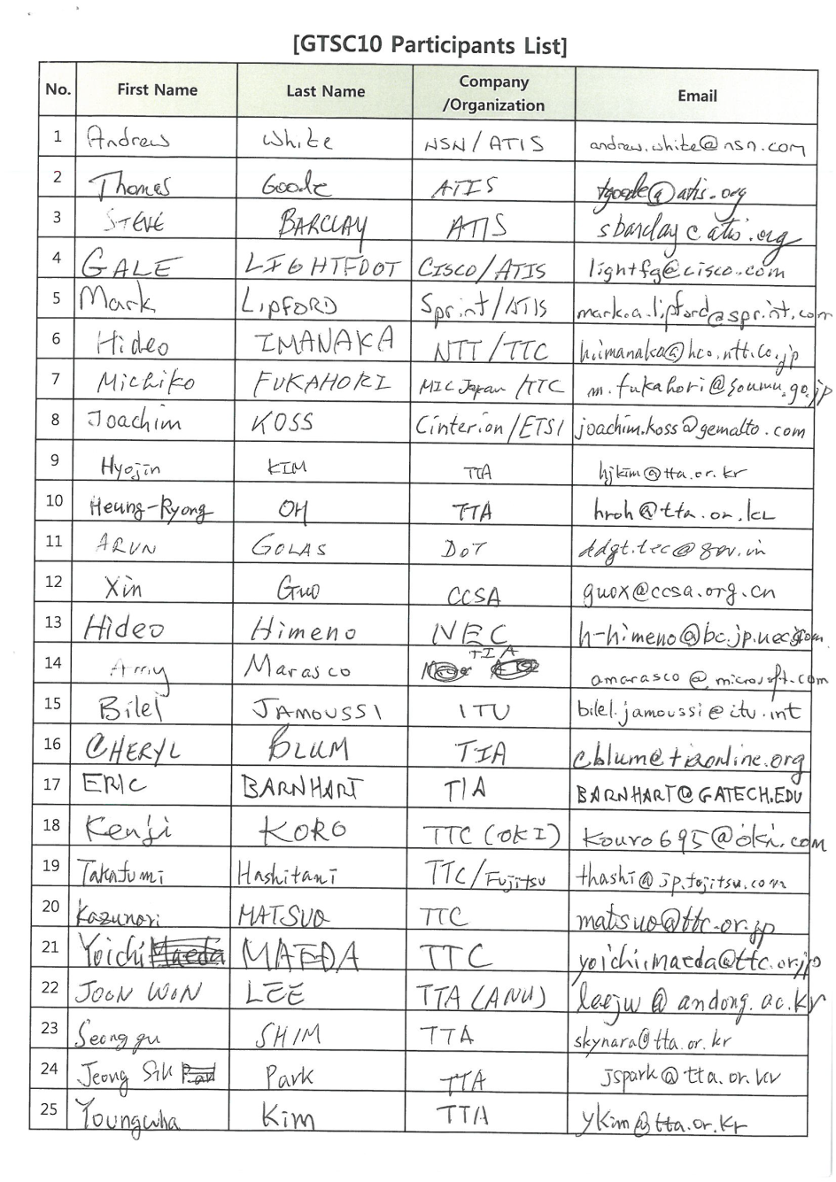
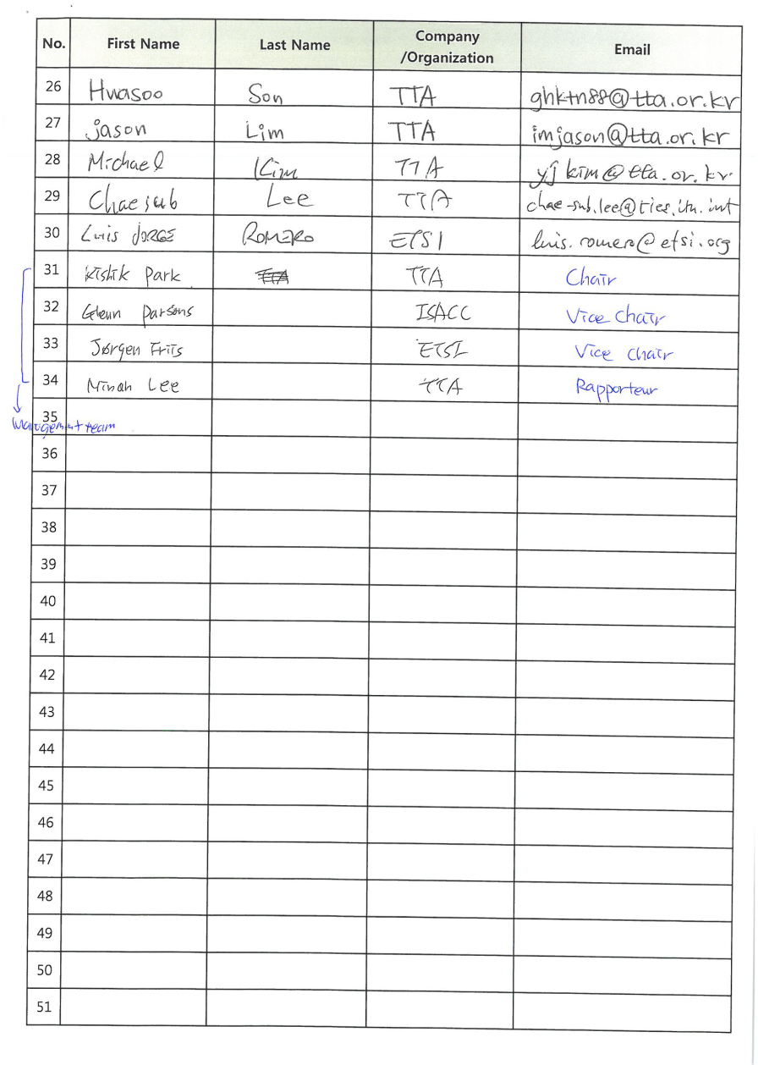
Supplemental Slides
Participants List of GTSC-10

