Slide 1
China Information Accessibility Standards
Document No: | GSC16-PLEN-74
Source: | CCSA
Contact: | Zhiqin WANG
GSC Session: | PLENARY
Agenda Item: | 6.12
Zhiqin WANG
CCSA

Slide 2
Guidelines for Presentations
Information accessibility standards research
Web accessibility standard implementation in china
Some Consideration for future work and international cooperation

Slide 3
China information accessibility Standards Research direction
for people with Physical hypo function
for people with low income or living in under-developed area
for people living in unacquainted language and culture environment
for people with special behavior habit
Notes:
RITT在2005年开始了信息无障碍标准的研究，为了解决人与人、人与社会的信息沟通交流问题，我们将研究方向确定为四个：
-为残疾人、老年人服务的信息无障碍标准
-为低收入或不发达地区人口服务的信息无障碍标准
-为生活在陌生语言文化环境下的人服务的信息无障碍标准
-为行为习惯差异人群服务（目前主要是左手族）的信息无障碍标准

Slide 4
Standards Research for people with Physical hypo function
Research on information present style transforming technical.
Research on communication terminal，hardware and software which could help these people access the network more conveniently.
Research on communication service system which could be built to help these people communicate with more convenience
Notes:
为身体机能差异人群服务的标准要研究以下内容：
- 信息表现形式转换的标准（例如，视频转化为声音，帮助盲人；声音转化为文本，帮助聋人）
助残、助老的终端软硬件产品标准
- 助残、助老的通信服务系统标准，例如无障碍呼叫中心标准，可帮助聋人参与社会生活。

Slide 5
Standards Research for people with low income or living in underdeveloped area
Research possible communication terminals which could be cheap enough for these people to afford.
Research possible communication assistant systems which could be built to help these people communicate in a low price.
Notes:
服务于低收入人口的信息无障碍标准，研究以下内容：
价格相对低廉的通信终端
服务于低收入人群的信息服务系统（这类系统可以是政府出资兴建的，以很低的价格甚至是免费向低收入人口提供信息服务）

Slide 6
Standards Research for people living in unacquainted language and culture environment
Research terminal, hardware or software which could help people communicate with different language conveniently.
Research information service system which could be built to help people living in unacquainted language environment.
Notes:
服务生活在不同语言文化环境下的人的标准:
- 帮助不同语言人群交流的终端机软硬件标准；
- 为外国人提供帮助的信息服务系统

Slide 7
Standards Research for people with special behavior habit
Today, some corporations have pay attention to how to provide convenient information terminal tools for left handed persons, and related technical should be tracked.
Notes:
目前主要是左手族的问题，处于跟踪研究阶段。

Slide 8
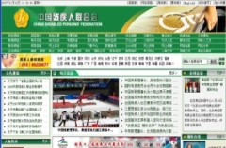
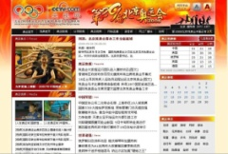
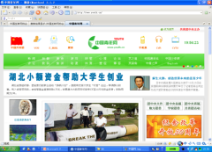
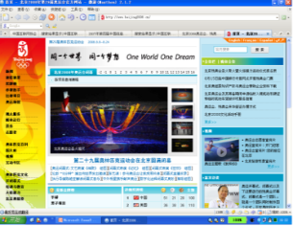
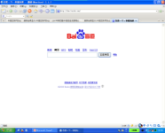
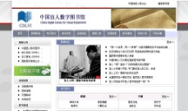
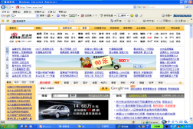
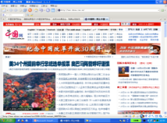
Standard Application
2008 Beijing Olympic Games
In order to help people with disabilities browse internet, CDPF,ISC and CCSA initiated a web accessibility action, and use YD1761-2008 standard as a guideline standard.
Several main government web sites and portal web site join this action, built an accessible Olympic and Paralympics web site or subject channel for people with disabilities according to the standard.
The web sites include Beijing Olympic Official Web site, China Portal Web site, CCTV, Xinhua, China Youth , sina, baidu, 21CN web site etc.
Shanghai government web improvement
In 2010，four government web sites initiated their web site accessible transformation project according to CCSA standards.
Notes:
由于Internet目前已经成立人们获取信息的一条主要渠道，而残疾人上网需求迫切，而中国在网站无障碍方面远远落后于发达国家，因此在上述标准中，制定和实施网站无障碍标准成为中国信息无障碍工作的重点。
中国残联CDPF、中国互联网协会ISC、中国通信标准化协议CCSA在2008年联合推进YD/T 1761-2008标准的实施，一些政府网站和门户网站积极响应，建立了无障碍网站，或建立了无障碍的奥运会、残奥会专用频道。
参与的网站包括北京奥运官方网站、中国网、央视国际、新华网、中青网、新浪、百度、21CN等。
2010年，4个政府网站也按照CCSA标准的要求实施了无障碍改造

Slide 9
Working Plan
Update web accessibility standard on the basis of standard implementation
Research on internet application software accessibility standards
Research on mobile terminal accessibility standards
Research on standards which could help low income persons get information in low cost
Notes:
下一阶段，将开展下列工作：
根据中国实施标准的经验，更新网站无障碍标准；
研究助残的网络应用软件无障碍技术标准；
研究助残的移动终端无障碍技术标准；
研究帮助低收入者享受低成本通信服务的标准。

Slide 10
Consideration about cooperation
Continue to cooperate with social welfare organizations and corporations, research and develop more information accessibility standards.
Continue to cooperate with government organizations and NGOs to implement more information accessibility standards in IT products and service systems development, and improve information accessible environment in china.
Try to cooperation with international corporations , GOs and NGOs to exchange ideas and experience in solving social problems by carrying out information accessibility under the support of government policy or native law.
Notes:
国内外合作方面，我们将：
继续与国内的社会福利机构、企业合作，共同研究并制定更多的信息无障碍标准；
继续与政府机构、非政府机构合作，共同推进无障碍IT产品、服务系统信息无障碍标准的实施，改善中国的无障碍信息环境；
寻求与国际企业、政府机构和非政府机构的合作，交流如何在国家政策或法律的支持下，通过推进信息无障碍标准实施，来解决一些社会问题的想法和经验。

Slide 11
Supplementary Slides

Slide 12
Information Accessibility Standards developed and issued by MIIT
Basic standards
YD/T 2313-2011 Information Accessibility Definitions, Symbols
And Commands
YD/T 2065-2009 Information Accessibility Design Guidelines to
Information Terminal Equipment for Persons with Physical Disabilities
Web standards
YD/T 1761-2008 Information Accessibility - for People with
physical disabilities – Technical Requirements for Web Accessibility
YD/T 1822-2008 Information Accessibility - for People with
Physical Disabilities - Testing Specification for Web Content
Accessibility Evaluation
Notes:
由于残疾人是获取信息最为困难的人群，也是国际上信息无障碍领域关注的重点问题，因此，我们目前的工作重点放在第一个方向上，制定了服务于身体机能差异人群的信息无障碍标准并由工信部发布实施。
其中包括基础标准、Web无障碍标准、终端产品无障碍标准、服务系统无障碍标准。
1）基础标准：
YD/T 2313-2011信息无障碍 术语、符号和命令
YD/T 2065-2009 信息无障碍用于身体机能差异人群的信息终端设备设计导则
2）Web标准：
YD/T 1761-2008信息无障碍-身体机能差异人群-网站设计无障碍技术要求
YD/T 1822-2008信息无障碍-身体机能差异人群-网站设计无障碍评级测试方法

Slide 13
Information Accessibility Standards developed and issued by MIIT
Terminal Product standards
YD/T 1885-2009 Technical Requirements and Test Methods for
Wired Headset Interface of Mobile Communication Terminal
YD/T 1889-2009 The Requirements of Hearing Aids Compatibility
And Test Methods for Telephone Handset
YD/T 1890-2009 Technical Requirements and Evaluation Methods
For Assistive Technology of Information Accessibility in Information
Terminals
YD/T 1643-2007 Requirements and Test Methods for Compatibility
between Wireless Communication Devices and Hearing Aids
13
Notes:
YD/T 1885-2009 移动通信手持机有线耳机接口技术要求和测试方法
YD/T 1889-2009 手柄电话助听器耦合技术要求和测量方法
YD/T 1890-2009 信息终端设备信息无障碍辅助技术的要求和评测方法
YD/T 1643-2007无线通信设备与助听器的兼容性要求和测试方法

Slide 14
Information Accessibility Standards developed and issued by MIIT
Service system standards
YD/T 2097-2010 Information Accessibility Technological
Requirement for Call Center
YD/T 2098-2010 Technological Requirement of Voice-Enabled
Web Service
YD/T 2099-2010 Information Accessibility Technical Requirements
for Deaf Assistant System in Public Place
Notes:
4）服务系统标准
YD/T 2097-2010 信息无障碍 呼叫中心服务系统技术要求
YD/T 2098-2010 信息无障碍 语音上网技术要求
YD/T 2099-2010 信息无障碍 公众场所内听力障碍人群辅助系统技术要求

