Slide 1
ATIS IPTV Standards Development via ATIS’ IPTV Interoperability Forum (IIF)‏
Document No: | GSC16-PLEN-68
Source: | ATIS
Contact: | Mike Nawrocki, michael.a.nawrocki@verizon.com
GSC Session: | PLEN
Agenda Item: | 6.5
Mike Nawrocki,
Director - Wireline Standards,
Verizon Network & Technology

Slide 2
Highlight of Current Activities (1)
Current Focus of IIF Standards
  Recently Completed
  Content On Demand (CoD) architecture and metadata
  Suite of test cases for non-IMS CoD, network attachment, remote device management, and linear IPTV
  QoS Metric metadata
  IPTV Media bookmark metadata
  Secure Time, DRM Server Side API and Trust Hierarchy interoperability
  Current Activity
  Internet-sourced content and inter-provider CoD services
  Identification and authentication
  Technical Report on Mobile IPTV QoS
  Test cases for Emergency Alert Service and IMS
  CoD

Slide 3
Highlight of Current Activities (2)
Current Focus of IIF Standards
  Impending Work
  Multiscreen & Mobile IPTV
  Extension to Adaptive Streaming (MPEG/DASH)
  Extension to support HTML5 (W3C)

Slide 4
Strategic Direction (1)
Expanding the capabilities for service providers to reach their customers by a variety of methods including OTT and unmanaged delivery as well as managed infrastructures
Whenever possible, IIF standards align with the work of other SDOs, including the ITU-T, DVB, CEA, Broadband Forum, and ETSI, ISO/MPEG.
  Continue with SDO and ITU-T coordination and collaboration.
  Established important relationships with all of the leading organizations working in the IPTV realm to share our end-to-end view of the standards being developed.

Slide 5
Strategic Direction (2)
ATIS IIF is developing standards within and across all of the domains.
IIF standards are data-driven, not protocol-driven
  Video is not the sole domain of any one access network technology—e.g., FTTP, Wireless, DSL
IIF continues to emphasize timely completion of deliverables to support deployment of standardized IPTV.
Content
Provider
Service
Provider
Network
Provider
Consumer
Source: “IPTV Architecture Requirements,” ATIS-0800002, May 2006

Slide 6
Next Steps/Actions
Complete currently defined work program work, per IIF Issue statements
IPTV Services Management - Ad Space Ordering API; led by TMOC.
Continue to work cooperatively with external organizations, such as ITU-T, DVB, VSF, and Broadband Forum, on aligning efforts and work products.
Continue to work cooperatively with internal organizations such as CSF, OBF, PRQC, PTSC, and TMOC.

Slide 7
Proposed Resolution
ATIS supports the reaffirmation of the existing IPTV Resolution contained in GSC-15/06.

Slide 8
Supplementary Slides

Slide 9
IIF Committees
IIF Architecture (ARCH) Committee
IIF IPTV Security Solutions (ISS) Committee
IIF Metadata and Transaction Delivery (MTD) Committee
IIF Quality of Service Metrics (QoSM) Committee
IIF Testing and Interoperability (T&I) Committee

Slide 10
IIF Committees (cont’d)
IIF Architecture Committee
The IIF Architecture Committee develops IPTV architecture requirements, specifications, protocols, and other documents required to enable deployment of a standardized, interoperable, access-agnostic IPTV service.
IIF IPTV Security Solutions (ISS) Committee
The IPTV Security Solutions Committee develops security standards with emphasis on a security requirements framework and an integrated toolkit of security functions that can be utilized for an interoperable solution for enabling IPTV services.

Slide 11
IIF Committees (cont’d)
IIF Metadata and Transaction Delivery (MTD) Committee
The Metadata and Transaction Delivery Committee develops standards that define metadata elements, the representation of metadata elements, and the content of application-level transactions where the MTD Committee is the primary developer of metadata standards in support of all ATIS IIF Committees.
IIF Quality of Service Metrics (QoSM) Committee
The Quality of Service Metrics Committee develops standards that define metrics, models, and approaches for measurement and reporting of quality of service (QoS) and quality of experience (QoE) for IPTV services.

Slide 12
IIF Committees (cont’d)
IIF Testing and Interoperability (T&I) Committee
The Testing and Interoperability Committee develops the necessary test scripting and test planning for the interoperability of ATIS IIF standards and addresses IPTV interoperability issues, providing recommended courses of action for mitigation of the identified issues.

Slide 13
Committee Work Program
Comprehensive Work Program
  The ATIS IPTV work program is comprehensive, including work planned or underway in areas such as architecture, multiple access network technologies, security and digital rights, testing, interoperability, metadata, operational support systems/business support systems (OSS/BSS), identity management, quality of service (QoS), and quality of experience (QoE).
Aggressive/Robust Program Management
  The ATIS IIF has an aggressive program management approach to driving standards development. This robust program drives the development of IPTV standards in the time and manner demanded by the business objectives of the ATIS member companies and the global marketplace.

Slide 14
ATIS’ Market-Driven
IPTV Work Program
Broad industry representation
  ATIS has representatives from the requisite industry sectors (service providers, vendors, customer equipment manufacturers, etc.) leading, supporting, and driving the IPTV work.
Broad industry liaisons
  ATIS has established important relationships with all of the leading organizations working in the IPTV realm to share our end-to-end view of the standards being developed.

Slide 15
ATIS Committee Involvement
IPTV, Primary (End-to-End) Responsibility
  IPTV Interoperability Forum (IIF)
IPTV Services Management
  Telecom Management and Operations Committee (TMOC)
  Ordering and Billing Forum (OBF)
  ATIS CIO Council
IPTV Identity Management
  Packet Technologies and Systems Committee (PTSC)
IPTV Cloud Services Coordination
  Cloud Services Forum (CSF)

Slide 16
IIF Mission
The IIF enables the interoperability, interconnection, and implementation of IPTV systems/services by developing ATIS standards and facilitating related technical activities. The IIF will place an emphasis on North American and ATIS Member Company needs in coordination with other regional and international standards development organizations.

Slide 17
IIF Scope
Coordinate standards activities that relate to IPTV technologies. This includes providing a liaison function between the various SDOs and forums that are each working on important components for multimedia, but may not have visibility to other aspects of the application.
Develop interoperability agreements, technical reports, or other types of ATIS standards where appropriate.
Provide a venue for interoperability activities.
Provide a venue for the assessment of IPTV issues in the context of NGN directions.

Slide 18
ATIS IIF Members
Alcatel-Lucent
ARRIS
AT&T
British Telecom
Brocade Communications
CenturyLink
Cheetah Technologies
Cisco Systems
Concurrent
DTS
Ericsson
Huawei
IneoQuest Technologies
Intel
JDSU
Juniper
LG Electronics
Microsoft
Motorola
NEC Corporation of America
Nielsen Company
Nokia Siemens Networks
Rogers Wireless
SeaChange International
Sumitomo Electric Networks
TDS Telecom
Telchemy
Telcordia Technologies
TELUS
Time Warner Cable
Verivue, Inc.
Verizon
ZTE

Slide 19
IIF Publications
ATIS-0800001.v002
Title: IPTV DRM Interoperability Requirements
https://www.atis.org/docstore/product.aspx?id=21212
Description: This document defines the requirements for the interoperability of systems and components in the IPTV DRM/security environment. The requirements defined in this document shall be used to create an IPTV DRM/security interoperability specification during the next phase of the IIF DRM TF.
ATIS-0800002
Title: IPTV Architecture Requirements
https://www.atis.org/docstore/product.aspx?id=21213
Description: IPTV is a suite of secure, reliable, managed video-related services. This document provides an initial industry consensus view on the requirements for an end-to-end architecture to support these services.

Slide 20
IIF Publications (cont’d)
ATIS-0800003
Title: IPTV Architecture Roadmap
https://www.atis.org/docstore/product.aspx?id=22572
Description: The IPTV Architecture Roadmap is intended as a companion to ATIS-0800002, IPTV Architecture Requirements. This document is intended to help guide the architecture specification development work of the IIF. The Roadmap provides an industry consensus perspective on the prioritization and scoping of the specification development efforts of the IIF.
ATIS-0800004
Title: IPTV QoS Framework Document
https://www.atis.org/docstore/product.aspx?id=22624
Description: This document provides an initial industry consensus view of scope, definitions, and tools to support the creation of IPTV QoS metrics and measurements within ATIS IPTV Interoperability Forum (IIF).

Slide 21
IIF Publications (cont’d)
ATIS-0800005
Title: IPTV Packet Loss Issue Report
https://www.atis.org/docstore/product.aspx?id=22659
Description: The IPTV Packet Loss Issue report is a technical report that explores a range of potential solutions to the problem of packet loss and makes recommendations regarding their applicability for an IPTV service.
ATIS-0800006.v002
Title: IIF Default Scrambling Algorithm
http://www.atis.org/docstore/product.aspx?id=25435
Description: This document provides the IIF Default Scrambling Algorithm (IDSA) Interoperability Specification. It supports interoperability by specifying a default scrambling/de-scrambling algorithm for the MPEG-2 Transport Stream and the scrambling algorithm signaling.

Slide 22
IIF Publications (cont’d)
ATIS-0800007
Title: IPTV High Level Architecture
https://www.atis.org/docstore/product.aspx?id=22679
Description: This document provides a high level architectural framework for end-to-end systems’ implementation and interoperability for the supporting network design.
ATIS-0800008.v002
Title: QoS Metrics for Linear Broadcast IPTV
http://www.atis.org/docstore/product.aspx?id=25549
Description: This document defines a base set of Quality of Service (QoS) metrics for Linear/Broadcast IPTV service.
Notes:
22
26/10/2011

Slide 23
IIF Publications (cont’d)
ATIS-0800009.v002
Title: Remote Management of Devices in the Consumer Domain for IPTV Services
https://www.atis.org/docstore/product.aspx?id=22867
Description: This document covers remote device management architecture and protocols, software download, provisioning, configuration, and monitoring of devices in the consumer domain for IPTV services.
ATIS-0800010
Title: Emergency Alert Provisioning Specifications
https://www.atis.org/docstore/product.aspx?id=22927
Description: The Emergency Alert System for IPTV addressed in this document broadens the delivery of EAS messages from a few linear channels to the complete IPTV experience, spanning the full range of activities from live and recorded TV viewing, through games, internet streaming and sourced content, and even including IPTV client menu activities.

Slide 24
IIF Publications (cont’d)
ATIS-0800011
Title: QoS Metrics for Public Services
https://www.atis.org/docstore/product.aspx?id=22790
Description: The goal of this document is to define a base set of QoS metrics for regulatory services, including Emergency Alert Systems, Closed Captioning and Content Advisories, and V-Chip Technology.
ATIS-0800012
Title: IPTV Emergency Alert System Metadata Specification
https://www.atis.org/docstore/product.aspx?id=22946
Description: Building upon the system requirements given in ATIS-0800010, Emergency Alert Service Provisioning Specifications, the IPTV Emergency Alert System Metadata Specification in this document defines an XML schema used for delivery of emergency alert signaling and information to the IPTV service provider’s EAS Ingestion System (EIS), and for delivery of alert information and signaling to the IPTV Terminal Function on the consumer premisis. In addition, the document specifies the methods used to authenticate EAS data and audio files.

Slide 25
IIF Publications (cont’d)
ATIS-0800013
Title: Media Formats and Protocols for IPTV Services
https://www.atis.org/docstore/product.aspx?id=24504
Description: This document identifies the media formats and protocols, including reliability protocols, required for implementation of ATIS IIF IPTV-related services.
ATIS-0800014.v002
Title: Secure Download and Messaging Interoperability Specification
https://www.atis.org/docstore/product.aspx?id=22885
Description: This document is one of a series of documents that specify the IPTV Security Solution (ISS). This document specifies the IPTV Security Solution/Authentication (ISS/A), which is used to authenticate downloads and messages to IPTV receiving devices.

Slide 26
IIF Publications (cont’d)
ATIS-0800015.v002
Title: Certificate Trust Management Hierarchy Interoperability Specification
http://www.atis.org/docstore/product.aspx?id=25563
Description: This document defines the specifications for the interoperability of systems and components in the IPTV DRM/security environment with respect to Certificate Trust management Hierarchy.
ATIS-0800016.v002
Title: Standard PKI Certificate Format Interoperability Specification
http://www.atis.org/docstore/product.aspx?id=25599
Description: This document specifies the default ATIS IIF certificate format, the IPTV Security Solution/Certificate (ISS/C), that can be used as part of the IPTV Security Solution (ISS).

Slide 27
IIF Publications (cont’d)
ATIS-0800017.v002
Title: Network Attachment and Initialization of Devices and Client Discovery of IPTV Services
https://www.atis.org/docstore/product.aspx?id=24591
Description: This document specifies the initial set of activities that prepare devices in the consumer domain to receive and consume IPTV services. The document describes the initialization and attachment phases of the Delivery Network Gateway (DNG) and the IPTV Terminal Function (ITF), covering network attachment, service provider discovery, service provider attachment, and services discovery procedures.

Slide 28
IIF Publications (cont’d)
ATIS-0800018
Title: IPTV Linear TV Service
https://www.atis.org/docstore/product.aspx?id=24503
Description: This specification defines the basic Linear TV service operation after the initialization, configuration, service provider discovery, and services discovery documented in ATIS-0800017, Network Attachment and Initialization of Devices and Client Discovery of IPTV Services, and ATIS-0800009, Remote Management of Devices in the Consumer Domain for IPTV Services.
ATIS-0800019
Title: Multicast Network Service Specification
http://www.atis.org/docstore/product.aspx?id=24903
Description: The multicast service must have a baseline set of requirements to ensure interoperability between the service provider IPTV multicast applications, the network provider domain, the home network, and the IPTV Terminal Function. This document describes an IP multicast service that the network provider can provide for use as a basis for a linear/broadcast TV service.

Slide 29
IIF Publications (cont’d)
ATIS-0800020.v002
Title: IPTV Electronic Program Guide Metadata Specification
http://www.atis.org/docstore/product.aspx?id=25525
Description: This document specifies the logical data model and delivery mechanisms for IPTV Electronic Program Guide (EPG) information to be delivered from EPG servers in the service provider domain to EPG clients in the consumer domain. The delivery specifications include fragmentation, encoding, encapsulation, and transport of the EPG information, with support for both multicast push and unicast pull transport.
ATIS-0800022.v002
Title: IPTV Consumer Domain Device Configuration Metadata
http://www.atis.org/docstore/product.aspx?id=25548
Description: This document complements ATIS-0800017, Network Attachment and Initialization of Decides and Client Discovery of IPTV Services, by specifying the data structures (metadata) and transactions that are necessary to implement network attachment of IPTV Delivery Network Gateway (DNG) devices and IPTV Terminal Function (ITF) devices and processes for service provider discovery, service provider attachment, and services discovery.

Slide 30
IIF Publications (cont’d)
ATIS-0800024
Title: Security Robustness Rules Interoperability Specification
https://www.atis.org/docstore/product.aspx?id=24595
Description: In the interest of promoting and maintaining secure environments for handling, storing, and transmitting of sensitive material, such as keys, certifications, operating code, etc., this document defines the IPTV interoperability specifications for Security Robustness Rules. This specification pertains to IPTV devices both on the server side and on the receiving side. This document augments the IPTV Security Solutions (ISS) Security Profiles by defining Secure Execution Environment elements and their robustness levels. The ISS Security Profiles and robustness levels may be useful in matching content value to platform security capability.
ATIS-0800025
Title: Test Plan for Evaluation of Quality Models for IPTV Services
http://www.atis.org/docstore/product.aspx?id=24905
Description: This document describes a test plan for validating objective perceptual quality models in the context of IPTV services.

Slide 31
IIF Publications (cont’d)
ATIS-0800028
Title: Fault Codes for IPTV
https://www.atis.org/docstore/product.aspx?id=24538
Description: This document contains a categorized listing of fault codes for IPV functions and components, including Linear TV, emergency alert services, device initialization and network attachment, digital rights management, IPTV service subscription, and data collection.
ATIS-0800029
Title: IPTV Terminal Metadata Specification
https://www.atis.org/docstore/product.aspx?id=24561
Description: This document specifies a logical data model to address the requirements related to IPTV services in the Consumer Domain, one of the domains defined in the ATIS IPTV architecture. The data model is specified using XML schemas and facilitates the exchange of data related to users and devices with which users consume IPTV services. Specifically, the following areas are addressed user preferences for content consumption and accessibility, services to which users are subscribed, and recording of content consumptions and user interaction.

Slide 32
IIF Publications (cont’d)
ATIS-0800030
Title: Technical Report on IPTV Advertising
http://www.atis.org/docstore/product.aspx?id=25366
Description: This technical report analyzes existing advertising standards and considers how they may be re-used for ATIS IPTV. Existing standards are identified to help determine further work areas for ATIS standards.
ATIS-0800032
Title: Metadata for IPTV Fault Codes
https://www.atis.org/docstore/product.aspx?id=24610
Description: The fault codes defined in ATIS-0800028, Fault Codes for IPTV, require a metadata exchange between consumer domain devices and service provider and/or network provider systems. This document and the associated XML schema provide this metadata.

Slide 33
IIF Publications (cont’d)
ATIS-0800033
Title: A-POD: An IPTV Separable Security Interface Specification
http://www.atis.org/docstore/product.aspx?id=24673
Description: This document specifies one potential example of an Internet Protocol Television (IPTV) security interface specification. The A-POD specification is not the only possible implementation of a Separable Security Element (SSE) within the IIF standards, or for IPTV in general. The solution specified in this document achieves a physically separable security solution for IPTV that is harmonized with and backwards compatible to the existing unidirectional and multi-stream, CableCARD™ standards. As such, the solutions defined in this standard may not be the most efficient method for accomplishing IPTV separable security.

Slide 34
IIF Publications (cont’d)
ATIS-0800034
Title: Secure Time Interoperability Specification
http://www.atis.org/docstore/product.aspx?id=25434
Description: This document defines the specifications for the interoperability of systems and components in the IPTV Security Solutions environment with respect to secure time.
ATIS-0800035
Title: Technical Report on a Validation Process for IPTV Perceptual Quality Measurements
http://www.atis.org/docstore/product.aspx?id=24974
Description: This document discusses a proposed test process for IPTV Perceptual Quality Measurements. It describes the industry standards test process currently followed, indicates its shortcomings, and suggests solutions for the identified weaknesses. The proposed process is flexible and is believed to address market needs better than the current process.

Slide 35
IIF Publications (cont’d)
ATIS-0800036
Title: XML Schema for ITF Execution Environment
http://www.atis.org/docstore/product.aspx?id=24900
Description: This specification provides an XML schema for the Execution Environment profiles for use in services and functions within an IPTV Solution.
ATIS-0800038
Title: IIF XML Guidelines
http://www.atis.org/docstore/product.aspx?id=25678
Description: This document specifies guidelines to be used in the development of XML Schemas by the ATIS IPTV Interoperability Forum (IIF).

Slide 36
IIF Publications (cont’d)
ATIS-0800039.v002
Title: DRM Server-Side Application Programming Interfaces Interoperability Specification
http://www.atis.org/docstore/product.aspx?id=25033
Description: This document contains the IPTV DRM Interoperability Application-Level Interfaces Interoperability Server-Side APIs Specification. Note – Annex A, XML Schema for DRM Server-Side APIs, of this Standard has also been formatted as a separate file and electronically packaged with this standard.

Slide 37
IIF Publications (cont’d)
ATIS-0800040
Title: IPTV MPEG Transport Stream Monitoring
http://www.atis.org/docstore/product.aspx?id=25390
Description: This recommended practice provides a common methodology for describing Transport Stream conformance criteria. It explicitly describes the elements and parameters that should be verified in an ATIS IIF-compliant Transport Stream for it to be considered a proper emission. This document incorporates by reference all of SCTE-142, except where explicitly extended or constrained.

Slide 38
IIF Publications (cont’d)
ATIS-0800041
Title: Implementer's Guide to QoS Metrics
http://www.atis.org/docstore/product.aspx?id=25412
Description: This document provides guidance to network providers and service providers on how to use ATIS IIF standard Quality of Service metrics, Quality of Experience indicators, and fault codes in testing and performance monitoring to run their IPTV services and bolster customer satisfaction. This version of the document focuses on Linear (broadcast) IPTV service.

Slide 39
IIF Publications (cont’d)
ATIS-0800042.v002
Title: IPTV Content on Demand Service
http://www.atis.org/docstore/product.aspx?id=25670
Description: This document specifies the use of relevant functions for delivery of an IPTV Content on Demand (CoD) Service. An instance of an IPTV CoD Service may be configured to provide a consumer experience similar to that of traditional Video on Demand (VoD) television services, but additionally provides access to the potentially greater functionality also available through capabilities of the IPTV infrastructure.

Slide 40
IIF Publications (cont’d)
ATIS-0800043
Title: Content on Demand Metadata Schema and Metadata Transactions
Description: This document defines the metadata for use on interfaces related to the delivery of Content on Demand according to ATIS-0800042, IPTV Content on Demand Service.
ATIS-0800044
Title: IPTV Media Bookmark Specification
http://www.atis.org/docstore/product.aspx?id=25553
Description: This document specifies the logical data model for the creation and use of bookmarks for IPTV programs or IPTV content. The logical data model is specified in the form of an XML schema.

Slide 41
IIF Publications (cont’d)
ATIS-0800045
Title: IPTV QoS Metrics Metadata
http://www.atis.org/docstore/product.aspx?id=25629
Description: The Quality of Service metrics defined in ATIS-0800008, QoS Metrics for Linear IPTV, need to be exchanged between metric points within the service provider and/or network provider systems and some element management systems. This document and the associated XML schema define the metadata structures for this exchange.
ATIS-0800046
Title: IPTV EPG Metadata for Light-Weight Devices
http://www.atis.org/docstore/product.aspx?id=25552
Description: The purpose of this specification is to define a subset of the Electronic Program Guide (EPG) metadata model in ATIS-0800020, IPTV EPG Metadata Specification, that includes the most important elements and attributes of the full EPG metadata model, but is small enough to be suitable for light-weight devices.

Slide 42
IIF Publications (cont’d)
ATIS-0800047
Title: Scenarios for ATIS IIF IPTV Interoperability Testing
http://www.atis.org/docstore/product.aspx?id=25645
Description: This ATIS document describes a set of physical scenarios to test the interoperability between key components of the ATIS IIF IPTV architecture. The interfaces to be tested are specified in terms of references to the appropriate ATIS IIF specifications.
ATIS-0800048
Title: Test Cases for Network Attachment, Service Provider Discovery and Attachment, and Services Discovery
http://www.atis.org/docstore/product.aspx?id=25656
Description: This ATIS document describes the test cases for the interoperability between key components of the IIF IPTV architecture. The interfaces to be tested are primarily specified in ATIS-0800017, Network Attachment and Initialization of Devices in the Consumer Domain, and ATIS-0800022, IPTV Consumer Domain Device Configuration.

Slide 43
IIF Publications (cont’d)
ATIS-0800049
Title: Test Cases for Linear TV Service Selection, Attachment, and Usage
http://www.atis.org/docstore/product.aspx?id=25657
Description: This ATIS document describes the test cases for the linear TV service, as primarily defined in ATIS-0800018, IPTV Linear TV Service, including terminal attachment and service usage.
ATIS-0800050
Title: Test Cases for Non-IMS Content on Demand Service Attachment and Service Use
http://www.atis.org/docstore/product.aspx?id=25660
Description: This ATIS document describes the test cases for the interoperability between key components of the IIF IPTV architecture. The interfaces to be tested are primarily specified in ATIS-0800042, IPTV Content on Demand Service.

Slide 44
IIF Publications (cont’d)
ATIS-0800051
Title: Test Cases for Remote Management of Consumer Domain Devices and QoS Metric Reporting
http://www.atis.org/docstore/product.aspx?id=25662
Description: This ATIS document describes the test cases for the interoperability between key components of the IIF IPTV architecture. The interfaces to be tested are primarily specified in ATIS-0800009, Remote Management of Devices, and ATIS-0800008, QoS Metrics for Linear IPTV.

Slide 45
IIF Active Issues
ARCH Committee; IIF Issue 105
Title: Revision to ATIS-0800042, IPTV Content on Demand Service
Target completion: 1st Quarter 2012
Description: This specification shall build on the existing CoD standard (ATIS-0800042) and provide updates as needed. The revised specification should give priority to the following topics:
  Adaptive HTTP Streaming (on-demand, live unicast)
  MP4 containers
  Multiscreen
  TV Everywhere (e.g., authorization, off-net delivery)
  URL for all IIF Issues: http://www.atis.org/iif/issues.asp
Notes:
45
26/10/2011

Slide 46
IIF Active Issues (cont’d)
ISS Committee; IIF Issue 8
Title: Distributing of Content in the Subscriber's Authorized Service Domain
Target completion: 2nd Quarter 2012
Description: This issue will produce a requirements document that primarily addressed the IPTV DRM interoperability requirements for the distributing of content in the subscriber’s authorized service domain (e.g. in the home). This requirements document will identify related work and gaps (as appropriate) that are currently done in the industry by other groups.
Notes:
46
26/10/2011

Slide 47
IIF Active Issues (cont’d)
ISS Committee; IIF Issue 47
Title: Client-Side Interoperability Application Level Interfaces Interoperability Specification
Target completion: 2nd Quarter 2012
Description: This issue shall produce a DRM Interoperability Specification/Standard that addresses all the requirements associated with Client-Side Interoperability Application Programming Interfaces (APIs).
Notes:
47
26/10/2011

Slide 48
IIF Active Issues (cont’d)
ISS Committee; IIF Issue 67
Title: Device Identity and Authentication
Target completion: 4th Quarter 2011
Description: ISS will examine a set of architecture specifications as directed by IIF Architecture Committee, where the Architecture Committee has identified a threat that it has deemed can be mitigated by authentication. ISS will identify types of procedures, services, and scenarios that require authentication and type of entities that need to be authenticated as part of those procedures and infrastructure available/required to perform the authentication.

Slide 49
IIF Active Issues (cont’d)
ISS Committee; IIF Issue 68
Title: Security for Content on Demand Services
Target completion: 2nd Quarter 2012
Description: Analyze the security needs of the Content On Demand solution(s) developed by the IIF ARCH Committee. Determine if additional or modified security techniques, APIs, or tools are needed.

Slide 50
IIF Active Issues (cont’d)
Metadata Committee; IIF Issue 93
Title: Internet-Sourced Content Metadata and Transaction Details
Target completion: 2nd Quarter 2012
Description: There is a need to develop and specify metadata and transaction details to support the use of Internet-sourced content in IPTV.

Slide 51
IIF Active Issues (cont’d)
QoSM Committee; IIF Issue 43
Title: QoS Metrics for Video on Demand (VOD)‏
Target completion: 4th Quarter 2011
Description: This document will establish basic QoS metrics for VOD. The work will establish interpretations of the meanings of these metrics, and measurement points and applicable measurements will be identified.
Notes:
51
26/10/2011

Slide 52
IIF Active Issues (cont’d)
QoSM Committee; IIF Issue 48
Title: IPTV QoE Requirements
Target completion: 4th Quarter 2011
Description: This document will provide a comprehensive survey of the various activities of other standards bodies in QoE as well as a detailed perspective that describes the overall needs around QoE particularly for all ATIS IIF-defined IPTV services.
Notes:
52
26/10/2011

Slide 53
IIF Active Issues (cont’d)
QoSM Committee; IIF Issue 101
Title: QoS and QoE for Stereoscopic 3D
Target completion: 4th Quarter 2012
Description: Stereoscopic 3D is a new area and it may be necessary to collect metrics related to 3D to understand 3D and user’s perceptions of 3D quality. These metrics could include depth, distortion, loss of resolution, left and right video synchronization, closed captioning, 3D fatigue, left-right cross-talk etc. Joint with VSF.

Slide 54
IIF Active Issues (cont’d)
QoSM Committee; IIF Issue 106
Title: Technical Report on Mobile IPTV QoS
Target completion: 1st Quarter 2012
Description: Mobile IPTV is a new delivery method for IPTV services. QoS mechanisms and metrics may be unique within this environment. Exploration of the technical issues is deemed highly beneficial before creation of any specifications.

Slide 55
IIF Active Issues (cont’d)
T&I Committee; IIF Issue 109
Title: Test Plan Development for Emergency Alert Service
Target completion: 1st Quarter 2012
Description: There is a need to develop test cases for the Emergency Alert Service (EAS) specified in ATIS-0800010, Emergency Alert Provisioning Specification, for the purposes of interoperability testing.

Slide 56
IIF Active Issues (cont’d)
T&I Committee; IIF Issue 110
Title: Test Plan Development for IMS Content on Demand
Target completion: 1st Quarter 2012
Description: There is a need to develop test cases for the IMS Content on Demand service specified in ATIS-0800042.v002, IPTV Content on Demand Service, for the purposes of interoperability testing.

Slide 57
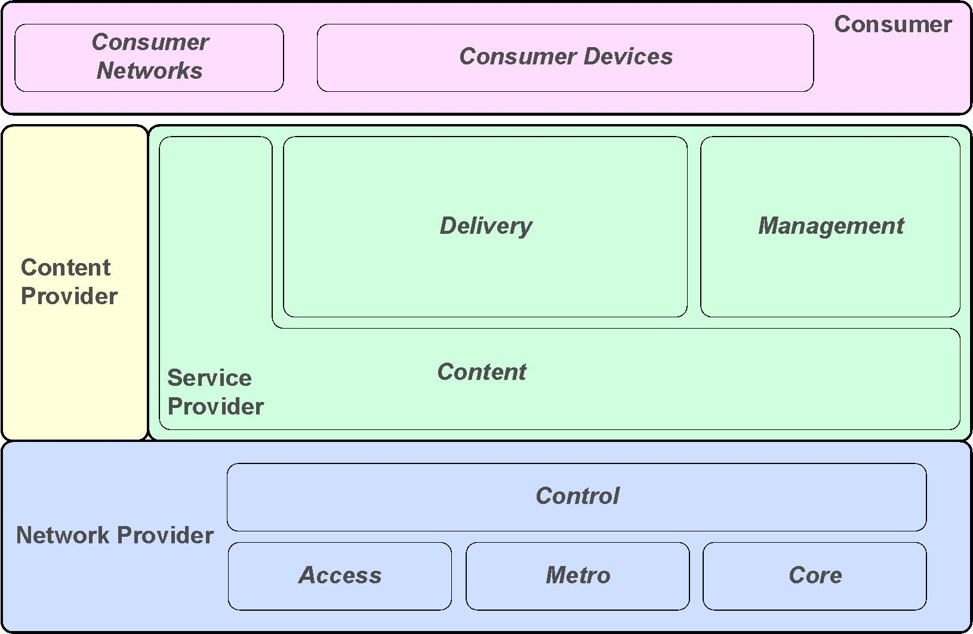
IPTV Sub-Domains
Source: “IPTV Architecture Requirements,” ATIS-0800002, May 2006

Slide 58
IIF DRM Components

Slide 59
IPTV OSS/BSS HLA
Description:
  Define high level architecture for IPTV OSS/BSS
  Uses eTOM (TM Forum/ITU-T) as basis
Goal of an OSS solution for IPTV:
  Enable the widest range of IPTV business models by a flexible service integration framework
Plan for continued collaboration with ITU-T and others as work evolves

Slide 60
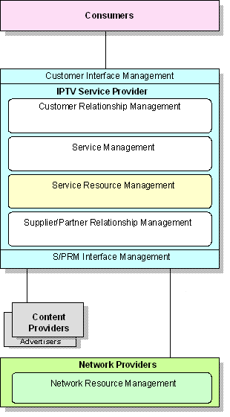
IPTV OSS/BSS HLA (cont’d)

Slide 61
IIF Liaisons or Collaboration Include…
ITU-T FG IPTV
European Telecommunications Standards Institute (ETSI) and TISPAN
ISO SC 29/WG 11
Digital Video Broadcasting Project (DVB)‏
Broadband Forum
Digital Living Network Alliance (DLNA)‏
Consumer Electronics Association (CEA)‏
Video Services Forum (VSF)

Slide 62
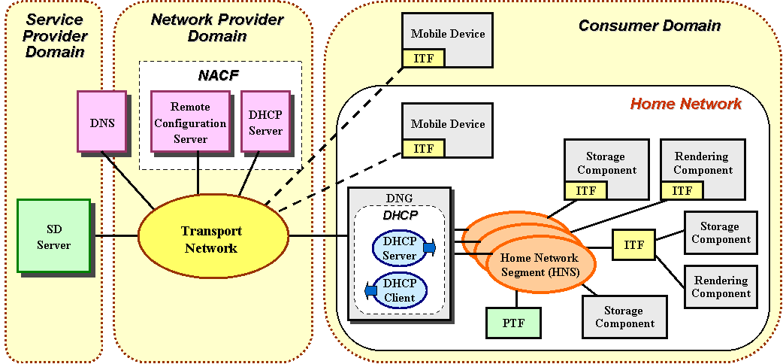
Service Network View

Slide 63
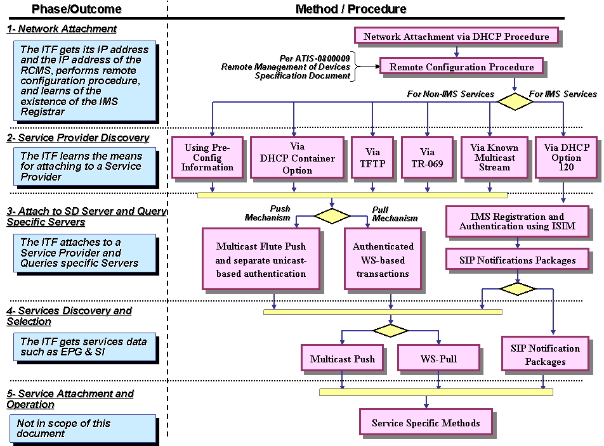
Connecting to an IPTV Network

Slide 64
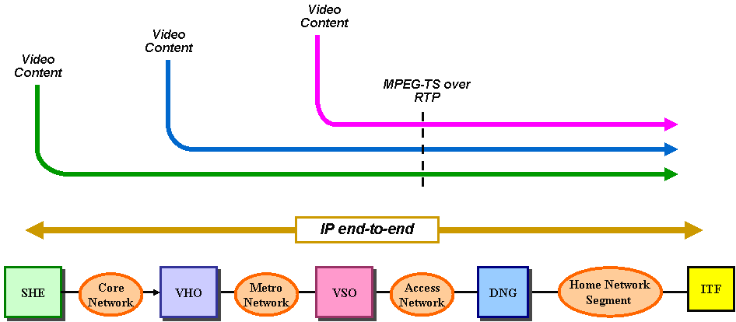
Video Service Flows

Slide 65
IIF Certificate Authority (CA) Hierarchy

Slide 66
IIF Security Profiles

Slide 67
High Level QOS Measurement Model
Content
Domain
Service
Domain
Network Domain
Content Source
0
Content
1
Content
2
A
Video Head End
Off
-
line
Ingestion
Encoding
[
Core
]
B
Content
3
Video Hub Office
Playout
[
-
]
0
2
C
Content Source
Content
1
Content
Video Serving
Off
0
4
-
Air
Acquisition
Trans
-
coding
Office
[
Metro
]
D
Tranaction
?
Server
Access
?
ITF
7
E
Home Networks
F
Network Stack
Decoder
8
Display
9
&
Routers
6
7
Customer Domain

