Slide 1
Wireless Charging System
Document No: | GSC16-PLEN-31r1
Source: | TTA
Contact: | Seung-ok LIM
GSC Session: | PLENARY
Agenda Item: | 6.13
Seung-ok Lim
solim@keti.re.kr
PG709(Wireless Charging and Applications)
Vice-Chairman
TTA

Slide 2
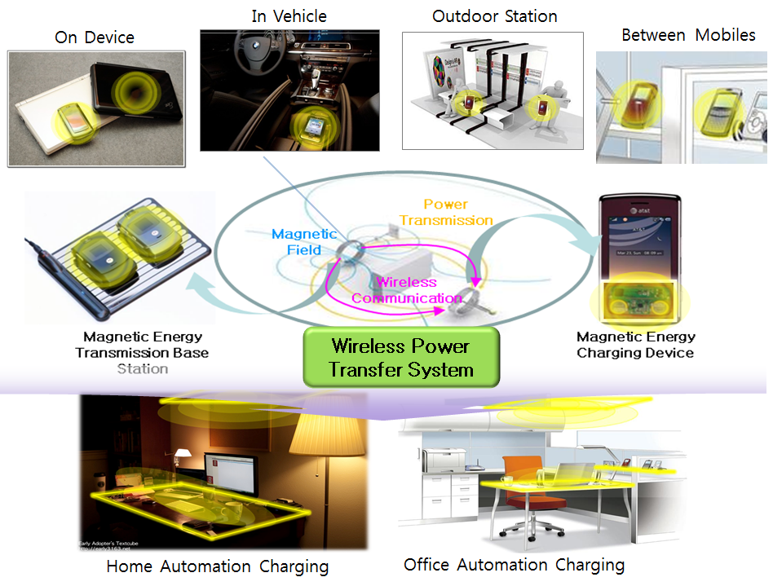
Wireless Charging System
Elimination of complicated wire cables
Wireless Charging System consist of two parts(transmitter & receiver)
Transmitter transfers energy to receiver without power line
Receiver charges battery with the received wireless power

Slide 3
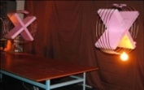
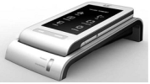
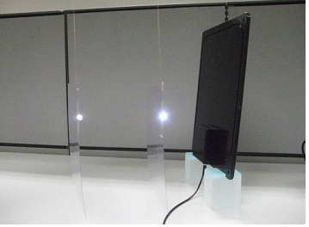
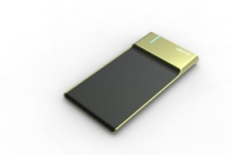
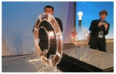
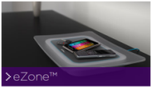
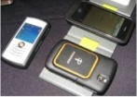
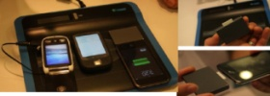
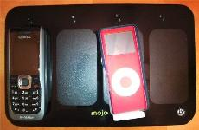
Technical Trends
Hundreds of companies are developing wireless charging system
Several companies released their products, using magnetic Induction
Magnetic resonance technology is in research level
Splashpower(Fluton)
Resonance Type
Fulton Innovation
Palm Pre
KETI
Witricity
LS Cable
Hanrim Postech
Intel
Qualcomm
Powermat
Aska
Seiko-Epson
Mojo Mobility
ConvenientPower

Slide 4
Issues of Wireless Charging System
Technical Issues
Wireless power transfer efficiency
Charging efficiency
Multiple devices wireless charging
Frequency bands
20~60 kHz
80~370 kHz
6.78, 13.56 MHz
Interoperability
Standardization
Safety
Human exposure

Slide 5
Highlight of Current Activities
TTA PG 709 (Wireless Charging and Applications)
Established in Mar. 2011
Scope:
Standard roadmap
Wireless Power transfer interface
Control mechanism
12 members
TTA PG709
Steering Committee
WG 1
WG 2
WG 3
Service & Structure
Interface
Evaluation

Slide 6
Strategic Direction
TTA’s plans
Market analysis
Use case & service scenario (4Q in 2011)
Standard
Wireless Charging protocol (1Q in 2012)
Wireless Charging interface (1Q in 2012)
Transfer efficiency measurement (4Q in 2012)
Collaboration
TTA plans to cooperate with other SDOs

Slide 7
Challenges
Product Diversification
As market is increasing, each vendor makes the Wireless Charging system which has different structure & protocol
Wireless Charging is possible only between systems having the same structure & protocol
Frequency Issues
Each vendor considers different frequency bands for Wireless Charging which causes lack of interoperability between Wireless Charging systems
Regulation Issues
Each country has different regulations for EMI/EMC, EMF, etc.

Slide 8
Next Steps / Actions
Standardization Activities for product diversification
System & interface
Control & management protocol
Conformance test & certification
Regulation Coordination & Compromise
Frequency band
EMI/EMC
EMF
Activities toward the global harmonization
Collaboration and sharing information is needed among SDOs towards Global Standard

Slide 9
Thank you!

