Slide 1
IPTV in TTC
Document No: | GSC16-PLEN-21r1
Source: | TTC
Contact: | Makoto Yamamoto, Suguru Higashino, Kaoru Kenyoshi
GSC Session: | PLENARY
Agenda Item: | 6.5: IPTV
Makoto Yamamoto
Suguru Higashino
IPTV Working Group of TTC

Slide 2
Highlight of Current Activities(1/2)
IPTV service in Japan
Widely spreading
Subscriber : over 1.5 million (increases 0.5 million than last year)
Service: IP multicast, VoD, real-time digital terrestrial retransmission, start over, multi screen
IPTV Working Group of TTC
Members :IPTV operators, Telcos, Broadcasters, Cable standardization organizations and manufactures (network, TV sets, etc.)
Discuss contributions to be submitted to a SDO (e.g. ITU-T IPTV-GSI)

Slide 3
Highlight of Current Activities(2/2)
Support on ITU IPTV Interop Event
ITU Study Groups are actively developing standards for conformity and interoperability testing – e.g. test suites for IPTV – which can be used by external certifiers.
TTC members have been actively participating in Interop Events
proposed test environment, scenarios, check items and did several tests and demos

Slide 4
Strategic direction
Harmonize between domestic and global de jure standardization (especially ITU-T IPTV-GSI)
Affirmative cooperation with global standardization members, especially GSC participants, is highly expected to create good quality standards.
Propose new standardization items from the point of view of the future promising IPTV services
The digital signage services, which are based on multimedia communication technologies as well as IPTV, also are being popular to GSC participants

Slide 5
Challenges
The digital signage services is growing and is expected to harmonize with wide range of new technologies and new services (e.g., collaboration with smartphones’ services);
Digital signage terminal devices have been able to see anywhere in the world e.g. flight schedule in the airports, hotel announcements etc.
IPTV key technologies can be applicable to out-of-home digital signage services e.g. Contents delivery over, multimedia presentation etc.
TTC drives ITU-T standardization works of digital signage, which guarantee connectivity among different vendors, to promote worldwide market growth.
Co-operation with a Japanese SDO, in which Telecoms, IT vendors and major home electronics vendors participate, in order to meet actual market demands.

Slide 6
Next Steps / Actions
Detailed and/or advanced features of digital signage will be targeted to be standardized. For example,
Communications during emergency, disaster relief and mitigation operations;
Variety of content deliveries methods such as multicast and distributed delivery;
Audience measurement by using video recognition technologies.
Recommendation on IPTV audience measurements will be consented in SG16 meeting, November 2011.
Promotion of the standard spread activities to Japan

Slide 7
Proposed Resolution
TTC propose to add the following descriptions to the present resolution
Considering:
that digital signage terminal devices have been able to see anywhere in the world and key technologies of IPTV can be applicable to out-of-home digital signage services.

Slide 8
Supplementary Slides

Slide 9
Interop Events
Geneva, Switzerland, July 2010
Singapore, September 2010
Pune, India, December 2010
Rio de Janeiro, Brazil,July 2011
Dubai, UAE, September 2011
Geneva, Switzerland, 24-27 October 2011

Slide 10
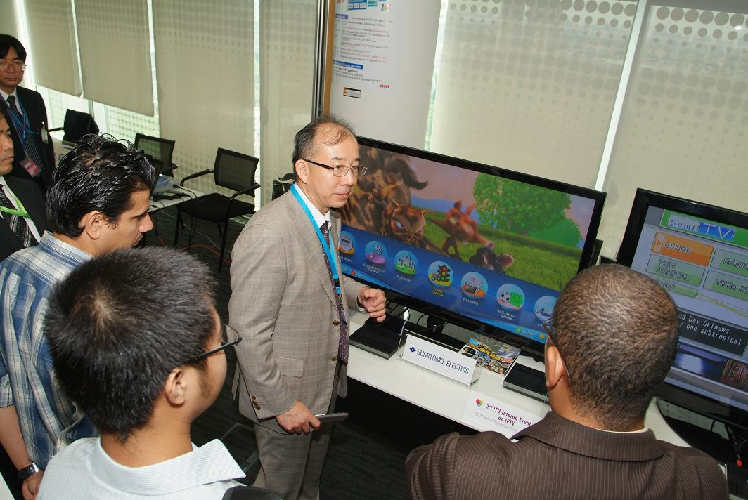
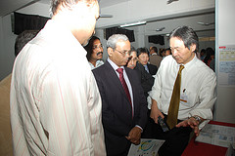
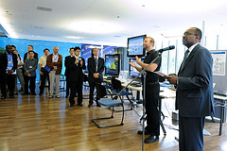
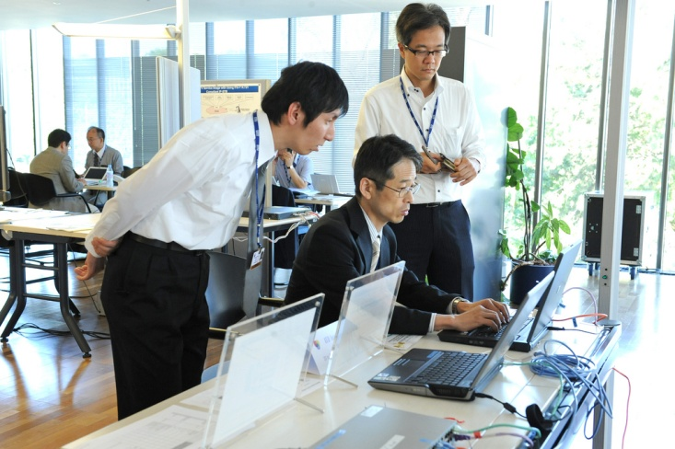
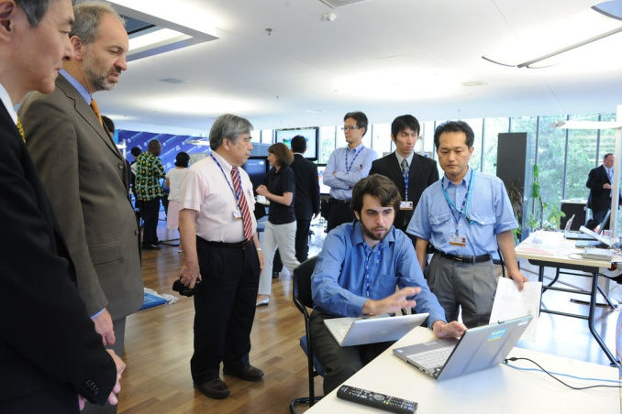
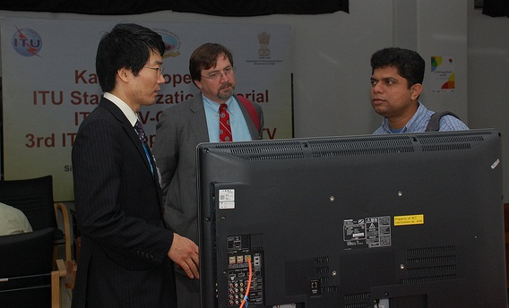
Some Shots from IPTV Interop

Slide 11
Introduction of the Digital Signage standard
Current works on digital signage services pay attention to develop a generic frame work.
Generic requirements, use-cases, architecture have been discussed.
Fig.1 Generic architecture
Fig.2 Simple use-case

Slide 12
ITU-T Workshop on Digital Signage
ITU-T is organizing a Workshop on Digital Signage in Tokyo, December 2011.
This workshop aims at sharing ideas and at providing insight on advanced digital signage service features and requirements, current best practices and existing standardization activities of key players.
General Information
Hosted by: Ministry of Internal Affairs and Communications (MIC), Japan
Date: 13-14 December 2011
Venue: Akihabara, Tokyo, Japan
Draft Programme: http://www.itu.int/ITU-T/worksem/iptv/201112/programme.html

