Slide 1
Datacenter Energy Efficiency Benchmarks and Standards
David Reiner
ISO/IEC SC39 Chair - Sustainability, IT and data centres
SPEC President
Chair of The Green Grid
AMD Datacenter Standards & Emerging Technologies Architect
April 2023

Slide 2
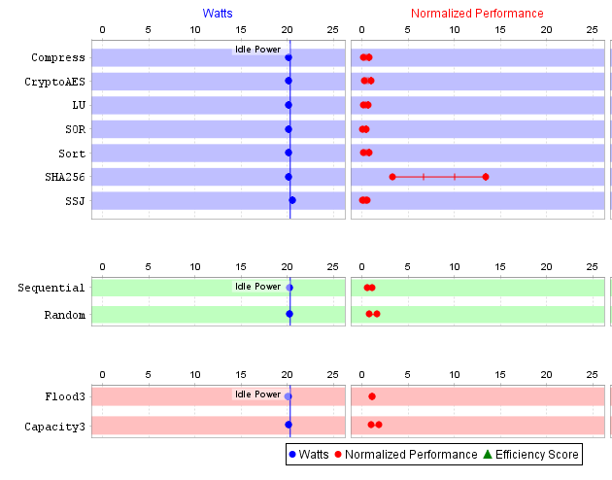
ISO/IEC and SPEC Datacenter Efficiency Benchmarks & Standards
SPEC SERT
SPECpower_ssj 2008
Marketing benchmark for standard servers
Introduced testing at “load levels”
SPEC SERT v2
Corresponding ISO/IEC 21836:2020 and EN 303 470 standard
Image copyright SPEC® 2017. Used with permission.
Test method for EU Lot 9, China CNIS, Japan Top Runner and US Energy Star regulations/programs
SNIA Emerald
Utilized SPEC Storage workload
Corresponding ISO/IEC 24091:2019 standard
SPEC CPU 2017 Energy
CPU, memory and compiler focused

Slide 3
Future Needs
Standardized Efficiency Benchmarks
Server types
HPC servers
GPU enabled servers
Storage heavy servers
Emerging workloads
Blockchain, machine learning, cloud native
Server components
Networking, DPUs, accelerators
Datacenter hardware
Network equipment

Slide 4
Future Needs
Standards & KPIs
Datacenter level KPIs
IT equipment KPIs to build upon PUE
Development efforts within The Green Grid (TGG) and European Datacenter Association (EUDCA)
Benchmark Related Standards
Coordinate new/updated standards with benchmark releases to ease timely adoption

