Slide 1
Sustainability in ATIS
Stephen Hayes
2023-04-27

Slide 2
ATIS Activities in Telecom Sustainability
Standardization:
Sustainability in Telecom: Energy and Protection Committee (STEP)
ATIS STEP helps reduce ICT’s environmental impact as well as operators’ energy costs and addresses industry power and protection issues. STEP deliverables enable vendors, operators and their customers to deploy and operate more reliable, environmentally sustainable, and energy efficient communications technologies. Examines the ability to:
measure equipment power usage to understand energy efficiency.
reduce the energy used to cool communications equipment.
reduce equipment downtime and provide safe, reliable and resistant networks.
reduce the energy used to reduce the power systems energy used to power communications equipment.

Slide 3
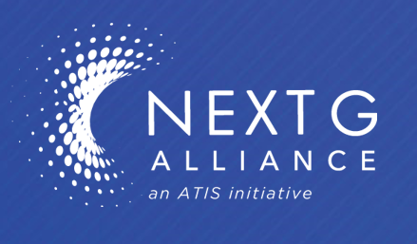
ATIS Future looking activities in Sustainability
6G systems will reduce environment impact, be more energy-efficient, and will
implement circular economy principles
Research Challenges
Research Challenges
Reduce ICT sector's energy consumption and decarbonize the energy supply
Leverage North American expertise in component design & manufacturing, advanced data modeling & optimization, power-efficient radio technologies, and carbon-neutral data center facilities
Energy reduction across Radio, Core Network, Cloud and Edge compute, IoT & connected devices
Environmental impact reduction related to raw materials, land and water use
Use of Green Credentials and metrics to promote resource efficiency

Slide 4
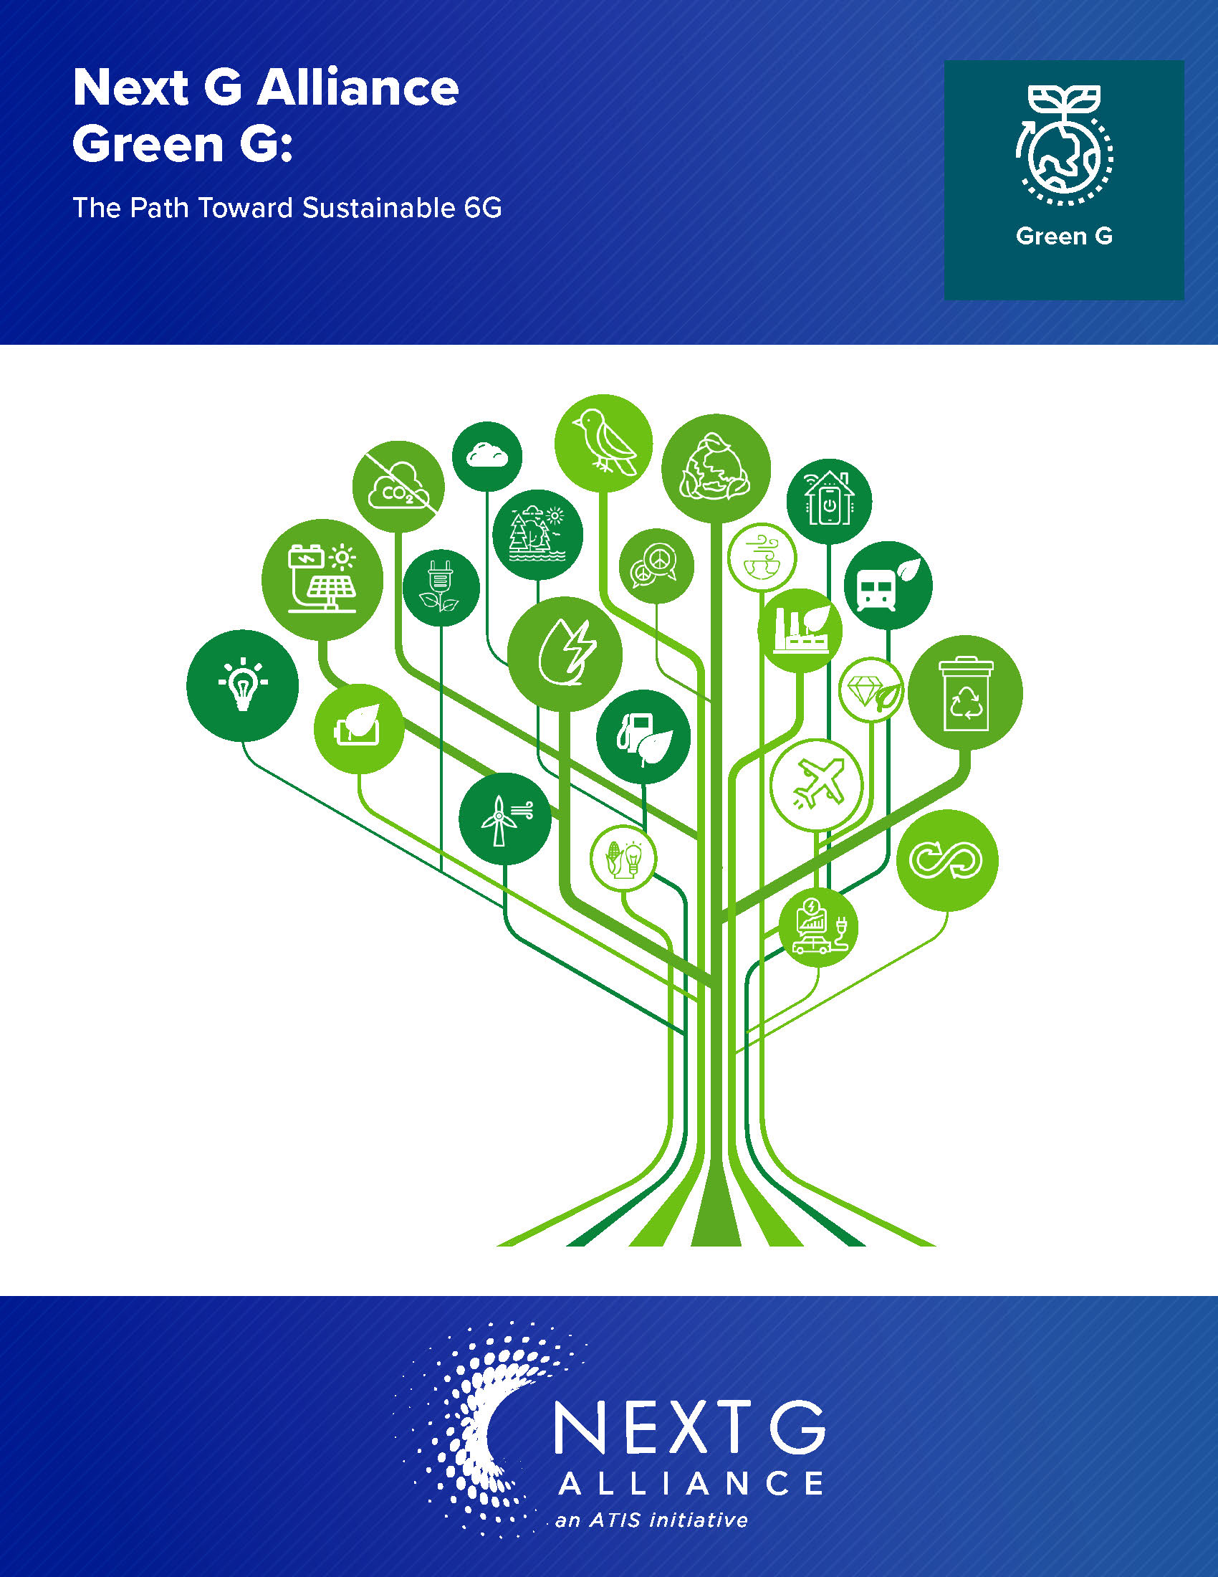
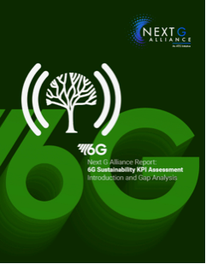
ATIS NGA Research Priorities
Reuse and recycling of water, waste and materials
Redesign manufacturing processes to be more sustainable and use more recycled, recyclable and sustainable components
Sustainable network optimization
Power and spectral efficient designs, deeper virtualization, AI-enabled power management
Sustainable supply chain and circular economy
Reduce the use of, of find alternatives for, rare, limited or non-renewable resources
Enabling decarbonization of other industries
Sensor networks, smart grids, grid-interactive datacenters
Research Challenges

