Slide 1
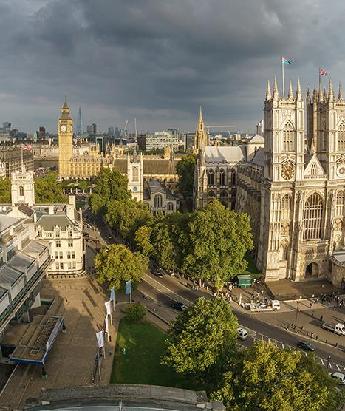
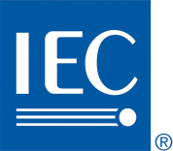
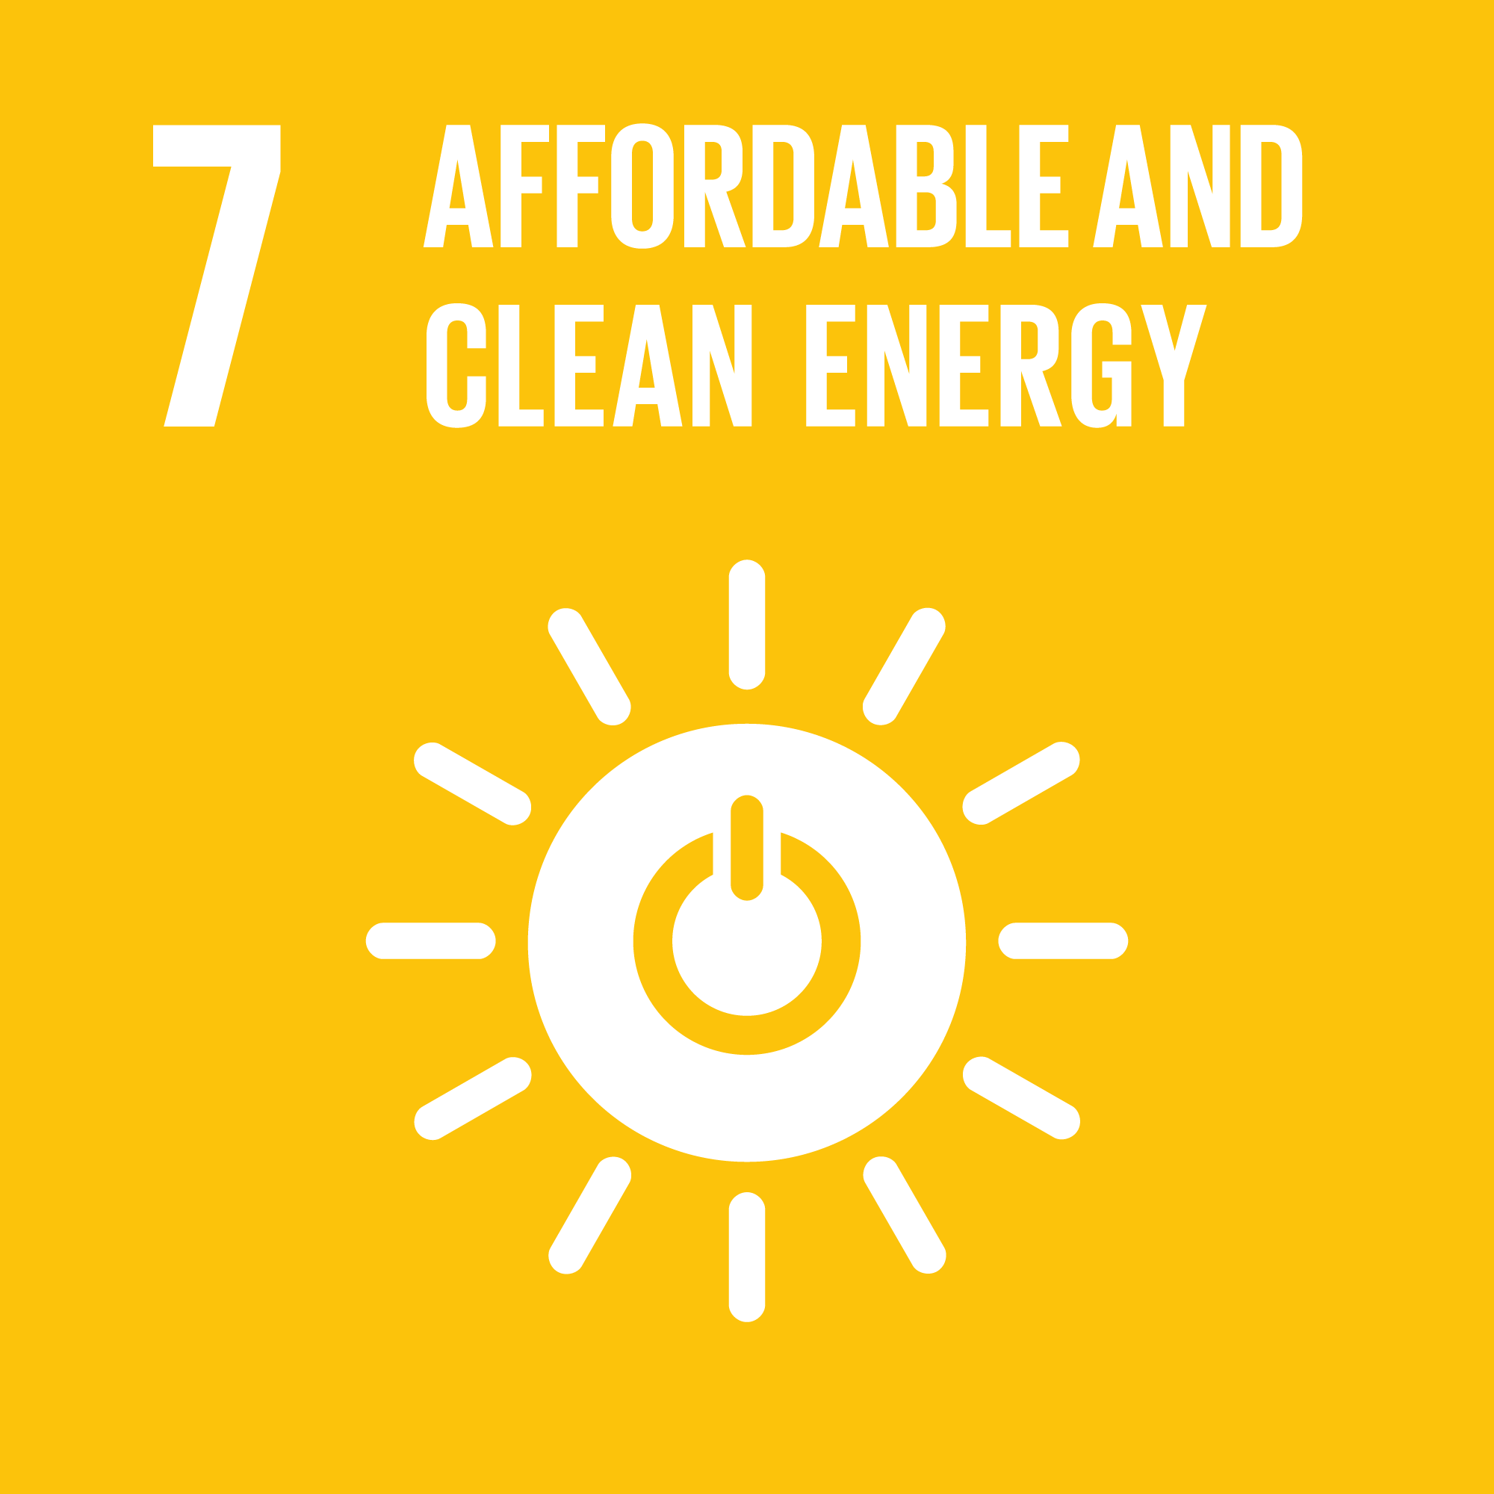
Value of Global Standards – One Example from IEC
Presented by: Gilles Thonet / Vimal Mahendru
26/04/2023

Slide 2
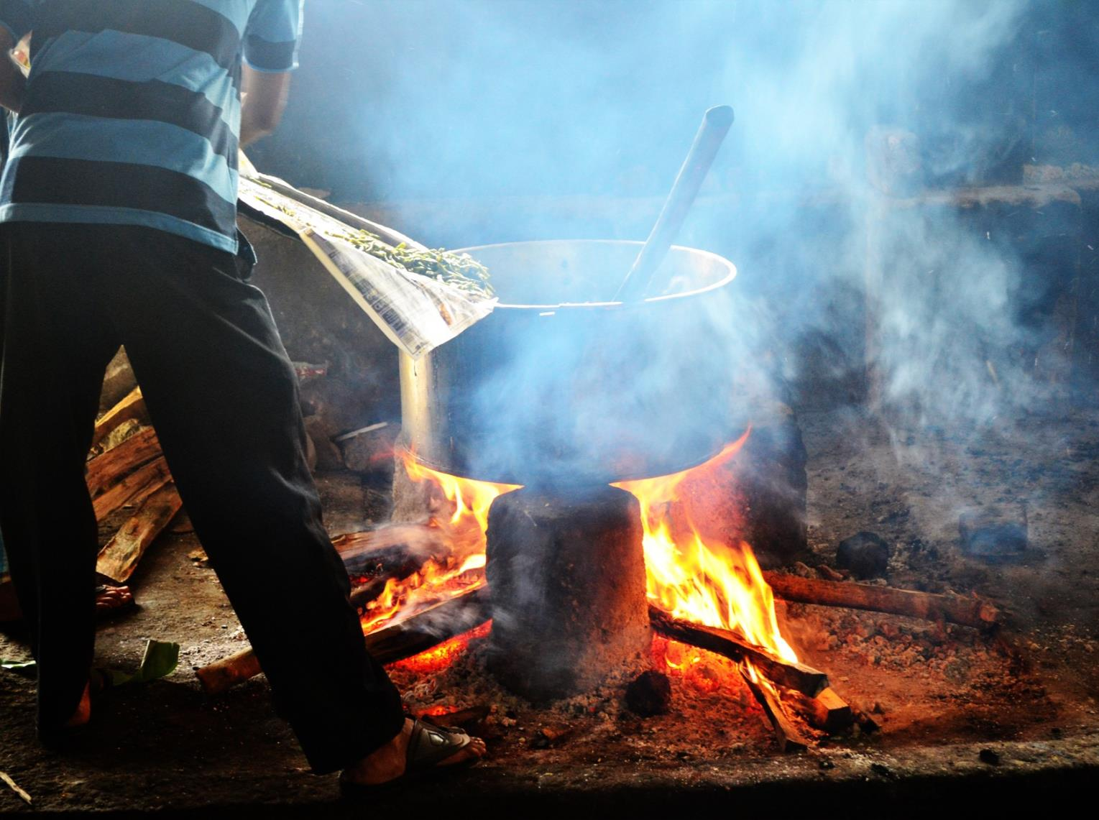
Even today 1.1 billion people have no access to electricity

Slide 3
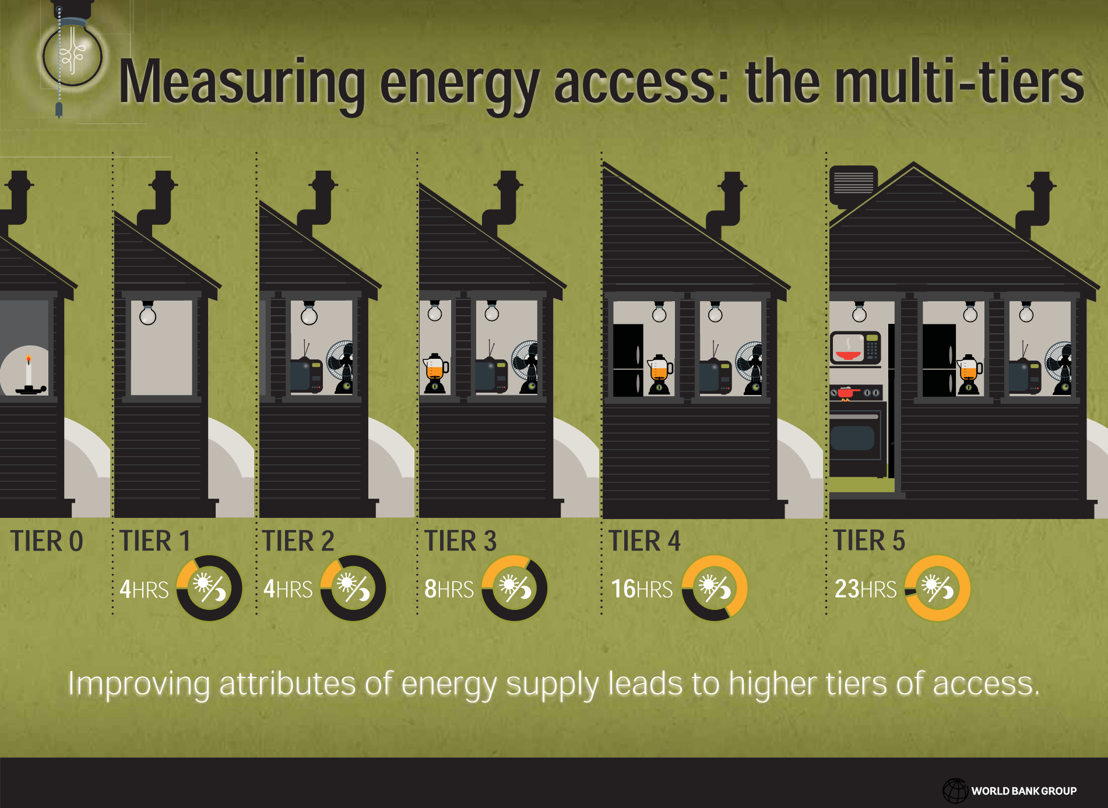
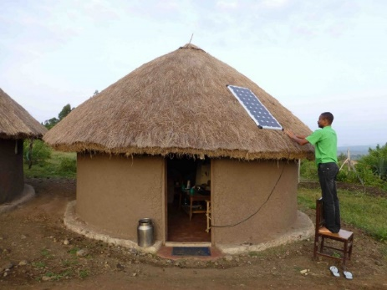
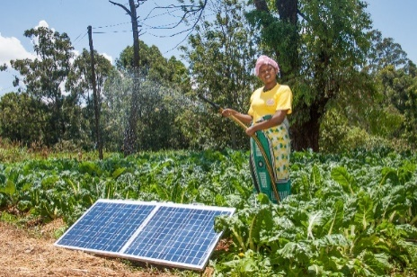
SyC LVDC standard for electricity access
World Bank Multitier Framework for Energy Access (https://www.esmap.org/node/55526)

Slide 4
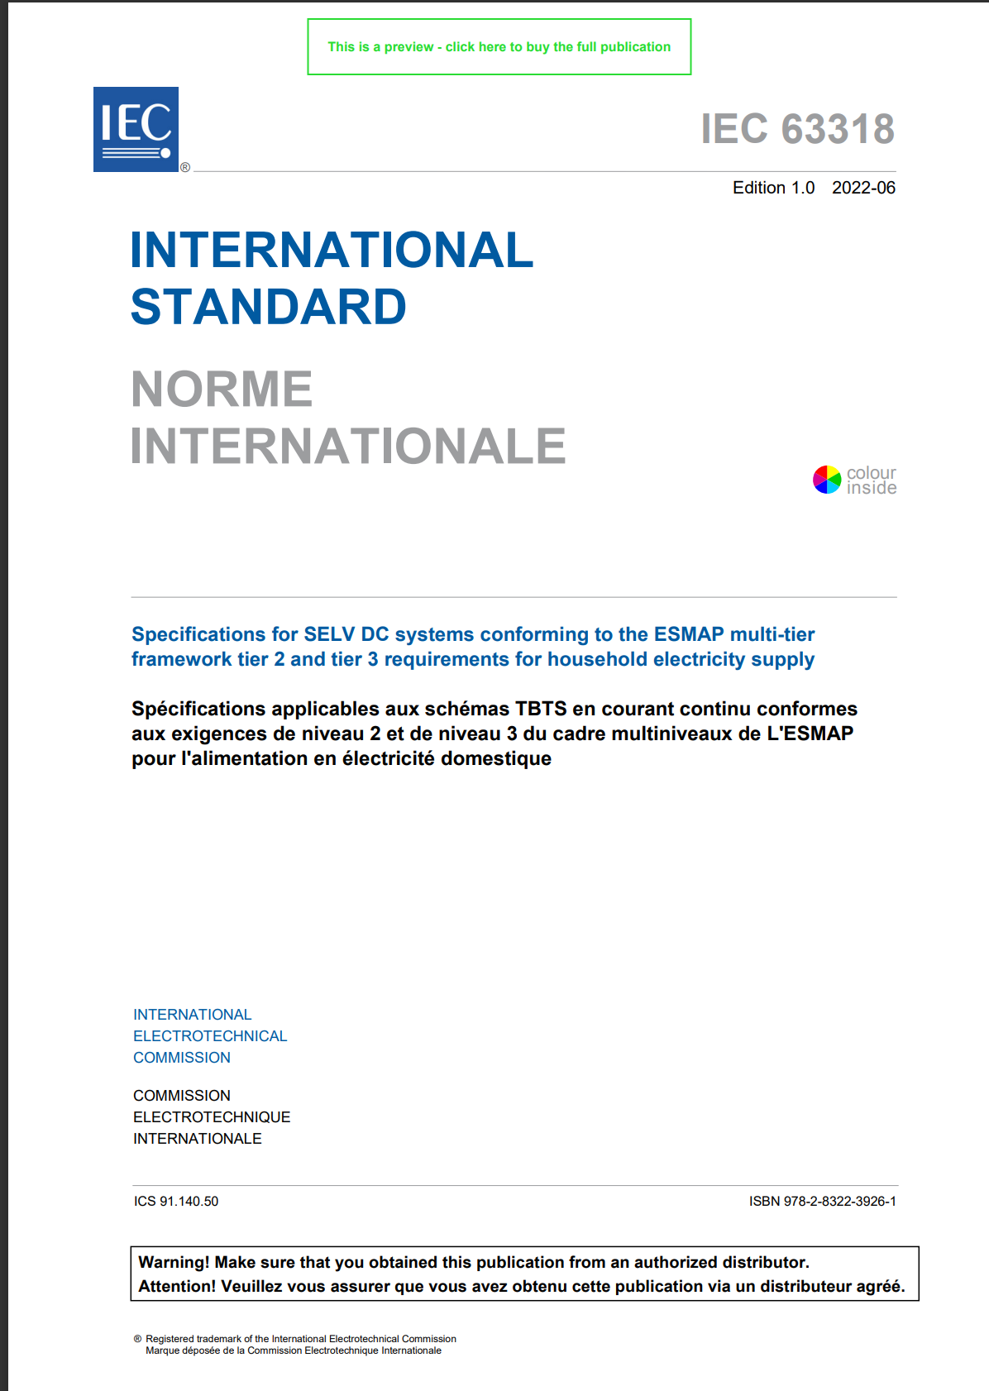
Global standard for low-cost electrification
IEC 63318:2022
Specifications for SELV DC systems conforming to the ESMAP multi-tier framework tier 2 and tier 3 requirements for household electricity supply
This standard enables low-cost electrification for powering:
A light bulb
A small fan
A small television
USB charging for mobile phones

