Slide 1
Document No: | GSC-21_042
Source: | Telecom Standards Development Society of India
Contact: | Pamela Kumar
Agenda Item: | Item 2.10
Priorities of TSDSI
GSC21
Pamela Kumar,
Director General, TSDSI
26-27 September 2017
HOSTED BY

Slide 2
Smart City, Smart Grid, Smart Nation etc.
e
Need to leapfrog &
embrace
emerging technologies

Slide 3
INDIA specific challenges
using TECHNOLOGY to leapfrog socio-economic development
Unique Challenges:
Rural Broadband for all – Fiber to Panchayat
Diversity ++
- language, culture
- last mile
- geographical
Greenfield deployment
Leapfrog Technology Solutions
 | AREA (million sqkm) | POPULATION (in Billion) | GDP nominal (Trillion $) | Average Watts/ person
NORTH AMERICA | 24.71 | 0.579 | 38.1 | 1378 -USA
EUROPE | 10.18 | 0.743 | 19.07 | 651 -EU
NA + Europe | 34.89 | 1.323 | 57.0
CHINA | 9.597 | 1.379 | 11.2 | 492
INDIA | 3.287 | 1.324 | 2.64 | 87

Slide 4
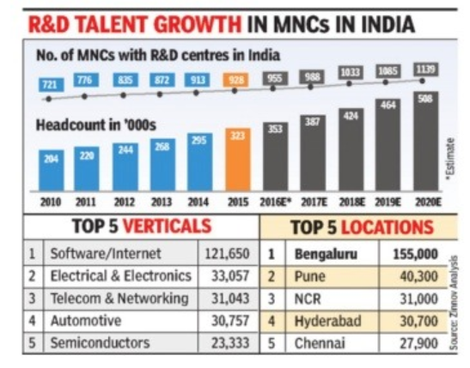
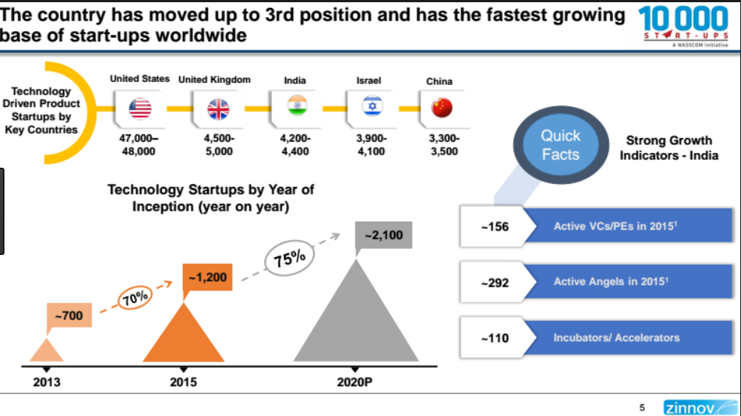
Growing Developer Community
Technical Community ready & aspiring to participate in the Global ecosystem
Pg 4 |

Slide 5
Mobilising the Standards Ecosystem
INDUSTRY
Academia
GOVERNMENT
Pre-Standards
Collaborations
NATIONAL PRIORITIES
POLICY , REGULATION
INVESTMENT, FISCAL INCENTIVES
Inclusive Accreditation framework
Standards
T
S
TSDSI is a COLLABORATION PLATFORM to DEVELOP STANDARDS to enable
USE in INDIA
&
MAKE in INDIA
D
S
RESEARCH & INNOVATIONS
CAPABILITY BUILDING
Technology accelerators
sustainable technology solutions
SERVICES, DELIVERY
& BUSINESS MODELS
TECHNOLOGY, INFRASTRUCTURE, & MANUFACTURING
I
Interoperability
Evaluation
START- UPs

Slide 6
TSDSI – Organization (regd. in 2014)
TSDSI General Body
R&R, Working Procedures & IPR Policy
Chair: Abhay Karandikar Vice Chair: Babu Narayanan KJ Treasurer: Amit Gupta
TSDSI Governing Council
(16 elected members + 5 Govt nominees)
TSDSI Technical Groups *
SG1 Networks
Wireless, Radio, Core, 5G
Optical
Access & Transport,
Back-haul
SG2 Services & Solutions
M2M,
Indian Language,
Energy efficiency,
Security
R&R, Finance, IP, Outreach Committees
Standardization, Roadmap, Transposition Committees
*2nd elections
TSDSI Secretariat : Director General - Pamela Kumar
Operations , Outreach & Strategy Support
BS Chauhan
Technical Activities: Standards, Pre & Post - standardization
Bindoo Srivastava
ADVISORs IT: Udayan Banerjee Networks: AK Mittal; Services & Solutions: Vijay Madan

Slide 7
Role of TSDSI – (Need of the Nation)
GOVERNMENT
National priorities & local challenges
Pre- Standardisation Strengthening the Standards Framework | Govt. /DoT Initiatives : 5G Forum / National Telecom Policy TEC/ TCOE Collaborations TRAI Consultations
 | Indo-EU/ IF3 –Workshops. Test Beds etc.
Standardisation India appropriate requirements Research & Innovation driven contributions to the Global Standards | ITU –R/T 11 Use cases for Smart Cities to ITU-T 20 LMLC mandatory for IMT2020 – ITU-R WP5D
 | 3GPP/ One M2M OP, Transposition & 100 + contributions
INDUSTRY
What is happening Globally?
ACADEMIA
Potential of TECHNOLOGY
COLLABORATION PLATFORM &
OPEN FORUM
START-UPS
India Centric Solutions
USERS
What India really needs ?
HIGH RISK, HIGH COST
CHURNING the OCEAN
NEEDS RESILIENCE

Slide 8
CONCLUSION
Technology developed for NA and Europe may not always work in India,
A fresh mindset is required to develop India appropriate standards (solutions) for eg :
Low Mobility, Large Cell,
Greenfield oneM2M,
Federated Cloud etc.
TSDSI is still in its infancy and needs
coaching and mentoring
sharing of best practices
some understanding and indulgence !!

Slide 9
Thank you
For more information, please contact:
Ms Pamela Kumar
dg@tsdsi.org
Affiliation Name: TSDSI
http://www.tsdsi.org/

