Slide 1


Document No: | GSC-21_041 (R1)
Source: | China Communications Standards Association (CCSA)
Contact: | Zemin Yang
Agenda Item: | 2.03
CCSA Report
Zemin Yang, Secretary-General, CCSA
26-27 September 2017
HOSTED BY

Slide 2
Contents
CCSA updated
Activities on 5G
Some activities on industrial IoT Deployment

Slide 3
CCSA membership

Slide 4
Changes to CCSA structure
Newly established STs/TC:
  ST7: Quantum Communication and Information Technology Special Task Group
  ST8: Industrial Internet Special Task Group
  ST9: Navigation and Location Service Special Task Group
Adjustment to existing TCs:
  The old TC1 and TC3 merged as the new TC3 named “Network and Service Capability”
  New TC1 named “Internet and Application Technology” (working on areas such as data center and cloud computing, and so forth)

Slide 5
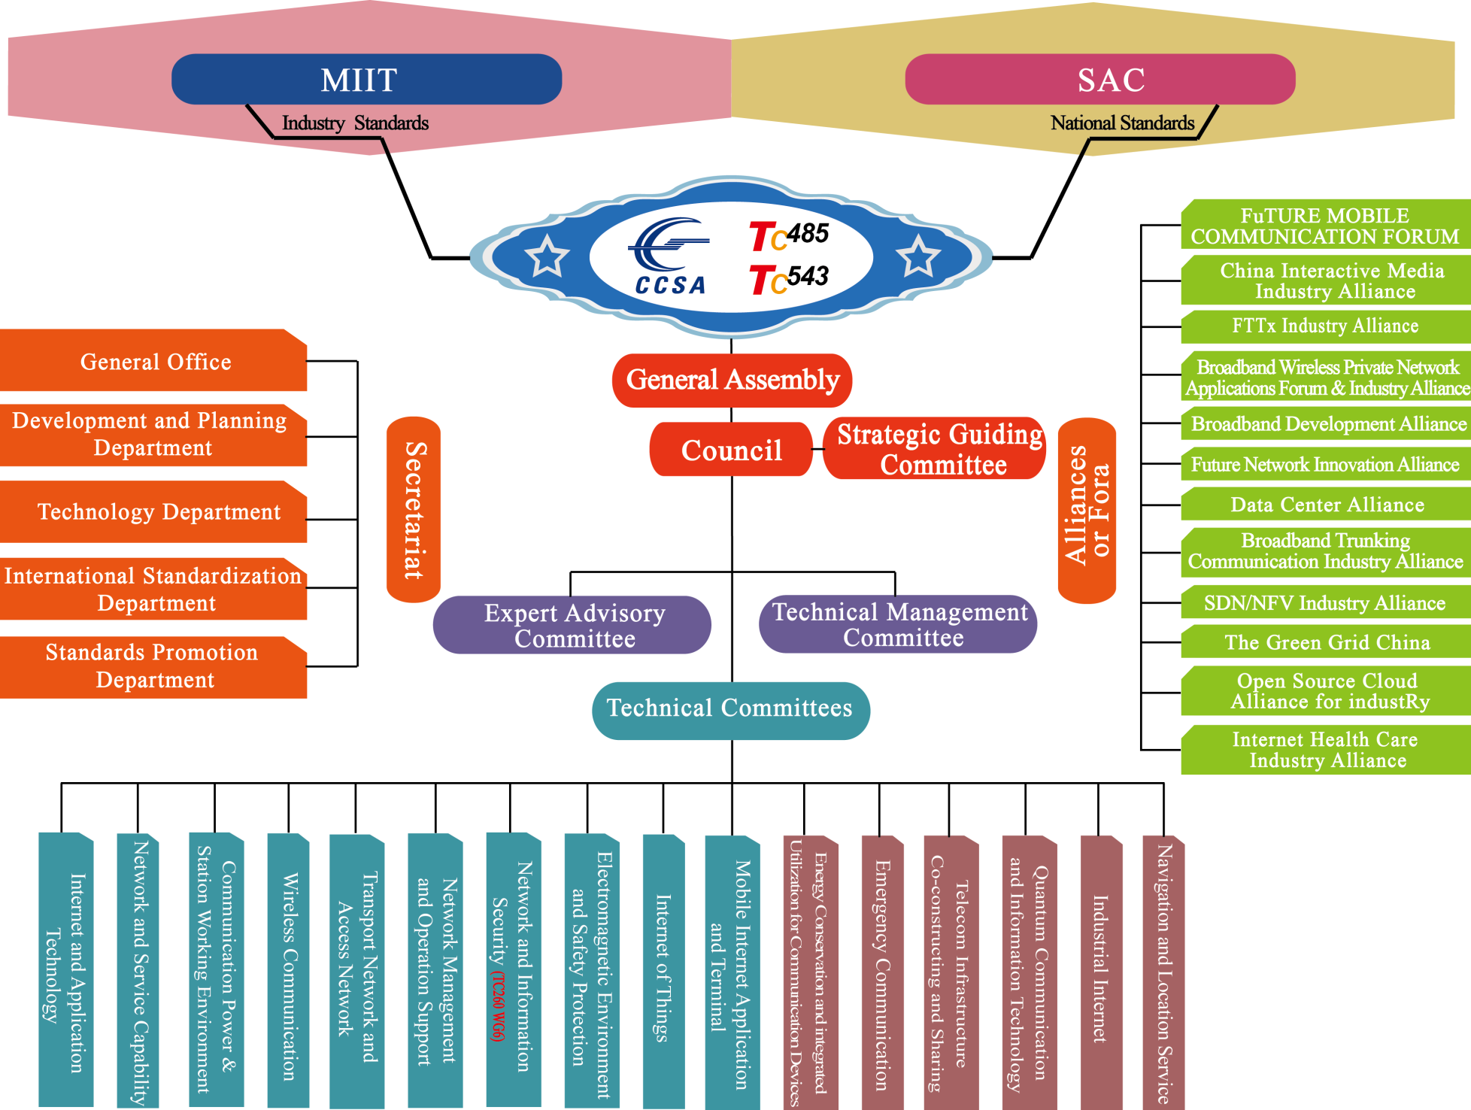
Organizational Structure in 2017
Newly established STs

Slide 6
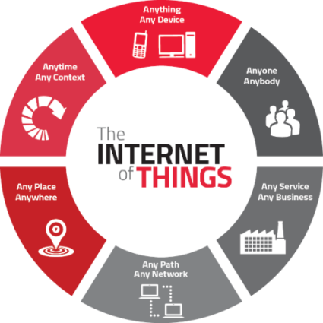

Hot areas of CCSA activities
NGN
  5G
  SND, NFV
  IDC, cloud computing
IoT/M2M applications
  Industrial Internet
  Connected Car
  Connected appliances and Smart home
  Standards on application side for some industry sectors
Network and information security
  Quantum Communication and Information Technology
  Blockchain
Green ICT

Slide 7

Some activities on 5G
Standardization
  Keep pace with activities of ITU and 3GPP on 5G
  Being part of IMT-2020 Promotion Group of China: draw and coordinate the efforts of Chinese ICT industry and cooperate with international SDOs
Test and verification
  Test and verification on key technology & product under R/D
  Plans and specifications for test and certification
  In house test & field trial (30 base stations and 6 venders so far)
Spectrum planning
  Reflects industry's requirements and thoughts on 5G spectrum
  Assists the gov’t with 5G spectrum planning above and below 6GHz

Slide 8



China 5G Evaluation Work Plan
No.26
(Feb.)
No.27
(Jun.)
No.28
(Oct.)
No.29
(Jan.)
No.30
(Jun.)
No.31
(Oct.)
No.32
(Jul.)
No.33
(Dec.)
No.34
(Feb.)
No.35
(Jun.)
No.36
(Oct.)
2017
2018
2019
2020
Evaluation
method
Step 3 : Submission&Reception of RITs and SRITs
Step 4: Evaluation of candidate RITs and SRITs by Independent Evaluation Groups
Rel-15
Rel-16
3GPP Self Evaluation
Updates on 3GPP SE
1st Submission
2nd Submission
Establishment of Chinese Evaluation Group (ChEG)
Internal coordination for evaluation submission to 3GPP
ChEG preliminary results
ChEG final results
2
4
5
No.26
(Feb.)
No.27
(Jun.)
No.28
(Oct.)
No.29
(Jan.)
No.30
(Jun.)
No.31
(Oct.)
No.32
(Jul.)
No.33
(Dec.)
No.34
(Feb.)
No.35
(Jun.)
No.36
(Oct.)
2017
2018
2019
2020
1
3
Consideration/evaluation on major technical features and configuration
Evaluation on possible 3GPP updated technical features

Slide 9
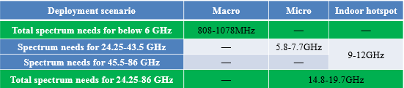
View and Progress on 5G Spectrum
China 5G Spectrum Need estimated by IMT-2020 PG
Low-frequency bands (< 6GHz) are the core bands for 5G systems to guarantee connectivity, coverage, mobility and capacity
High-frequency bands (> 6GHz) are suitable for high traffic off-loading in hotspot areas.
*24.25-43.5 GHz for Micro scenario can also be reused in indoor hotspot
China’s 5G Spectrum Plan Goes A Big Step Forward in Recent Days
On June 5, MIIT posted a draft of initial 5G spectrum plan, where 3300-3600 MHz and 4800-5000 MHz are opened as IMT-2020 frequency bands with the following requirements.
  3300-3400 MHz is used for indoor in principle, but can be used outdoor if it does not cause interference to the existing radiolocation service stations
  In 3300-3600 MHz, IMT-2020 systems should not cause interference to FSS and satellite telemetry
  In 4990-5000MHz, IMT-2020 systems should not cause interference to radio astronomy service.
  On June 8, MIIT posted a call for proposals on 5G mmWave frequency bands, including 24.75-27.5GHz, 37-42.5GHz bands, and other millimeter wave bands. The feedback deadline is August 7, 2017.

Slide 10

5G Network Deployment in China
2018
2019
2020
Scale Trial
Pre-commercial Trial
Commercial Deployment
Standalone offers larger scale economies and higher performance for long-term development
5G Core
Higher performance via innovative technologies
Larger scale economies for the entire life cycle of 5G
Accelerate the maturity of 5G product and industry
Avoid the complexity of 4G/5G integration
Save the total migration cost from 4G to 5G
Standalone 5G NR with 5G Core
5G NR
UE
Non-standalone is an option to meet early service demand in some scenarios
EPC
Anchored in LTE with Legacy S1 interface
Attach to EPC network
5G Core
Anchored in LTE with NG RAN-CN interface
Attach to 5G core network
S1
S1
NG
NG
LTE
NR
eLTE
NR
Xx
Xx

Slide 11




















5G R&D Trials of China
Promote the R&D of 5G key technologies, technical solutions, and global unified standards, accelerate the development of 5G products, and build 5G ecosystem
2015
2016
2017
2018
2019
2020
Step 1: Key tech trial
Phase 1: Technology R&D Trial
Step 2: Tech scheme trial
Phase 2: Product R&D Trial
Step 3: System trial
Research
Operator
Equipment
Chipset
Instrument
Broad participators
Joint test specifications
Multi-vendor interoperability
Integration with vertical industries

Slide 12
Summary and Outlook
Building Globally Unified 5G Standards and Ecosystem
In the framework of globally unified 5G standards, synchronously promote the study of eMBB and IoT standards via technical innovation
Actively promote 5G low-frequency planning & allocation, 5G high-frequency planning study, and global harmonization
Use 5G trial as a carrier to support 5G technology R&D, standardization, industrialization, and commercialization in 2020
Enhance the research and practice on 5G vertical applications, especially in requirements, technical solutions, business model, and industrial ecosystem.

Slide 13
Activities on IoT industrial Employment
Connectivity
Infrastructure
Essential
Tech & Standards
Could be shared Brd
Security
Data Structure
IoT Indstr
Employ-ment
......
Commercialized
Chipset
Supply
Some standards
For one or few industry only
But need be adequately converged
All the other
Factors Enabling
A big succsess
BUSINESS
？

Slide 14
Engaged in activities related with all aspects of standards in IoT domain
?
Power
Automotive
Household Appliances
.....XYZ......
通用积木
...XYZ...
Application layer
Common blocks
...XYZ...
...XYZ...
ISO/IEC
oneM2M
连接层面
通用积木
连接层面
通用积木
XYZ...
连接层面
通用积木
IEEE
Connection layer
Common blocks
3GPP
ITU

Slide 15
Some “minor” standards on application side
These standards(protocals), in terms of technologies,
are not complex
With no major IPR issues
Yet hard to harmonize
They may affect the widespread
commercialization of certain applications
  With stds sufficiently converged,
  the commercialization of chips becomes feasible
  The complexity of cross-industry multi-stakeholders
  issues makes it hard to converge this kind standards
Working mechanism issues should be considered
?
Power
Automobile
Household Appliances
.....XYZ......
...XYZ...
通用积木
...XYZ...
Application layer
Common blocks
...XYZ...
...XYZ...
oneM2M
连接层面
通用积木
XYZ...
连接层面
通用积木
IEEE
连接层面
通用积木
3GPP
Connection layer
Common blocks
ITU

Slide 16
The formation mechanism of standards in IoT application side: ICT in Charge
Features of the mechanism
  ICT ecosystem
  Verticals are weak in our Eco and very
  often, when they don’t like our idea,
  they vote with foot (just won’t use such stds)
Our objectives
  Sufficiently converged “stds” that would be
  practically used by the industries other sectorss
  Not necessarily “perfect” works
Special mechanisms may be needed
Household appliance enterprises
FA_SWG
CCSA Menbership

Slide 17
A virtual Client/Server model
The 2 parties: United virticals of a few & many ICT Co.s as the majority
The procedure
  The clients party (united) raises basic
  requirements and tentative solutions
  The server party (multiple) offers suggestions
  on improvement
  The clients considers the offers and works out
  a new draft of solutions
  The server party offers further (if any) solutions
  on improvement
  Repeat step 3 and 4 if necessary, until
  The clients party makes the final decision
Aiming for dredging the whole channel to the success
of a real business
Membership
@CCSA.TC11.FA_SWG
A virtical Co.
A ICT Co.

Slide 18
Comparison of some possible models in this case
Model 1: The classical working model
of ICT-SDOs
Model 2: What CCSA tried in this case
Model 3: Vertical-industry-in-charge model
Model 4: A best practice project with one or
a few virticals in charge
A vertical Co.
An ICT Co.
CCSA
Menbership
ICT in charge
Virtical in charge
A project
Charged by a few Vtcs
Vtc in charge

Slide 19
?
  The industrial IoT deployment and the way we have relative standards created might show a colourful complexity
  Should we need adjust ourselves and get used to this

Slide 20
Thank you
For more information, please contact: Zemin Yang
Email address: Yangzemin@ccsa.org.cn
Affiliation Name: CCSA
www.ccsa.org.cn

