Slide 1
Document No: | GSC-21_039
Source: | TIA
Contact: | Stephanie Montgomery
Agenda Item: | 2.09
TIA Overview & Outlook
Stephanie Montgomery, Vice President, Technology and Standards
26-27 September 2017
HOSTED BY

Slide 2
TIA Overview & Outlook
SUMMARY
How TIA Works
Structure & Membership
Operating Areas
Always Evolving: Recent Organizational Changes
Mission
Organization & Innovation Agenda
Priorities for 2017 – 2019
Macro & Long-Term

Slide 3
TIA Overview & Outlook
MISSION
Advance global communications. Operate at the intersection of vision & reality to accelerate our members’ business growth through policy, technology, innovation enablement, and business connections.
MEMBERSHIP
250+ members/500 standards participants
Membership: Global, primarily U.S.
Components
Network Service Providers
Suppliers
Services & Solutions Providers
Cloud & Datacenters
Over-the-Top Content Providers
Intelligence
End Users

Slide 4
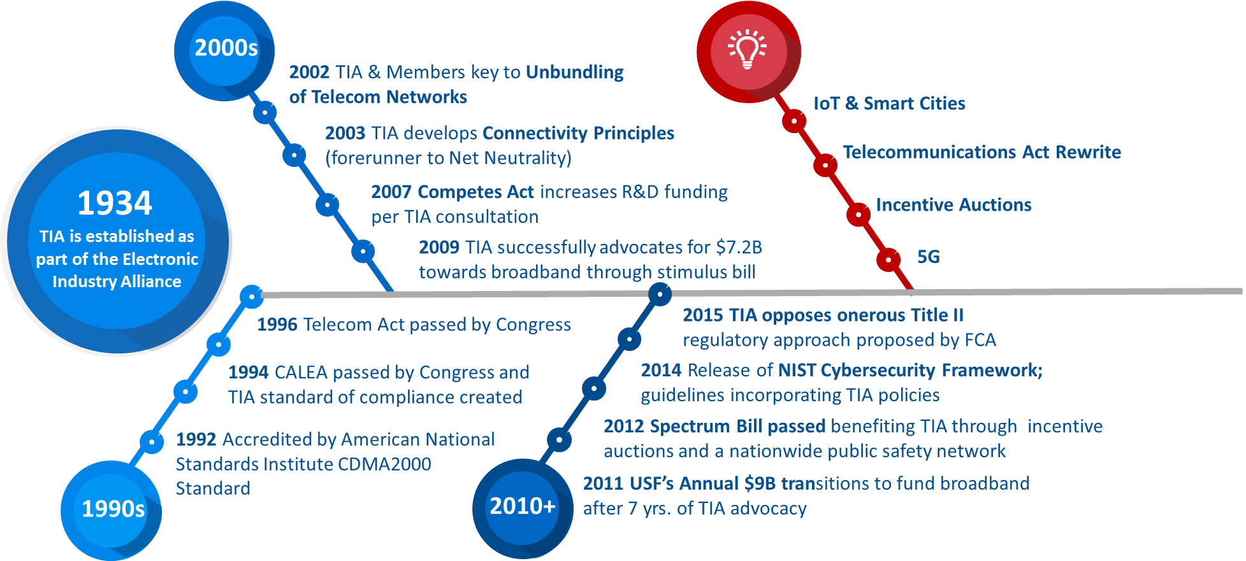
TIA Overview & Outlook
OPERATING AREAS: POLICY, STANDARDS & NETWORKING

Slide 5
TIA Overview & Outlook
OPERATING AREAS: POLICY, STANDARDS & NETWORKING
TIA’S STANDARDS AND TECHNOLOGY DEPARTMENT + 12 ENGINEERING COMMITTEES
GUIDELINE DEVELOPMENT AREAS
FOUNDATIONAL PRINCIPLES
Private Radio Equipment & Cell Towers
Data Terminals
Satellites
Telephone Terminal Equipment
Accessibility
Video & VoIP
Structured Cabling
Data Centers
Mobile Device Communications
Multimedia Multicast,
Vehicular Telematics,
Smart Device Communications
Smart Utility Mesh Networks
Due Process
Consensus Driven
Balanced
Open
1992
Accredited by American National Standards Institute

Slide 6
TIA Overview & Outlook
OPERATING AREAS: POLICY, STANDARDS & NETWORKING
KEY PROGRAMS
IN PROGRESS
TIA-222-H: (Tower Structure) Published
TIA-942-B (Data Center) Published

Slide 7
TIA Overview & Outlook
OPERATING AREAS: POLICY, STANDARDS & NETWORKING
UPCOMING WOKSHOPS
Smart Communities and Transportation Workshop: Building a Comprehensive, Ubiquitous Connected Environment
Virtualization: Impacts on Performance Assurance and Business Models
Optimizing Data Center Performance
Get Amped! Wireline Phones’ New Verification Seals
Smart Communities and Autonomous Vehicles
TIA NOW – The Innovation Xchange

Slide 8
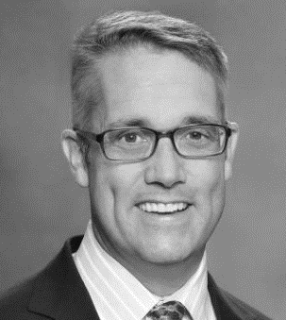
TIA Overview & Outlook
ALWAYS EVOLVING: ORGANIZATION UPDATES
Wes Johnston
Joined TIA in May 2017
Formerly an executive at a major system integrator
Serves as chairman of the board of a major media service company
CEO

Slide 9
TIA Overview & Outlook
PRIORITIES: ORGANIZATION & INNOVATION
Short-Term (through 2019)
Infrastructure Development
Edge Computing
Smart Communities
Transforming Broadband
& Wireless Connectivity
Operating Next Gen Networks
Deploying the
Internet of Things

Slide 10
TIA Overview & Outlook
PRIORITIES: ORGANIZATION & INNOVATION
Macro & Long-Term
Excellence
Partnership
Solutions
Accelerate the introduction of new technologies
Network Performance
NFV, Open Source
Network Management
Quality, SON
Network Security
Sustainability
Customer experience
Connectivity
Virtualization
Internet of Things
Operationalizing

Slide 11
Thank you
For more information, please contact: Stephanie Montgomery
Email address: Smontgomery@tiaonline.org
Affiliation Name:
Tiaonline.org

