Slide 1
Document No: | GSC-21_038
Source: | Telecom Standards Development Society of India
Contact: | Abhay Karandikar
Agenda Item: | 1.04
Summary of GSC20
Prof. Abhay Karandikar, Chairman, TSDSI
and
Professor, Department of Electrical Engineering, Indian Institute of Technology Bombay, Mumbai
26-27 September 2017
HOSTED BY

Slide 2
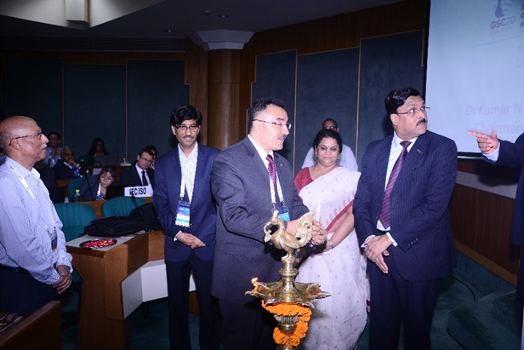
Summary of the Meeting
The 20th GSC meeting was hosted by TSDSI in New Delhi on April 26-27, 2016.
Approx. 100 delegates from 12 member organizations participated in the meeting.
IEC and ISO joined the GSC as new members at the meeting.
Special Addresses by Secretary - Telecom and Secretary Electronics and IT, GoI.
Guest presentations from GCF, TCCA, and Counselor (ICT) – EU Delegation to India

Slide 3
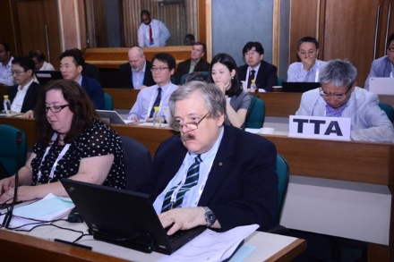
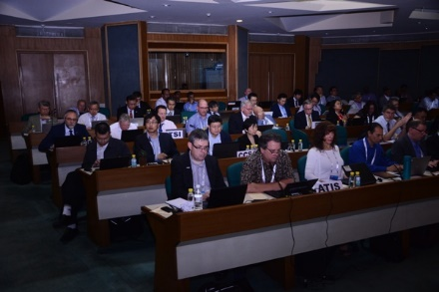
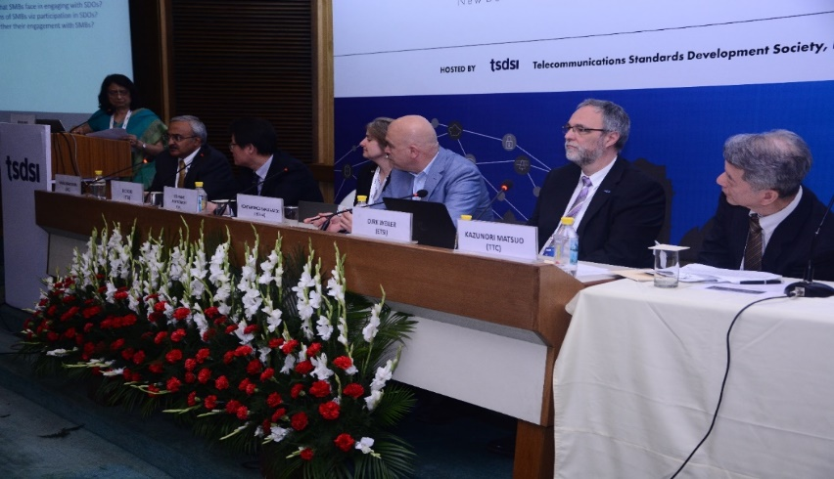
Deliberations at the Meeting
Member SDOs Priorities
Strategic Topics of Discussion:
IoT
5G
Security and Privacy.
Focus session on “Role of Small and Medium Enterprises in Standardization Activities”
Report from Emergency Communications TF
Notes:
IoT: Specific applications and use cases from Smart Cities and Intelligent Manufacturing were discussed.
Importance of increasing outreach to both end users and industry stakeholders to accelerate the development and adoption of future proof IoT standards was emphasized. Enhanced collaboration amongst SSOs is vital to avoid a fragmented Standards landscape in this space.
5G: Regulators and Businesses need to be continually engaged with for development of 5G technologies. Managing scarce spectrum resources is a key challenge. Non-Radio aspects need to be addressed. Involvement of developing countries in standardization activities is essential.
Security & Privacy: in an increasingly ubiquitous digital environment, to integrate Security and Privacy (Trust) early in the innovation process, by design rather than by mere afterthought. Principles for management of identity need to be established.
Role of SMBs: Members shared their experiences on the difficulties and barriers faced by SMBs in participating in standardization activities.

Slide 4
Key Takeaways from the meeting
Deepening collaboration between various SSOs is vital for accelerating the successful deployment of IoT.
Involve Regulators and User segments for developing 5G technologies.
Align and adapt existing standards to increasingly diverse security and privacy requirements arising from the advent of IoT, M2M (machine-to-machine), Cloud, big data and smart environments.
Efforts to facilitate participation of SMBs in standardization activities should be promoted.

Slide 5
Meeting Artifacts
Meeting documents are available here.

Slide 6
Thank you
For more information, please contact:
Prof. Abhay Karandikar
chairman@tsdsi.org
Affiliation:
Professor, Department of Electrical Engineering,
Indian Institute of Technology Bombay,
Mumbai

