Slide 1
Document No: | GSC-21_036 (R1)
Source: | TIA
Contact: | Stephanie Montgomery
Agenda Item: | 4.08
Building the Smart City Together
Stephanie Montgomery, Vice President, Technology and Standards
26-27 September 2017
HOSTED BY

Slide 2
Building the Smart City Together
Smart Cities in US context
NIST
Cybersecurity Framework (2017 update)
Smart City Framework
US Ignite – Advanced Wireless Consortium
FirstNet (TIA TR-8)
Several Smart Cities projects – pilots and live deployments
https://www.nist.gov/news-events/news/2017/01/nist-releases-update-cybersecurity-framework
https://pages.nist.gov/smartcitiesarchitecture/community/consensusppi/ - NIST, 2016 - 2017
https://www.us-ignite.org/news/wireless/

Slide 3
Building the Smart City Together
Recent activities
US TAG Secretary for IEC SyC Smart Cities
Small Cell Forum MOU
US Ignite MOU
NIST Partner
Global Smart Cities Partner – based on TTA, Sejong University initiative
oneM2M-based TIA strategy
Cisco (Chair), Corning, NIST, Crown Castle, InterDigital, CommScope, Eaton, Sensor Wireless Network Technologies Inc., CSA Group
https://pages.nist.gov/GCTC/about/partners/

Slide 4
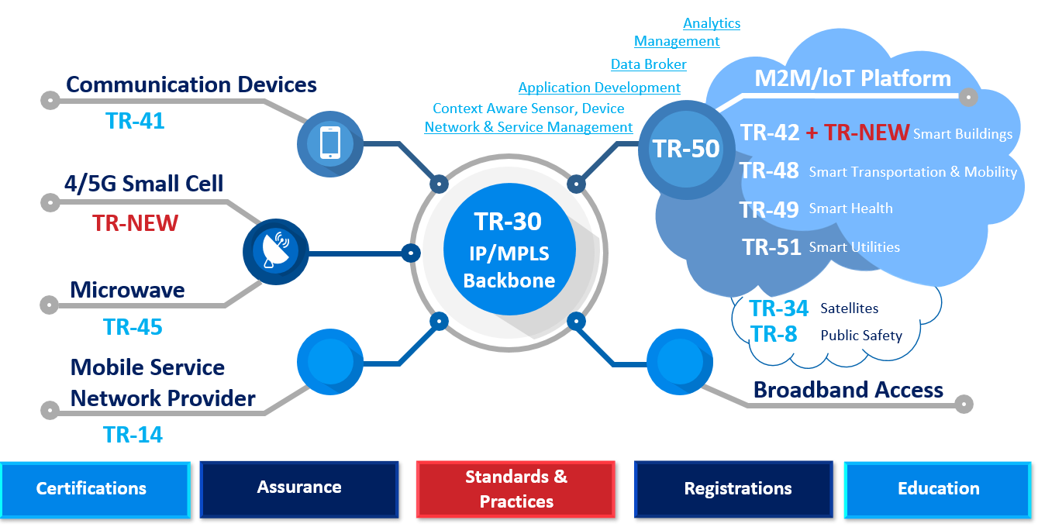
Building the Smart City Together

Slide 5
Building the Smart City Together
The oneM2M Advantage
Set of specifications that standardizes interoperability for M2M and IoT
Enables quicker adoption and time-to-market
Enables flexible, scalable, platform-agnostic solutions, including Smart Cities
Accommodates an expanding global ecosystem
Enables global certification
onem2m.org
oneM2M part of TIA Core Platform Architecture, Across Programs

Slide 6
Building the Smart City Together
Building blocks
Standards-based Infrastructure
Assurance
Benchmarking, test criteria, devices, gateways, platforms, services/apps
Global certification enables Global Smart Cities thru interoperability, collaboration
Built-in security approach
Deliverables: standards, best practices, blueprints
Interactive education: working groups, roundtables, training

Slide 7
Thank you
For more information, please contact:
Stephanie Montgomery
smontgomery@tiaonline.org
TIA
www.tiaonline.org

