Slide 1
Document No: | GSC-21_034
Source: | ISO/TC 184/SC 4 Industrial data
Contact: | Howard Mason
Agenda Item: | 3.06
Communications Technology and Artificial Intelligence in Autonomous Systems
Howard Mason
Chair, ISO/TC 184/SC 4
BAE Systems plc
26-27 September 2017
HOSTED BY

Slide 2
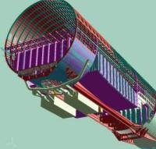
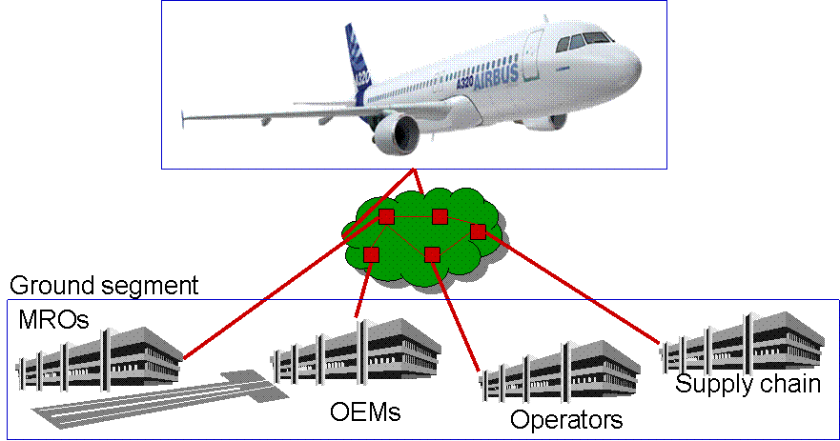
The Aerospace and Defence Challenge
Concept Development
Design, manufacture & Assembly
Validation & Certification
Operations
Full virtual rigs deployed with Testing Labs and Certification authorities
Operational simulation deployed with operators and customers
Full virtual concept deployed with system contractors and with disciplines
Full 3D configured DMU deployed with component and sub-assembly Suppliers
Smart Manufacturing
with optimised utilisation of factory
Full virtual A/C services deployed with operators and MROs
How to organise collaboration around these artefacts? How to reach optimum industrial performance?
How to maximise operational performance?

Slide 3
Three Dimensions of Information
Across the supply network
Across business functions
Customer
Integrated
Vehicle
Health
Mgmt
Integrated
Modelling
Design
Manufacture
Support
Disposal
Through the life cycle
Supplier
Current IT
Systems
New IT
Systems
3

Slide 4
The Information Explosion
Safe usage
Operational records
Maintenance records
Valid configuration
One Design
Multiple copies
Each with their own history
4

Slide 5
The Value of Standards
Benefits of a common data backbone
Right data to the right people at the right time
In a form in which it can be used
Avoid the costs of maintaining point-to-point solutions through changes in
organisations
application software
hardware
US DoD assessment $100Kpa per interface
Basis of data quality management
Data requirements in standard form
Avoiding manual conversions

Slide 6
Views of the product – ISO 10303
Process & use cases
Concept
Simulation
Definition
Manufacture
Support
Disposal
Product Life Cycle
Information
AP 209 Multi-disciplinary Analysis & design
AP 242
Managed Model Based 3D Engineering
Suite of AIA - ASD ILS Specs (SX000)
Based on PLCS
AP 233
Systems
Engineering
AP 239
Product Life
Cycle Support (PLCS)
AP 238 Integrated CNC Machining
AP 235 Engineering Properties for product design & verification
AP 210 Electronic
assembly, interconnect & packaging design.

Slide 7
Key success factors
Application of intelligence (human or artificial) requires data quality
Understanding the meaning
Provenance
Accuracy
Completeness
Automated data capture
IoT – Internet of (Industrial) Things
Data security
Blockchain?
ISO 8000

Slide 8
Opportunities for AI
As part of the product
Challenges of safety – automated reconfiguration
Optimizing the use of resources for manufacture
Lifecycle of manufacturing network
Supporting the mission
Sensor fusion – situational awareness
Supporting the product
Vehicle health monitoring
Automated maintenance management
Fleet Management
Optimised deployment of assets

Slide 9
Example - Autonomic Logistics
Maintenance – planned and unplanned
Derived from known design criteria – component life
Derived from vehicle performance and self analysis
Downloadable in flight
Maintenance programme available on landing
Supply chain management for components and materials
Assessment of fleet availability
Optimised deployment of assets

Slide 10
Some challenges
Records for safety certification
Must be sustained through life of product
Data quality – everyone’s responsibility
Secure communication

Slide 11
Thank you
For more information, please contact: Howard Mason
howard.mason@baesystems.com
ISO:
www.iso.org

