Slide 1
Document No: | GSC-21_030
Source: | ISO
Contact: | Sergio Mujica
Agenda Item: | 2.07
ISO Update and Priorities
Sergio Mujica
Secretary-General
26-27 September 2017
HOSTED BY

Slide 2
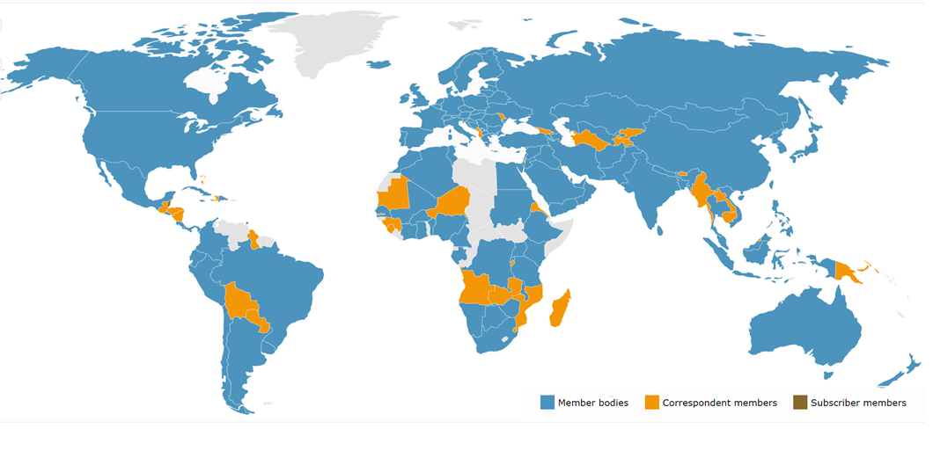
162 members (National Standards Bodies)
worldwide

Slide 3
ISO – a global system
ISO – a global system
ISO EXPERTS
238 active TCs
3 555 technical bodies
4 997 work items under development
ISO MEMBERS
162 national members
98% of world GNI
97% of world population
Over 711 organizations in liaison
ISO Strategy 2016-2020
Collection of 21 478 ISO Standards
1 381 standards produced in 2016
ISO/CS
Central Secretariat in Geneva
144 FTE staff from 20 Countries

Slide 4
Blockchain and distributed ledger technologies
ISO/TC 307 formed in 2017
Twenty-one member countries participating, 15 members observing
Study Groups exploring:
Reference architecture, taxonomy and ontology
Use cases
Security and privacy
Identity
Smart contracts
Recently-launched project: ISO 22739: Blockchain and Distributed Ledger Technologies -- Terminology and Concepts

Slide 5
Smart Cities

Slide 6
Internet of Things (IoT)
JTC 1/SC 41: Internet of things and related technologies established in November, 2016
Twenty-one member countries participating, eight members observing
Focus for JTC 1’s standardization program on IoT, including sensor networks and wearable technologies
Projects include: IoT definitions and vocabulary, IoT reference architecture, Interoperability for IoT systems, IoT use cases

Slide 7
IT Security Techniques
Featured Strategic Topic for GSC-20
ISO/IEC 27001:2013 – Information technology – Security techniques – Information security management systems – Requirements continues to be in very high.
JTC 1/SC 27 focuses on the development of generic standards for the protection of information and ICT. This has led to a large number of liaisons to SDOs and industry bodies which typically use SC 27 standards as a basis for developing their own sector-specific security implementation standards.

Slide 8
Thank you
For more information, please contact: Sergio Mujica
mujica@iso.org
Affiliation Name: ISO
www.iso.org

