Slide 1

Document No: | GSC-21_029 (R2)
Source: | Telecom Standards Development Society of India
Contact: | Aurindam Bhattacharya
Agenda Item: | 4.09
India’s SMART Cities Initiative and the role of standardization
Aurindam Bhattacharya, Group Leader, C-DOT
26-27 September 2017
HOSTED BY

Slide 2
Some Statistics about India
Area
Population
India : 3.287 Mil Sq. Km.
China : 9.597 Mil Sq. Km.
USA : 9.834 Mil Sq. Km.
India : 1.343 Billion
China : 1.410 Billion
USA : 325 Million
Population | Rural | Urban
Now | 67% | 33%
20 Yrs Ago | 75% | 25%
According to McKinsey Global Institute:
42 Cities today have population in excess of 1 Million which is likely to cross 68 by 2030
(Europe has 35 today)
By 2030 590 Million People will live in Cities (Twice that of Whole of USA)

Slide 3
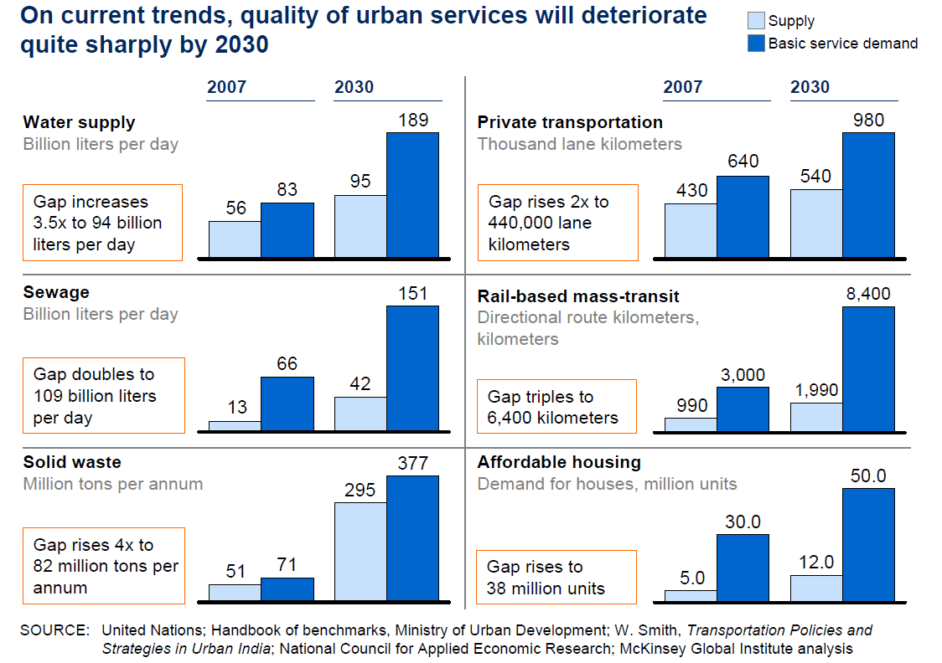

Slide 4
Smart City Mission of Government of India
The objective of the Smart Cities Mission is to promote cities that provide core infrastructure and give a decent quality of life to its citizens, a clean and sustainable environment and application of 'Smart' Solutions. The focus is on sustainable and inclusive development.
The strategy of the Smart Cities Mission is:
Pan-city initiative - at least one Smart Solution is applied city-wide.
Develop Areas step-by-step – three models of Area-based Developments –
  Retrofitting: Development of an existing built area greater than 500 acres
  Redevelopment: Replace existing built environment in an area of more than 50 acres and enable co-creation of a new layout,
  Greenfield: Develop a previously vacant area of more than 250 acres
  [1 Acre = 4,046.9 m² ]

Slide 5
Smart City Features
Promoting mixed land use in area based development
Creating walkable localities –reduce congestion, air pollution and resource depletion, boost local economy, promote interactions and ensure security.
Promoting a variety of transport options - Transit Oriented Development (TOD), public transport and last mile para-transport connectivity;
Making governance citizen-friendly and cost effective - increasingly rely on online services to bring about accountability and transparency, especially using mobiles to reduce cost of services and providing services without having to go to municipal offices.
Applying Smart Solutions to infrastructure and services in area-based development in order to make them better. For example, making Areas less vulnerable to disasters, using fewer resources, and providing cheaper services.

Slide 6
PAN City Smart Solutions

Slide 7
Core infrastructure in Smart Cities
The core infrastructure elements identified for the Smart Cities are:
Adequate water supply,
Assured electricity supply,
Sanitation, including solid waste management,
Efficient urban mobility and public transport,
Affordable housing, especially for the poor,
Robust IT connectivity and digitalization,
Good governance, especially e-Governance and citizen participation,
Sustainable environment,
Safety and security of citizens, particularly women, children and the elderly
Health and education.

Slide 8
Smart City selection Process
The city selection process is based on the idea of Cooperative and Competitive Federalism.
Cities are diverse - Each city has to construct its idea and vision of a smart city that is aligned to its local context.
The city selection process follows a Challenge method - two stages, in conjunct, to select cities.
Stage – I : Intra-State city selection on objective criteria to identify cities to compete in stage-II.
Stage – II: All India competition to select smart cities for multiple rounds of selection.

Slide 9
Stage-I Competition (within State)
Number of potential Smart Cities are intimated to each State, based on an equitable & objective based formula.
An intra-state competition to select proposed Smart Cities, based on the conditions precedent and the scoring criteria laid out.
The selected cities were called the short listed Smart Cities.

Slide 10
City Selection Criteria : Stage-II
The 100 short listed potential Smart Cities are selected through an inter-state competition
The 100 selected cities prepare their Proposals for All India competition with capacity assistance
Based on pre-defined Stage 2 criteria , the evaluation is done by national and international organisations
Winners declared for Round – 1
Winners set-up SPV and start implementation. Preparation of DPRs, tenders etc.
Non-Winners prepare to improve their proposal for Round - 2

Slide 11
Four Pillars: Comprehensive Development
Physical
Energy
Water
Social
Education
Healthcare
Economic
Market Growth
Job Creation
Transport
Building homes
GDP Contribution
Institutional
Security
ICT based service delivery
Environment
Connectivity
Entertainment
Livelihood Activities
Enforcement
Waste Management
Inclusive City Development
Skill Development

Slide 12
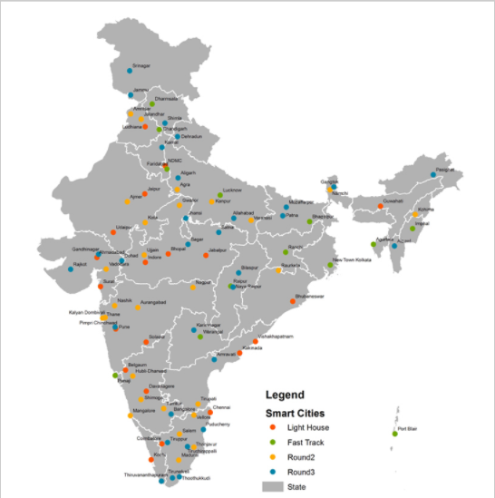
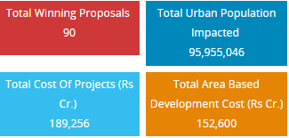
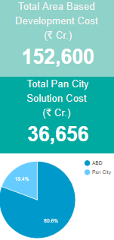
Title with subhead and image
Intro text here
Add image here

Slide 13
ICT and Non ICT needs of Smart Cities
From an analysis of 90 SCP’s [First 20, next 13, following 27 and the recent 30]
Type | Unique Use Cases
ICT | 47
Non-ICT | 53
Courtesy: GAIA Smart City

Slide 14
Budgets in ICT of Smart City
Combination of ABD and PC
Solution | Budget (Rs. Cr)
Category
Command & Control; Connectivity | 6,265.11
Energy | 11,288.16
Water | 10,517.12
Transport | 15,273.98
Waste Mngmt | 5,952.62
Other | 5,210.08
Total | 54,507.07
Courtesy: GAIA Smart City

Slide 15
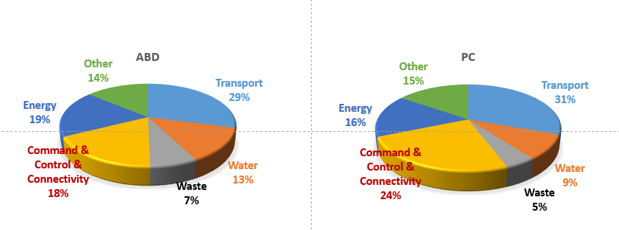
Area Based and Pan City Solutions

Slide 16
What is “Smart” in these “Smart cities
"The real 'smartness' of a 'Smart City' is in using IoT/M2M Communications in standardized, safe, secure, accountable and harmonized way to fulfil the dreams and aspirations of its citizens.“
Vipin Tyagi,
ED, C-DOT
Vipin Tyagi,
ED, C-DOT
standardized
safe
secure
accountable
harmonized

Slide 17
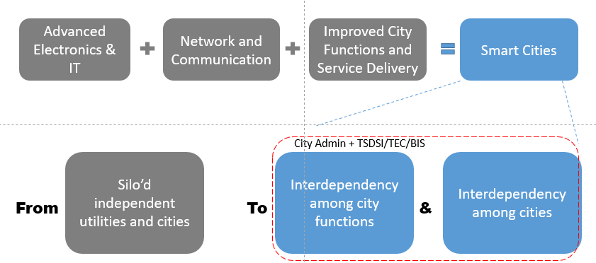
No Smart City without ICT/IoT

Slide 18
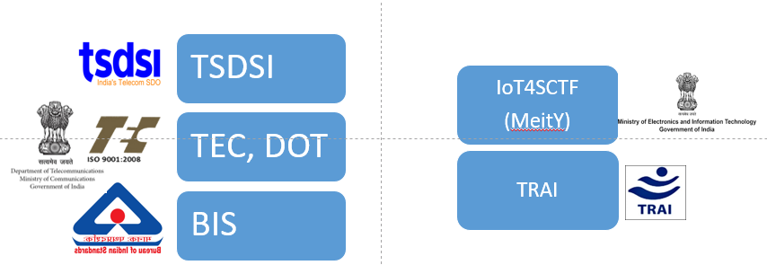
Pre-Standardisation or Standardisation initiatives towards ICT/IoT for Smart Cities

Slide 19
Efforts in homogenising IoT/ICT for Smart Cities
Oct 30
TSDSI (Initial version completed)
TEC, DOT (Work in Progress)
Overview of Smart Cities and Use Cases
IoT Use case identification in 10 verticals
Reference framework for Indian Smart cities
(Technical Specification of) Smart City Data Model
(General characteristics of) City Planning & Assistance Tools
BIS (Work In Progress)
Smart City Proposals Review & identifying pain points and gap areas (ICT).
ICT Reference Architecture & Framework for Smart Infrastructure
Communication Architecture
IoT4SCTF, MeitY (Work In Progress)
  Use Case Analysis
  Reference Architecture
  RFP Guidelines

Slide 20
Thank you
For more information, please contact:
Aurindam Bhattacharya
aurindam@cdot.in
Affiliation Name: C-DOT
http://www.cdot.in/

