Slide 1
Document No: | GSC-21_023
Source: | TSDSI
Contact: | Samar Shailendra
Agenda Item: | 3.08
Augmental Robotics – An Indian Perspective
Samar Shailendra, Scientist, TCS Research
26-27 September 2017
HOSTED BY

Slide 2
Augmental Robotics (AuR)
Robots perform certain tasks to improve the human efficiency and reduce human errors.
Robots co-exist, and augment humans to enhance their capability in performing certain tasks.
Robots are able to infer their environment and take their autonomous decisions.
Robots are not necessarily replacing Humans or taking away their jobs !
Use Cases - Industry 4.0 (Smart Warehouse, Smart Factories etc.), Tele-diagnosis and Tele-surgery in remote areas.

Slide 3
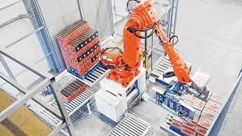
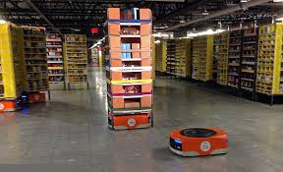
Augmental Robotics (Scenario-1)
Robots Working standalone
Robotic picking and dropping inside warehouse/assembly line.
Robotic arm carrying out a reparative task without any intervention.
Requires continuous instructions and monitoring by humans!

Slide 4
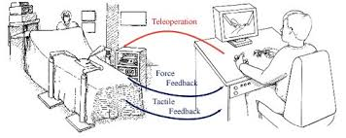
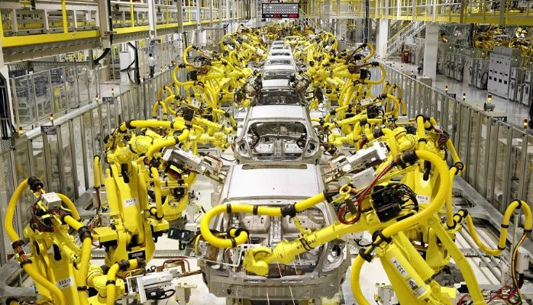
Augmental Robotics (Scenario-2)
Robot to Robot collaboration
Robots providing tele-health services in remote areas.
Robots collaborating in Manufacturing and Assembly Line.
Perform a specific task based on static instruction and supervision by humans !

Slide 5
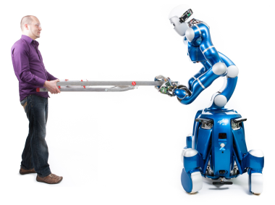
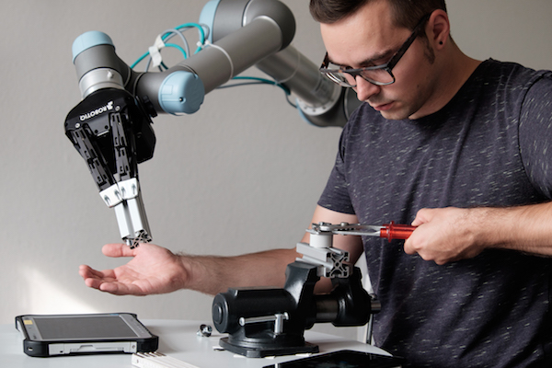
Augmental Robotics (Scenario-3)
Robot to Human collaboration
Robots and Humans are lifting a ladder together.
Robot is assisting human in executing repairing task.
Robots and humans need to understand and interact with each other!

Slide 6
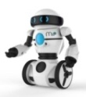
Requirements & Challenges [1/2]
Knowledge Representation
Unified representation of learning, emotions, senses is essential.
Unambiguous sharing of information and interoperability
among robots and robot to human is critical !
Safety and Trust
The operating environment must be safe for humans.
For human-robot collaboration, the robotic system must be utmost trustworthy.
Affective Model
to represent
emotional state
Effective language
for Communication

Slide 7
Requirements & Challenges [2/2]
Networking & Communication
Different types of data with different QoS
requirements – e.g. Telematics, Control, Perception.
Co-existence and interoperability of multiple
heterogeneous devices and communication technologies.
Should be able to provide all of above using public infrastructure !
Cloud
Inter Robot Communication

Slide 8
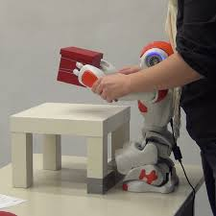
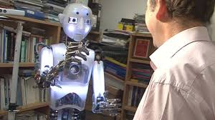
AuR Challenges – Knowledge Representation
Robots and Humans need to understand each other
What is Knowledge ?
How that can be represented, stored, retrieved and exchanged efficiently ?
Understanding of Robots by the Humans makes it even more challenging !
Semantically connected Knowledge Representation
Robots must autonomously learn, represent and adapt to the knowledge in real time.
Requires semantic link between knowledge items.
Must be able to share this knowledge with peers.
I know it! I saw you cleaning !!

Slide 9
AuR – Standardization Effort
Knowledge Representation should be able to address the aspects of
Knowledge about environment and planning for the same
Understanding of human colleagues and other co-workers based upon their capabilities
Must be able to represent gestures, signs and expressions of human colleague
Still an open area of research
IEEE Standard Ontologies for Robotics and Automation (IEEE SA - 1872-2015)
Thing-to-thing research group at IRTF (t2trg)

Slide 10
AuR Challenges – Safety and Trust
Need to re-define the safety and trust for collaborative environment
In such environment, Guidelines are required for
Monitoring and Action
Hand and Facial Guiding
Speed and Distance handling
Force, Power and Thrust
Additional safety and fault tolerance in the system to safeguard the human colleague is of paramount importance !

Slide 11
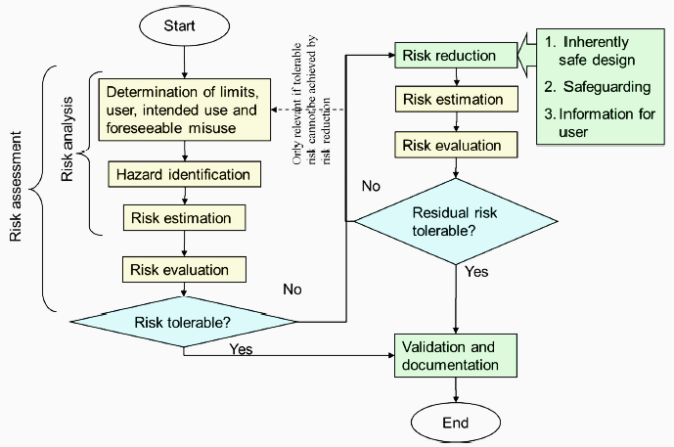
AuR Standardization – Safety and Trust
Guidelines For Industrial Robotic Environment
Multiple standards related to Industrial Robotics by International Organization for Standardization (ISO)
ISO 10218-1:2011
ISO 10218-2:2011
Different types of environment (e.g. electronic, chemical etc.) has different safety requirements
Provides classification for various Safety Hazards
More elaborate Safety guidelines to be defined for co-existence of robots in Social Environment !

Slide 12
AuR Challenges – Networking
Diversity in Communication Requirements
Diverse QoS, Latency, Bandwidth and Reliability requirements.
Interoperability of diverse technology and devices.
Current Network is not apt for Reliable, High bandwidth, Low Latency comm.
For complete AR/VR applications BW : ~1-5 Gbps, End-to-end latency : <5ms.
Machines and Humans operate in different timescales.
Limits are imposed by Physics on the distances ( < 150 km for 1ms latency)
Can this be run on Public Network infrastructure ?
Essential for developing Nations like India.
Introduces additional challenges of scale, infrastructure, scheduling, fairness etc.

Slide 13
AuR Standardization – Networking
Multiple Ongoing Standardization efforts to support AuR use-cases !!
IEEE Standards Association
P1918.1 - Tactile Internet
Haptic Codecs for Touch, Feel and sense.
Decrease volume and Increase reliability.
IEEE 802.1 – Time Sensitive Networking (TSN)
TSN standards are developed for low latency and deterministic communication to satisfy industry requirements (For L2 devices).
Industrial Internet Consortium (IIC) has developed a testbed.
Haptics
Video
Local
Network
Core
Network
Local
Network
Velocity
Force
Operator
Tele-Operator

Slide 14
AuR Standardization – Networking
Deterministic Networking (DetNet) – IETF
Time synchronization of 1 µs, Packet Error Rate (<10⁻⁸).
Guaranteed end-to-end latency and bounded jitter.
Dynamic reliability and resource reservation based upon the application context !
3GPP/TSDSI – AuR use-cases for 5G and beyond
For India Tele-health is one of the most promising use-case.
60% (~780 million) without access to basic healthcare.
Frugal 5G has been proposed to connect remote areas
Requires high bandwidth (several Gbps), Low latency ( <5ms), Low PER (<10⁻⁷) and ultra high reliability (<3.5 sec of outage per year).
Expert/Doctor
Core Network
Robotic Edge
at Patients End

Slide 15
Concluding Remarks
Critical requirements and KPIs such as semantics, latency, data priority etc. need to be defined before Augmental Robotics to be feasible.
Representation of Human Senses and Emotions require significant research.
Standardization is essential for interoperability of heterogeneous devices and technologies.
Aspects of Computing, and Security etc. also need to be addressed and standardized !
Developing Countries like India poses unique challenges in terms of infrastructure, cost and scale !!

Slide 16
Thank you
For more information, please contact:
Dr. Samar Shailendra s.samar@tcs.com
Affiliation Name:
TSDSI
www.tsdsi.org

