Slide 1
Document No: | GSC-21_019
Source: | ISO
Contact: | Bernard Gindroz and Heng Qian
Agenda Item: | 4.06
ISO Smart and Sustainable Cities developments
Dr. Bernard GINDROZ – Chair of ISO TC 268
Mr. Heng QIAN, convener of ISO/IEC JTC1/WG11
26-27 September 2017
HOSTED BY

Slide 2
ISO Smart and Sustainable Cities developments
Context & Challenges faced by cities
By 2050, the population is forecast to be just under 10 billion people, with 80% of that population expected to be urbanized.
The challenge that every city is facing is how to best deliver the resources and services needed to ensure a thriving population and good economic performance.

Slide 3
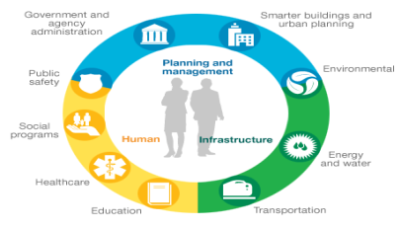
ISO Smart and Sustainable Cities developments
Holistic Approach - Smart Cities require a holistic approach for sustainable development…
Challenges faced by Cities are very complex and multi dimensional, multisectorial.
Big challenge is to develop comprehensive policies, consistently applied over different municipal areas.
A focus on citizens with new governance models
5 major areas of priorities with dedicated KPIs:
People
Planet
Prosperity
Governance
Replication-Dissemination

Slide 4
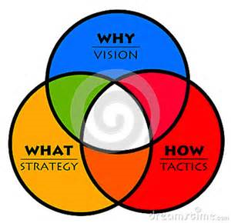
ISO Smart and Sustainable Cities developments
Support from ISO :
1. At “City” level (ISO TC 268)
2. At “machine” level (ISO/IEC/JTC1 WG11)
Vision
Commitment/Decision
Strategy with objectives
Roadmap with targets
Implementation and culture of results
Measure progress and monitor
Evaluate against planned targets
Improve to meet the objectives
Communication & reporting

Slide 5
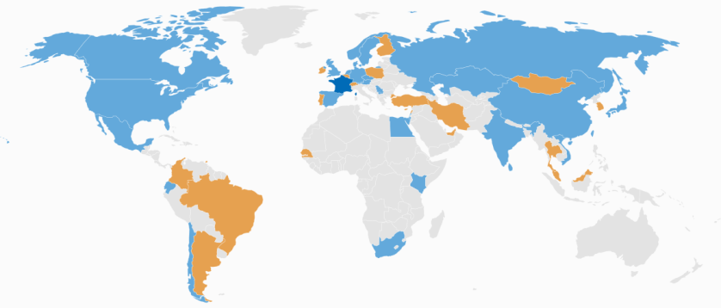
ISO Smart and Sustainable Cities developments
ISO TC 268
Standardization in the field of Sustainable Cities and Communities including development of requirements, frameworks, guidance, supporting techniques and tools related to the achievement of sustainable development considering smartness and resilience, to help all Cities and Communities and their interested parties in both rural and urban areas become more sustainable. TC 268 contributes to the UN Sustainable Development Goals through its standardization work.
The proposed series of International Standards will encourage the development and implementation of holistic and integrated approaches to sustainable development and sustainability.
Participating countries: 29
Observing countries: 23
Secretariat: AFNOR, Mr. Etienne Cailleau Chairman: Dr. Bernard Gindroz Creation date: 2012
Pg 5 |

Slide 6
ISO TC 268
→ Use ISO 37100 «Terminology »
→ Use ISO 37105 « description of cities »
→Use the ISO 3712x indicators in the baseline review
→ Use the standard ISO 37106 « Strategy for smart city »
→ Use ISO 3715x (Infrastructures, data exchange,...)
→ Use ISO 37106 « Strategy for smart city »
→ Use the ISO 3712x to measure progress towards sustainability, smartness and resilience
→ ISO 37104 series Dedicated application guidelines to ISO 37101
2. PLAN
3. DO
4. CHECK
5. ACT
1. DECISION/ COMMIT
→ Use ISO 37101 Sustainable Communities Management system

Slide 7
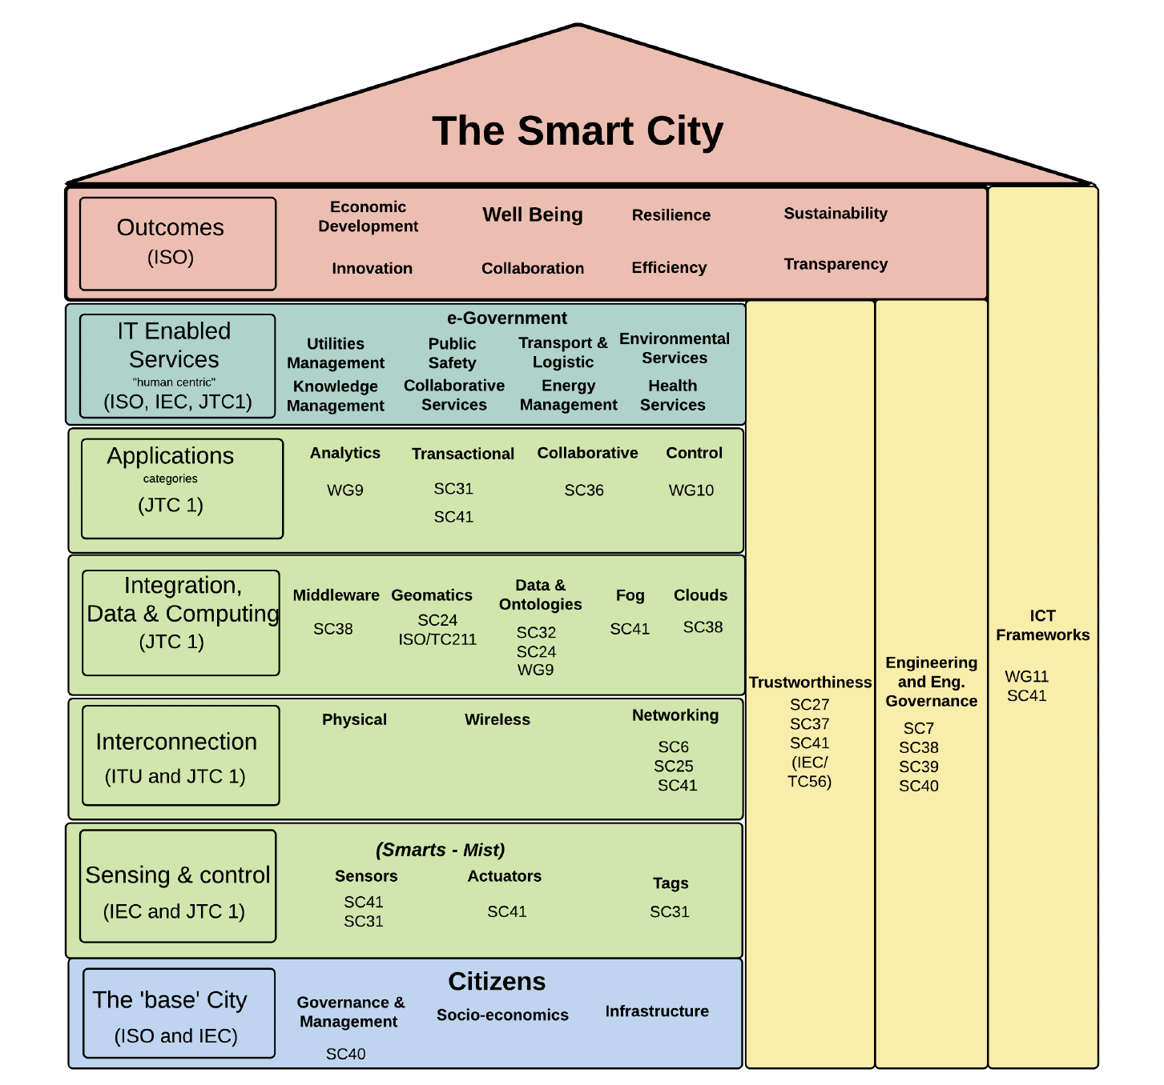
Arena of
ISO/IEC JTC1
Information Technology
key enablers to Smart Cites

Slide 8
Technical Areas | JTC1 Subcommittees and Working Groups
Application Technologies | SC 36 – Information technology for learning, education and training
Cultural and Linguistic Adaptability and User Interfaces | SC 02 - Coded Character Sets SC 35 - User interfaces
Data Capture and Identification Systems | SC 17 - Cards and security devices for personal identification SC 31 - Automatic identification and data capture techniques WG 09 - Big Data
Data Management Services | SC 32 - Data management and interchange
Document Description Languages | SC 34 - Document description and processing languages
Information Interchange Media | SC 23 – Digitally recorded media for information interchange and storage
Multimedia and Representation | SC 24 - Computer graphics, image processing and environmental data representation SC 29 - Coding of audio, picture, multimedia and hypermedia information
Networking and Middleware | SC 06 - Telecommunications and information exchange between systems SC 25 - Interconnection of information technology equipment SC 38 - Cloud computing and distributed platforms
Office Equipment | SC 28 - Office equipment
Green IT | SC 39 – Sustainability for and by information technology
Programming Languages and Software Interfaces | SC 22 - Programming languages, their environments and systems software interfaces
Security | SC 27 - IT security techniques SC 37 - Biometrics
Software, Processes and Systems | SC 07 - Software and systems engineering SC40 – IT service management and IT governance
Internet of Things | SC41 – Internet of Things and related technologies
Smart Cities | WG11 Smart Cities

Slide 9
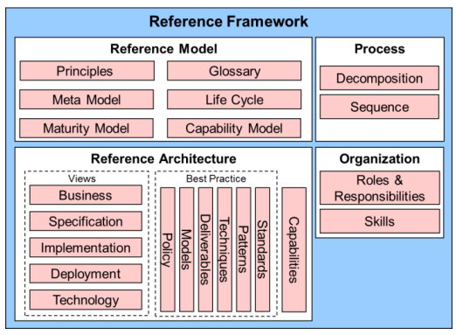
High level guideline :Reference Framework*
*Project underway in ISO/IEC JTC1 WG11

Slide 10
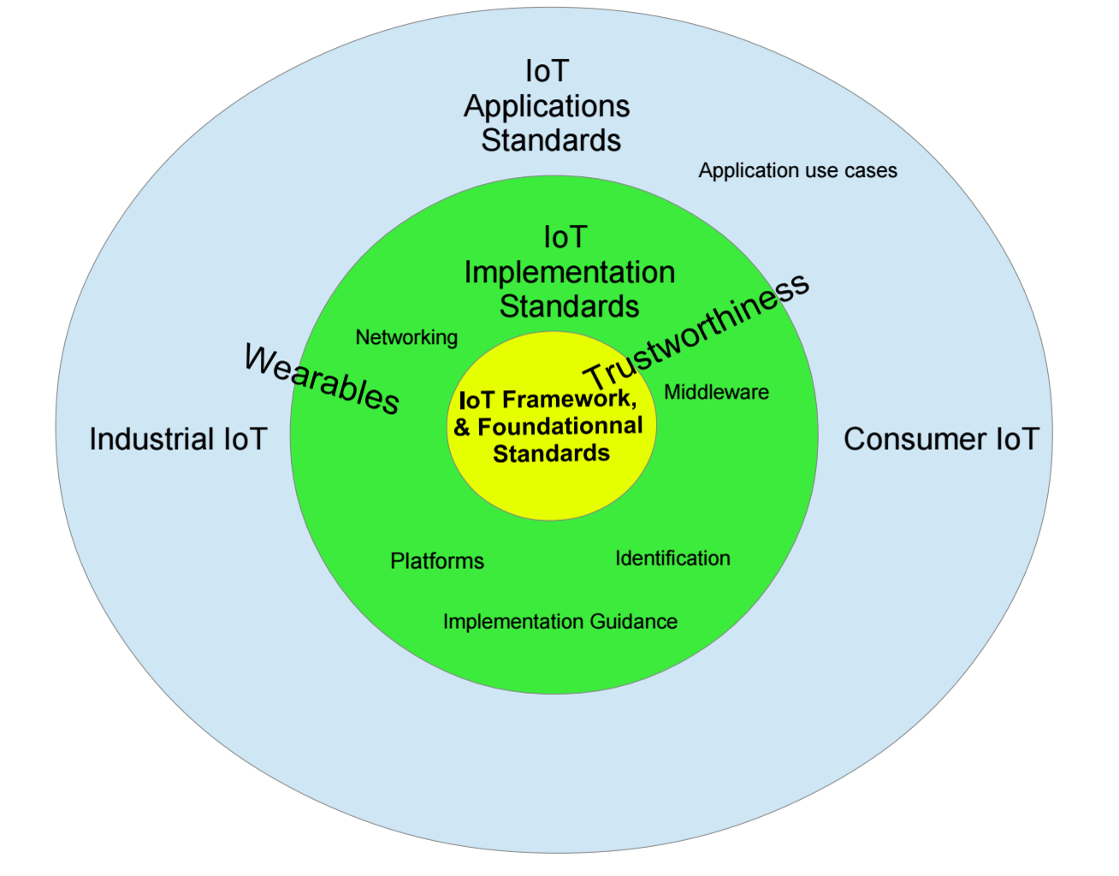
Most active topic: ISO/IEC JTC1/SC41 IOT

Slide 11
Baseline for SMC: JTC 1/SC 27 – IT Security Techniques
Information security and privacy governance
Information security management system (ISMS) requirements, methods and processes
Security controls (including application and sector specific e.g. cloud, telecoms, energy, fInance), codes of practice, frameworks
Security services (including application and sector specific e.g. cloud), IT network security, 3rd party services, IDS, incident management, cyber security, application secuirty, disaster recovery, forensics
Privacy controls & ID management methods (including application specific e.g. cloud), techniques, frameworks, biometric info protection, biometric authentication
Security Evaluation, Testing, Processes, Methods and Specification (products, devices and system of products)
WG 1
WG 2
WG 3
WG 4
WG 5
Accreditation, certification and auditing requirements and methods for Management Systems
Economics of information security and privacy
Cryptographic and security mechanisms and technologies
Pg 11 |

Slide 12
Thank you
For more information, please contact:
Dr. Bernard GINDROZ gindrozb@gmail.com
Mr. Heng QIAN qianheng@sdis.cn
Affiliation Name: ISO
https://www.iso.org

