Slide 1
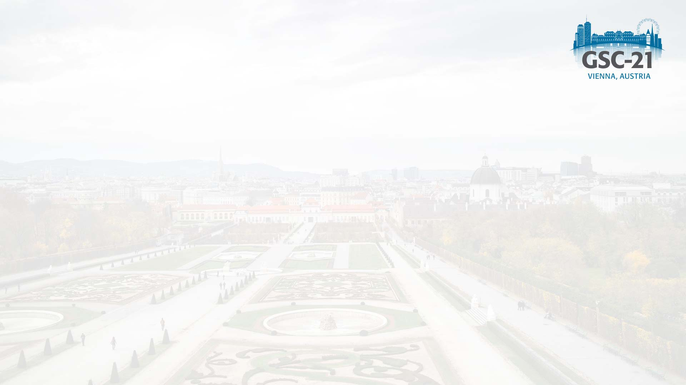

Document No: | GSC-21_018
Source: | IEC
Contact: | Michael Mulquin Gennaro Ruggiero
Agenda Item: | 4.04
IEC - using a Systems Approach to develop Smart City standards
Michael Mulquin, Vice-Chair IEC SyC Smart Cities
Gennaro Ruggiero, Secretary IEC SyC Smart Cities
26-27 September 2017
HOSTED BY

Slide 2
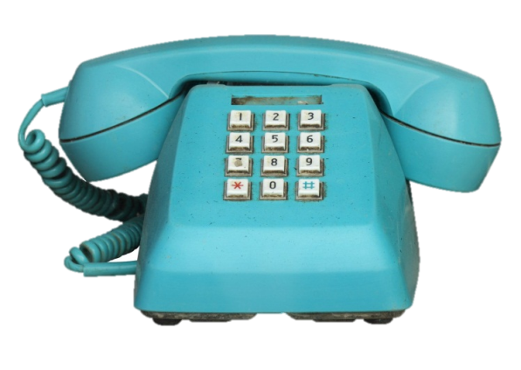
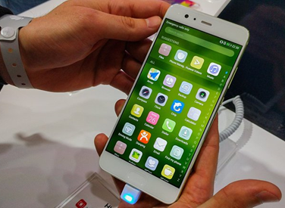
Why a Systems Approach?
Products become multifunctional
A phone years ago…
A phone today
  Music, photos, video, GPS, Internet…
  2G, 3G, 4G, WIFI, Bluetooth, NFC…
  Touch screen, battery, USB, HDMI…
  Accelerometer, gyroscope, proximity sensor ….
… and you can still make a call with it !
An ever increasing number of technologies and standards are involved

Slide 3
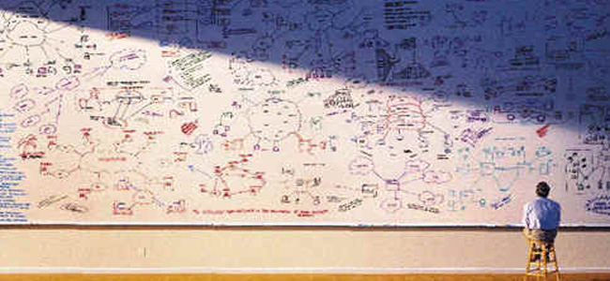
Why a Systems Approach?
Complexity of Technologies
Multiplicity and convergence of technologies
Large-scale infrastructures
Need for inter-operability
Many new and emerging markets
An ever increasing number of
technologies and standards are involved
Multiplicity and convergence of technologies
Large-scale infrastructures
Need for inter-operability
Many new and emerging markets
An ever increasing number of
technologies and standards are involved
Pg 3 |

Slide 4



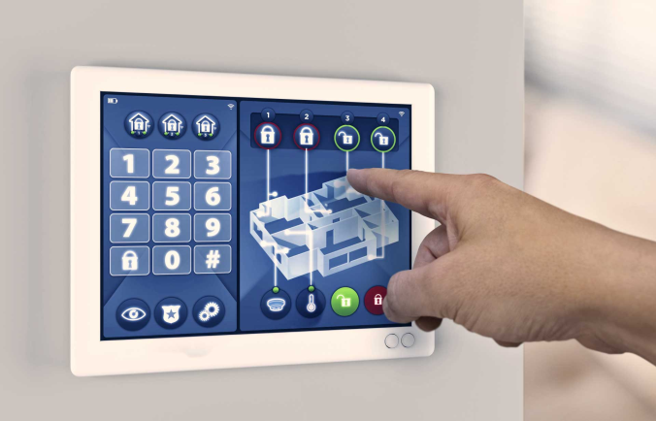
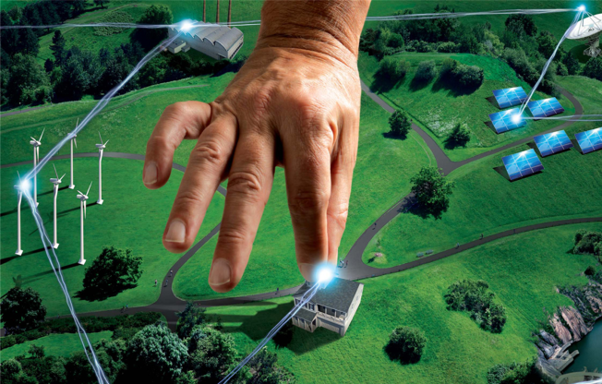
How IEC is using a systems approach to standards
  SyC Smart Cities
  SyC Smart Energy
  Systems Work@IEC
  SyC AAL
  SyC LVDC
Notes:
Systems Committees
Active Assisted Living
Low Voltage Direct Current
Smart Energy
Smart Cities

Slide 5
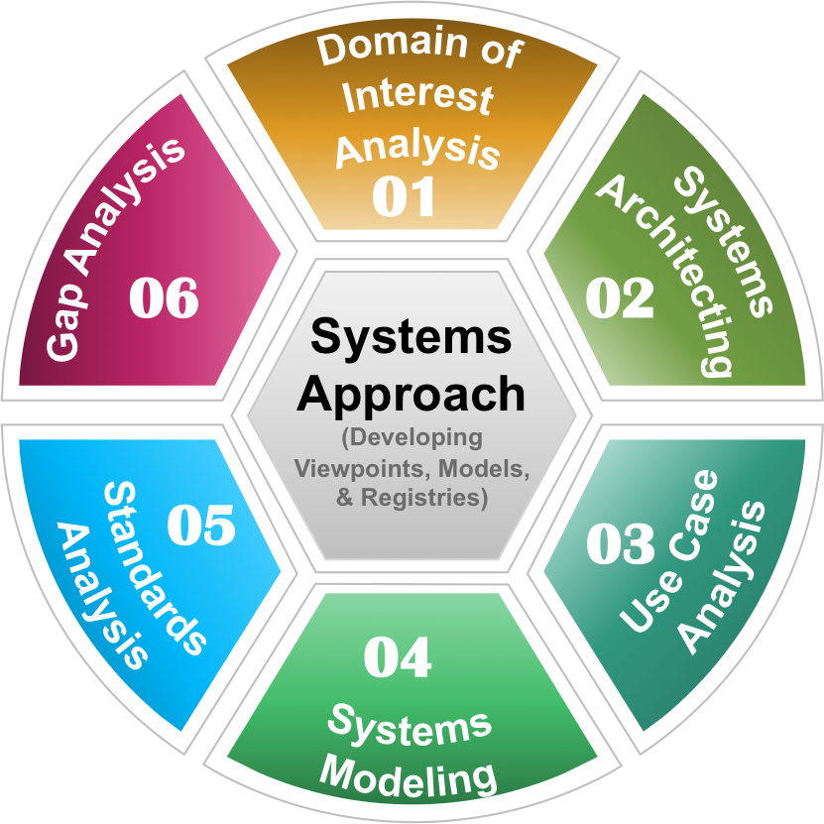
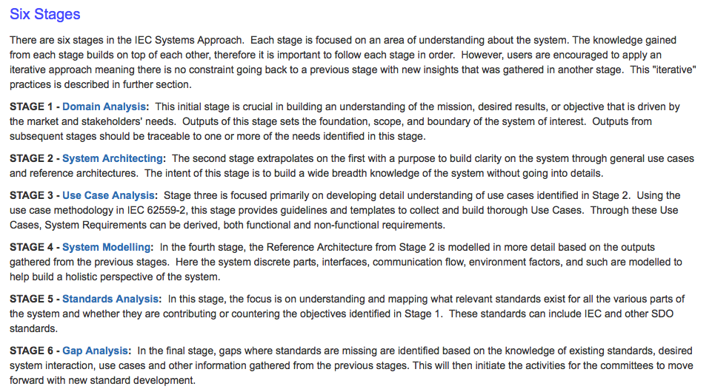
The IEC Systems Approach
IMPORTANT CONCEPTS
Collaborative
Iterative
Maintain & Organize Data
Traceability
“Complex Systems with complex problems need a systems approach”

Slide 6
The initial steps
NEEDS
TERMS
BENEFICIARY STORIES
STAKE-HOLDERS
HIGH LEVEL USE CASE
“Important to understand the traceability”

Slide 7
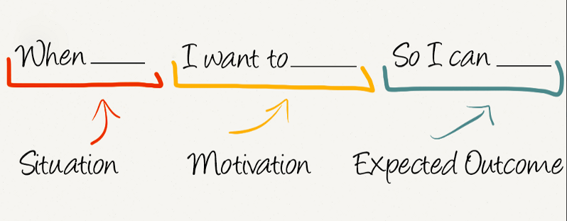
Beneficiary stories
The aim of this step is to collect information about the system-of-interest from the beneficiaries' viewpoint - WHY this system-of-interest will exist and WHAT is meant to do. (The system-of-interest is a black-box for its beneficiaries.)
Such information is captured in form of stories. Ideally, each story is physical, functional and quality (or non–functional) need that a system-of-interest must be able to perform or demonstrate
NEEDS
TERMS
BENEFICIARY STORIES
STAKE-HOLDERS

Slide 8
High level Use Case
Beneficiary Story
In the classroom/ building
As a city student,
When I am at school,
I want to breath clean air,
So I can stay healthy
monitor
Use Case
Use Case Name: Monitor classroom air quality
Scope/Objective: Ability to monitor the air quality in the classroom environment.
Narrative: This use case defines the scenario in which a collection of
Actors (technology and people) interact to provide information about the quality of the air in the classroom. Various characteristic of the air is captured by different technology and monitored. This information is monitored and analyzed by specific actors.
Actors: student, teacher, school maintenance manager, facility staff,
Oxygen sensors, temperature sensor, particle sensor, data collector/gateway, air quality monitor/analytic system
UC-ID_001

Slide 9
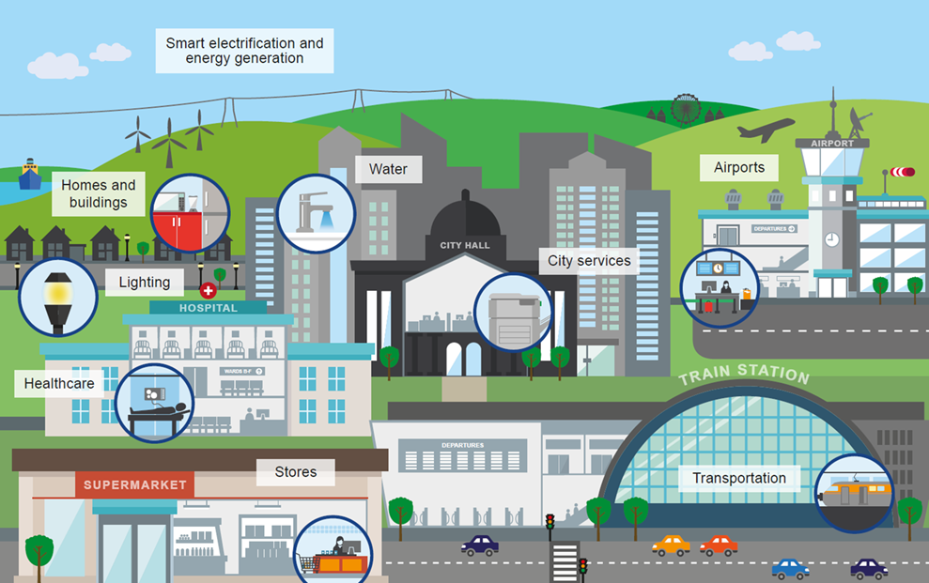
446 Energy
Standards
93 Water
Standards
248 H/B
Standards
264 City Service
Standards
Welcome To
IEC Smart City
Population: 1 814 Standards
141 Transport Standards
87 Healthcare
Standards
375 ICT
Standards
Notes:
The IEC provides the majority of the International Standards needed to safely interconnect and automate much of the city infrastructure that generates or uses electricity and contains electronics. They cover all forms of energy generation and distribution. The whole infrastructure of trains, trams, metro systems, airports, electric and fuel cell buses and all types of electric vehicles, as well as supporting systems such as lighting, displays, ticketing, escalators, etc.

Slide 10
History
IEC/SMB agreed to set up a Systems Evaluation Group (SEG) on Smart Cities in June 2013.
First meeting December 2013.
Finalised report recommending the setting up of a Systems Committee (SyC) on Electrotechnical aspects of smart cities in August 2015.
IEC organises the World Smart City Forum in Singapore, July 2016, to get other SDO’s to cooperate on Smart Cities.
The first meeting of SyC takes places in conjunction with the WSCF.
Plenary in Tokyo February 2017.
Working group meetings in Shanghai June/July 2017.

Slide 11
IEC Systems Committee on Electrotechnical aspects of smart cities
To foster the development of standards in the field of electrotechnology to help with the integration, interoperability and effectiveness of city systems.
This will be done:
- by promoting collaboration and systems thinking between IEC/TCs, the SyC and other SDOs in relation to city system standards;
- by undertaking systems analysis to understand the needs for standards and assess new work item proposals related to city systems;
- by developing systems standards where needed and by providing recommendations to existing SyCs, TCs/SCs and other SDOs

Slide 12
Where the SyC sits ….?
Smart Cities
IEC TCs and SCs
IEC SyC smart cities
Industry
Other SDOs

Slide 13
How the SyC works
Industry
Cities
Reference architecture WG 3
IEC TCs and SCs
CAG coordination
CAG strategy
Market Relations WG 2
SDOs
SDOs
Terminology WG 1

Slide 14
Prioritisation and coordination
 | Highly relevant | Relevant | Irrelevant | Unknown
IMPORTANCE
Value for citizens
Value for enterprise and business
Value for city administration
Value for smart city solutions providers
WHO SHOULD LEAD
Electrotechnical
Systems approach

Slide 15
An An example standard
City Service Continuity against disasters - the role of the electrical supply
Proposed by Japan and recently agreed for development by the SyC Participating Member countries

Slide 16
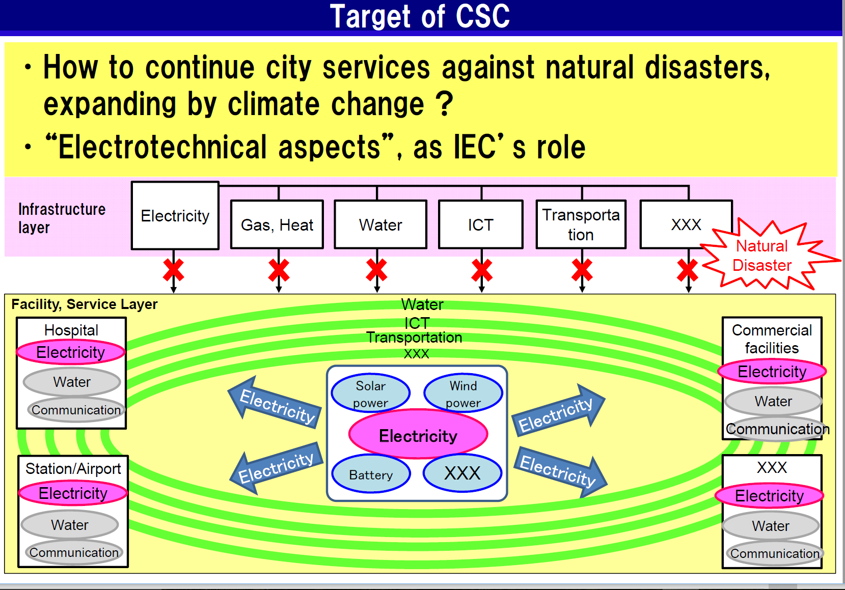

Slide 17
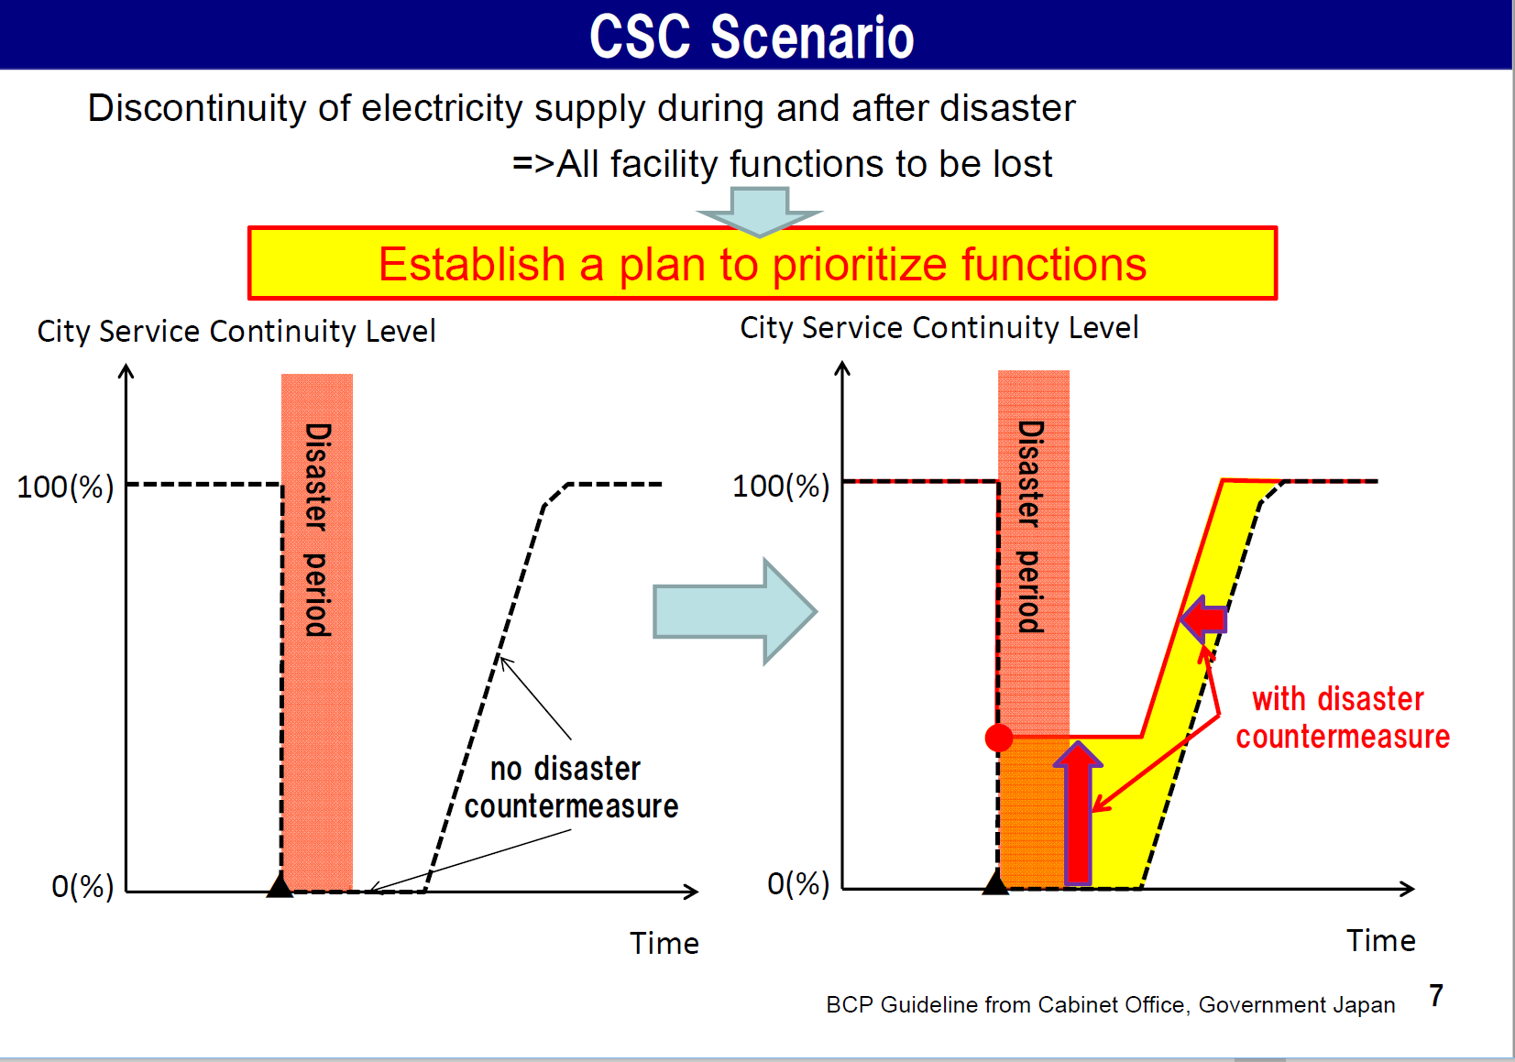

Slide 18
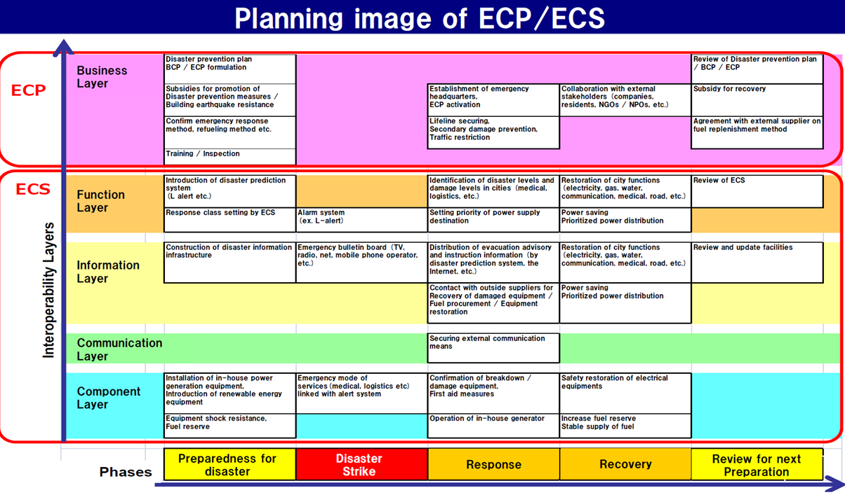
Notes:
Electricity Continuity Plan
Electricity Continuity System

Slide 19
How the SyC is dealing with this
Industry
Cities
Reference architecture WG 3
IEC TCs and SCs
CAG coordination
CAG strategy
Market Relations WG 2
SDOs
SDOs
Terminology WG 1

Slide 20
Thank you
For more information, please contact:
Michael Mulquin michael@iscommunications.co.uk
Gennaro Ruggiero gru@iec.ch
IEC: http://www.iec.ch/
IEC SyC Smart Cities: http://www.iec.ch/smartcities/

