Slide 1
Document No: | GSC-21_017 (R1)
Source: | IEEE-SA
Contact: | Glenn Parsons
Agenda Item: | 4.05
IEEE Smart Cities
Glenn Parsons, IEEE Standards Association
26-27 September 2017
HOSTED BY

Slide 2
IEEE Smart Cities Initiative
The IEEE supported a “Smart Cities Initiative” approved by the IEEE Board of Directors and Technical Activities from 2013-2016
The IEEE Smart Cities Initiative is a global, multi-disciplinary effort to:
Drive a Top-Down Initiative where the IEEE worked directly with the municipalities Create a vibrant and world wide network of cities, providing education, insights and expertise
Collaborate to share knowledge, experience and good practices
Involve local governance, universities, industries and local IEEE volunteers
Assist municipalities in managing the transition to urbanization
Raise awareness of the benefits and downsides of technology and help guide the appropriate uses of technology
The IEEE Smart Cities initiative is now managed by IEEE PES from 2017

Slide 3
The Initiative Galaxy The Smart Cities Initiative Network & Forum
IEEE Affiliated Cities
Buenos Aires, Argentina
Cape Town, South Africa
A Coruña, Spain
Ariana, Tunisia
Diamniadio, Senegal
Guayaquil, Ecuador
Issy-les-Moulineaux, France
Medellín, Colombia
Natal, Brazil
Pune, India
Sabadell, Spain
Sfax, Tunisia
Core Cities
Trento
Wuxi
Guadalajara
Casablanca
Kansas City
Good Practices
Conferences
White Papers
Knowledge
MOOCs
Standards
Pg 3 |
Notes:
IEEE has organized local and regional events in targeted cities with international experts in the specific areas of focus. A fundamental undertaking of the IEEE Smart Cities initiative, the IEEE Core Smart Cities program recognizes and helps cities that are establishing and investing both human and financial capital into smart city plans. Acceptance into the initiative requires an articulate, pragmatic plan for how the city can become smarter in how it is run, with the goal of improving its citizens’ quality of life. Selected cities receive strategic and practical advice from a team of IEEE experts to help conduct activities and further the well-being of its citizens in a sustainable environment.
In addition, we have partner with affiliated cities to help with education and information exchange for knowledge transfer and awareness
For each of the selected cities
Completion of workshops in cities planning or building a smart city
Working groups and whitepapers
Metrics to measure effectiveness of municipality efforts to evolve to Smart City
Published theses and doctoral dissertations from university students in each city
MOOCs Courses developed by the universities on jointly agreed upon topics
Follow-on conferences
Standards

Slide 4
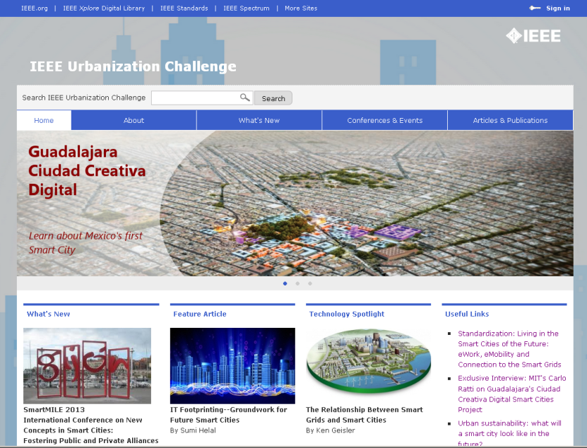
IEEE’s Smart Cities Initiative Urbanization Challenge
Purpose & Scope:
Assist municipalities in managing this transition to urbanization.
Raise awareness of the benefits and downsides of technology and help guide the appropriate uses of technology.
By engaging with IEEE, municipalities would be assured that the “best of breed” technologies and standards are being utilized in their projects.
Pilot in Guadalajara, Mexico
The Guadalajara Municipality has launched a major project, Guadalajara Ciudad Creativa, (GCC) whose goals are very much aligned with the IEEE Urbanization initiative.
http://smartcitygdl-ieee.org/index.html
Portal: http://smartcities.ieee.org/

Slide 5
Initiative Deliverables
As a framework for the initiative
Web Portal
Knowledge Database: Whitepapers, applications, metrics, uses cases, etc.
On-Line Technical Community
Dissemination through press releases, newsletter, conferences, social media…
For each of the selected cities
Completion of workshops & conferences in cities planning or building a smart city
Working groups and whitepapers
Metrics to measure effectiveness of municipality efforts to evolve to Smart City
Published theses and doctoral dissertations from university students in each city
MOOCs Courses developed by the universities on jointly agreed upon topics
Standards
Notes:
Completion of one workshop per city
One or more whitepapers per workshop
Metrics to measure effectiveness of municipality efforts to evolve to Smart City
Published theses and doctoral dissertations from university students in each city
IEEE to have rights of use outside the country where developed
Estimate 2 PhD dissertations and 7-10 theses for Guadalajara
Four MOOCs per city developed by the selected universities
IEEE to have rights of use outside the country where developed
Courses developed by the universities on jointly agreed upon topics
IEEE volunteers will assist in course design and peer review
Follow-on conferences organized by each region every two years
Five conferences per year; assuming 10 workshops in first two years
Web Portal
On-Line Technical Community
Knowledge Database
Whitepapers, applications, metrics, use cases, etc.
02/08/10
5

Slide 6
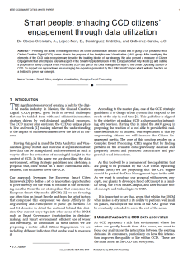
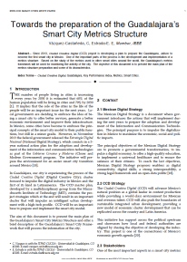
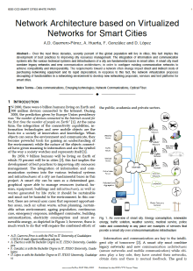
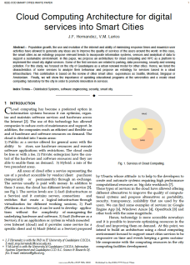
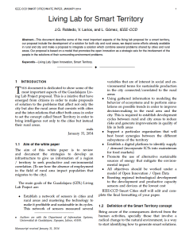
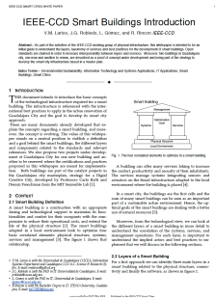
Whitepapers http://smartcities.ieee.org/
Kansas City United States
Lidar Data in City Planning
A Vision for Smart Cities
Adaptive System for Multiple Policy Goals
capacity planning of wireless networks using user mobility behavior in smart cities
High Reliability 4G and 5G Cellular Wireless Services for Smart Cities
Privacy Protection for Police Body Camera Systems
Ubiquitous Wireless Connectivity through Dense Small Cell
Resilience and Survivability for Future Wireless
Real-Time Low Cost Surveillance System based on Raspberry Pi
Using Gamification for Resident Engagement
Trento Italy
Energy Systems for Smart Cities
Big Data and Open Data for a Smart City
Fostering Smart Mobility for Middle Sized Cities
Innovative Tourism Services
Smart Citizens for Healthy Cities
Smart Government -Toward an Innovative Concept of a “One-Stop Shop” for Interactive Online Services
Guadalajara Mexico
Cloud Computing Architecture
Smart Buildings Introduction
Living Lab for Smart Territory
Virtualized Networks for Smart Cities
Smart people: Through Data Utilization
Guadalajara’s SmartCity Metrics Structure
Data Analytics for Smart Grid Efficiency
Data Visualization for Georeferenced IoT Open Data Flows
Digital Interactive Kiosks Interfaces
The role of the Data Scientist within Smart Cities
Sensor Networks and the IoT
Urban Operating Systems for Sensor Network Management in Smart Cities
NoSQL method for the metric analysis s
ODF best practices
Smart Food: Integrated Supply Chain in a Smart City
Application of Business Analytics on Big Data Scenarios
Wuxi China
Current Situation and Future Plan
Smart Environment Protection
Solutions and Plan of Smart Healthcare

Slide 7
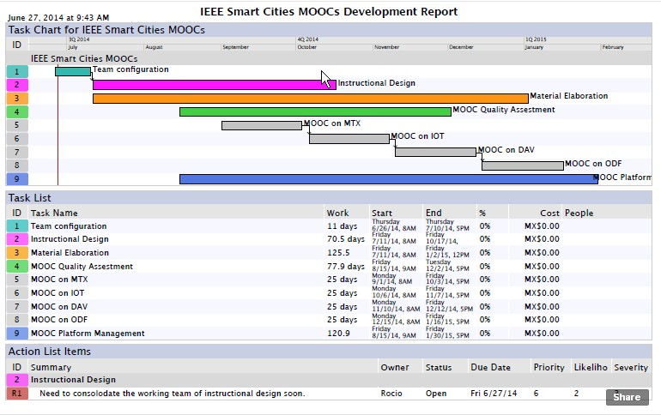
MOOC Development Underway
Four areas of focus for Massive Open Online Courses (MOOCs)
Metrics for Smart Cities
Internet of Things (IoT)
Data Analytics & Visualization
Open Data Framework
Notes:
IEEE is committed to making information about standards and the standards-setting process available to individuals around the world. Utilizing the power of online education to reach a greater audience, IEEE is delivering Massive Open Online Courses (MOOCs).

Slide 8
IEEE-SA: Home for Emerging Technologies
Industry Connections Program
Incubation program for pre-standards work and related standards work
Helps incubate new standards and related products and services
Facilitating collaboration among organizations and individuals as they refine their thinking on rapidly changing technologies
The output of IC programs can be several
White paper development
Standards Gap Analysis – identify need for new standards
Creation of awareness on emerging technologies through workshops
Test bed development
http://standards.ieee.org/develop/indconn/index.html

Slide 9
IEEE-SA IC Programs – Few Examples
IEEE Open Data
Engage stakeholders to assess existing Open Data initiatives, identify standards needs; Having a globally accepted definition, and structure for Open Data will enable interoperability
In assisting local government to make data open, companies will benefit from access to these institutions. We need to ensure that the local ecosystem is maintained.
IEEE Smart Cities Compliance Indicators
The goal of the activity is to come up with a definition of a Smart City and the factors that determine the ‘smartness’ of a city.
Identify the ‘indicators of smartness’ for a city to be called as a smart city; based on these indicators and their impact on the overall environment of the city we will develop a rating index.
IEEE Actionable Databook for Education
IEEE Digital Inclusion through Trust and Agency
IEEE Big Data Governance and Metadata Management
…
Notes:
IEEE Actionable Data book: Creating and demonstrating prototypes for new methods of activity-based mobile learning via an open-standard e-book format with new forms of interactive learning technology and functionality.
IEEE Digital Inclusion through Trust and Agency: This Industry Connections Activity will identify and create consensus throughout technologies that have a potential to alter policy and business landscape, with particular focus on disruptive innovation. It will address inclusion through trust and agency, working toward solutions that promote agency over our data, cyber-identity and internet-related security including, but not limited to, distributed ledger technologies.
IEEE Big Data: The proposed work will guide how big data and big data exchange is governed. It will enable consumers of big data to better understand what is available and how to access it. It will help producers of big data properly set expectations and take steps to ensure that their datasets can be maintained and shared in accordance with their wishes. It will help organizations that store big data make decisions concerning how the big data is stored, curated, exposed, and otherwise governed so as to best serve consumers and producers.

Slide 10
Integrated Horizontal and Vertical Technologies
IEEE-SA has a strong presence in the complete lifecycle of standards development – Industry Connections, Standards Development & Conformity Assessment
Vertical Focused Standards
Horizontal Platforms
Smart Grid
Transportation
Digital Health
Infrastructure Management
Industrial Automation/Smart Factory
Smart Homes
…
IEEE 802 (wired/wireless) protocols
IEEE 5G standardisation
IEEE IoT standardisation
Augmented Reality
Cybersecurity
Blockchain
Ethics
…

Slide 11
IEEE Standards Impact Smart City Technology

Slide 12
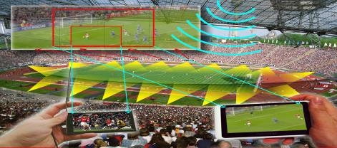
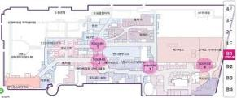
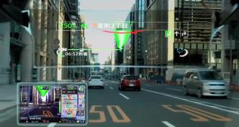
IEEE Standards on Smart Cities Seamless Connectivity - New 802 Initiative:
High Efficiency WLAN (HEW)
Point-of-Sight in Stadium
Location Services
Enhanced Video
Consumer Wearable
Pg 12 |

Slide 13
IEEE P1931.1 - Standard for an Architectural Framework for Real-time Onsite Operations Facilitation (ROOF)
Technical and functional interoperability for IoT systems that operate and co-operate in a secure and independent manner within the context of a local environment such as home, factory, office or airport, etc.
Defines an architectural framework, protocols and Application Programming Interfaces (APIs) for providing Real-time Onsite Operations Facilitation (ROOF).
ROOF computing and networking for the data and the devices include next-hop connectivity for the devices, real-time context building and decision triggers, efficient backhaul connectivity to the cloud, and security & privacy.
Defines how an end user is able to securely provision, commission and decommission the devices.

Slide 14
IEEE 5G Standards: Creating a paradigm shift
Advanced Communication Systems (“5G” and beyond)
Evolutionary
Providing higher bandwidth and lower latency than current-generation technology
Revolutionary
Expected to enable fundamentally new applications, with much more stringent requirements in latency (e.g., real time) and bandwidth (e.g., streaming)
Benefits promised by 5G cut across multiple layers
Software-defined networking (SDN)
Network-functions virtualization (NFV)
Internet of Things (IoT)
Benefits for end users
Flexibility
Ease of use
Dynamic nature of the network
Quality of Service
Anytime/Anywhere Connectivity
Frugal 5G

Slide 15
IEEE: Standards and Global Collaboration for 5G
IEEE provides a complete, end-to-end, collaborative framework today for accelerating the realization of 5G and its revolutionary use cases tomorrow
IEEE 802.11
standard supported by almost any mobile device in the market today
Mobile Edge Cloud brings SDN/NFV frameworks and data path programmability to the proximity of end users as key enablers for service differentiation
IEEE
WiFi
FH
Tactile Internet
eHealth
IoT
AR
SoftRAN
+Fog
Open MEC
IEEE 1914 & IEEE 802.1CM
flexible, efficient and scalable packet-based fronthaul transport networks
SoftRAN is to create a SD RAN flexible enough to control applications with the wireline centric concepts of “fog” in a SD-controller
IEEE 1918
non/mission-critical applications (e.g. manufacturing, transportation, healthcare, mobility, edutainment, events)
IEEE P1589/P1587.6/P1857.9/P3333.2.4 Industry Connections
the integration of computer-generated sensory content with the physical world
IEEE 11073
provides a global platform for eHealth stakeholders
IEEE P2413 / 1471 / 42010

Slide 16
Thank you
For more information, please contact:
Glenn Parsons
glenn.parsons@ericsson.com
IEEE-SA
standards.ieee.org

