Slide 1

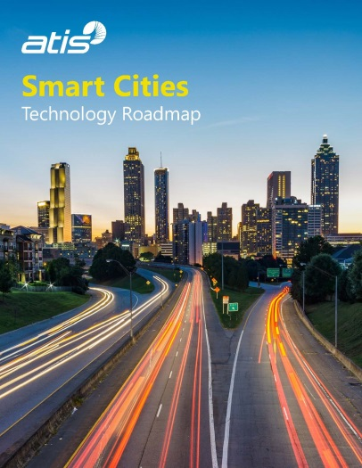


Document No: | GSC-21_016
Source: | ATIS
Contact: | Michael Nawrocki, ATIS
Agenda Item: | 4.01
ATIS Initiatives in Support of Smart Cities
Michael Nawrocki,
Vice President of Technology and Solutions
ATIS
26-27 September 2017
HOSTED BY

Slide 2
Background
Smart Cities projects are rapidly evolving to Smart Cities plans
In 2016, ATIS began to engage its members invested in Smart Cities infrastructure and North American city decision-makers (CIOs/CTOs)
These discussions lead to the development of an ATIS Smart Cities Technology Roadmap published in May, 2017
    1-4 year view of key technology developments intersecting with Smart Cities
    Simplified technology framework that delivers end-to-end view
    Technology enablers that would promote investments and create value
  ATIS has undertaken Phase 2 work, building upon the Technology Roadmap

Slide 3
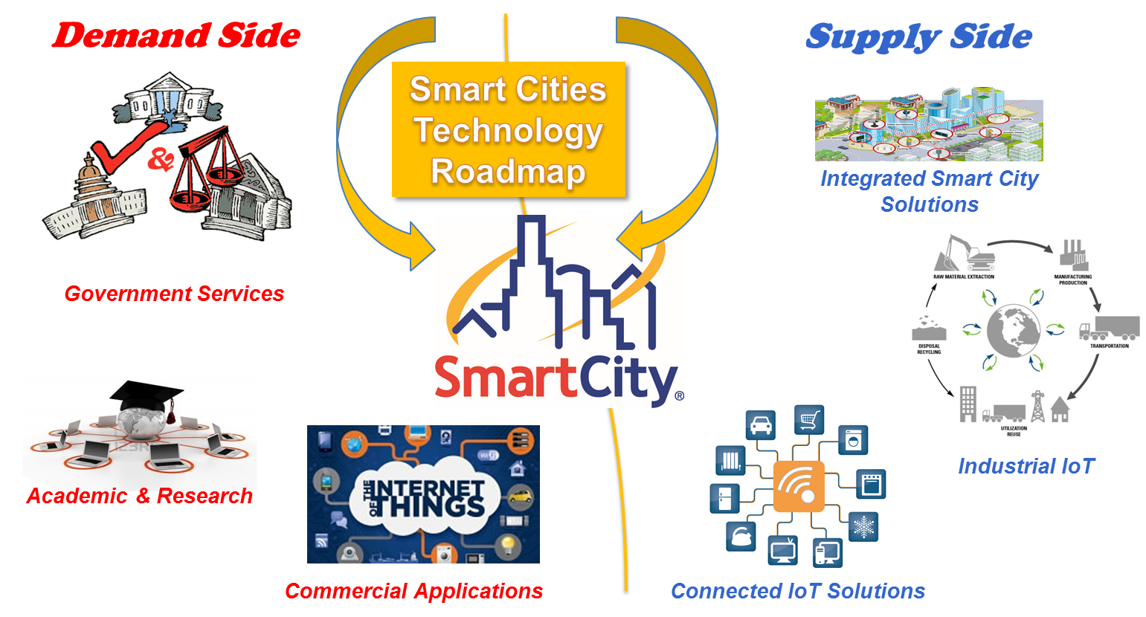
Smart Cities Landscape

Slide 4
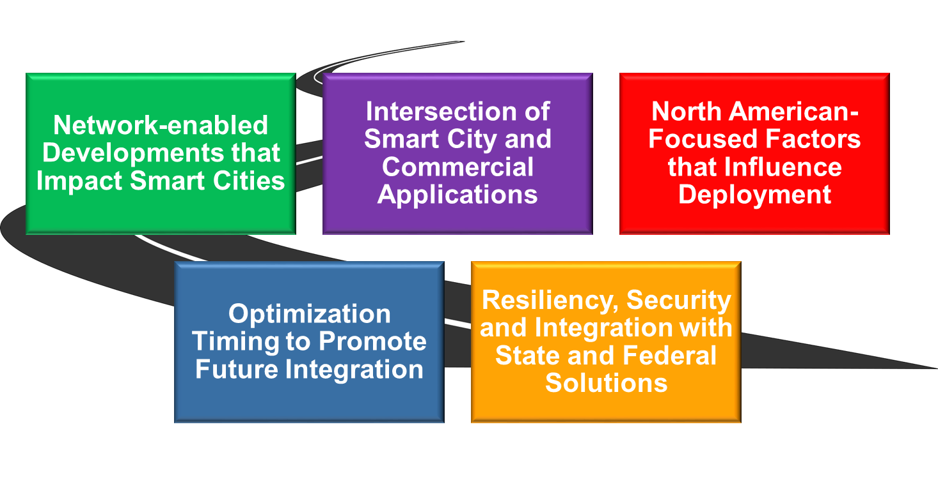
Scope of Technology Roadmap

Slide 5
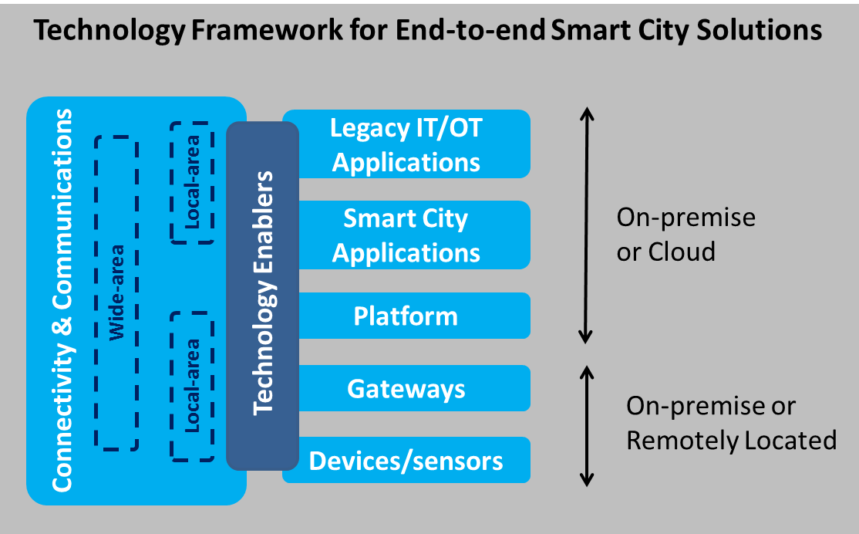
Technology Framework
Technology Enablers
Access Enablers – create and/or manage access to sources of city or citizen data
Platform Enablers – support the distribution, management, exchange and integration of data and services
Application Enablers – apply rich content and promote the development and use of open APIs for Smart City services
Infrastructure Enablers – provide improved means to manage and protect city and citizen assets

Slide 6


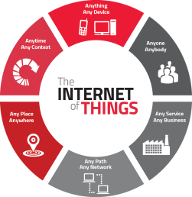
Technology Enablers
Access Enablers
Crowdsourced data
Context-awareness
Next Gen Geo-location
Privacy and security controls
Platform Enablers
Advanced Analytics/Machine Learning
Data Integration platforms
Data Exchanges
Augmented Reality platforms

Slide 7
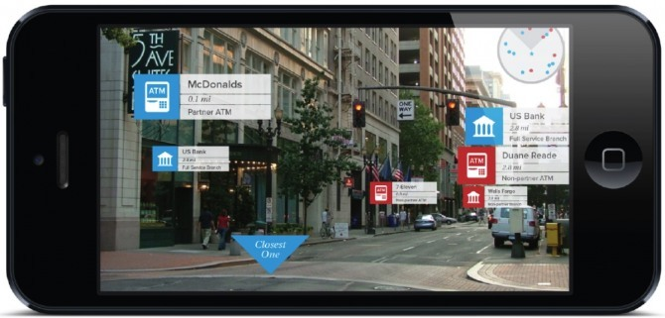
Technology Enablers (Continued)
Application Enablers
App Marketplaces
AR/VR Content
Evolution of Content Ecosystem
Infrastructure Enablers
Distributed Resiliency
Enhanced Asset Management
Emergency Preparedness
Level 1
New Infrastructure
Level 2
Design and Configure
Level 3
Fully Integrate and Optimize
Smart Cities - Levels of Resiliency

Slide 8
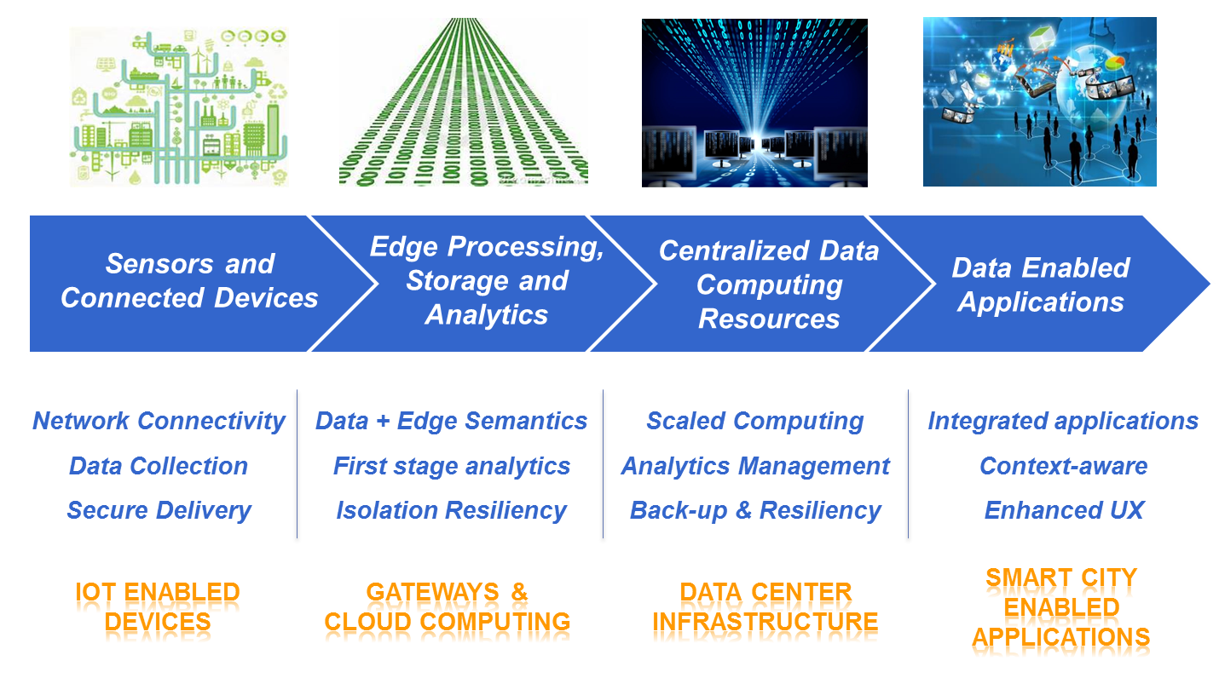
Data Framework

Slide 9
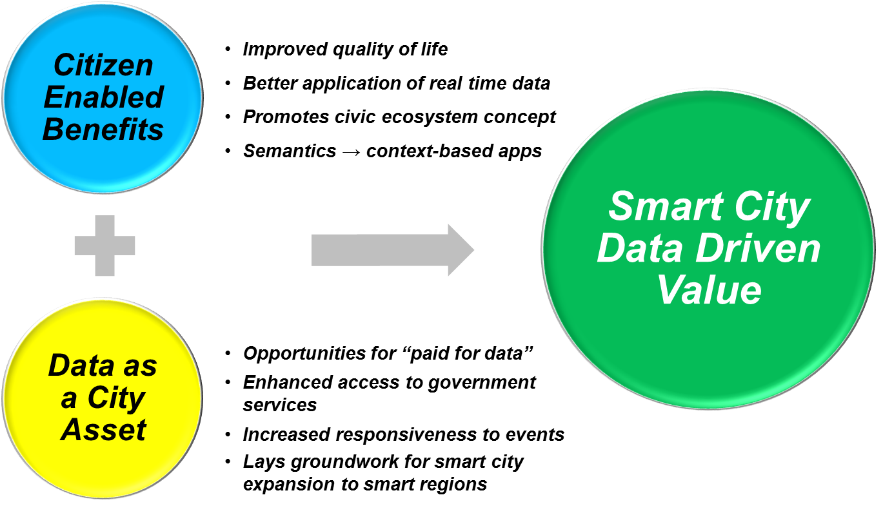
Utilizing Data Analytics to Create Value

Slide 10
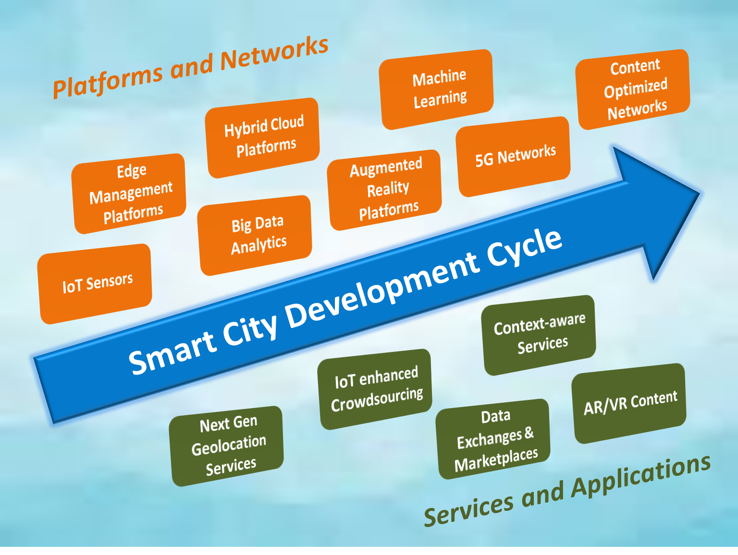
Technology Development Cycle

Slide 11
Conclusions
Smart Cities initiatives are beginning to move from point solutions to longer term visions, requiring business and technology planning.
It is important that city decision-makers understand the future trajectory of technology and how it can create new opportunities.
Data will play a key role in advancing from Smart Cities infrastructure to applications that meet city and citizen demands.
Data sharing outside of city operations will require data exchanges, which can eventually evolve to robust data marketplaces.
As part of its Phase 2 work, ATIS is working with the industry and cities to develop data sharing approaches.

Slide 12
Thank you
For more information, please contact:
Michael Nawrocki, ATIS
mnawrocki@atis.org
ATIS:
www.atis.org

