Slide 1


Document No: | GSC-21_014
Source: | TTA
Contact: | Hyun Seo Oh
Agenda Item: | 5.03
V2X Frequency Harmonization for C-ITS
Dr. Hyun Seo Oh, ITS/Vehicle ICT PG,TTA
26-27 September 2017
HOSTED BY

Slide 2
Introduction
V2X communication technology : 5.9GHz WAVE vs. LTE V2X
C-ITS pilot test & applications in Korea
V2X frequency assignment for ITS
TTA V2X communication standards
Concluding remarks

Slide 3
V2X Communication Technology
V2V and V2I Wireless Networking for Vehicle Safety & C-ITS
US WAVE (Wireless Access in Vehicular Environment) & EU ITS G5
Less than 100msec Latency and 1km Radio Coverage
Frequency Band : 5.855 ~ 5.925GHz
RSE
Center
RSE
V2I
Emergency
Brake Warning
V2V
OBE
OBE

Slide 4
V2X communication Specification
Item | USA | EU | Korea | Japan
Frequency Band(GHz) | 5.855~5.925GHz (7 CH) | 5.855~5.925GHz (7 CH) | 5.855~5.925GHz (7 CH) | 700MHz (1 CH)
Channel Bandwidth | 10MHz, 20MHz | 10MHz | 10MHz | 10MHz
Modulation Type | OFDM (BPSK, QPSK, 16QAM,64QAM) | OFDM (BPSK, QPSK, 16QAM,64QAM) | OFDM (BPSK, QPSK, 16QAM,64QAM) | OFDM (BPSK, QPSK, 16QAM,64QAM)
MAC | CSMA/CA | CSMA/CA | CSMA/CA (Time Slot based) | CSMA/CA
Data Rate | 3,4.5,6,9,12,18,24,27, 36, 48, 54 | 3,4.5,6,9,12,18,24, 27 | 3,4.5,6,9,12,18,24, 27 | 3,4.5,6,9,12,18

Slide 5

LTE V2X Technology
Coexistence study between WAVE and LTE V2X in 3GPP
LTE V2X interworking standard in ISO CALM architecture
LTE V2X interworking standard in TTA Communication platform
Center
802.11p V2V
802.11p V2V
Network
RSE
LTE V2V
LTE V2I
E-Node B

Slide 6
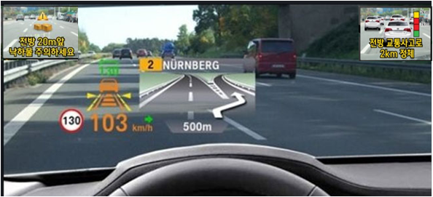
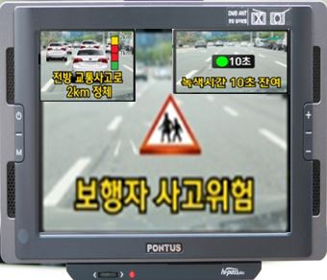
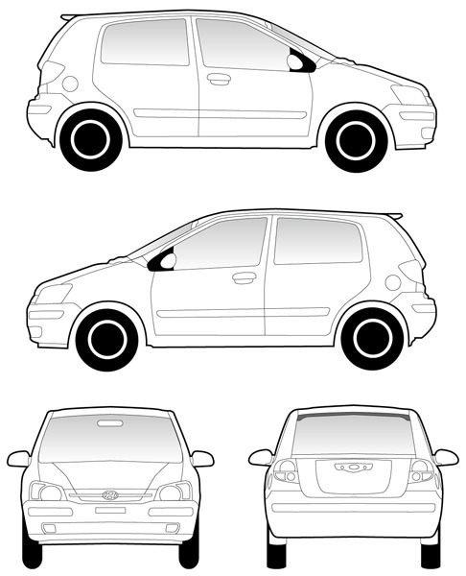
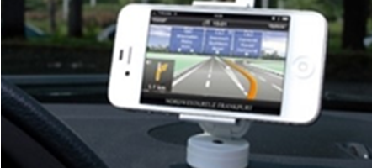
Pilot Testing in Korea
V2V Field testing to verify V2X based C-ITS applications [2014~2017]
System Configuration: 3000 Terminals, 95 RSE, Traffic Center
Terminal Types: Head Up Display(HUD), Navigation, Smart Phone
GPS ANT
Head Up
Display
WAVE Module
HMI
WAVE ANT
ECU Interface
Navigation
Smart
Phone

Slide 7
6 Categories & 15 Applications
Service Categories | Applications
Vehicle Safety | Vehicle Collision Warning Road Hazard Warning Road and Weather Condition Warning Road work warning
Intersection Safety | Intersection Collision Warning Signal Phase/Timing Information
Protection for Disabled Person | Yellow Bus Warning School Zone Warning Pedestrian Waning
Emergency Situation | Emergency Warning Emergency Preemption Warning
Cooperative Traffic Management | Location based Position Information Gathering Location based Traffic Information Provision
Smart Tolling | Multi-lane Toll Charging
Public Transportation Management | Public Transportation Management

Slide 8
ITS Frequency Band
ITS(DSRC)
R
172
174
5.825
180
182
184
USA
176
178
5.855
5.865
5.875
5.885
5.895
5.905
5.915
5.925
ITS(G5)
5.835
EU
5.855~5.875
Non-safety ITS
5.875~5.905
ITS road-safety
5.905~5.925
Future extension
700MHz
ITS(DSRC)
5.845
Japan
5.770 ~ 5.850 GHz (70MHz)
5.855
ITS(DSRC)
C-ITS
Korea
5.795~5.815
(20MHz)
5.835 ~ 5.855
(20MHz)
5.855~5.925(70MHz)
5.865
Frequency
(GHz)
5.815
5.875
5.785
5.795
5.805
5.885
5.895
5.905
5.915
5.925

Slide 9
Frequency Assignment in Korea
Frequency assignment completed in 2016
Frequency Band: 5.855~5.925GHz(70MHz)
Applications : Vehicle Safety and C-ITS
Technical Requirements
  Channel Bandwidth : less than 10MHz
  Modulation : OFDM
  Transmitted Power : Max. 100mW(20dBm)
SCH
SCH
SCH
SCH
CCH
SCH
SCH
Frequency
5.855 5.865 5.875 5.885 5.895 5.905 5.915 5.925 [GHZ]
* CCH : Control Channel, SCH : Service Channel

Slide 10
TTA Standard
Vehicle Communication Technology
  TTAK KO-06.0175/R1: Vehicle Communication System Stage 1: Requirement
  TTAK KO-06.0193/R1: Vehicle Communication System Stage 2: Architecture
  TTAK KO-06.0216/R1: Vehicle Communication System Stage 3: PHY/MAC Layer
  TTAK KO-06.0234/R1: Vehicle Communication System Stage 3: Networking Layer
  TTAK KO-06.0242/R1 : Vehicle Communication System Stage 3: Application Protocol Interface
  TTAK KO-06.0440: Methods of Measurement for WAVE PHY Layer(IEEE 802.11p)
Vehicle Communication Technology
  TTAK KO-06.0344: In-Vehicle Signage System for Vehicle Safety Guidance Stage 1: Requirements
  TTAK KO-06.0344-Part II: In-Vehicle Signage System for Vehicle Safety Guidance Stage 2: Data Exchange

Slide 11
Concluding Remarks
Regarding WRC-19 AI 1.12, Korea supports relevant ITU-R studies on evolving ITS applications.
Also, supports the frequency band 5.855-5.925 MHz as globally or regionally harmonized spectrum for V2X based ITS applications in the view of the previous APG-19 meeting
Coexistence and interworking on 5.9GHz V2X and LTE V2X needs to be studied
  Option A : Primary use for 5.9GHz V2X, Secondary use for LTE V2X if channel is idle.
  Option B : Separate frequency band allocation for 5.9GHz V2X(WAVE, ITS G5) and LTE V2X

Slide 12
Thank you
For more information, please contact: Hyun Seo Oh
hsoh5@etri.re.kr:
ETRI:
www.etri.re.kr

