Slide 1
Document No: | GSC-21_012 (R1)
Source: | TTA
Contact: | SungDuck Chun
Agenda Item: | 3.02
Communication technologies for autonomous vehicles
SungDuck Chun, LG Electronics
26-27 September 2017
HOSTED BY

Slide 2
Topics in this presentation
Introduction to autonomous vehicles
The role of communication in autonomous vehicles
Standardization activities of C-V2X
Performance of C-V2X
Topics for discussion

Slide 3
Levels of autonomous driving
There are multiple levels for autonomous vehicles
Level 1
Driver Assistance
Level 2
Partial
Level 3
Conditional
Level 4
High
Level 5
Full automation
Overview
Driving assistance by using either steering or braking/ acceleration
Driver assistance by combining multiple operation simultaneously (e.g. by steering control while accelerating)
Driving control with assumption that drivers can intervene when requested
Driving control even if drivers can not react immediately
Not applicable to all scenarios (e.g. highway driving, parking)
Driving control even if drivers can not react immediately
Applicable full-time
Benefit
Assist drivers attention
Assist driver with basic repetitive operations
Assist driver by doing some operations such as lane changing.
Burden on the driver can be reduced
Drivers may do other tasks as long as drivers can take control when requested by driving system
In certain scenario, driver can do other tasks
Efficient use of time by drivers
Drivers can always do other tasks than driving
Reduced traffic jam
Operation efficiency of vehicles maximized

Slide 4
Elements to the next levels
There are multiple levels for autonomous vehicles
Human-based driving
System-based driving
Level 5
Level 4
Level 3
Fully covered high definition map (e.g. even parking area)
Dynamic map update (e.g. event-triggered map update)
Reliability enhancement in sensing/decision/control (to support even eye-off)
Infra-structure assistance (e.g. old vehicles, pedestrians)
Understanding of other vehicle (e.g. behavior on curved road, or future trajectory)
Cloud computing, artificial intelligence
Level 2
High definition positioning
High definition map (exit, merge, intersection, etc.)
Sensing non-visible area (e.g. during overtaking)
Level 1
Advance in sensor technologies
Sensor fusion
Combination of multiple operations

Slide 5
Examples of limitation in case of sensors only
1
2
3
HV
1
Sensors don’t know when/whether other vehicles will change lanes.
2
Sensors may not detect this vehicle which is not in line-of-sight.
3
Sensors cannot know whether lane change is happening or the vehicle is moving on curved road.
4
4
Sensors don’t know which route should be avoided

Slide 6
Then, what communication can do
I will change lane X seconds later
1
I’m on the curved road
I’m here
3
2
HV
Communication can deliver information beyond what sensors can detect. E.g.:
Status information (speed, location, heading, etc.) of each vehicle, even if it is not in line-of-sight
Intention information (future planned trajectories, negotiation of future movement)
Shared awareness (information exchange of detected objects, other events such as roadwork)
Road work at location K
4

Slide 7
Or, even cloud computing can be supported
While hardware installed in a vehicle may not be upgraded, artificial intelligence in the cloud will continuously evolve. As long as communication path is available between vehicle and A.I. in the cloud, new and advanced service can be provided to a old vehicle.
Image processing to calculate position, to identify objects
Coordination of future trajectories of vehicles
Planning of future route
Remote driving control of vehicle
A.I. in the cloud

Slide 8
Roadmap of Cellular V2X
3GPP finished the first phase of C-V2X and has moved into next phases
Stage-1
Use case, Requirements
(SA1) LTE V2X (`15.02~ `16.03)
(SA1) eV2X (`16.05~ `17.03)
Stage-2
Architecture
(SA2) LTE V2X (`15.10~ `16.09)
(SA2) eV2X (`17.04~ `18.09)
Stage-3
Protocols
(RAN) LTE V2X (`15.06~ `17.03)
(RAN) LTE eV2X (`17.04~ `18.06)
(RAN) NR eV2X (`17.3Q~ `19.4Q)
Basic V2X services
Advanced V2X services
Road hazard warning
Intersection movement assistance
Forward collision warning
Autonomous driving
CACC, Platooning
Tele-operated driving
Sensor data sharing
-> Higher reliability, Higher throughput, Lower latency

Slide 9
Topics for discussion
Standardization of V2X Applications for beyond Day 2:
For some advanced V2X applications, progress of standardization is slow. For other advanced V2X applications, there is no plan at all. (e.g. video sharing, remote driving, etc.)
Cloud-to-cloud connectivity between stake-holders also needs to be considered. (e.g. how one OEM cloud connects to other OEMs cloud? how operators’ cloud connects to other OEMs’ cloud or operators’ cloud?)
Coexistence and evolution
ITS band (e.g. 5.9 Ghz) is technology neutral, allowing access of both C-V2X and DSRC/ITS-G5.
How to ensure coexistence of both technologies within same band?
How to ensure the evolution of access technologies?
What and to which extent interoperability should be supported?
Competition and collaboration
Which part of V2X service is up for competition/implementation and which part of V2X service is up for collaboration/standardization?
Which part of V2X specification is up for competition or collaboration among SDOs?

Slide 10
Annex A: Evolution of Cellular technologies
Cellular technologies are merging, what about V2X?
2G
3G
4G
EDGE
GSM/GPRS
WCDMA/HSxPA
LTE
LTE-A
LTE-Pro
IS-95A/B
CDMA2000
1x, EV-DO, Rev A/B

Slide 11
Annex B: Evolution of IMS Standardization
IMS specification also converged, then what about V2X?
Pre 3GPP Release 6
3GPP Release 6
3GPP Release 7
3GPP Release 8
3GPP Release 9
3GPP
3GPP IMS Specs
Common IMS (i.e. Access agnostic) Specs
Common IMS Specs
Common IMS Specs
Common IMS Specs
3GPP2
TISPAN
MMD
specs
IMS Release-1 specs
IMS Release-2 specs

Slide 12
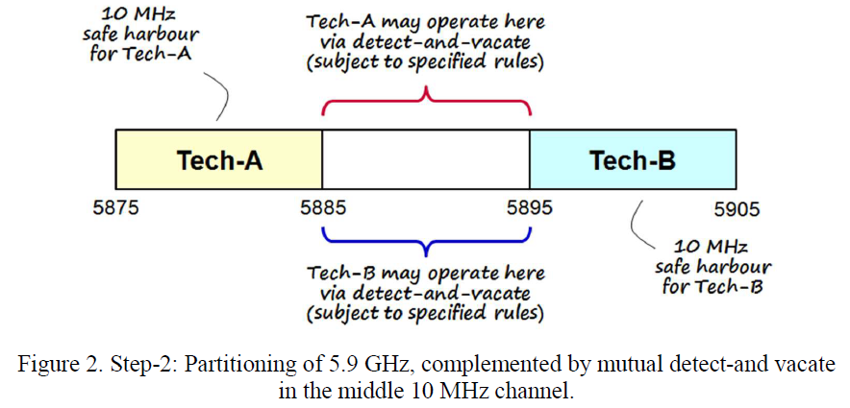
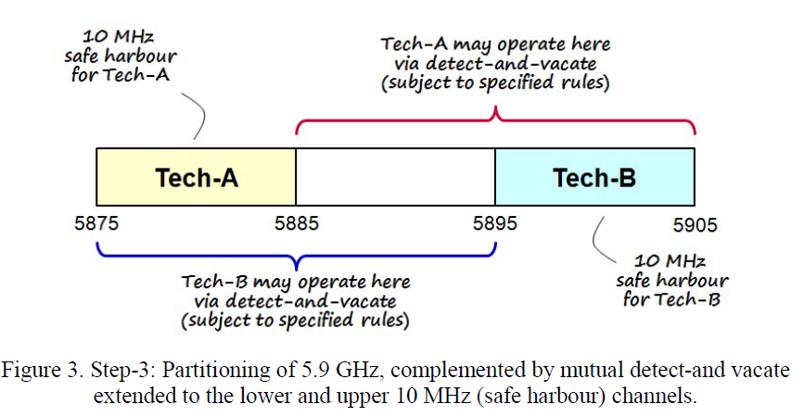
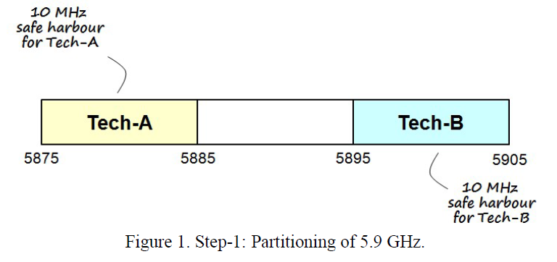
Annex C: Co-existence example
5GAA’s approach on co-existence

Slide 13
Thank you
For more information, please contact: Sungduck Chun
sungduck.chun@lge.com
Affiliation Name:
www.lge.com

