Slide 1


Document No: | GSC-21_011
Source: | ARIB
Contact: | Seiji Nishioka
Agenda Item: | 2.01
ARIB Activity and Strategy
Seiji Nishioka
Executive Director, ARIB
26-27 September 2017
HOSTED BY

Slide 2
ARIB Activity - Work Contents -
Study/R&D - Standardization
- work on telecom (Radio) & broadcasting fields
- develop Standard by consensus
Promotion of Radio Industry
- hold special seminars, monthly seminars
- issue yearbook, quarterly bulletin, weekly news
Consultation on Radio Wave Use
- design radio links / select best available frequency
for microwave and satellite links
Cooperation with SDOs
- having MoU and Agreement with 16 organizations
world wide

Slide 3
ARIB Activity - Statistics -
(FY) 2013 2014 2015 2016
Member
Regular members 208 211 195 189
Supporting members 4 4 4 13
Income (100M\)
member fee 2.4 2.4 2.3 2.3
Business 7.1 6.4 5.3 5.2
- consultation 3.0 2.4 1.8 2.0
- others 4.1 4.0 3.5 3.2
Standard
STD (Standard) 155 159 166 165
TR (Technical Report) 64 63 66 70

Slide 4
R&D Items
Establishment of 5G Trial Project Promotion Center
・Actively involved in the 5G Field Trial led by MIC
Development of New Wireless Access System towards IoT
Development of Advanced private wireless communication systems

Slide 5
Standardization
Three Pillars
5G : Collaborate worldwide through 5GMF
UHDTV : Promote the system worldwide
ITS : Harmonized (co-existence of ITS standards, ITS and other systems) frequency bands for the implementation
of evolving ITS
Close cooperation with Fora / Consortia
- draft standard with complete specification
- full IPR submission
・ gathering and analyzing information on IPR policy
- English Version of ARIB Standards

Slide 6
Three Pillars on Standardization
      5G
      UHDTV
      ITS

Slide 7
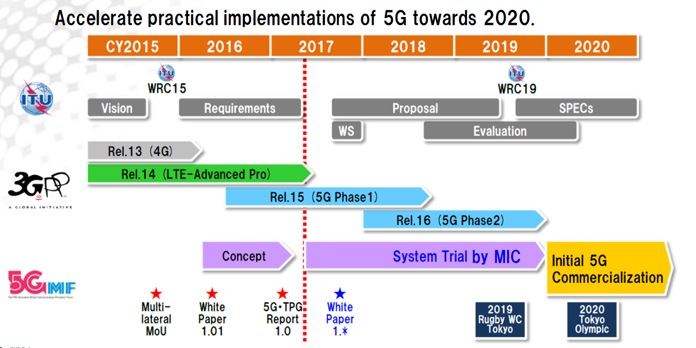
【5G】 Action plan (mid-term) of 5GMF
2019
Rugby WC
Tokyo
2020
Tokyo
Olympic
Paralympic
5GMF White Paper
http://5gmf.jp/wp/wp-content/uploads/2016/07/5GMF_WP101_All.pdf

Slide 8
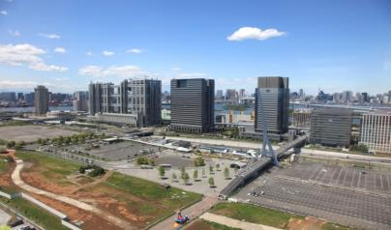
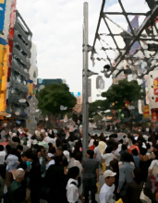
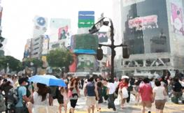
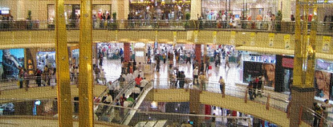
【5G】 Image of 5G Verification Trial
Coverage and outdoor driving experiments
in a large premise
Outdoor trial in open square environments
crowded with people
Indoor environments crowded with people

Slide 9
【UHDTV】 Japan’s Roadmap for 4K/8K

Slide 10
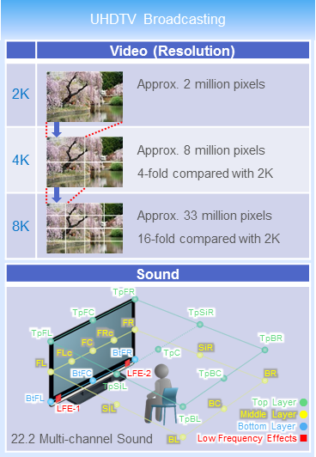
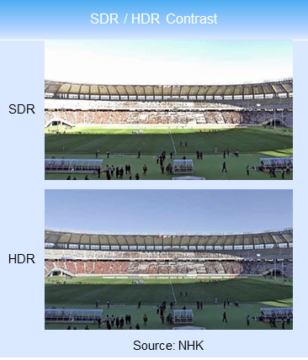
【UHDTV】 Technology for 4K/8K

Slide 11
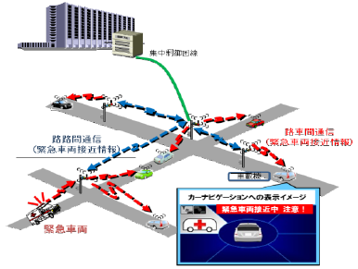
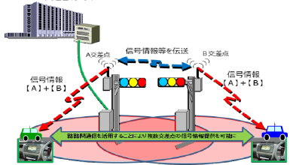
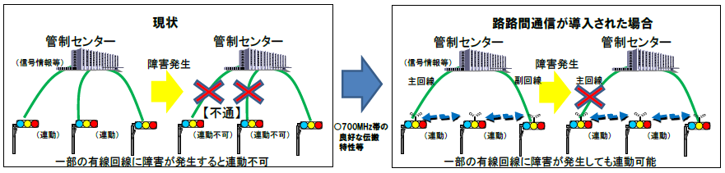
【ITS】 Enhancement of ITS Connect servicese
Addition of Infrastructure-to-Infrastructure Communication (700MHz)
(1) Broad provision of approaching
emergency vehicle
(2) Broad provision of traffic signal information
(from multiple intersection)
Traffic control center
Traffic control center
Exchanging
Traffic signal
information
Intersection A
Intersection B
Traffic signal
information
[A+B]
Traffic signal
information
[A+B]
Emergency vehicle
approaching alert
(I⇒V)
Emergency vehicle
approaching alert (I⇔I)
On-vehicle device
Intormation provision from multiple intersection
Display image
Emergency
vehicle
(3) Failure resistant
Current system
I to I communication added system
Traffic control center
Traffic control center
Traffic control center
Traffic control center
Traffic signal
information
Line failure
Traffic signal
information
Line failure
Secondary
line
Disconnection
Disconnection
Main line
Interlocking
Interlocking does not work
Interlocking
Interlocking

Slide 12
Thank you
For more information, please contact:
Seiji NISHIOKA, Executive Director
Email address: s-nishioka@arib.or.jp
Affiliation Name: ARIB
http://www.arib.or.jp/english/index.html

Slide 13
Annex Slides

Slide 14
ARIB in Summary
[ as of 31 March, 2017 (31 March, 2016) ]
Membership Regular Member : 189 (195)
Supporting Member : 13 ( 4)
Standardization Standard (STD) : 165 (166)
Technical Report (TR): 70 ( 66)
Technical Committee Study Group : 1 ( 3)
R&D Group : 4 ( 4)
Advanced Wireless Communications Study Committee (ADWICS)
Subcommittee : 4 ( 4)
Promotion Strategy Committee
Subcommittee : 1 ( 1)
ISDB-T : 19 countries ( 18)
(new : El Salvador, January 2017)
Electromagnetic Environment Committee
Subcommittee : 2 ( 2)

Slide 15
Secretariat
Secretary General : Mr. Fusaki MATSUI
Managing Director : Mr. Shunsuke KODAMA
Executive Director : Dr. Shigeki MORIYAMA
Executive Director : Mr. Seiji NISHIOKA
Administration Department
・General Affairs
・Personal Affairs
・Accountants
Development Center
R&D Headquarters
5G Trial Project Promotion Center
・Investigation and R&D
・Development of Technical Standards
9 Groups
Radio Utilization Consulting Department
・Consultation and Information Services for Spectrum Utilization
Planning and International Affairs Department
・Administrative work related to “ARIB Standards”
・Education and Popularization
・Correspondence with other national/international standards organizations

Slide 16
Outcome from Standard Assembly
ARIB Standard (STD)
  Technical requirement for radio systems
ARIB Technical Report (TR)
  Operational guidelines for radio systems
Number of STD and TR
[As of 31 March, 2017]
 | STD | TR
Telecommunications | 92 | 24
Broadcasting | 73 | 46
URL for ARIB Standards
  http://www.arib.or.jp/english/html/overview/index.html

