Slide 1
Document No: | GSC-21_010
Source: | ARIB
Contact: | Takeshi Yamamoto
Agenda Item: | 5.05
Activities of ARIB on WRC-19 AI 1.12
Takeshi Yamamoto, ARIB
26-27 September 2017
HOSTED BY

Slide 2
ITS applications in Japan
Electronic Toll Collection (ETC)
90% of vehicles are using ETC for toll payment in Japan.
5.8 GHz band, ARIB STD-T75
Additional applications available (e.g. Hazard, Traffic jam Warning) by ETC 2.0
Cooperative ITS
Vehicle-to-Vehicle and Vehicle-to-Infrastructure (V2X) driving assistance services since 2015 (https://www.itsconnect-pc.org/en/)
760 MHz band, ARIB STD-T109

Slide 3
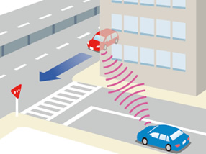
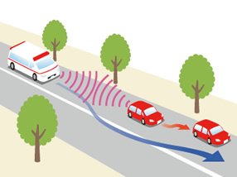
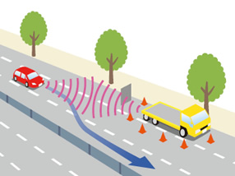
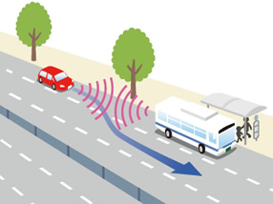
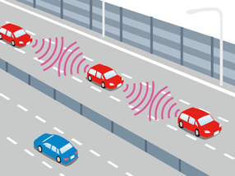
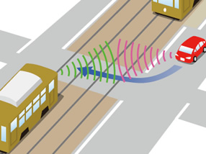
Cooperative ITS: V2V applications in Japan
Collision Avoidance Assistance
Assistance in Confirmation of Nearby Vehicles
Information Support on Status of Nearby Vehicles
Information Support on Status of Passengers
C-ACC (Cooperative Adaptive Cruise Control)
Information Support Regarding Incoming Trams
Source: ITS Connect Promotion Consortium https://www.itsconnect-pc.org/en/about_its_connect/service.html

Slide 4
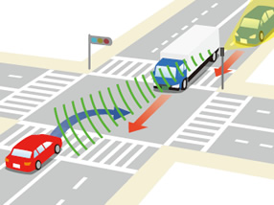
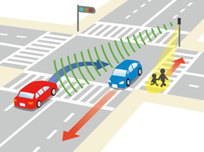
Cooperative ITS: V2I applications in Japan
Collision Avoidance Assistance during Right Turns
Assistance in Avoiding the Overlooking of Pedestrian Crossings
Source: ITS Connect Promotion Consortium https://www.itsconnect-pc.org/en/about_its_connect/service.html

Slide 5
References by ITS info-communications Forum (ITS Forum)
ARIB STD-T109 has been developed based on study and guidelines by ITS Forum.
RC-006: Experimental Guideline for Vehicle Communications System using 700 MHz-Band
RC-008: Operation Management Guideline for Driver Assistance Communications System
RC-009: Security Guideline for Driver Assistance Communications System
RC-011: 700MHzBAND INTELLIGENT TRANSPORT SYSTEMS ‐ TEST ITEMS AND
CONDITIONS FOR MOBILE STATION INTEROPERABILITY VERIFICATION GUIDELINE
RC-012: 700MHz BAND INTELLIGENT TRANSPORT SYSTEMS
‐ Experimental Guideline for Roadside‐to‐Roadside Communications
RC-013: 700MHz BAND INTELLIGENT TRANSPORT SYSTEMS
‐ Experimental Guideline for Inter‐vehicle Communication Messages
Source: http://www.itsforum.gr.jp/Public/guideline/index.html

Slide 6
Contribution to DG1.12 in APG19
DG1.12 in “APT Preparatory Group for WRC19” (APG19) is developing preliminary APT common view to CPM-19 report on WRC-19 AI 1.12.
In Japan, 5.8 GHz band is used for ETC and 760 MHz band is used for Cooperative ITS.
Japan recognizes that some other countries are going to use 5.9 GHz band for Cooperative ITS.
At APG19-2 (July 2017, Bali), Japan proposed to include 5.8 GHz band in the draft of DG1.12.
ARIB supports the development of the draft for the frequency harmonization.

Slide 7
Contribution to ITS Usage report
ITS Usage report is under development in ITU-R WP5A and AWG. The report will describe ITS usage in the world including Asia-Pacific countries.
The text of the report is expected to be referred in CPM-19 report.
Japan proposed the development of the report and ARIB is contributing to the text of the draft in WP5A and AWG.

Slide 8
Contribution to ITU-R Rec. M.[ITS_FRQ]
WP5A started development of ITU-R Recommendation M.[ITS_FRQ] in May 2017.
Germany proposed the development and the recommendation will describe frequency bands used by ITS applications.
Since the recommendation is expected to be related to WRC19 AI 1.12, Japan/ARIB supports the development in WP5A and relevant activities in AWG starting at AWG-22, September 2017.

Slide 9
Considerations
Japan, as the proposer of WRC-19 AI 1.12, will continue the work on the agenda item for global or regional harmonized frequency bands for ITS applications.
In Japan, 5.8 GHz band is used for ETC and 760 MHz band is used for Cooperative ITS. Japan proposed to include 5.8 GHz band in the draft of DG1.12 in APG19-2.
5.8 GHz and 5.9 GHz are to be considered as proposed harmonized frequency bands for ITS applications.
Considering WRC-19 AI 1.16 – RLANs in the 5 GHz band, careful study is required for coexistence of ITS applications in 5.8/5.9 GHz band and RLANs in the 5GHz band.

Slide 10
Thank you
For more information, please contact: Takeshi Yamamoto
t-yamamoto@bu.jp.nec.com
Affiliation Name: ARIB
http://www.arib.or.jp/english/index.html

Slide 11
Annex Slides

Slide 12
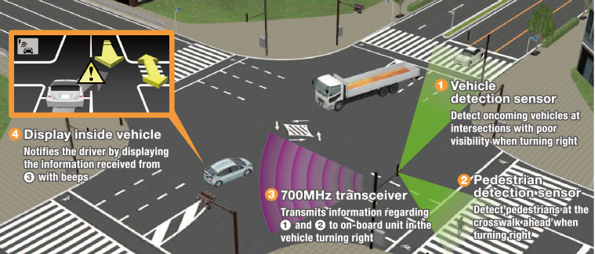
Vehicle-to-Infrastructure Communication
ARIB STD-T109 700MHz BAND ITS
Right-turn collision prevention system（ ）
Crossing pedestrian recognition enhancement system（ ）
This service uses roadside infrastructure to detect in real time and notify the driver of oncoming vehicles
and pedestrians at the crosswalk ahead when turning right.
1
3
4
2
3
4
Reference TOYOTA home page
http://www.toyota-global.com/innovation/intelligent_transport_systems/infrastructure/

Slide 13
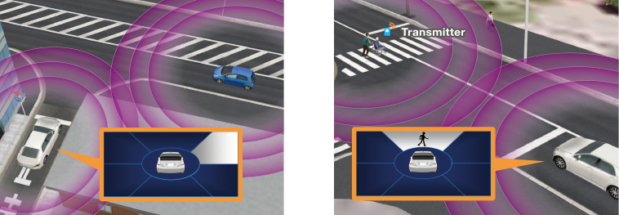
Vehicle-to-Vehicle Communication
Vehicle-to-Pedestrian Communication
Crossing collision prevention system
This service uses direct communication between
vehicles to exchange
Pedestrian existence advisory system
The vehicle communicates with terminals (transmitters) which are carried by pedestrians to notify the driver of Pedestrians, including children, elderly persons and other road users in.
Sales of vehicles equipped with “700MHz band ITS connect” from October 2015
CROWN
Lexus RX
PRIUS
PRIUS PHV
Reference TOYOTA home page

Slide 14
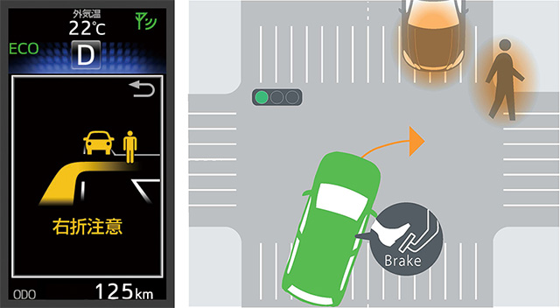
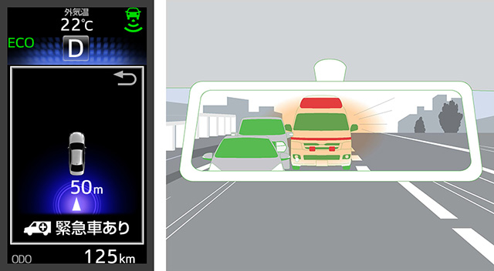
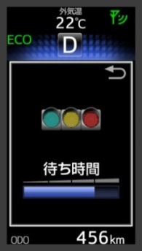
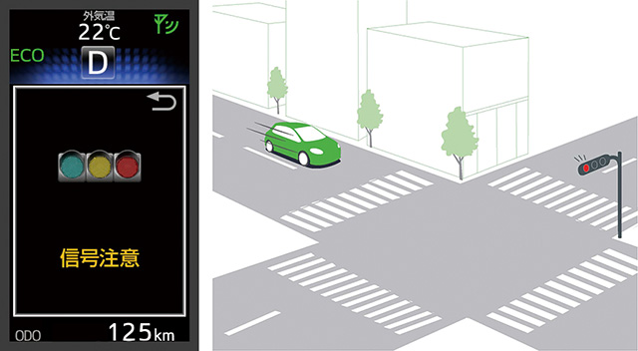
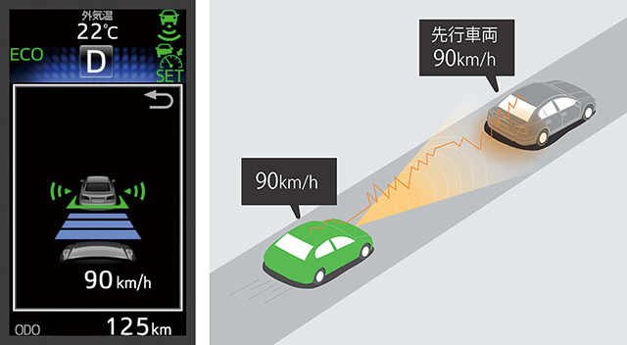
Right-turn Collision Caution
Emergency Vehicle approach notification
V 2 I
V 2 V
V 2 I
V 2 V
Signal Change Timer
Red Light Caution
Communicating Radar Cruise Control （CACC）
Signal Change Advisory
Reference TOYOTA home page

Slide 15
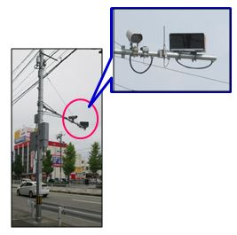
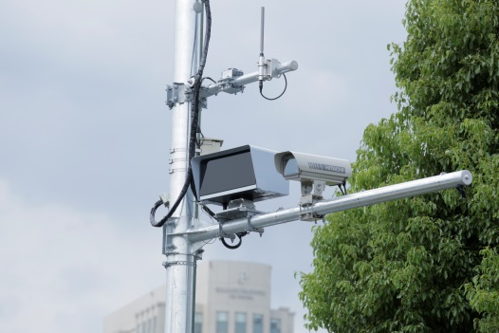
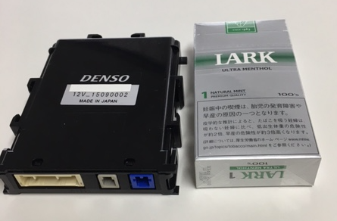
700MHz band Roadside Units
700MHz Antenna
Vehicle/ Pedestrian
detection sensor
700MHz band OBU（On Board Unit）
Shark fin Antenna
(Omni pattern Antenna)

Slide 16
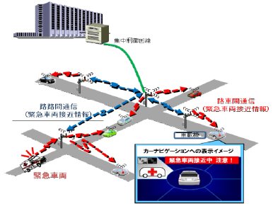
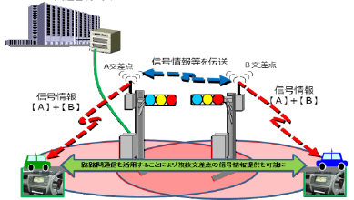
Enhancement of ITS Connect services
Addition of Infrastructure-to-Infrastructure Communication (700MHz)
(1) Broad provision of approaching emergency vehicle
(2) Broad provision of traffic signal information (from multiple intersection)
Traffic control center
Traffic control center
Exchanging
Traffic signal
information
Intersection A
Intersection B
Traffic signal
information
[A+B]
Traffic signal
information
[A+B]
Emergency vehicle
approaching alert
(I⇒V)
Emergency vehicle
approaching alert (V⇔V)
On-vehicle device
Intormation provision from multiple intersection
Display image
Emergency
vehicle
(3) Failure resistant
Current system
I to I communication added system
Traffic control center
Traffic control center
Traffic control center
Traffic control center
Traffic signal
information
Line failure
Traffic signal
information
Line failure
Secondary
line
Disconnection
Disconnection
Main line
Interlocking
Interlocking does not work
Interlocking
Interlocking
ARIB STD-T109 700 MHz BAND INTELLIGENT TRANSPORT SYSTEMS （New Revision Date：July 27, 2017）

Slide 17
Ambulance presence notification
Ambulance presence notification
・Vehicle position, speed,
Progressing direction
・emergency transfer
(siren and Warning lamp)
Effect of shortening transport time by ITS connect
Expected to reduce emergency vehicle accidents
＜Confirm effect on ambulance＞
ITS Connect
ambulance
ITS Connect General vehicle
(１) Questionnaire period
March 13,2017 ～ March 24,2017
(２) Number of people
159 people (Driver only)
＜Opinions sent to the questionnaire＞
・Vehicles stopping at shoulder are coming out.
・Since ITS Connect is indispensable for safe driving, I want to be installed in all vehicle.

Slide 18
Web questionnaires given to ITS connect users(Tokyo, Aichi)
“Emergency Vehicle existence notice Highly appreciated”
100.0
：Tokyo
：Aichi
：Total
80.0
60.0
Answer that it was helpful （%）
40.0
20.0
0.0
Apps
in general
Red Light
Caution
Emergency
Vehicle
approach
notification
Apps
in general
Red Light
Caution
Right-turn Collision Caution
Signal Change
Timer
CACC

Slide 19
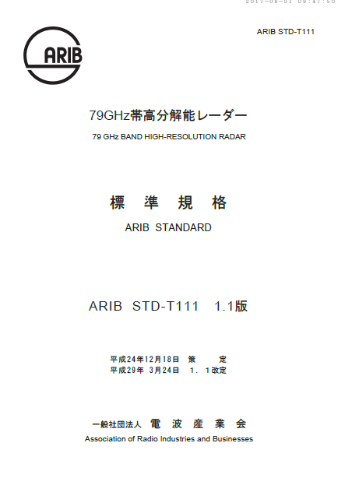
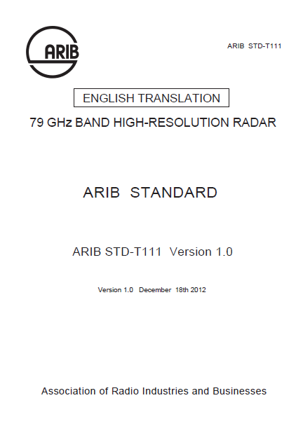
Activities of 76/79GHz band Radar
ARIB STD-T48 76GHz band Radar
ver.2.2 3. December 2015 76.0GHz～77.0GHz：occupied bandwidth （500MHz ⇒1GHz）
ver.2.1 30. November 2005 rule revision （ITU ⇒ MIC）
ver.2.0 2. February 1999 add to 76.0GHz～77.0GHz
ver.1.0 26. December 1995 60.0GHz～61.0GHz
ARIB STD-T111 79GHz band Radar
ver.1.1 24. March 2017 Designated frequency 77.0GHz～81.0GHz （Reflects WRC15）
ver.1.0 18. December 2012 Designated frequency 78.0GHz～81.0GHz
（New Revision Date：March 24, 2017）
（update “E/T” Schedule is next October）
Version 1.1
ARIB STD-T111
79GHz band Radar
ENGLISH TRANSLATION

