Slide 1
Document No: | GSC-19_009
Source: | ISO and IEC
Contact: | Henry Cuschieri, Gilles Thonet, Jim MacFie
Agenda Item: | 2.11
Guest Presentation by ISO and IEC
Henry Cuschieri, ISO
Gilles Thonet, IEC
Jim MacFie, JTC 1

Slide 2
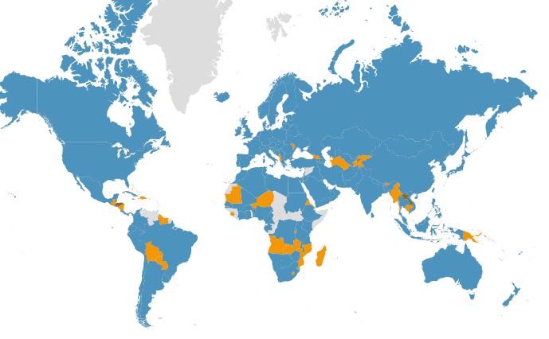
ISO in figures (2015)
162 members
100 000 experts
238 technical committees (521 SCs)
19 meetings every day
4700 active projects
1 852 registered in 2014
2 506 new projects vs. revisions
1 468 publications in 2014
20 493 publications in catalogue

Slide 3
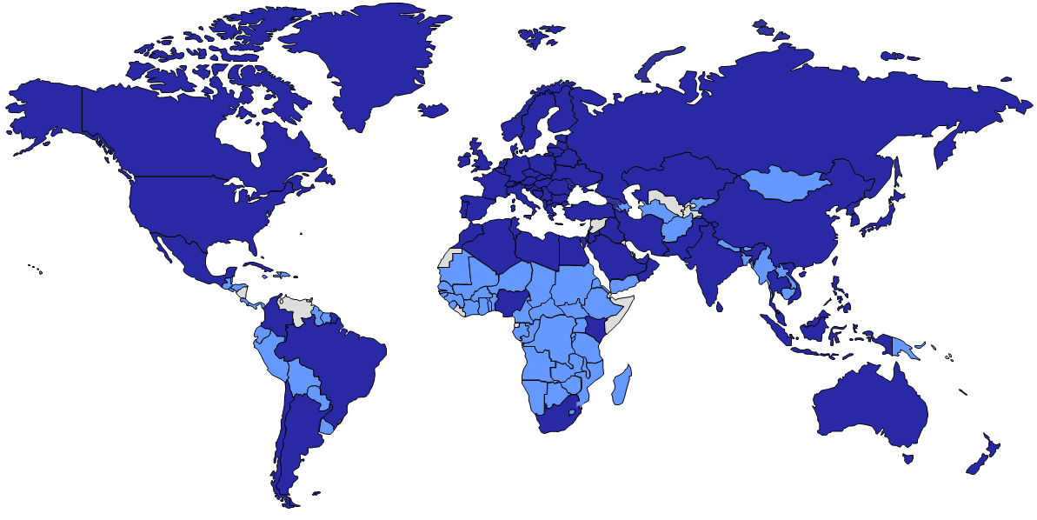
IEC in figures (2015)
World’s leading provider of International Standards and Conformity Assessment Systems in Electrotechnology
83 Members + 83 Affiliates
174 Technical Committees (> 90% led by Industry)
15 000 Experts
> 7’000 International Standards
4 Conformity Assessment Systems
IECEE (Electrical & Electronic Equipment)
IECEx (Hazardous Environments)
IECQ (Electronic Components)
IECRE (Renewable Energy)
> 1 million Certificates issued
Geneva
Boston
Nairobi
Sao Paulo
Singapore
Sidney

Slide 4
ISO engagement with GSC
JTC 1
Information Technology
ISO/TC 68
Financial services
ISO/TC 20
Aircraft & space vehicles
ISO/TC 130
Graphic technology
ISO/TC 204
Intelligent transport systems
ISO/TC 204
Intelligent transport systems
ISO/TC 171
Document management applications
ISO/TC 268
Sustainable development in communities
ISO/TC 215
Health informatics
ISO/TC 46
Information
and documentation

Slide 5
IEC engagement with GSC
TC 46
SG 9 Communication Technologies
TC 8
TC 13
TC 86
Interconnections
SyC Smart Energy
TC 65
Communications for
Smart Grids & Smart Cities
Coordination across TCs on:
Use cases
Communication protocols
Networking architectures
Security
Regulatory aspects
Future trends …
TC 48
Industrial Communication Systems
SEG 1 Smart Cities
TC 57
TC 80
Maritime Radiocommunications
Radio
Transmitters
TC 103
SyC
AAL
Electro-medical Equipment
TC 62
TC 77
Electromagnetic Compatibility
Information Technology
CISPR International Special Committee on Radio Interference
Multimedia Systems
TC 100
JTC 1

Slide 6
Why GSC? Why now?
We are leaders in many sectors but communications is vast and we are not alone. Many organizations. All equal players.
ISO TMB and IEC SMB focus on maximum coordination, coherence of program of work and lack of duplication.
In many cases, your stakeholder experts are also our stakeholder experts. Greater coordination at organizational levels.
Support GSC principle: “Within GSC, all member organizations have equal rights”

Slide 7
ISO/IEC Joint Technical Committee on Information Technology - Vision
Scope: International standardization in the field of Information and Communication Technology
Vision Statement
JTC 1 is a standards development organization where experts come together to develop worldwide ICT standards for business and consumer applications
JTC 1 provides the environment for integrating diverse and complex ICT technologies. These standards rely upon the core infrastructure technologies developed by JTC 1 complemented by specifications developed in other organizations.
System integration is a key role

Slide 8
ISO/IEC Joint Technical Committee on Information Technology - Mission
Focal point for globally recognized ICT standardization encompassing all technologies for the capture, storage, retrieval, processing, display, representation, organization, management, security, transfer, and interchange of data and information
Develop, maintain, promote, and facilitate ICT standards required by global markets meeting business and user requirements, including:
Telecoms and information exchange between systems (SC 6)
Interconnection of IT equipment (SC 25)
Security techniques (SC 27)
Coding of audio, picture, multimedia and hypermedia information (SC 29)
User interfaces (SC 35)
Cloud computing and distributed platforms (SC 38)
Sustainability for and by Information Technology (SC 39)
Big data (working group 9)
Internet of things (working group 10)
Smart cities (study group 1)

Slide 9
Conclusion
ISO and IEC each seek to join the GSC
Each group will bring different stakeholder perspectives
JTC 1 will contribute through both groups

