Slide 1
Document No: | GSC-19_301 (Rev.1)
Source: | ITU
Contact: | Colin Langtry / Peter Ashwood-Smith
Agenda Item: | 5.2
Brief update on ITU activities related to IMT-2020
Colin Langtry, Chief, Study Groups Department, BR Peter Ashwood-Smith, Chair, ITU-T FG IMT-2020

Slide 2
ITU-R activities on IMT-2020
WP 5D has established the overall roadmap for the development of IMT-2020
A draft Resolution about the use of the name IMT-2020 is being submitted to the Radiocommunication Assembly for consideration.
WP 5D has developed the “Vision” for IMT-2020 systems and defined the overall goals, process and timeline. Study Group 5 in July will present this to the ITU membership for approval.
WP 5D together with its partners (ITU membership, mobile industry, SDOs, etc…) agreed to apply the same open process that was used for the development of IMT-2000 and IMT-Advanced.

Slide 3
5G Related Aspects in ITU-R Working Party 5D - Key Current Milestones
Draft New Recommendation ITU-R M.[IMT-Vision] “Framework and overall objectives of the future development of IMT for 2020 and beyond” has been completed by WP 5D and forwarded to ITU-R Study Group 5 in July for the final steps of approval.
Draft New Report ITU-R M.[IMT.ABOVE 6 GHz] “The technical feasibility of IMT in the bands above 6 GHz” has been completed by WP 5D and forwarded to ITU-R Study Group 5 for the final steps of approval.

Slide 4
Key themes on the Timeline & Plan for “IMT-2020”
Working Party 5D will essentially use the same process successfully utilized in the development of IMT-Advanced.
In the 2016-2017 time-frame, WP 5D will define the performance requirements and evaluation criteria and methodology for the assessment of the new IMT terrestrial radio interface(s).
The timeframe for proposals will be focused in 2018 (late 2017 to mid-2019).
In 2018-2020 the evaluation by independent external evaluation groups and definition of the new radio interfaces to be included in IMT-2020.
A workshop in late 2017 will allow for an explanation and discussion on performance requirements and evaluation criteria and methodology for candidate technologies for IMT-2020.
IMT-2020 is planned to be completed in 2020 when a draft new ITU-R Recommendation with detailed specifications for the new terrestrial radio interfaces of “IMT-2020” will be submitted for approval.
Enhancements and additional capabilities for IMT-2020 are expected to start in 2021.

Slide 5
Overview of timeline for IMT development and deployment

Slide 6
WP 5D Timeline for “IMT-2020” related to the Terrestrial Radio Interface Technology and Systems Source 5D/929 Att 2.12, Figure 1, Meeting #21 (27 Jan – 4 Feb 2015)
July 2015
2014
2015
2016
2017
2018
2019
2020
WRC-15
WRC-19
5D
#18
5D
#19
5D
#20
5D
#21
5D
#22
5D
#23
5D
#24
5D
#25
5D
#26
5D
#27
5D
#28
5D
#29
5D
#30
5D
#31
5D
#32
5D
#33
5D
#34
5D
#35
5D
#36
Report Technology trends (M.2320)
Technical Performance Requirements
Proposals “IMT-2020”
Evaluation
Report IMT feasibility above 6 GHz
Evaluation criteria & method
Consensus building
Recommendation Vision of IMT beyond 2020
Outcome & Decision
Requirements, Evaluation Criteria, & Submission Templates
Modifications of Resolutions 56/57
Workshop
“IMT-2020” Specifications
Circular Letters & Addendum
Background & Process
Note: While not expected to change, details may be adjusted if warranted.
6

Slide 7
“IMT-2020” Standardization Process
Development Plan
Market/Services View
Technology/
Research Kick Off
Vision - IMT for 2020
Name
< 6 GHz Spectrum View
Process
Optimization
Spectrum/Band
Arrangements
Technical
Performance
Requirements
Evaluation Criteria
Invitation for Proposals
> 6 GHz Spectrum View
Proposals
Evaluation
Consensus
Building
Spectrum/Band
Arrangements
Decision & Radio Framework
Detailed IMT-2020 Radio Specifications
Future Enhancement/
Update Plan &
Process
2012-2015
2016-2017
2018-2019
2019-2020
Setting the stage for the future:
vision, spectrum, and
technology views
Defining the
technology

Slide 8
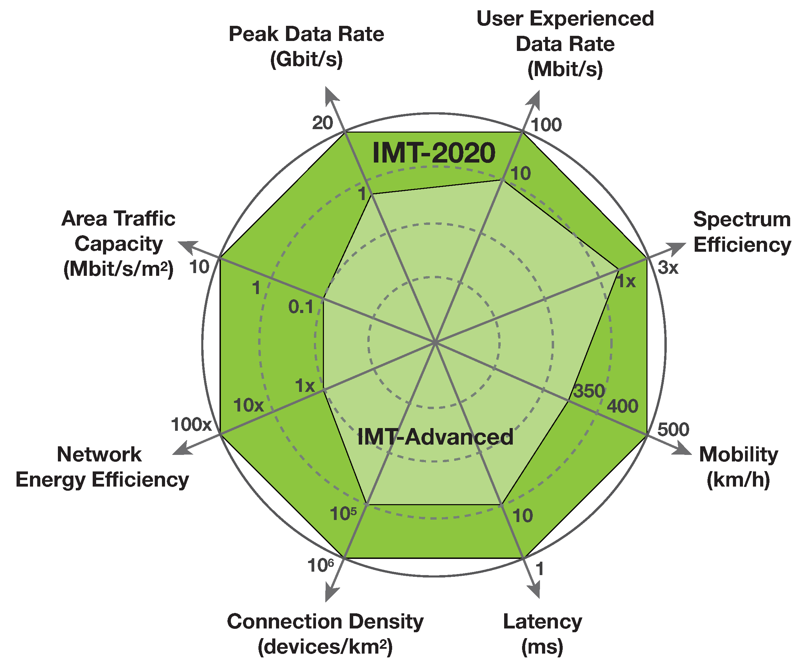
8 Key Capabilities of IMT-2020

Slide 9
Coordination with activities in External Entities engaged in 5G developments
Liaisons dispatched from WP 5D in February 2015 to the following entities provided the detailed time plan and requested certain information:
3GPP,
3GPP2,
4G Americas,
5G Infrastructure Public Private Partnership (Europe),
5G Innovation Centre,
APT Wireless Group,
Fifth Generation Mobile Communications Promotion Forum (Japan),
ARIB,
ATIS,
CCSA,
CDG,
ETSI,
EU METIS Project,
GSMA,
IEEE,
IMT‐2020 Promotion Group (China),
ITRI,
NGMN,
NYU Wireless,
Telecommunications Standards Development Society (India),
TIA,
TTA,
TTC,
UMTS Forum,
WiMax Forum,
Wireless World Research Forum
…
We welcome any other interested partner
9

Slide 10
ITU-T Focus Group on IMT-2020 - Background
Launched in May 2015 by ITU-T’s lead study group on Future networks including cloud computing, mobile and next-generation networks (SG13)
Scope: non-radio aspects of 5G
Focus Group objectives:
Identify the standardization needs of the ‘wireline elements’ of 5G networks
Be launching point for ITU-T’s contribution to IMT-2020 standardization
Align deliverables with those of ITU-R

Slide 11
Structure and participation
Diverse participation and management team
Vendor (Huawei Technologies)
Operators (China Mobile, NTT, Telecom Italia)
R&D (ETRI Korea)
Focus Groups are open to participation by any interested party
Technical contributions invited on “How should 5G function as a whole?” to identify gaps, overlaps and differences in views
Major challenges are the broad scope and of course how far too look into the future.

Slide 12
Ambitious schedule
Face-to-Face Meetings
8-9 June 2015, San Diego, US
13-14 July 2015, Geneva, CH
21-24 September 2015, Turin, IT
tbc: 27-30 October 2015, Beijing, CN
Report back to ITU-T SG13 in December 2015
More information at http://itu.int/en/ITU-T/focusgroups/imt-2020/
Participant affiliations
(60)
(60)

Slide 13
Some IMT-2020 “5G” challenges highlighted in contributions to first FG meeting
10 years battery (IOT)
M2M ultra low cost
10-100x more devices
> 10GBps peak data rates
100Mpbs wherever needed
1ms latency
Millions of users per square km
Terabits per square km
Virtualized infrastructure
Multi tenancy
Low cost operations/mgmt
Orch/Mgmt
SDN/NFV
IP, ICN?
MPLS/SR?
Packet?
Optical?
WIRE-LINE VIEW
RADIO VIEW
(including ITU-R IMT-VISION)
Notes:
Focus Group will align these targets with Recommendation ITU-R M.[IMT.VISION].

Slide 14
Possible IMT-2020 “5G” wire-line architecture
8
Optical front-haul (DWDM?)
Packet Optical backhaul (DWDM?)
Distributed CRAN for baseband, split?
TSDN control front, backhaul, mm-uWave
NFV in DCs for all packet applications
SDN control of DC/NFV fabric
Hierarchical SDN/Orch for overall control
Applications on top of orchestration
ICN etc. data-plane for IOT
Flexible B/W assignment
Flexible compute assignment
Flexible disaster recovery
Latency control/BW density control
Optimum resource assignments
Optimum content placement
APP
APP
…………………
APP
1
2
ORCHESTRATION
7
((( )))
3
((( )))
NFV/DC
5
NFV/DC
4
((( )))
9
5
2
X
X
5
((( )))
9
X
6
4
SDN
TSDN
3
C-RAN
6
9
C-RAN
3
((( )))
7
X
((( )))
((( )))
X
X
X
9
8
X
X
NFV/DC
9
((( )))
((( )))
((( )))
9
)))))))))))))))))))))))))) ((((((((((((((((((((((((((
1
((( )))
IP control
Packet/optical/DWDM/OTN
uWave/ mmWave
RF
)))))))))))))))))))))) ((((((((((((((((((((((
(((( ))))
Notes:
Initial topics identified / agreed in first meeting re-appear in this chart:
Overview of use cases and terminology
High level technology targets
High level architecture
E2E QoS
Next generation network technology (e.g., ICN, CCNx, …)
Network softwarization
Fronthaul & Backhaul (e.g., RoF)
Other topics of interest identified in first meeting:
Challenges and enablers for 5G
Integrated management of all segments (mobile-transport) and technology
Smooth Transition Model
Security aspects

Slide 15
Sub-topics (so far)
# | Topic | Contribution # addressing the topic | Contributing organisations (1st meeting) | Champion
1 | Overview of use cases and terminology | I-030, [IMT.VISION] I-016, I-024 | TSB, ETRI, Ericsson | NEC
2 | High level technology targets | I-030, I-014.1, I-14.2, I-015, [IMT.VISION] | U Tokyo / TTC, China Mobile | [Vodafone]
3 | High level architecture | I-008, I-009, I-021, I-022, I-028 | ETRI, KT, SKT, China Mobile | ETRI
4 | E2E QoS | I-009, I-010, I-011, I-012, I-028 | KT, SKT | KT
5 | Next generation network technology (e.g., ICN, CCNx, …) | I-032, I-033 | Cisco, PARC | Cisco
6 | Network softwarization | I-028 | 5GMF, KT, SKT | 5GMF / U Tokyo
7 | Fronthaul & Backhaul (e.g., RoF) | I-018, I-019, I-026 | ITU-T SG15, Huawei, 5GMF / U Tokyo | Huawei
 | Challenges and enablers for 5G | I-025 | Huawei
 | Integrated management of all segments (mobile-transport) and technology | I-14.2, I-031, I-008, I-009 I-020, I-021 | TTC, Huawei , KT, China Mobile, ETRI
 | Smooth Transition Model | I-033, I-029, I-027 | CISCO, ALU, STC
 | Security aspects | I-014.1 | TTC

Slide 16
Conclusions
The development of IMT-2000 and IMT-Advanced has been an open, collaborative process involving the ITU’s Member States, national and regional standards development organizations, equipment manufacturers, network operators, academia and industry fora
This collective achievement is serving as the "model" for IMT-2020 development
Frequent interactions between ITU, SDOs and other partners (Operators, Industries, Academia, Regulators, etc...) using coordinated work plans will be required to achieve this aim by 2020
Encouraging feedback on open Focus Group on IMT-2020 wire-line aspects
Launch of gap analysis and work on wire-line technologies supporting ‘5G’

Slide 17
Thank You

