Slide 1
Document No: | GSC-19_307
Source: | CCSA
Contact: | Hu Jinling, hujinling@catt.cn
Agenda Item: | 5.8
Research Activities of IMT-2020 (5G) Promotion Group
Hu Jinling, CCSA

Slide 2




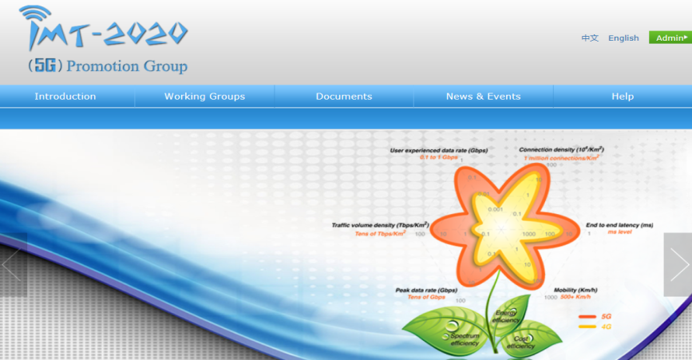






IMT-2020 (5G) Promotion Group Structure
Expert Committee
Secretariat
Requirement WG
Spectrum WG
ITU WG
Network
Tech. WG
Wireless
Tech. WG
IEEE WG
IPR WG
3GPP WG
IMT-2020 (5G) Promotion Group is the major platform to promote 5G research in China
The Group has 56 members including the main operators, vendors, universities, and research institutes in China.
Official website: www.IMT-2020.cn
Notes:
This slides shows the structure of
IMT-2020 (5G) Promotion Group is the major platform to promote 5G research in China, it is supervised by expert committee, which is lead by Ms cao
There are 8 WGs, including ……
The Group has 56 members

Slide 3



IMT-2020 PG Activities
5G summits in every year
  2013: 5G Vision
  2014: 5G Objective & Capability
  2015: 5G Technology Architecture
Summits
IMT-2020 PG will be more positive and open to co-work with the global industry
4 whitepapers published
  5G Vision and Requirements (May. 2014)
  5G Concept (Feb. 2015)
  5G Wireless Technology Architecture (May. 2015)
  5G Network Technology Architecture (May. 2015)
5G Research Platform
5G PPP: Completed the draft MOU which will be signed soon.
5G Forum: Hold two joint meetings per year, and launched two research projects in early 2015.
NGMN: Established the liaison mechanism, and share the research progress of 5G
International Cooperation
Whitepapers
Notes:
Plan to hold a 5G summit every year in late May to facilitate 5G development and global collaboration.
IMT-2020 PG will be more positive and open to co-work with the global industry.
Preliminarily discuss 5G vision, requirements & technologies
Identify 5G vision & requirements and clarify 5G objective & capability
Propose 5G wireless and network technology architectures
5G PPP: Completed the draft MOU which will be signed soon.
5G Forum: Hold two joint meetings per year, and launched two research projects in early 2015.
NGMN: Established the liaison mechanism, and share the research progress of 5G

Slide 4

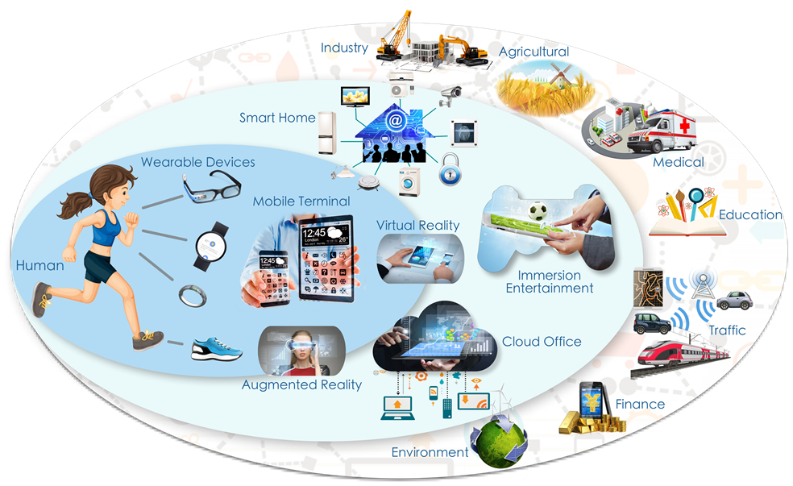
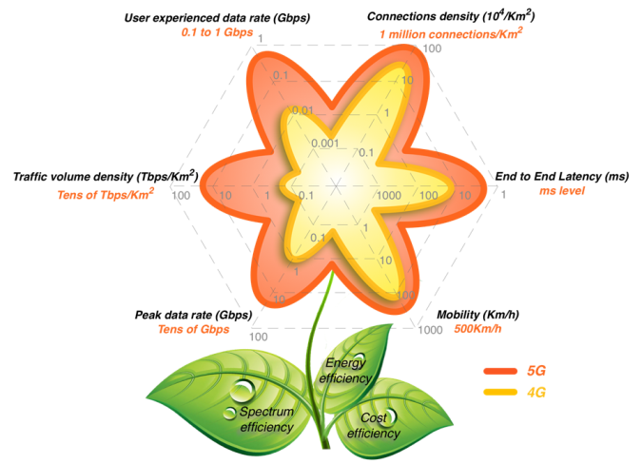
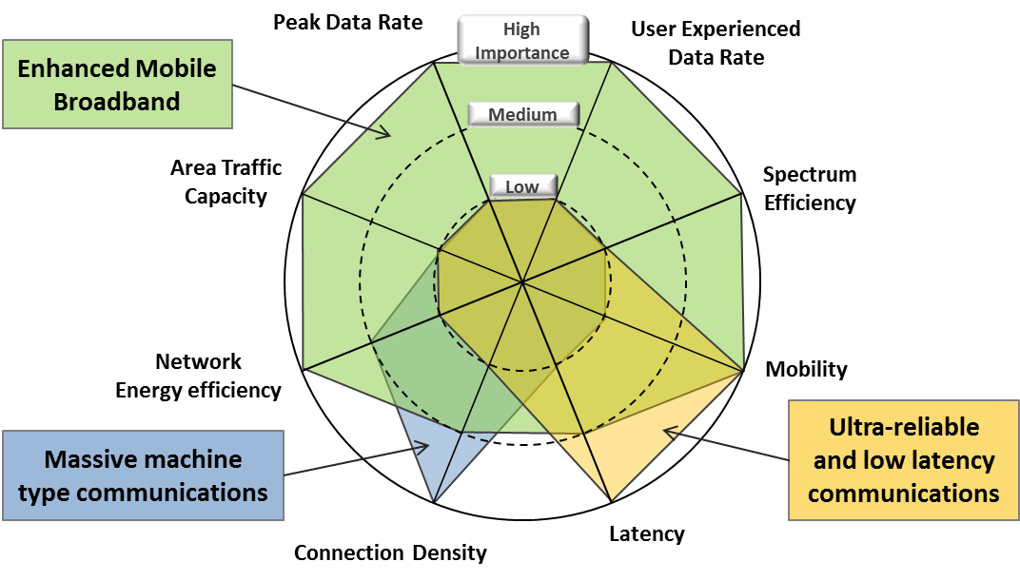
Research Progress: 5G Vision and Requirements
Identified 5G vision and requirements
Promote global consensus on 5G vision
Main Drivers: Mobile internet and Internet of Things
5G Vision: Information a finger away, everything in touch
5G Key Capability ---- 5G Flower
ITU IMT-2020 vision has been determined in ITU-R WP5D #22.

Slide 5
5G Concept and Key Technologies
5G Concept = “A Core KPI + A Group of Key Technologies”
The core KPI
Gbps User Experienced Data Rate
Traffic volume density
E2E Latency
Spectral efficiency
Mobility
Other KPIs
Connection density
Peak data rate
Energy efficiency
Key technologies
Massive MIMO
Ultra-Dense Network
Novel Multiple Access
All-Spectrum Access
New Network Architecture
F-OFDM
Polar codes
FBMC
Network coding
Flexible Duplex
Full duplex
M-ary LDPC
D2D
Other technologies

Slide 6
5G Air Interface Technical Framework
A unified, flexible, and configurable framework is needed to better balance the performance for diverse scenarios and the implementation cost for standardization & industry.
Scenarios & KPIs
Available bands
Equipment capability
Cost requirement
……
Requirement Sets
SCMA/PDMA/MUSA
Massive MIMO
Ultra-dense network
All-spectrum access
F-OFDM/UFMA/FBMC
Flexible/Full duplex
Polar codes
……
5G Air Interface Technical Framework
Frame structure
Channelization
Protocol
Multiple access
Modulation
Coding
Duplex
Waveform
Antenna
Configure the related technical modules and parameters
Able to support various scenarios, even including the future possible new scenarios
Optimized Solutions

Slide 7
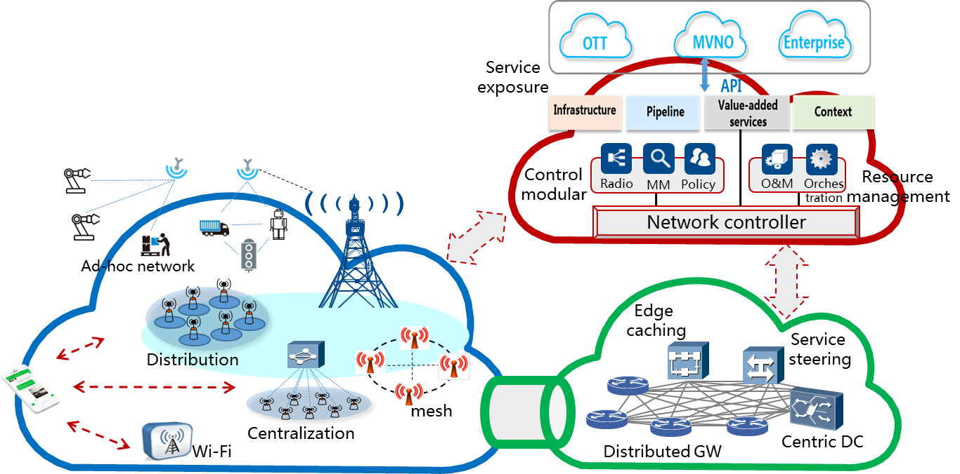
5G Network Technology Architecture
Driven by requirements and new IT technologies, 5G network can be re-constructed into three-planes based architecture.
Requirements driven
Three-planes based 5G network architecture
5G scenarios and KPI
Operation enhancement
Smooth evolution consideration
control
plane
Technologies driven
NFV
separation of software and hardware ，provide flexible infrastructure platform
SDN
separation of control function and forwarding function ，impact on architecture design
Access plane
Forwarding plane

Slide 8
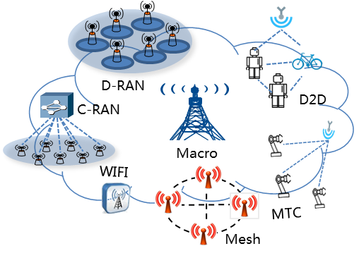
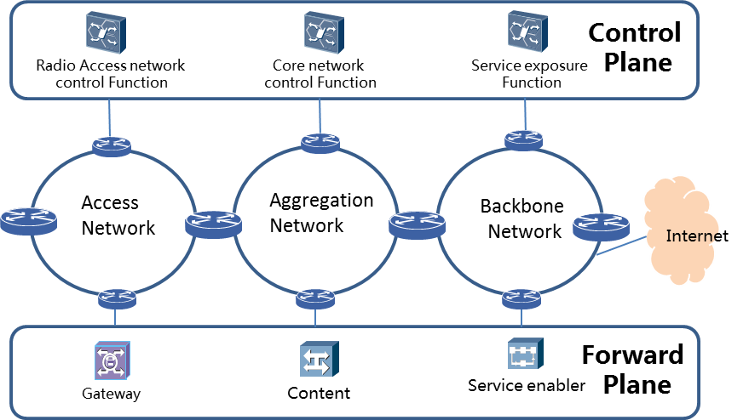
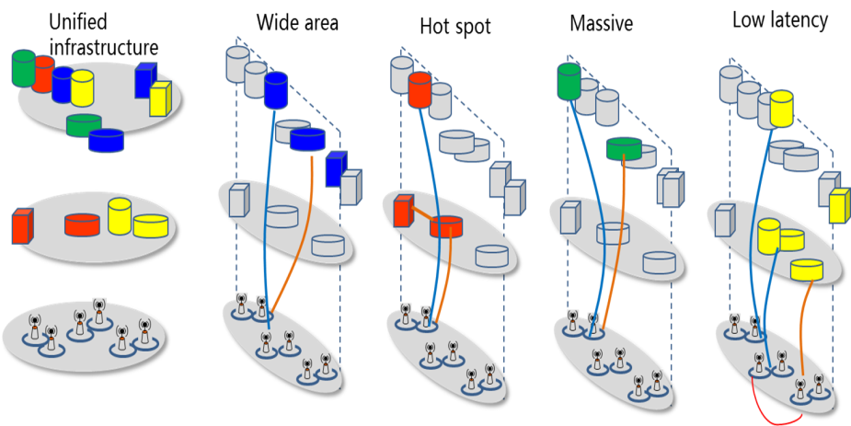
5G Network Technology Features
The innovative features of 5G network can be summarized as diversified RAN networking, flexible function deployment, and on-demand slicing.
Diversified RAN networking
Flexible function deployment
On-demand slicing
Plug-in
One Logical Architecture, maps to multiple Service Slices.
Orchestrating network resource on-demand for each slice.
Isolated slices ensure efficiency, elasticity, security and robustness
Support diverse networking mode: C-RAN, D-RAN, mesh,D2D, BS plug-in
To fit different 5G wireless scenarios
Modularized Network function
Network functions can be deployed flexibly based on NFV platform

Slide 9

Potential Candidate Bands for 5G
Low-frequency bands below 6GHz are always necessary for IMT
2015
High-frequency bands within 6-100 GHz can be introduced in 2019 and beyond
2019
Several potential candidate bands within 6~100GHz are selected.
With different channel properties and coexistence situations.
Studies on channel measurement, modeling and coexistence are ongoing work.
To promote establishing a new agenda item in WRC-19.
Exploit the bands identified for IMT in the Radio Regulations, including 450-470MHz, 698-806MHz, and 3400-3600MHz
0
450
MHz
2G/3G refarming
3GHz
3.3
~
3.4
3.4
~
3.6
4.4
~
4.5
4.8
~
4.99
6GHz
25-30
40-50
71-76
81-86
100GHz
Get new bands below 6GHz in WRC-15 AI 1.1

Slide 10
Work Plan for 2015-2016
Technology Study
  5G wireless and network technical schemes
  Evaluation of 5G system schemes & key technologies
Standardization
  5G standard framework and time plan
  The requirements of RAN and SA
  Standardization of 5G key wireless and network technologies
Requirements
  5G evaluation scenarios, minimum requirements, and evaluation methodology
Spectrum
  Promote low-frequency bands for IMT systems in WRC-15
  Narrow the frequency range of candidate bands above 6 GHz
Trial Promotion
  Verification of 5G key technologies and early standards
  Demos of 5G-based new services and applications, especially in IoT and vertical industries

Slide 11
THANK YOU!

