Slide 1
Document No: | GSC-19_306a
Source: | European Commission
Contact: | Dr. Thibaut Kleiner
Agenda Item: | 5.7
5G Approach in the EU
Dr Thibaut Kleiner
Head of Unit Network Technologies
DG CONNECT – European Commission

Slide 2
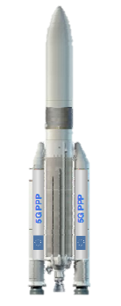
Phased Approach planned in the EU
Phase III (2017-2018)
Large-scale trials
Phase II (2016-2017)
System optimisation Phase I (2014-2015)
Research (I) work
Ignition phase (2012-2013)
Project sMETIS, 5GNOW, iJOIN, TROPIC, Mobile Cloud Networking, COMBO, CROWD, MOTO, PHYLAWS..

Slide 3
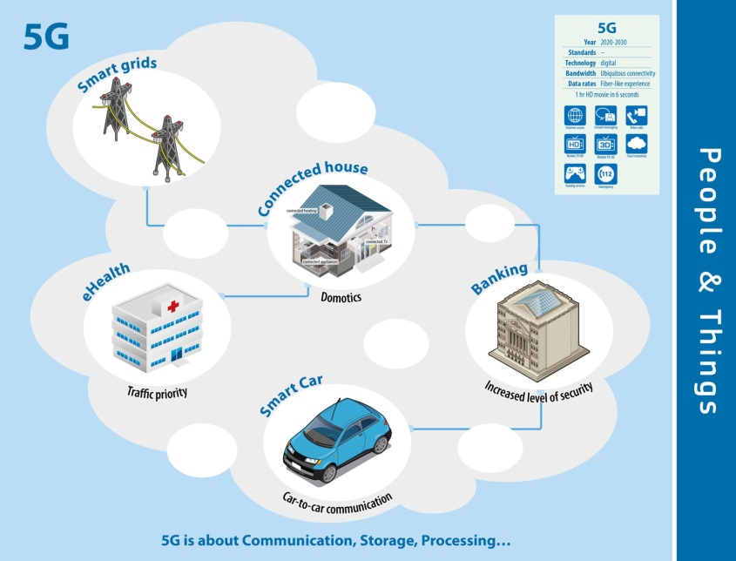
5G ≠ 4G + 1
Digital infrastructure used by ALL
Need to convince vertical industries to embrace 5G (not a trivial issue!)
Building trust = avoid deceptive announcements!
Regulatory and spectrum requirements
Standardization and harmonization
at a global level

Slide 5
Time to agree about what 5G is!
Joint Agreements between leading regions
Need to converge on common 5G vision
Global meeting on 5G vision and policy
20 October 2015, Lisbon (during ICT 15)
Upon invitation by Commissioner Oettinger
Time-frame: 5G will not be available in 2018
Trials and demos maybe, but no complete 5G standard before 2020

Slide 6
Call a cat a cat
5G

