Slide 1
Document No: | GSC-19_305a (Rev.2)
Source: | 5GMF
Contact: | Takaharu NAKAMURA, Fujitsu, ARIB
Agenda Item: | 5.6 Strategic Topic #3: IMT-2020/5G
5GMF activities for 2020 and beyond in Japan
Takaharu NAKAMURA, Fujitsu, ARIB
n.takaharu@jp.fujitsu.com

Slide 2
Contents
Organization of 5GMF
On going studies in 5GMF
(Separate presentation for the NW architecture)
Action plan towards ‘5G’
Collaboration activities
Summary

Slide 3
1. Organization of 5GMF

Slide 4
Roadmap towards implementation of 5G mobile in Japan
In 2012 2013
2014 2015 2016 2017 2018 2019 2020 2021
Promoting
Body
Rugby
World Cup
ARIB
2020 and Beyond Adhoc
Tokyo Olympic / Paralympic Games
Established in Sep. 30th
Activities by The Fifth Generation Mobile Communications Promotion Forum(5GMF)
R&Ds
Giving strategic guidance on R&Ds, standardization, international cooperation & public relations
R&Ds on 5G through Industry-Academic- Government Cooperation
World’s
first 5G implemen- tation
Investigation into potential spectrum for 5G through R&D activities
Amend regulations, allocating Spectrum, deploy base stations, etc
International
Affairs
Examine 5G Requirements and Service image Propose & Evaluate Interface
●ITU-R Report IMT.FUTURE TECHNOLOGY TREND
ITU .
World Radio Conf.
(WRC-12)
●ITU 5G Workshop
●ITU-R Rec. IMT.VISION
World Radio Conf.
(WRC-15)
5G Standardization
Activities
World Radio Conf.
(WRC-19)
Secure additional spectrum to 4G Discussion of spectrum for 5G
Possibilities of
identification
of 5G bands
Study on spectrum for 5G
as a preparation of WRC-18 with attention to international harmonization
Translated from “Final Report from the Radio Policy Vision Council", Ministry of Internal Affairs and Communications, Japan, December 2014.

Slide 5
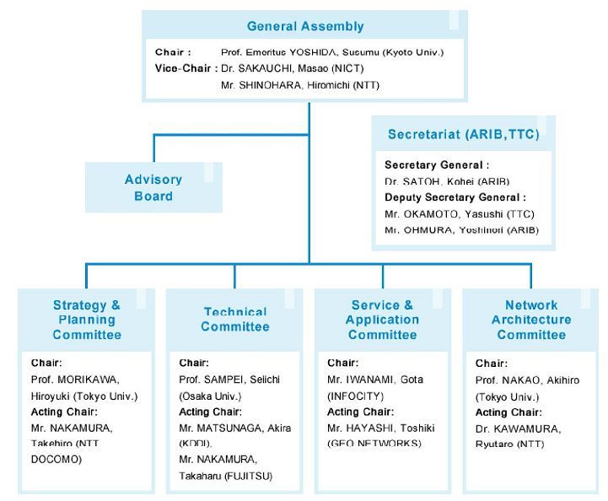
Organizational Structure of the 5GMF
http://5gmf.jp/en/outline/organization/

Slide 6
































Members
Ordinary member:61, Individual member:14, Special member: 3 (MIC, ARIB, TTC)
Total: 78 members (as of 1 July 2015) http://5gmf.jp/member/

Slide 7
2. On going studies in 5GMF

Slide 8

Market and User trends
Industries, Healthcare, Infrastructures
Business office, education,
social lives, shopping
Social security, disaster prevention/protection, welfare, ecology
"Mobile Communications Systems for 2020 and beyond", ARIB 2020 and Beyond Ad Hoc Group White Paper, October 2014.

Slide 9

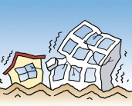
Use case example: Socio-economic satisfaction
Transportation
More efficient and safer
Navigation
Autonomous driving
Richer contents Multiuser UHD teleconference, Purchase enriched video, music, book
Health care
Remote medical examination
5G will enhance the socio-economic satisfaction
House
Home security
Disaster relief
Prediction
Robustness to disaster
Consumer electronics
Remote control
Education
Distance learning
Virtual experience
Safety and lifeline system
Collision avoidance
Rescue
(Distress, Accident, etc.)
"Mobile Communications Systems for 2020 and beyond", ARIB 2020 and Beyond Ad Hoc Group White Paper, October 2014.

Slide 10
Framework of ‘5G’
Dashed line indicates that the exact typical throughput associated with 5G RAN are not yet determined.
Normalized
Typical User
Throughput
[bps/device]
Higher throughput
5G RAN
x 100
Enhanced
-
x 1
New RAT(s)
Big Cell
Small Cell
IMT-Advanced
Coverage expansion
IMT-Advanced
Increase capacity
x 10⁻³
10⁻³
1
10³
User density
[10⁴devices/km²]
Isolated
Rural
Urban
Dense
Extreme
"Mobile Communications Systems for 2020 and beyond", ARIB 2020 and Beyond Ad Hoc Group White Paper, October 2014.

Slide 11
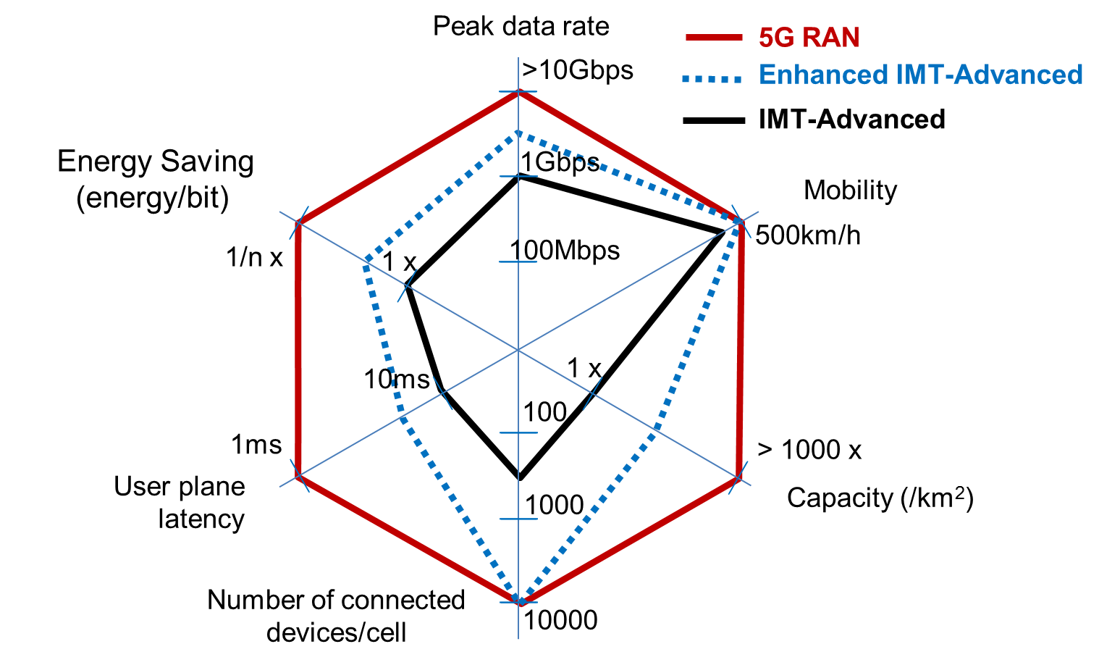
Maximum system capability example
"Mobile Communications Systems for 2020 and beyond", ARIB 2020 and Beyond Ad Hoc Group White Paper, October 2014.

Slide 12
Example of Framework for 5G
Video Streaming
User throughput
Virtual Reality
M2M Communication
(eg. sensors)
High
Autonomous driving
(eg. Collision avoidance)
Low
Latency
Mobility
High
Low
Low
High
"Mobile Communications Systems for 2020 and beyond", ARIB 2020 and Beyond Ad Hoc Group White Paper, October 2014.

Slide 13
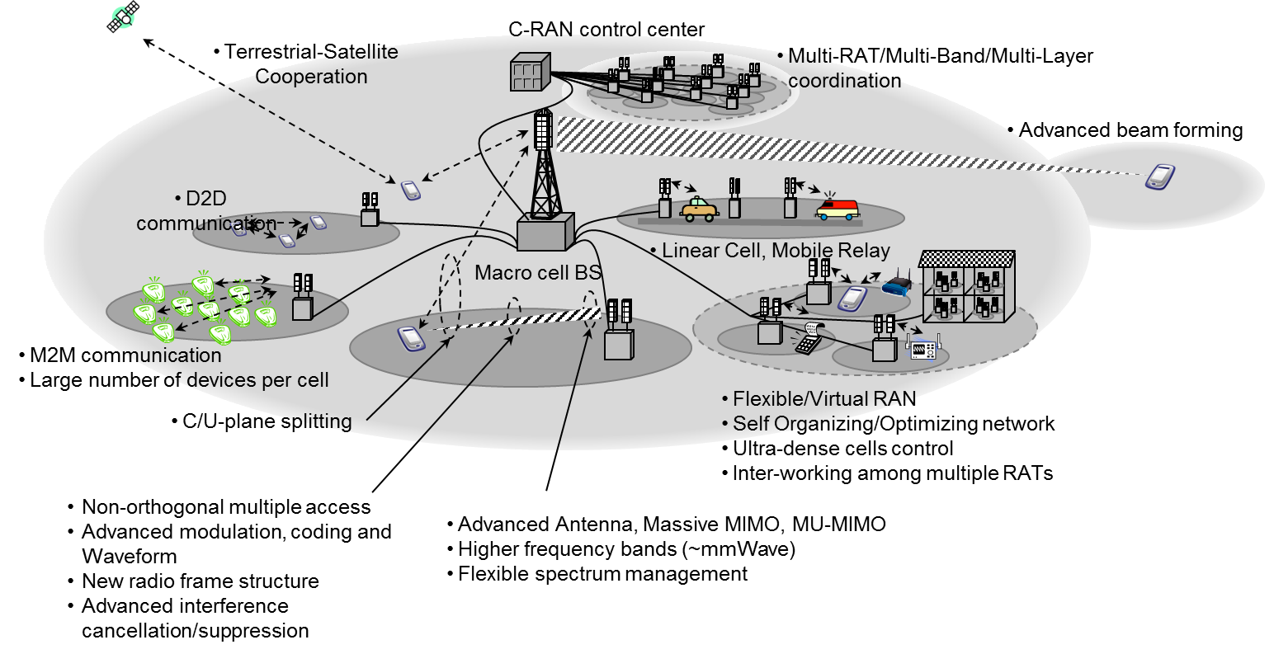
Radio Access Technologies for 5G mobile
"Mobile Communications Systems for 2020 and beyond", ARIB 2020 and Beyond Ad Hoc Group White Paper, October 2014.

Slide 14
3. Action plan towards ‘5G’

Slide 15
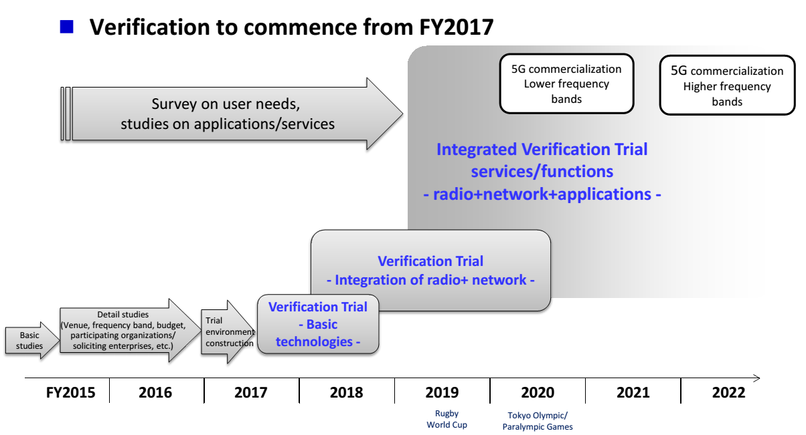
Time plan of Proof of 5G mobile concept
http://5gmf.jp/PDF/poc_1506_e.pdf

Slide 16
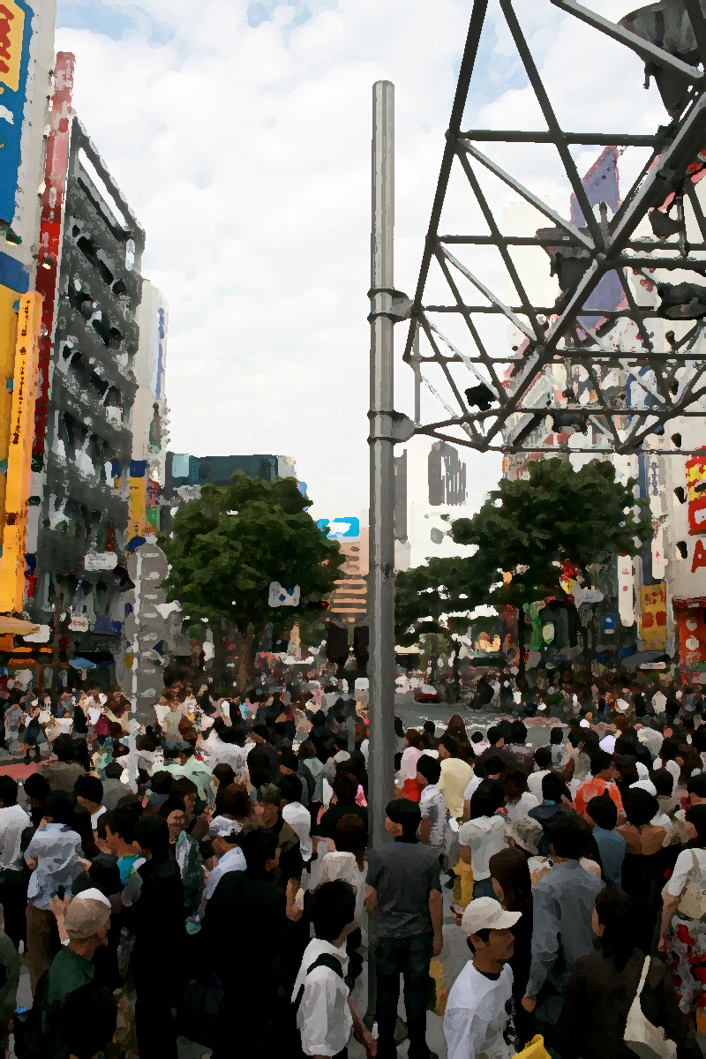

PoC scene example: Open square
Open squares in downtown areas

Slide 17
4. Collaboration activities

Slide 18
Collaboration activities
Bilateral collaboration with other organizations
  5G PPP
    Meeting with 5G PPP in Munich on 11th April 2014
    MoU on 5G PPP in Frankfurt on 25th March 2015
  Korea 5G Forum
    Meeting with 5G Forum in Tokyo on 19th August 2013
    Meeting with 5G Forum in Tokyo on 3rd July 2014
    MoU with 5G Forum in Tokyo on 6th April 2015
Workshop or Seminar on 5G issues
  5G workshop on 5G during the CEATEC-Japan on 8th October 2014
  5G workshop on 5G during the 18th meeting of APT Wireless Group in Kyoto on 9th March 2015
  5G workshop on 5G during the CEATEC-Japan on 8th October 2015

Slide 19
Summary

Slide 20
Summary
Activities in 5GMF is briefly introduced:
Organization of 5GMF
  Nation-wide cooperation amongst academia, industry and government offices.
  Involving virtual stake holders: Applications, NW, RAN.
On going studies in 5GMF
  Use cases, Requirements, framework and RAN technologies.
Action plan towards ‘5G’
  PoC plan towards 2020 and beyond
Collaboration activities
  Bilateral collaboration with 5GPPP, 5G Forum (KR)
  ‘5G’ workshops being planned: CEATEC-Japan (Oct.)

Slide 21
Thank you
for your kind attention!

