Slide 1
IMT2020:
5G Forum, Korea
Youngnam Han, Chair
Steering Committee

Slide 2
Contents
Introduction
Organization
Use cases, requirements;
Spectrum aspects
Technology (radio & network) aspects
Conclusions

Slide 3
Introduction
5G Forum
Structure
Public private partnership to promote 5G Mobile communications R&D
  Established May 30, 2013, Seoul (www.5gforum.org)
Members:
  30 Cooperate members: Operators, Vendors, both domestic and global
  Individual members: Academia, SMEs and Ventures
Executive Board
Auditor
Advisory Counsel
Steering Committee
Secretariat
Wireless Technology
Subcommittee
Network Technology
Subcommittee
Global Strategy
Subcommittee
Spectrum
Subcommittee
Convergence Service
Subcommittee

Slide 4
5G Forum
Global
Collaboration
Joint R&D Discussion
CHINA
Regular Meetings
JAPAN
Pre Discussions
IMT-2020 PG,
FuTURE Forum
2020B AH
-> 5GMF
KOREA
5G Forum
EUROPE
Global Forum
5GPPP
INDIA
WWRF
NGMN, ..
GISFI ?
TSDSI ?

Slide 5
5G Forum
Global Collaboration
: Joint R&D w/China
China
Korea
Spectrum (1 M$/Yr)
(SRMC, CATR, Huawei, CATT, BUPT, Tsinghua )
Spectrum
(0.40Mn$/Yr)
ETRI, LG, SNU, KHU
Evaluation Methodology (0.5Mn$/Yr)
(CATR, CMCC,
China Telecom,
Huawei, ZTE, CATT)
Eva. Meth. (0.25Mn$/Yr)
KT, Korea Univ., KAIST
Korea-EU
In Progress
Collaboration
(0.15Mn $/Yr)
Forum
IMT-2020 PG
5GPPP, 5GMF

Slide 6
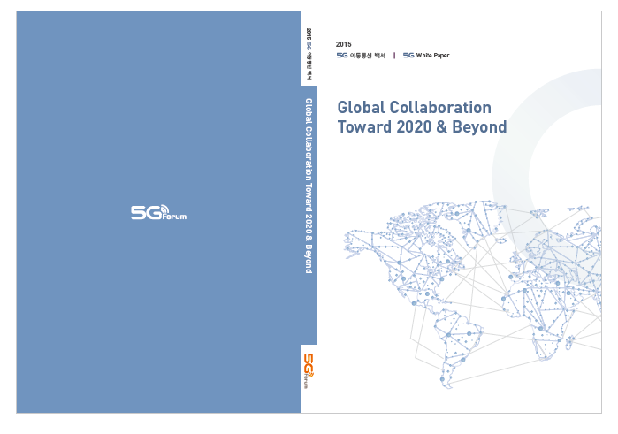
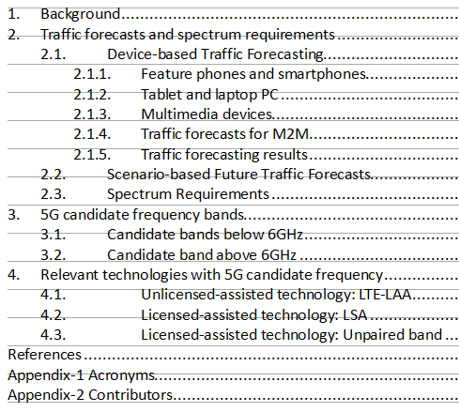
5G Forum
Activities:
White Papers

Slide 7


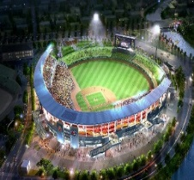

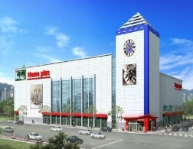


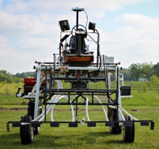
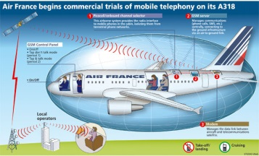
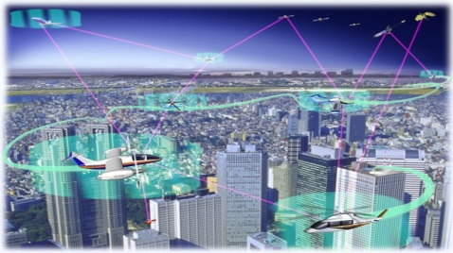
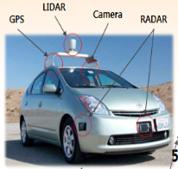
5G Forum
Service Aspects
Use cases/
Requirements
Mobile
Contents
Streaming
Social
Knowledge
Sharing
5G Extension
Services
Smart
Physical
Systems
High-Density
User
Public
Safety

Slide 8
Spectrum
Aspects/
Traffic
Estimation
Forecasts of total mobile broadband traffic until 2020 (Korea)
Category | Predictions (TB/month)
 | 2014 | 2015 | 2016 | 2017 | 2018 | 2019 | 2020
Feature phone | 214 | 206 | 211 | 221 | 232 | 243 | 253
Smartphone | 74,503 | 92,890 | 102,350 | 111,049 | 119,503 | 127,963 | 136,562
Laptop PC | 415 | 457 | 526 | 605 | 695 | 800 | 920
Tablet PC | 3,453 | 4,722 | 5,889 | 7,345 | 9,160 | 11,424 | 14,247
Multimedia | 19,272 | 27,732 | 36,390 | 47,751 | 62,660 | 82,223 | 107,894
M2M | 12,553 | 18,924 | 20,148 | 21,364 | 22,717 | 24,307 | 26,222
Total traffics | 110,410 | 144,931 | 165,514 | 188,335 | 214,967 | 246,960 | 286,098
Future Spectrum Requirements (Estimation by 2013)
 | Spectrum Requirements [MHz]
 | 2014 | 2015 | 2016 | 2017 | 2018 | 2019 | 2020
Maximum | 653 | 669 | 714 | 882 | 927 | 985 | 1353
Minimum | 467 | 515 | 541 | 744 | 780 | 829 | 1061

Slide 9
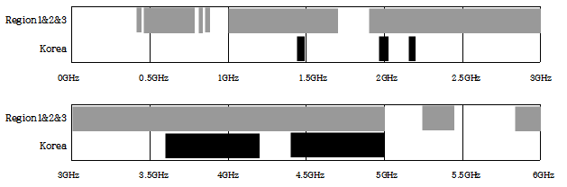
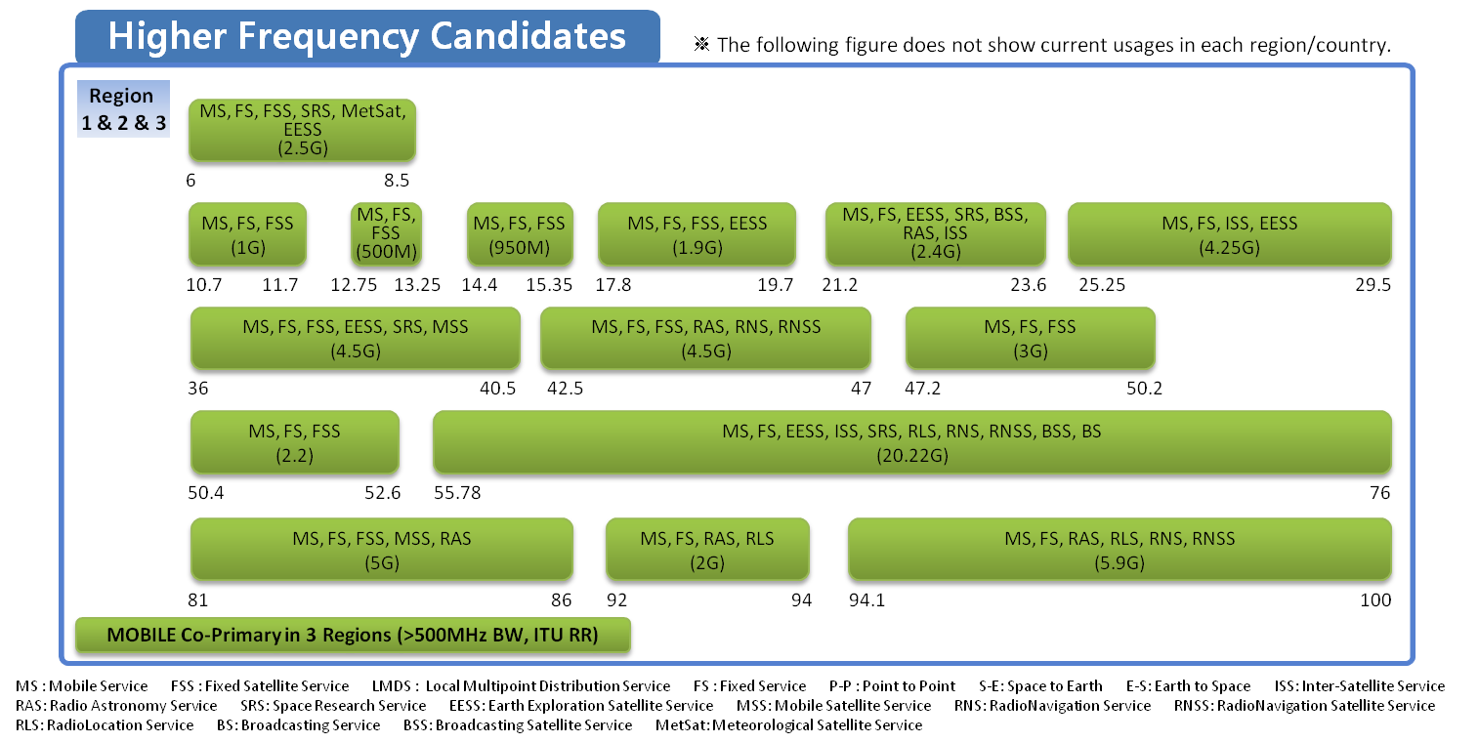
Spectrum
The frequency band below 6GHz proposed to ITU-R WP5D (July, 2012)
The frequency band above 6GHz

Slide 10
KPIs’/
Service Requirements
Index | Requirement | Value
R1 | Cell spectral efficiency | DL: 10 bps/Hz/cell UL: 5 bps/Hz/cell
R2 | Peak data rate | DL: 50 Gbps UL: 25 Gbps
R3 | Cell edge user data rate | DL: 1 Gbps UL: 0.5 Gbps
R4 | Latency | Control plane: 50 ms User plane: 1 ms
R5 | Mobility | 500 km/h
R6 | Handover interruption time | 10 ms
R7 | Areal capacity | [TBD]
R8 | Energy efficiency | [TBD]
R9 | Connectivity | [1000 times]
R10 | Positioning | [a few cm]
Handover
Interruption
Time [sec]

Slide 11
Enabling
Technology:
Radio
Category | Enabling Technologies |  | 5G RAN Requirements
 |  |  | R1 | R2 | R3 | R4 | R5 | R6 | R7 | R8 | R9 | R10
Wide and Flexible Bandwidth Technology | Millimeter-wave Band Communication |  | ✓ | ✓ |  | ✓
 | Spectrum Integration | Integrated Tx/Rx with WLAN and WPAN |  |  |  |  |  |  | ✓ | ✓
 | Cognitive radio and spectrum sharing |  | ✓ |  |  |  |  |  | ✓ | ✓
Advanced Transmission Technology | Modulation | Advanced modulation: FQAM | ✓ |  | ✓
 | Waveform | FBMC | ✓ |  | ✓
 |  | GFMC
 | Duplexing | In-band full duplexing | ✓ |  |  | ✓ |  |  | ✓
 | Multiple Access | NOMA | ✓ |  | ✓
 |  | SCMA
 | Large-scale Antenna | Large-scale antenna below 6GHz | ✓ | ✓ | ✓
 |  | Large-scale antenna above 6GHz | ✓ | ✓ | ✓ |  |  |  |  |  |  | ✓
 | Advanced Interference Management |  | ✓ |  | ✓
Access Architecture- related Technology | Advanced Dense Small Cell |  |  |  |  |  |  |  | ✓ | ✓ |  | ✓
 | Virtualized RAN |  |  |  | ✓ | ✓ |  |  | ✓
 | Enhanced Wireless Backhaul |  |  |  | ✓ |  |  |  | ✓
 | Advanced Relay |  | ✓ |  | ✓
 | Moving Network |  |  |  | ✓ |  |  |  | ✓
 | Device-to-Device (D2D) communication |  |  |  |  |  |  |  | ✓ | ✓
 | Massive Connectivity |  |  |  |  | ✓ |  |  | ✓ | ✓ | ✓
R1: Cell Spectral Efficiency
R2: Peak Data Rate
R3: Cell Edge User Data Rate
R4: Latency
R5: Mobility
R6: Handover Interruption Time
R7: Areal Capacity
R8: Energy Efficiency
R9: Connectivity
R10: Positioning

Slide 12


Enabling
Technology :
Network
Architecture
…
5G Services
M2M service
AAA
Location
Mgmt
D2D
…
Logical GW
E3
T2
T4
Mobility
Fine Grain
Geo Loc.
Policy &
Charging
T3
Radio Info
Resource
Status&Topo.
NFV Control
(SDN controller)
Virtualized Control Plane
T5
Sensor
Macro Cell
Personal Cell
RRH
Content & Service
Cache
Content
Cache
E1
Relay station
Macro
BS
5G-GW
Data plane
Internet
Type1 WLAN
B2
B1
E2
Small Cell
BS
D2D
5G-GW Data Plane
Wire-line
Terminal
AP
Type2 WLAN
B1: Seamless mobility
B2: Multi-RAT interworking
T1: Wired/wireless terminal switching
T2: Network on demand
T3: Context-aware best connection
T4: Single ID for multiple access
T5: Fine grained location tracking
E1: Distributed architecture
E2: Inter-GW mobility
E3: Flexible reconfiguration & upgrade
T1
D2D

Slide 13
Conclusions
Status
Future plan
Global Cooperation
Converged Services & Technologies
Global Harmonization
    Spectrum
    Technologies
Global Standard

