Slide 1
Strategic Topic #3:
IMT-2020/5G
15-16 July 2015
5G in the Americas
Requirements, Recommendations and Vision
Chris Pearson • President • 4G Americas • www.4gamericas.org

Slide 2
4G Americas Board of Governors
MISSION: 4G Americas will advocate for and foster the advancement and full capabilities of LTE mobile broadband technologies, including LTE-Advanced and beyond to 5G, throughout the ecosystem’s networks, services, applications and wirelessly connected devices in the Americas.
www.4gamericas.org
Notes:
To start things off, I wanted the audience to be aware of our association. 4G Americas is a wireless industry association of leading wireless operators and vendors.
We work in three main areas:
Technical facilitation and recommendations
Regulatory Policy
Industry wide education on mobile broadband technology
The consortium has been recognized throughout the world as a leader in representing 5G in the Americas.
In 2014, we published two white papers regarding 5G.

Slide 3
Deployments of LTE and LTE-Advanced
LTE-Advanced
69 networks
39 countries
Global
425 networks
145 countries
US/Canada
68 networks
Latin America
& Caribbean
67 networks
27 countries
www.4gamericas.org
Notes:
Before we move to the 5G aspects, I feel it is important to state that 4G Americas is very bullish and POSITIVE on LTE and LTE-Advanced on out into the distant future.
There are 418 LTE commercial networks in 142 countries. And LTE-Advanced features are deployed in 67 of those networks.
Asia-Pacific had 330 million LTE connections and 49% of total global LT E connections and 13% of tht total mobile connections in the Asia Pacific Region.
North America had 185 million LTE connections, 28% of the total global total, and 45% of total NA connections.
In 2015, wireless carriers’ commercial LTE service revenue will reach nearly $170 Billion
By 2020, LTE infrastructure spending will account for nearly $33 Billion

Slide 4
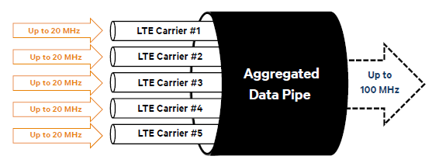
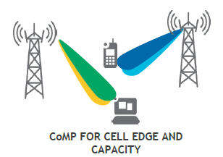
LTE-Advanced: Foundation for the Future
Flexibility
Performance
Creativity
Evolving Carrier Aggregation
LTE Broadcast
Device Interference Cancellation
SON
LTE Direct
Coordinated Multipoint
D2D
Further Enhanced HetNets
More advanced antenna features and 256 QAM
Higher bands and new licensing models
(Authorized Shared Access)
CoMP for Cell Edge and Capacity
Higher capacity for M2M and Smartphone signaling
www.4gamericas.org
Notes:
LTE-Advanced is a further enhancement to LTE which improves performance and data rates using features such as the aggregation of carriers, interference management and advanced antenna techniques.
LTE Advanced has a tremendous technical innovation roadmap for years to come. With over 418 fully commercial network launches, LTE has become a mainstream technology, and a number of wireless carriers have already deployed LTE-Advanced feature.
Flexibility, Performance and Creativity
Driven by the important technical enhancements and revenue opportunities, operators continue to aggressively invest in LTE infrastructure
In fact, by 2020 nearly 60% of all LTE subscriptions will be on LTE-Advanced networks

Slide 5
Technology Coverage in 2020
World Population Coverage by Technology
95 %
90 %
85 %
70 %
60 %
HSPA, HSPA+
GSM
20 %
2013
2020
2013
2020
2013
2020
www.4gamericas.org
Source: Ericsson Mobility Report, November 2014
Notes:
3G and 4G LTE networks will continue to thrive throughout the world as we look toward 2020.
This chart highlights the amount of coverage that LTE will have in 2020.
LTE is expected to cover 70% of the world’s population by 2020.

Slide 6
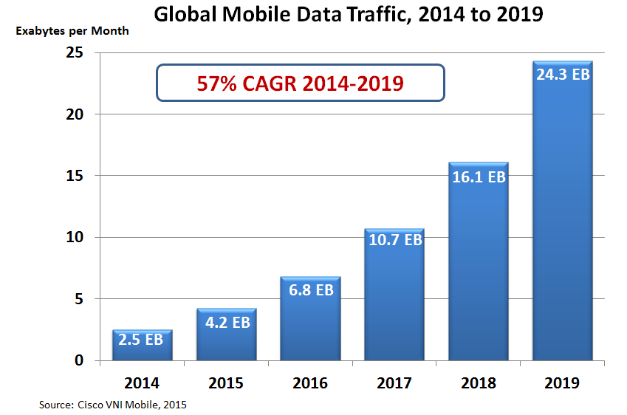
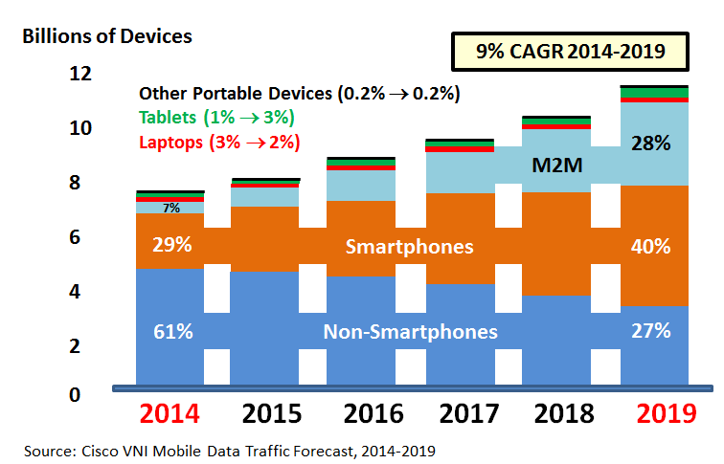
The Challenge and the Opportunity in 2020
Global Mobile Devices & Connections Growth
Global Mobile Data Traffic
2014 to 2019
www.4gamericas.org
Notes:
However, as we look at the future toward 2020, we see both challenges and opportunities.
Global Mobile Data Growth is expected to grow at a compounded annual rate of 57%.
U.S. consumers on average chewed through around 2.5GB of cellular data per month in the first quarter of 2015.
The trends are both astounding. However, in many ways this is a good thing. What industry wouldn’t love to hear that their product or service is growing at 57% per year?
The challenge for the industry is to efficiently deliver services to customers.

Slide 7
4G Americas Recommendations on 5G Requirements and Solutions
Available for free download at www.4gamericas.org
www.4gamericas.org

Slide 8
Key Principles
Architected to meet the expected use cases/demand in 2020 and beyond
Allows time for true advances of technology, feasibility studies, standardization and product development
Inclusive of the entire ecosystem, including air interface, devices, transport, packet core and more
Features considered 5G requirements should be implemented as LTE-Advanced extensions in advance of full 5G availability.
www.4gamericas.org

Slide 9
Requirements
Battery Life
Per-user Data Rate and Latency
Robustness and Resiliency
Mobility
Seamless User Experience
Context Aware Network
USER DRIVEN
Scalability
Network Capacity
Cost Efficiency
Automated System Management & Configuration
Network Flexibility
Energy Efficiency
Coverage
Security
Diverse Spectrum Operation
Unified System Framework
NETWORK DRIVEN
www.4gamericas.org

Slide 10
5G Market Drivers and Use Cases
Extreme Video and Gaming Applications
Internet of Things
Context Aware Services
Explosive Data Density
PSTN Sunset
Public Safety
www.4gamericas.org

Slide 11
Industry Consensus 5G Diverse Performance Considerations
IoT
Macro
cellular
mmWave
Data Rate
1Kbps – 1 Mbps
100 Mbps
1-10Gbps
Latency
1ms - hours
Moderate
1ms
Battery Life
10-15 years
3-7 days
Varied
Coverage
Very high
Good
Low
Network
Overlay
HetNet
Underlay
Access
Massive # modules
Smart phones
Opportunistic
Varied 5G use cases will drive performance criteria
www.4gamericas.org

Slide 12
Building on 4G for 5G
5G WILL ENHANCE SOME OF THE BUILDING BLOCKS DEFINED IN 4G
Networking flexibility
More flexible mobility solutions
Additional support for essential functions as fundamental attributes of networking layer
Expanding form of multi-RAT integration and management
Enhanced efficiency for short burst or small data communication
Expanding context information known to the network
www.4gamericas.org

Slide 13
4G Americas’ Recommended Potential 5G Technologies (1)
Massive MIMO
RAN Transmission – Centimeter and Millimeter Waves
New Waveforms
Shared Spectrum Access
Advanced Inter-Node Coordination
Simultaneous Transmission Reception
Multi-RAT Integration & Management
www.4gamericas.org

Slide 14
4G Americas’ Recommended Potential 5G Technologies (2)
D2D Communications
Efficient Small Data Transmission
Wireless Backhaul / Access Integration
Flexible Networks
Flexible Mobility
Context Aware Networking
Information Centric Networking
Moving Networks
www.4gamericas.org

Slide 15
End-to-End 5G Ecosystem
REGULATORY
Spectrum
Emergency Services
Lawful Intercept
Resiliency
Spectrum Sharing
RADIO
CORE
APPLICATIONS
Advanced Interference Management
Mesh Networks
NFV
Security
M2M/IoT
Flexible Networks
Security
World Wide Wireless Web
Context Aware Networking
Massive MIMO
Security
Cloud RAN
M2M/IoT
Modulation
M2M/IoT
Ubiquitous
Storage & Computing
Cloud
M2M/IoT
Millimeter Wave
D2D Apps
DEVICES
Mesh Networks
D2D
Modulation
Context Aware Networking
www.4gamericas.org
Notes:
5G is an end-to-end ecosystem to enable a fully mobile and connected society.
It empowers value creation towards customers and partners, through existing and emerging use cases, delivered with consistent experience, and enabled by sustainable business models. The ITU has defined requirements and approved standards for IMT-2000 (“3G”) and IMT-Advanced (“4G”) and will do so for 5G.
The current discussion by leading global bodies will provide consensus for what the mobile industry needs by 2020 and beyond.
4G LTE has a robust innovation roadmap through 2020 with enhancements in Carrier Aggregation, small cells and device to device signaling, among other 3GPP release enhancements.
Associations such as 4G Americas are working on recommendations and requirements for 5G technology solutions to continue innovation and success in the industry.

Slide 16
5G Conclusions: An Opportunity for Innovation for Networks in 2020 and Beyond
Increased Performance
Increased Innovation
Increased Capacity
Increased Adaptability
Increased Flexibility
www.4gamericas.org

Slide 17
Thank you!
www.4gamericas.org
www.facebook.com/4gamericas
twitter.com/4GAmericas
www.linkedin.com/company/4g-americas

