Slide 1
Document No: | GSC-19_302
Source: | 3GPP SA Chairman
Contact: | Erik Guttman, erik.guttman@partner.samsung.com
Agenda Item: | 5.3
3GPP and The Road to 5G
Erik Guttman, 3GPP SA Chairman, Consultant to Samsung Electronics Co., Ltd.

Slide 2
Context of 5G Work in 3GPP
3GPP Release 13 (Stage 3 Freeze Dec 2015)
  Work on Release 13 is ongoing.
3GPP Release 14 (Stage 1 began Jan 2015)
  Have started study of "5G" use cases, service requirements.
  Efforts are underway to establish requirements for Rel-14 studies and standardization, based on white papers from diverse sources – NGMN, IMT2020 (5G) Promotion Group, 4G America, others.

Slide 3
"5G" The Term
"5G", as used in this presentation, does not represent actual 3GPP project planning.
3GPP will begin to use more specific terms in its work.

Slide 4
In Progress: 3GPP Advances Further
Added capacity through off-loading and use of unlicensed spectrum
  Includes Wi-Fi interworking
    Mobility and non-seamless offload, with increasingly fine grained policies.
    Integration and interworking with E-UTRAN, per 3GPP policies, Aggregation of LTE and Wi-Fi radio links.
  LTE over unlicensed spectrum, "License-Assisted Access"operation
    Provides additional resources for aggregation, if so configured.
    Coexistence with Wi-Fi: no more impact than additional Wi-Fi network on the same carrier.
      Study is ongoing on functions to achieve coexistence with other systems and between operators.
Advances
  Carrier Aggregation (up to 32 carriers – a major leap in achievable data rates)
  Ongoing development of MIMO (increasingly relevant with use of higher frequencies in future)
  Indoor Positioning (a study at this point, to improve location capability indoors)
Support for New Services
  Proximity Based Services (discovery & communication enhancements), Vehicle to Vehicle Communication
  Internet of Things (low power consumption, low complexity)

Slide 5
In Progress: Service Delivery Features
Dedicated Core Networks
  Separates the serving nodes from service, based on policy associated with individual subscribers, allowing flexible deployment of Enhanced Packet Core functions.
Flexible Mobile Service Steering
  Introduces a new capability to steer traffic towards 'service functions' external to the 3GPP Enhanced Packet Core Network – e.g. NAT, security filters, media enhancers, etc.). Steering uses 3GPP-defined policies.
Machine Type Communication Service Enablement
  Service capability exposure to 3GPP information and functionality – in Release 13 for Monitoring and Group Enhancements – extensible to more.

Slide 6
In Progress: NFV-related
Study ongoing in the 3GPP Telecom Management working group on network management of virtualized networks
  ETSI ISG NFV 'MANO' / 'IFA' architecture framework as starting point
Conclusions have not yet been documented in the TR; normative work is expected to begin shortly:
  specify the architecture, concepts, use cases and requirements for mobile networks that include Virtual Network Functions
  specify management solutions for Fault Management, Configuration Management, Performance Management, Lifecycle Mangement functions

Slide 7
Services and Markets Technology Enablers (SMARTER)
Discusses use cases, derived from 5G white papers.
  Use cases consider combinations of new capabilities: Low Latency, High Bandwidth, High Reliability, Highly Mobile, Management of Network (for diverse criteria for services, markets, etc.), Flexible Deployment (of resources), others.
  Use cases will be consolidated to identify requirements.
It is foreseen that this work will provide the basis for system and architecture work, as well as input for RAN requirements.
  This work has yet to start in 3GPP.

Slide 8
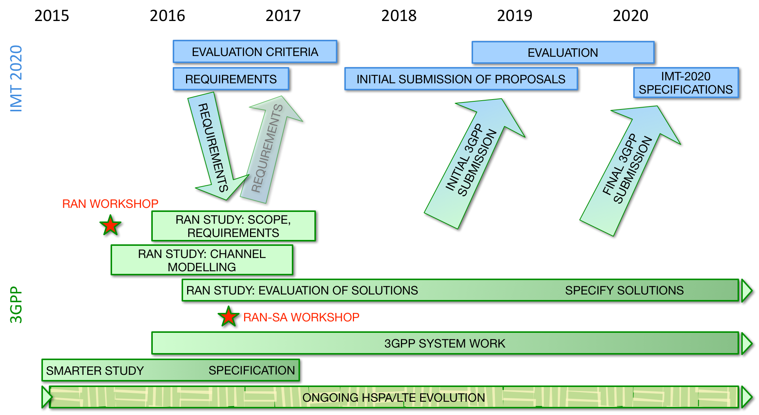
3GPP "5G" Timeline
Notes:
The timeline is tentative & will be further revised.
The goal is to provide a timely submission to IMT 2020.

Slide 9
Thank you for your attention.
Erik Guttman • 3GPP TSG SA Chairman • erik.guttman@partner.samsung.com

