Slide 1
Document No: | GSC-19_202
Source: | CCSA
Contact: | Heyuan XU
Agenda Item: | 4
Internet of Thing in China
Heyuan XU, CAICT

Slide 2
Hot topic and active field in IoT
…..
Internet of things (IoT): A global infrastructure for the information society, enabling advanced services by interconnecting (physical and virtual) things based on existing and evolving interoperable information and communication technologies.
IoT
M2M
Vehicle networking
Industrial Internet
Smart cities

Slide 3
M2M

Slide 4
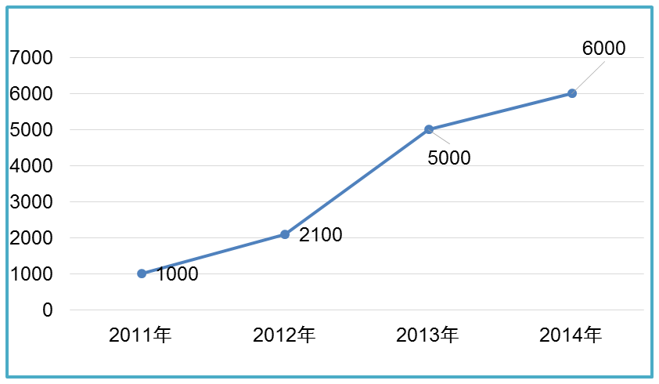
M2M users maintain sustained growth
At the end of 2014, the number of M2M users reached 60 million, Compound Annual Growth Rate(CAGR) is 20%.
2G: GSM, CDMA
3G: WCDMA, cdma2000,TD-SCDMA
4G: FDD, TDD
3 operators: China Mobile, China Telecom, China Unicom

Slide 5
M2M : Terminal, communication and platform are paid more attention to advance
A embedded IC card , M2M service platform and protocols are being studied and standardized under CCSA.
Dedicated M2M network is being deployed by China Mobile.
M2M terminal and chip
IoT dedicated chip
M2M communication module
Service platform among operators
MTC
M2M dedicated network
M2M horizontal service platform(OneM2M)
M2M networking
M2M service platform

Slide 6
Vehicle networking

Slide 7
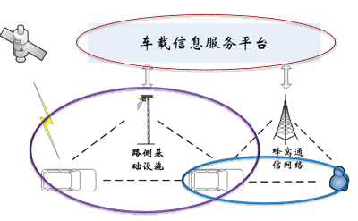
The understanding for car networking and Key elements
Vehicle ntworking：Utilizing the new technologies, such as wireless communication, positioning and navigation, context awareness, to implement the connections between vehicle to vehicle, vehicle to man, vehicle to infrastructure, so that the integrated service can be provided.
Vehicle information service platform
Wireless communication
Vehicle terminal

Slide 8
The progress of Vehicle Networing in China in 2014
Vehicle terminal
Vehicle information service platform
  Baidu：CarNet, which is vehicle networking related product ，was released in 2014
中国移动
The contract was signed between China Mobile and Germany Telecom. for vehicle joint company in 2014，the service of which is oriented to end to end solution for vehicle networking.
Wireless communication
阿里巴巴
The cooperation agreement was signed between Alibaba and Shangqi Group. for Intenet Carin in 2014, both sides will start to cooperate to setup “Internet Car” ecosystem.
  Vehicle networking was taken as an important use case of 5G requirement by IMT-2020(5G) Study Group of China in 2014
  DSRC based on LTE was paid more effort to study by Da Tang , Huawei, feasibility analysis of DSRC was finished in 2014.
8
Notes:
Windows; word

Slide 9
Industrial Internet

Slide 10
The driving force and challenges of China industrial development
Comparative advantage
Internal driving force
External driving force
Development challenges
Unbalanced distribution of manufacturing enterprises
Cross-boundary cooperation lacks unified standards
Big gap in mastering crucial technologies
Informatization level of manufacturing enterprises is generally low
Rapid breakthrough in information technology
Internet industry well developed and prosperity
Continuous improvement about surroundings of policy
Shortage of resources and energy
Demographic dividend gradually disappear,
labor costs rising
Low value-added products
Ecological environment is fragile, the pollution of regions are severe
Backflow of manufacturing industry of developed countries
Relocation of labor-intensive industries to the Southeast Asia and other regions

Slide 11
Government actions to Promote integration of information technologies and industrial development in China
On August 23, 2013, the Ministry of Industry and Information Technology of China issued Special Action Plan of Deep Integration of Informatization and Industrialization 2013-2018, it is the guideline for the deep integration of informatization and industrialization
On March 2015, MIIT issued Special Action Plan of Intelligent manufacturing 2015, it aims to promote industry transformation and upgrading, as well as to redouble our efforts to upgrade China a manufacturer of quality.
The Chinese Government will implement the "Manfuracture in China 2025" strategy from 2015.

Slide 12
Special Action Plan of Intelligent manufacturing 2015
Flow Manufacturing， focus on intelligent factory
Intermittent/Discrete Manufacturing, focus on digitalized plant
Six directions
Pilot demonstration
Intelligent equipment and intelligent products
new models and new forms of business of Smart manufacturing, focus on Customization manufacturing, Collaborative development, e-business
Smart management, focus on logistics informationization, and smart energy management
Smart services, focus on online monitoring, remote diagnosis and Cloud computing services

Slide 13
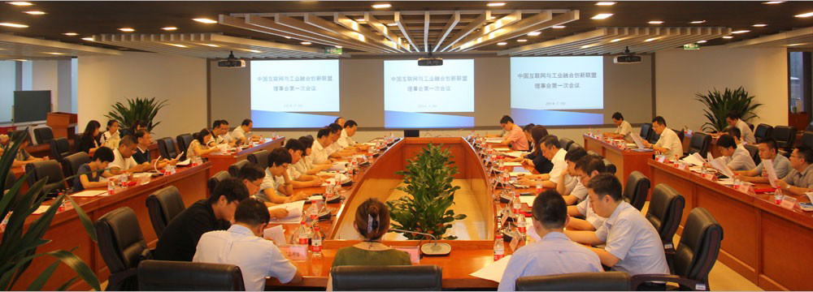
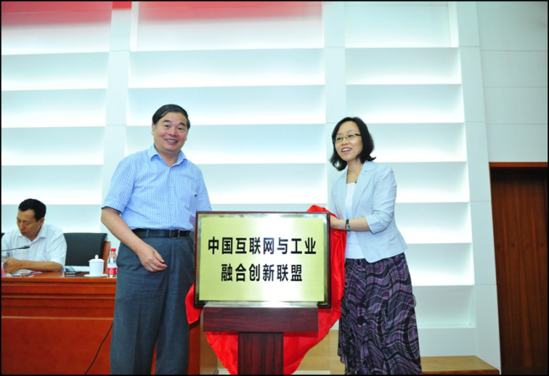
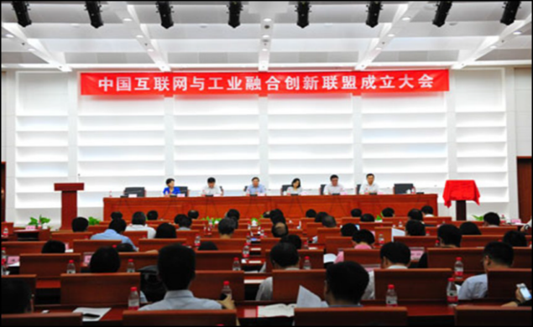
Industry actions（China Integration and Innovation Alliance of Internet and Industry）
In order to fulfill the needs between the government policies and industry development, on July 30, 2014, China Integration and Innovation Alliance of Internet and Industry(CIIAII) was founded in Beijing, China.
Xueshan Yang, Vice Minister of MIIT, was selected as the Director of the Steering Committees
Government Representative
Shumin Cao, President of CAICT, was selected as the chairman of CIIAII
Industry Representative

Slide 14
Smart cities

Slide 15
Smart City is an important direction of urban informatization and urbanization
“A Smart Sustainable City is an innotive city that uses Information and Communication Technologies (ICTs) and other means to improve quality of life, efficiency of urban operation and services, and competitiveness, while ensuring that it meets the needs of present and future generations with respect to economic, social and environmental aspects”.
Source: ITU-T FG-SSC, 2014.
Smart City
A Smart city is senior phase of urban informatization，is extension and enhancement of Digital City, Wireless City and Boradband City.
Broadband City
城市信息化
Informaization
Wireless City
Digital City
90s
2005
2009
Time

Slide 16
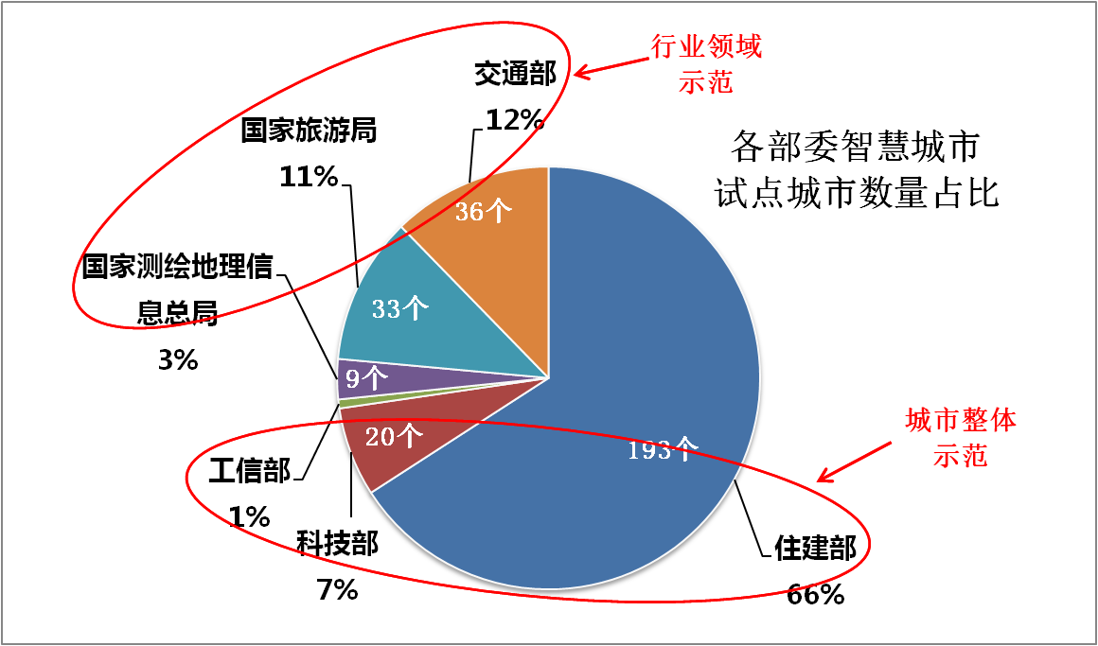
A Smart City was demonstrated by multiple Ministries
    293 cities to ratified to demonstrate Smart
The work was led by 6 Minstries or administrations
    Ministry of Housing and Urban-Rural Development(MOHURD)
    Ministry Of Science and Technology
    Ministry of Industry and Information Technology
    Ministry of Transport
    National Tourism Administration
    National Administration of Surveying, Mapping and Geoinformation
Two mode was used:
Mode1：Demonstration for whole city
  MOHURD：193
  MOST：20
  MIIT：2
Mode2：Demonstration for the sector
    Ministry of Transport：36
    National Tourism Administration：33
    National Administration of Surveying, Mapping and Geoinformation：9

Slide 17

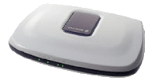
Smart City Framework-CCSA
Smart Governance
Smart Economy
Smart Life
运行和指挥中心
智慧环保
智慧物流
智慧旅游
智慧医疗
智慧教育
Application
政府监管
智慧
…
智慧园区
智慧
…
智慧社区
智慧
…
Sector Repository
Data and platform
Public Support Platform
Public Repository
Computering and Storage
Private networking
Inforstructure
Public Networking
Sensoring
Data collecting
Extension networking

Slide 18
Thank you !

