Slide 1
Document No: | GSC-19_201
Source: | CCSA
Contact: | Hu Jinling, hujinling@catt.cn
Agenda Item: | 4
Progress of LTE V2X in China
Hu Jinling, CCSA

Slide 2
Highlights of CCSA Current Activities
Standardization progress in CCSA
SI of “ Short Range Communication Based on TD-LTE for Vehicle Safety Application “ was accomplished in 2014
Studied the use cases and communication requirements of V2V
Studied the evaluation methodology of V2V and feasibility of technology based on TD-LTE
SI of “Security Requirements, Threat Analysis and Countermeasures for V2X Systems“ was accomplished in 2014
Analyzed the threat and challenge for V2X system
Studied the general security requirements and security architecture for V2X systems

Slide 3
Highlights of CCSA Current Activities
Standardization progress in CCSA
Work on Industrial standard of “General technical requirements of Communication Based on LTE for Vehicle Application” was approved and started in November, 2014
Its scope includes the requirements of communication, network architecture and general system requirements
Standardization is planned to be finished in the middle of 2016 and following series industrial standards will start
SI of “Spectrum requirement and coexistence study on intelligent transportation system V2V/V2I active safety application” was approved in March,2015 and planned to be accomplished at the end of 2016
Output of this SI will be a recommendation to the National Regulatory Authority in China for spectrum allocation

Slide 4
Several alliances involved in the LTE V2X
China ITS Industry Alliance (C-ITS) which is led by the Ministry of Transport
Co-leading LTE V2X standardization with CCSA
Formulating the application standards of connected vehicles
Collaborating the relevant stakeholders to validate the key technology of connected vehicles
Telematics Industry Application Alliance which is led by the Ministry of Industry and information Technology
Investigating candidate spectrums for connected vehicles
Discussing the field test among the stakeholders
China Industry Technology Innovation Strategy Alliance for Internet of Vehicles (IOV) which is led by Society of Automotive Engineers of China
Coordinating and promoting the pilot projects in Jiading,Shanghai
Demos of V2X services and applications

Slide 5
National projects related to V2X
National 863 Program
which is led by Ministry of Science and Technology of People’s Republic of China
Established a project of key technology study of smart V2X which was accomplished in 2014
National Science and Technology Major Project
which is also led by Ministry of Science and Technology of People’s Republic of China
Established a project of study and validation of technology for scenarios with low latency, high reliability in 2015 and will be accomplished in 2016

Slide 6
CCSA Strategic Direction
CCSA will continue to support and promote the study of LTE-V technologies, especially for LTE-V Standardization
In CCSA , members such as CATT, CAICT,Huawei,etc are very active in developing LTE based Vehicular communication (LTE-V) Standards
CATT and Huawei both have developed LTE-V prototype systems. Demos have been made on April 27~29, in 14th ITS Asia-Pacific forum
CCSA will also harmonize the LTE V2X standard progress with other organizations such as 3GPP
In 3GPP, LTE V2X have been discussed in SA1 and RAN
Members of CCSA play an important role on the LTE V2X discussion
CCSA will also collaborate with other alliances, especially with vertical partners to promote the application of LTE-V
CCSA has signed Memorandum of Understanding(MoU) with TC/ITS in 2011

Slide 7
Highlights of China governments activities
National plan ——“Made in China 2025”
Endorsed by Premier Li Keqiang, is the country's first action plan focusing on promoting manufacturing
Focus on the upgrading of the manufacturing sector to improve innovation ability
Integrate informatization and industrialization
Focus on the development of fully-automated "smart" factories
Ten key sectors
new information technology; high-end numerically-controlled machine tools and robotics;
aerospace equipment； ocean engineering equipment and ships with high technology;
advanced railway traffic equipment; energy saving and new energy vehicles;
power equipment; new materials; biological medicine
and high-performance medical devices; and agricultural production machinery.
“

Slide 8
Highlights of China governments activities
Internet Plus Action plan
Unveiled in the government work report ,proposed by Premier Li Keqiang
Aims to integrate internet technology with modern manufacturing while encouraging entrepreneurship and innovation
An Internet Plus guideline was approved. It maps development targets and measures to establish new industrial modes
Including agriculture, energy, finance,
public services ,logistitics,
e-commerce, traffic,
biology and artificial intelligence

Slide 9
Supplement Slides- CATT LTE-V concepts
Architecture for
Centralized Network
Architecture for
Decentralized Network
LTE-V
LTE-V-Cell
LTE-V-Direct
Local Lightweight
Broadcast
Slotted MAC:
Flexible and Reliable

Slide 10
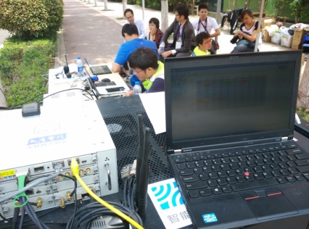
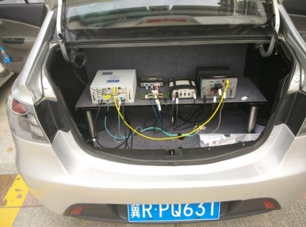
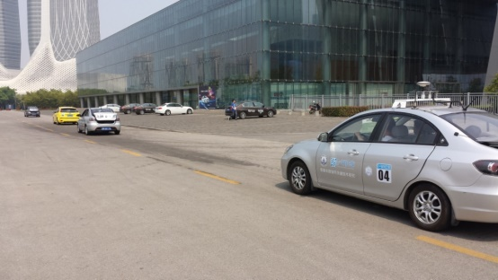
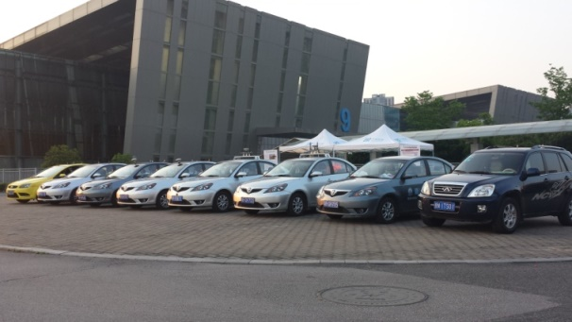
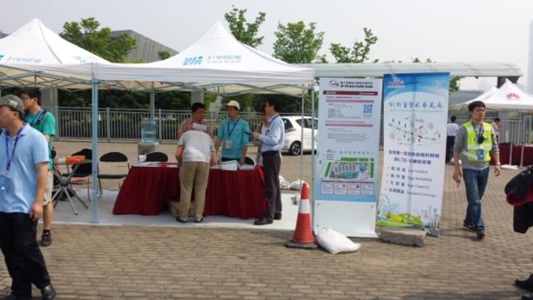
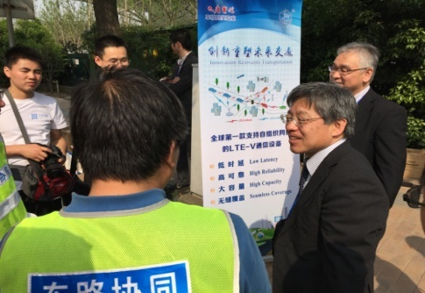
Supplement Slides- CATT LTE-V Demo
Demo
Partners : Tsinghua university, Chang An automaker
9 OBU nodes, 3 RSU nodes, with CATT LTE-V devices.
Use Cases:
V2V safety warnings
Speed advisory
Pedestrians detection
LTE-V Road Side device
On Board LTE-V device
Real Road Demo

Slide 11
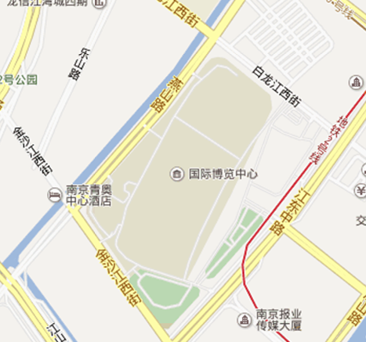
Supplement Slides- CATT LTE-V Demo
终点
V2V based detection and aided control for lane-changing
V2V based detection and aided control for car-folllowing
V2V based crash avoidance
V2V based signal priority control for emergency vehicles
V2I based speed guidance and control
V2I based warning for construction area and slippery pavement
Pilot safety based on traffic signal control
V2I based conflict recognition for pedestrians in intersections
V2I based warning for special group
8
9
7
RSU
3
6
4
5
1
2
9
8
RSU
起点

Slide 12
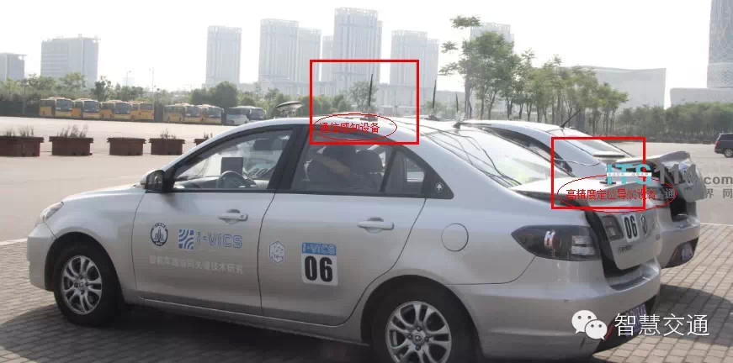
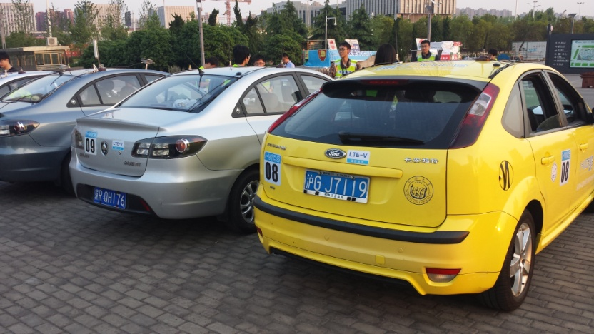
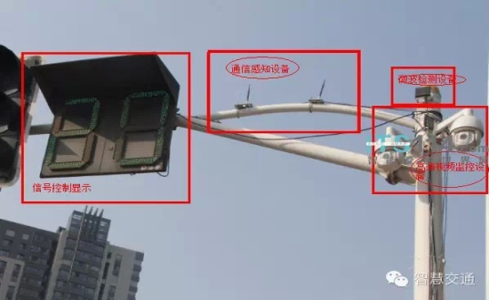
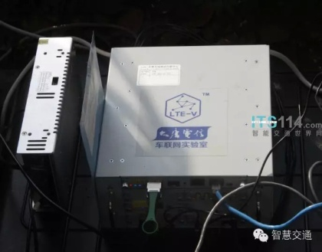
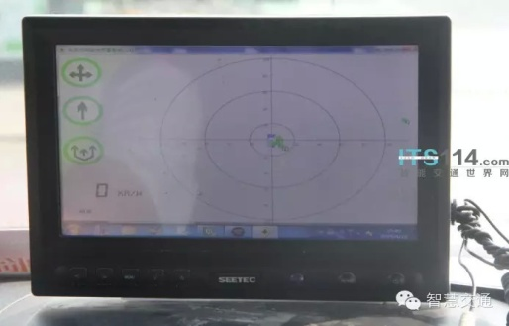
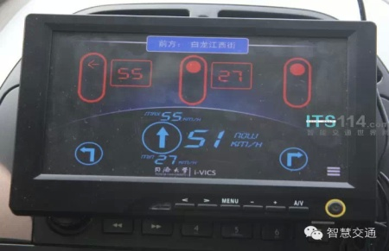
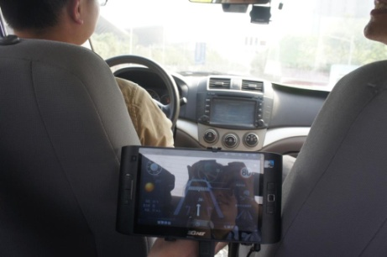
Supplement Slides- CATT LTE-V Demo
LTE-V 设备
OBU
RSU

Slide 13
THANK YOU!

