Slide 1
Document No: | GSC-19_112
Source: | The Telecommunication Technology Committee (TTC)
Contact: | Hiroshi Hamano
Agenda Item: | 3.12
TTC Activities on Emergency Call Accessibility
Hiroshi Hamano, Sadahiko Kano, Yuji Nakabayashi, TTC

Slide 2
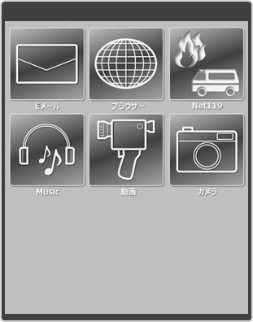
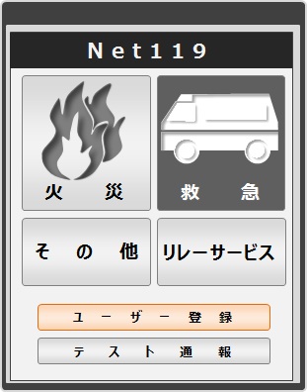
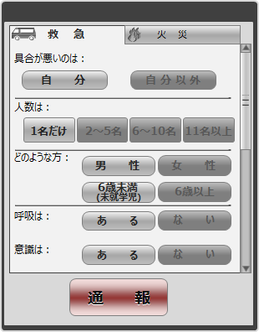
Net119 Emergency Call System
Study of emergency call system which enables people with hearing and speaking disabilities to request rescue to appropriate agencies (fire and ambulance) using smart phones
Click to choose
Click to choose
Net119
Net119 – Ambulance -
Sick
Injury
Email
Browser
Net119
Which part of the body?
Fire
Ambulance
Front view
Relay
Service
Other
Safety
Servise
Back view
Music
Movie
Camera
Bleeding
Pre-registration
Yes
No
Trial
SEND
Net119 : The appellation of the emergency rescue request system for fire and ambulance in Japan

Slide 3
Needs for Emergency Call other than Oral Communication
360,000 oral communication-disabled people in Japan
Emergency call should be a universal social infrastructure.
FAX is currently the only alternative to phone calls.
Emergency call through internet (Smartphones, Cell phones, and PCs)
FAX
Email
Web
Private Security
Service
Emergency Call other than
Oral Communication
Source : Fire and Disaster Management Agency
‘Technical meeting about emergency call system for people with hearing and speaking difficulties’

Slide 4
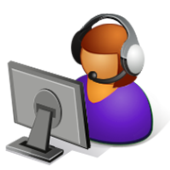
Net119 System Configuration
GW Administrator
Net119 GateWay
Internet
(3G/4G/Wi-Fi)
HTTPS
IP-VPN
HTTP
Caller
FireWalls
Control Center
Sign Language
Translator
HTML
PTN
Relay Service Center

Slide 5
‘Emergency Call WP’ Activities
Started in 2012
25 companies and organizations involved
First proposal to ITU-T SG16/Q26 in June 2014
Draft Recommendation* was accepted as the baseline text
for further study.
*Draft new ITU-T H.ACC-RDE: Application layer information elements at the terminal-to-
network interface to improve accessibility to fire and ambulance emergency services
2 contributions in February 2015
Field tests with cooperation by oral communication-disabled people
in December 2014.
Updated draft Recommendation to be submitted to SG16/Q26
in October 2015.

Slide 6
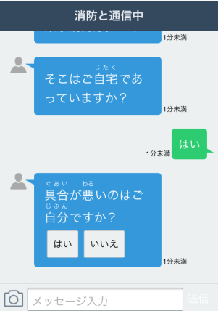
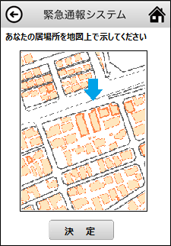
Field Test Results (in December, 2014, at Saitama Seibu Area outside of Tokyo)
Text chat duration does not fit to the emergency call, especially in a panic situation.
Simple Yes/No pre-set questions improved the correspondence delay.
GPS data of the user terminal proved to be powerful to identify user’s location.
Additional manual location pointing on a map improved the location search accuracy.
Emergency Call Duration | User Device | # | Text Chat | Y/N Q/A Map I/O | Ref.
Incident : Fire Location : Not at home Outside of the building Local fire dept. service area | Android Smart Phone | 1 | 75 sec | 46 sec | 42 sec Normal Voice Call (Ave.)
 |  | 2 | 71 sec | 32 sec
 |  | 3 | 77 sec | 24 sec
 | iPhone | 1 | 88 sec | 46 sec
 |  | 2 | 83 sec | 32 sec
 |  | 3 | 94 sec | 30 sec
 | Feature Phone | 1 | 169 sec | 40 sec
 |  | 2 | 145 sec | 35 sec
 |  | 3 | 148 sec | 38 sec

Slide 7
Anybody, Anywhere, Any Circumstances
Goal : Seamless and Universal Emergency Call Systems
Potential 20M elderly people with listening difficulties
The fact would be a substantial issue in the highly-aging society.
Increasing foreign visitors with language disabilities
The Issue would be extended to the different communication disability cases.
Similar or better usability and performance compared to the telephone systems
‘Telephone’ or ‘Internet’ would be an option for the normal users.
PSTN showed weakness, compared to Internet, under the earthquake disaster
Emergency call via internet would provide an alternative measure
during a telephone network congestion or outage.

Slide 8
‘Accessibility Sub-WG’ Formation
To the Domestic, Asia-pacific, and International Standard :
Step up from WP to Sub-WG
Study and discuss a variety of issues related to the Net119 applications
Accelerate the contribution submissions to ITU-T and other standard bodies
Target global service evolution achieving universal application interface
Contribute to improve the global public safety, enabling foreign travelers
to make emergency calls in any countries and situations, including disasters
Further Steps :
Accelerate the system installation across the country
Serve with ‘Omotenashi’ (Japanese hospitality) in 2020 to Tokyo Olympic/Paralympic
game visitors

Slide 9
Thank you !!

