Slide 1
Document No: | GSC-19_107
Source: | ETSI
Contact: | Adrian Scrase (adrian.scrase@etsi.org)
Agenda Item: | 3.7
An update on eCall activities in ETSI (and other related bodies)
Adrian Scrase, ETSI CTO

Slide 2
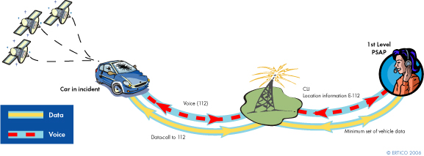
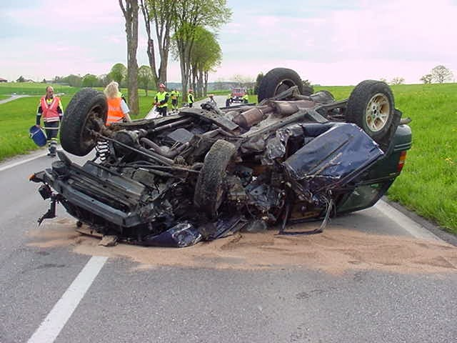
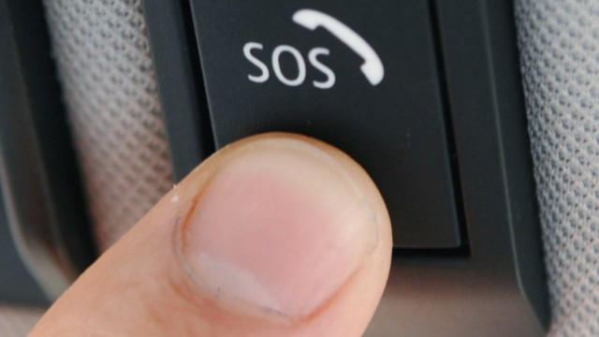
What is eCall ?
...an emergency call that can be generated either manually or automatically when a serious road accident occurs...

Slide 3
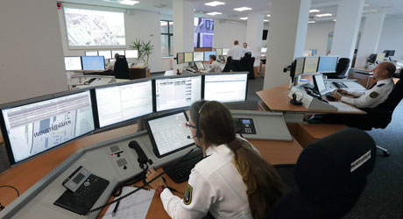
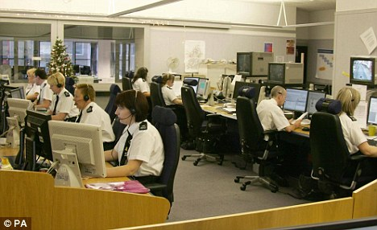
eCall standardization achieved so far
3GPP specifications for eCall based 112 over GSM/UMTS stable for several years
Define services principles and transport protocol to send the Minimum Set of Data (MSD) from the In-Vehicle System (IVS) to the Public Safety Answering Point (PSAP)
CEN TC 278 specifications are stable too
Define content and format of the MSD (e.g. vehicle type, identification, type of engine, time, location, direction and number of passengers)
ETSI publications since GSC#18 (ETSI TC MSG)
Next generation eCall: ETSI Technical Report on eCall for VoIP (covering eCall over LTE) published (ETSI TR 103 140).
eCall HLAP (High Level Application Protocol) Conformance Test Suite for CEN TS 16454 (Test purposes) (ETSI TS 103 321)

Slide 4
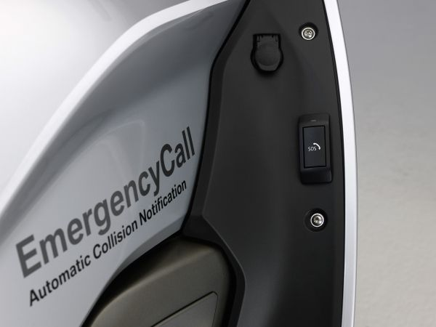
Latest developments
3GPP has agreed Stage 1 Change Requests to 3GPP TS 22.101 on evolution to, and Interworking with, eCall in IMS (EIEI)
Update of eCall definition to include IMS emergency call based eCall
Support of IMS emergency calls in IMS Centralized Services (ICS)
Update of transfer of MSD to include IMS emergency call based eCall
CRs are expected to be included in 3GPP Release 14
CEN TC 278 WG15 still working on eCall
Considering potential new work items to extend eCall for other user categories (e.g., motorcycles) and for medical devices.

Slide 5
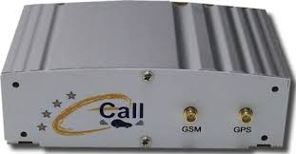
What is coming next?
ETSI-ERTICO 4th eCall TESTFEST (9th -13th November 2015, Prague) to conduct interoperability test cases on eCall specifications from 3GPP and CEN
Part of ETSI work item for eCall HLAP Interoperability Testing
Discussions in the European eCall Implementation Platform (EeIP) to guide, coordinate and monitor implementation progress of the eCall service across Europe
Life Cycle Management (LFM) to resolve issues around end-of-life of vehicles
Periodic Testing Group (PTG) investigating a uniform testing regime for eCall devices

Slide 6
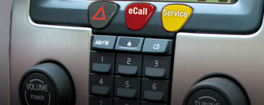
Implementation
eCall “mandatory” in all new types of cars and light commercial vehicles placed on the European market after 31st March 2018
(excl. heavy goods vehicles, buses, coaches, powered two-wheelers and agricultural tractors)
EU Member States “mandated” to upgrade PSAPs for eCall by 1st October 2017
Mobile operators have been “formally recommended” to support eCall by 31st December 2014
Some countries are eCall ready now (e.g. Romania, Croatia and Czech Republic)
Some countries outside of Europe expressing interest in eCall (e.g., Israel, China, Japan, Qatar and UAE)
European legislation leaves room for the co-existence of Third Party Service eCall (TPS eCall) and eCall based on 112.

