Slide 1
Document No: | GSC-19_104a
Source: | GSC-EM Task Force Convenor
Contact: | Chantal Bonardi
Agenda Item: | 3.4
Individual to Authority standardisation
Chantal Bonardi, GSC-EM Task Force Convenor

Slide 2
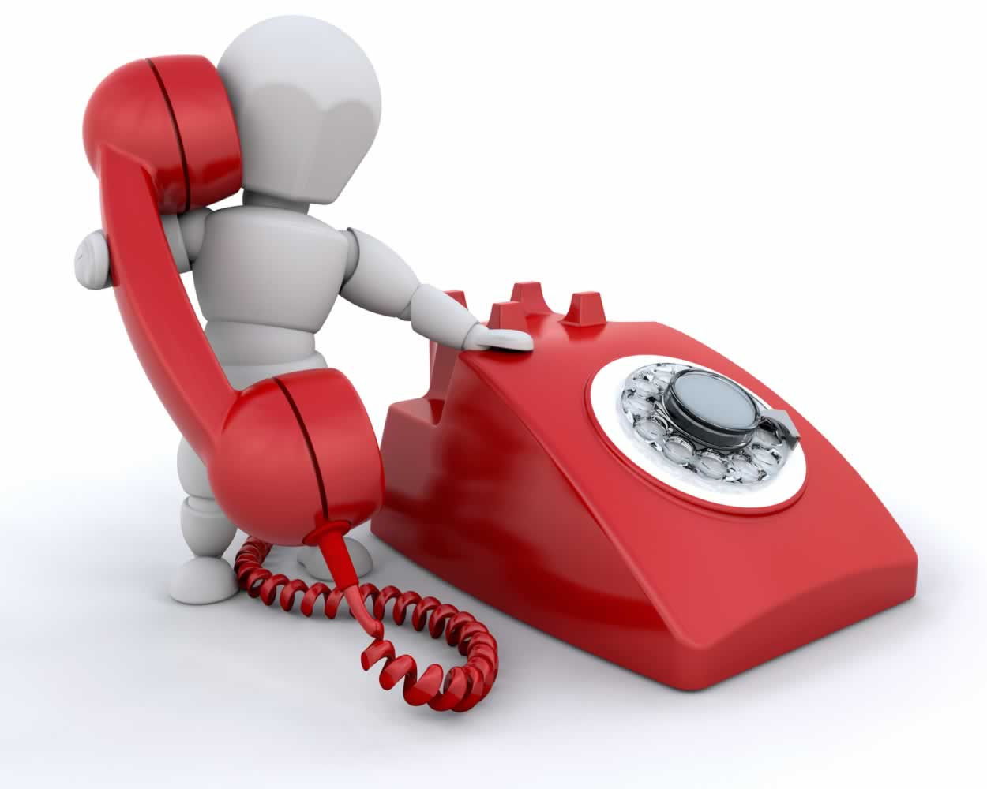
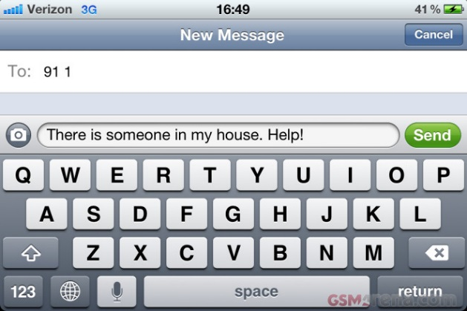
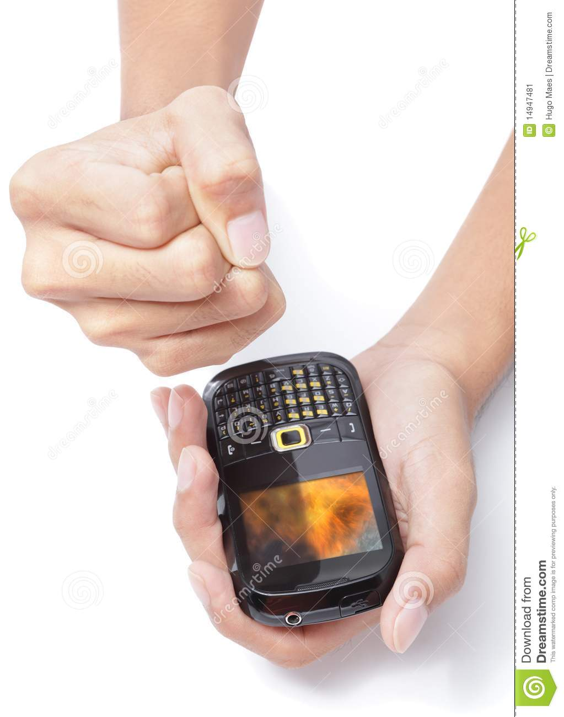
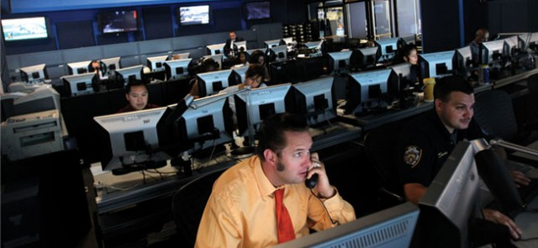
Standardisation for emergency calls is not a new topic … however requirements have evolved

Slide 3
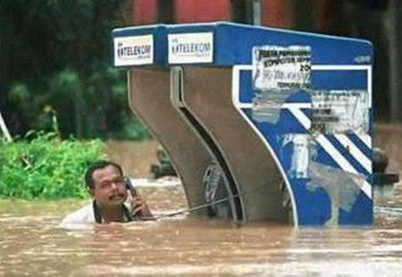
The general requirements are rather clear, even if they may slightly vary from one country/region to another
Location has to be accurate and reliable
Fast call connection
Priority service call
Widely available
Available to all
Network resilience and recovery
Circuit switched and IP based network
Additional information, if possible

Slide 4
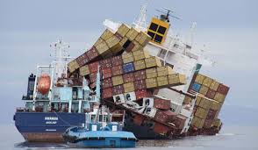
Good news with GSC Members’ countries (1)
A national emergency number, and sometimes an emergency number for a region or part of a region has been mandated.
Global Maritime Distress and Safety System (GMDSS) is implemented in most of these countries.
On the road
Global standardization with ITU-T
eCall mandated in Europe
Where no standards on road safety there are studies for standardization, at least with Cooperative ITS or Dedicated Short Range Communications (DSRC) in U.S.
Caller location information accuracy and reliability
Global standards exist like with User Equipment localisation (e.g. OMA Secure User Plane Location recognized by 3GPP) or 3GPP network provided location information to IMS.
Most of these countries have standards for this topic; in some countries it is even mandated.

Slide 5
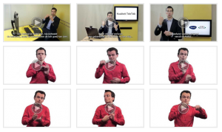
Good news with GSC Members’ countries (2)
Non-voice communication: can be used by all
Global standardisation exist like with 3GPP MMES (Multimedia Emergency Services).
In some countries national solutions like with SMS/MMS to 9-1-1 solution in U.S., 119 app on smart phone in Korea.
In Europe, Total Conversation.
Network resilience and recovery
Global standardization exists like with ITU-T.
Standards in most of these countries.
Additional data
ITU Internet of Things (IoT) and ubiquitous sensor networks can be used to assist in the collection of data and alerting authorities.

Slide 6
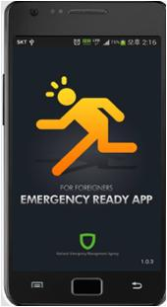
What’s next?
eCall with LTE
First 3GPP publications expected in Release 14
ITU-T Focus Group on Disaster Relief Systems, Network Resilience and Recovery (FG-DR&NRR) study should lead to new standards.
Smartphone facilities and functionality could be used to provide a more precise location for emergency calls, like in UK.
Address next-generation network interconnection and interoperability issues associated with emerging technologies, like in U.S.
Get input from further countries to the GSC-EM Task Force report to have a worldwide overview.

Slide 7
What could be improved in GSC Members’ countries?
The national emergency number: have the same worldwide or at least the same per area or region?
Road safety: from prevention to an emergency call solution?
Some countries have already implemented MMS or SMS to national emergency number that can be worth for location or people with disabilities
Expand to other countries?
Most of these countries have produced standards for network resilience and recovery
Why not a global standard now?

Slide 8
I encourage all of you to read the GSC-EM Task Force report (document GSC-19_104b) for further details, and particularly clause 6.
Thank you!
chantal.bonardi@etsi.org

