Slide 1
Document No: | GSC-19_103
Source: | TETRA and Critical Communications Association (TCCA)
Contact: | Phil Kidner
Agenda Item: | 3.3
Critical communications moving towards broadband
Phil Kidner
CEO, TCCA

Slide 2
What is happening in the rest of the world ?
Things are different in Europe and the rest of the world
In Europe TETRA and TETRAPOL
Elsewhere TETRA and other PMR technologies

Slide 3
What TETRA currently delivers
TETRA is a voice and narrow band data technology
TETRA can be a voice and wide band technology
TETRA is not a voice and broadband technology

Slide 4
What TETRA data currently delivers
Data base queries
Images
Group data
Simultaneous voice and data

Slide 5
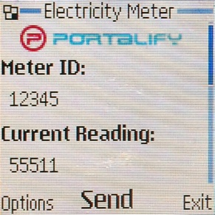
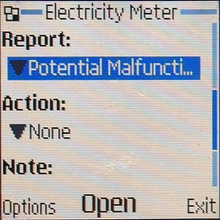
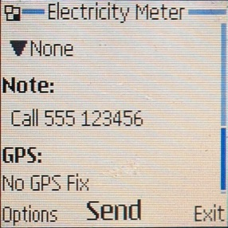
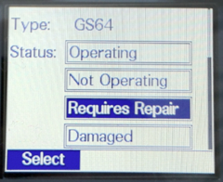
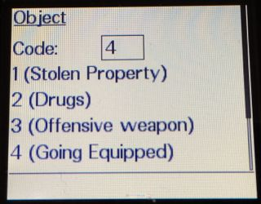
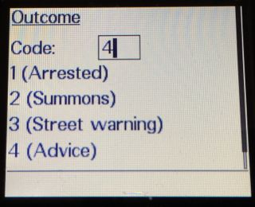
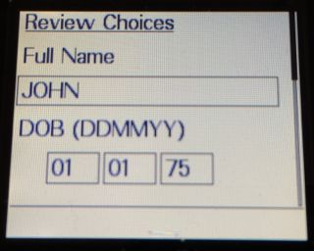
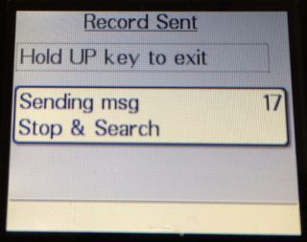
Things TETRA can do today - databases

Slide 6
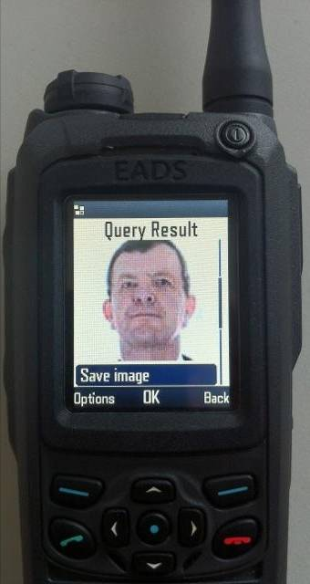
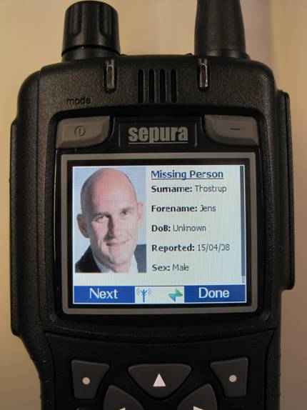
Things TETRA can do today -Images
Notes:
Delivered over SDS.
Concurrent voice and data

Slide 7
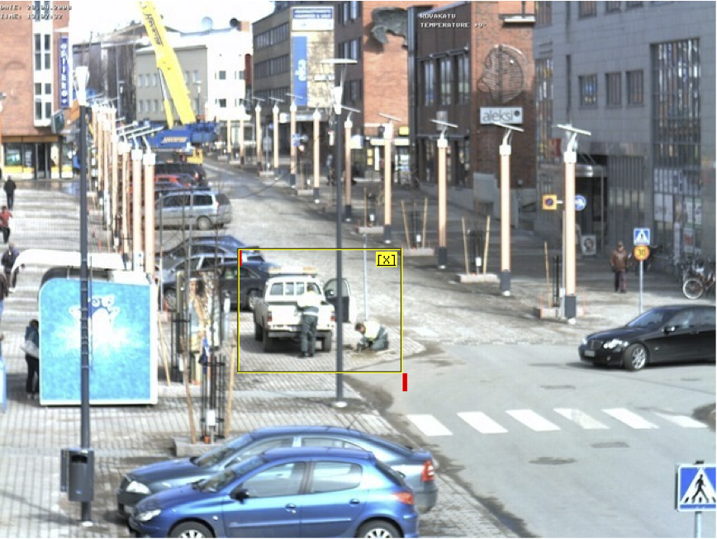
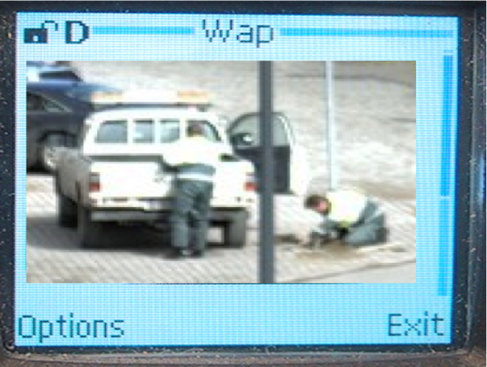
Things TETRA can do today - CCTV
500k
1.5k
Notes:
Summary
- From Picture information to useful commanding tool

Slide 8
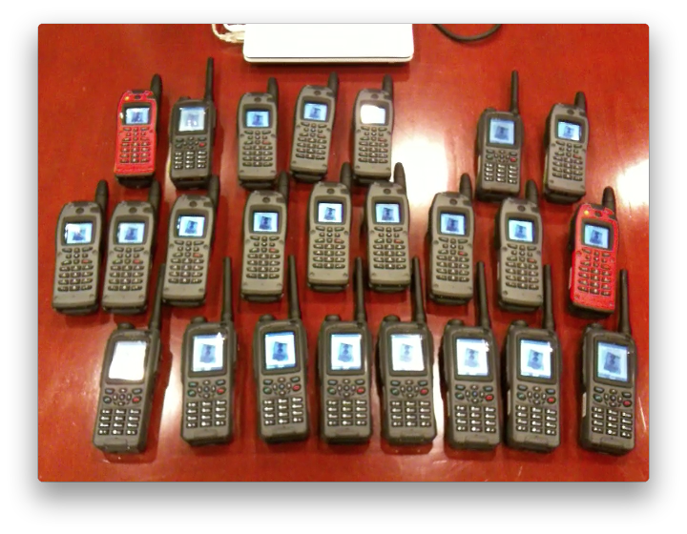
What TETRA can do today – group data

Slide 9
What TETRA currently delivers
Data base queries
Images
Group data
Simultaneous voice and data

Slide 10
What TETRA struggles to deliver
Is it just Video ?

Slide 11
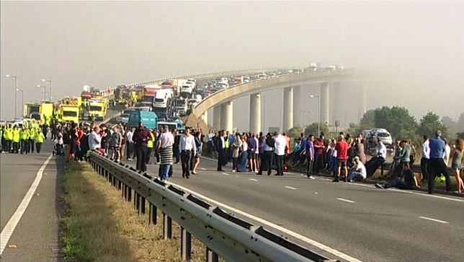
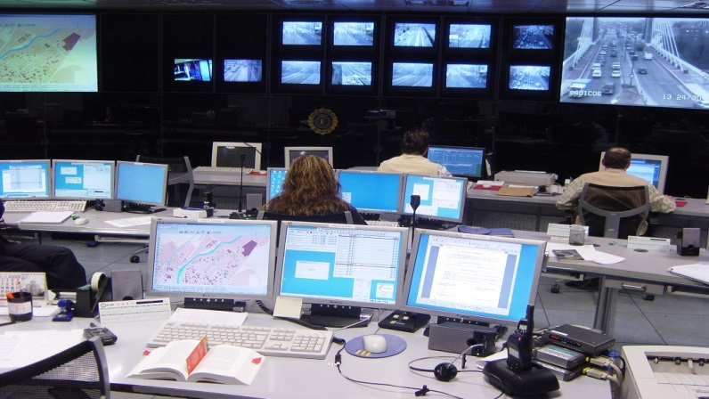
Things TETRA struggles to do today – Live Video Streaming
Notes:
Streaming live video direct from the scene of a Motorway accident….

Slide 12
Live Video Streaming
Notes:
Or from a helicopter…..

Slide 13
What TETRA struggles to deliver
Is it just Video ?
Improved data functionality

Slide 14
Spectrum challenges
Current data is delivered in 25 kHz and exceptionally 50 kHz channels
No spectrum has been identified for PPDR in Europe
Will other critical communications users have access to sufficient spectrum ?

Slide 15
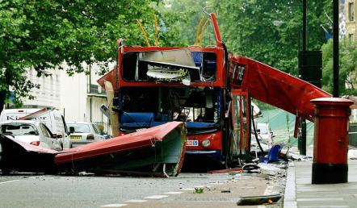
Public systems
Are critical communications users being pushed towards sharing public systems ?

Slide 16
Are hybrid systems the future ?
Huge investment in current technology
Designed for critical communications users
Available when and where users require
Absence of standards currently
But …. There is a need for broad band data

Slide 17
TETRA continues & data develops in parallel
Time window for managed transition from TETRA
Non-critical LTE voice
Critical LTE data+voice (LTE Rel 12+) available
Broadband capability
LTE operating capability via MVNO
Commercial complementary data access + MVNO
TBS2 → TB3 renewal
Manufacturer’s TETRA Rel8/9 LTE voice phase 2+3
TETRA- capabilities
Manufacturer’s TETRA Rel7 Dual homing + LTE voice phase 1
Manufacturer’s TETRA Rel6 DXT3
TETRA voice and data
2010
2015
2020
2025
Need for dedicated data solution
Notes:
TETRA kehittyy edelleen – standardointi jatkuu
– valmistauminen siirtymään alkaa (IP transmissio, IP sovellukset …)

Slide 18
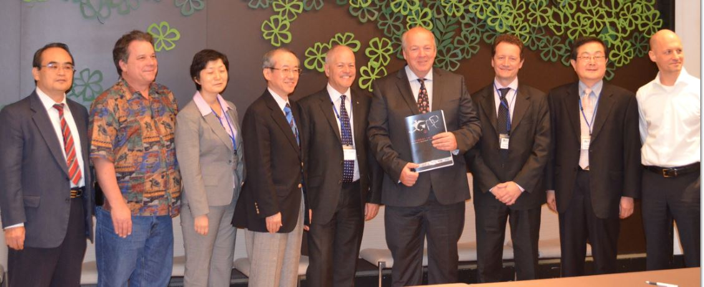
How can the TCCA help ?
Bring users together
Advise the LTE community
Encourage global standards
Address the “Gap”
Focus on applications
Lobby for spectrum
Education

Slide 19
Conclusion
The latest PMR technologies are designed to meet the needs of critical communications users
Until LTE can provide the equivalent standardised functionality then PMR and LTE are likely to exist in parallel
There is a lack of spectrum particularly in Europe for PPDR. There is unlikely to be sufficient spectrum available for all critical communications users
Public systems have so far failed to deliver critical communications
There is a need for global co-operation.

Slide 20
Thank you

