Slide 1
Document No: | GSC-19_102
Source: | ATIS - Public Safety Communications Research (NTIA/ITS.P)
Contact: | Andrew Thiessen
Agenda Item: | 3.2
Public Safety Broadband Efforts in the United States
Andrew Thiessen, Division Chief
Public Safety Communications Research (NTIA/ITS.P)

Slide 2
Agenda
Background on Public Safety interoperability in the United States
U.S. Land Mobile Radio landscape
Primer on the First Responder Network Authority (FirstNet)
Public Safety standards strategy
Testing efforts at PSCR for Public Safety

Slide 3
Public Safety Interoperability
Why public safety couldn’t talk
Incompatible and aging communications equipment
Limited and fragmented funding
Limited and fragmented planning
Lack of coordination and cooperation
Limited and fragmented radio spectrum

Slide 4
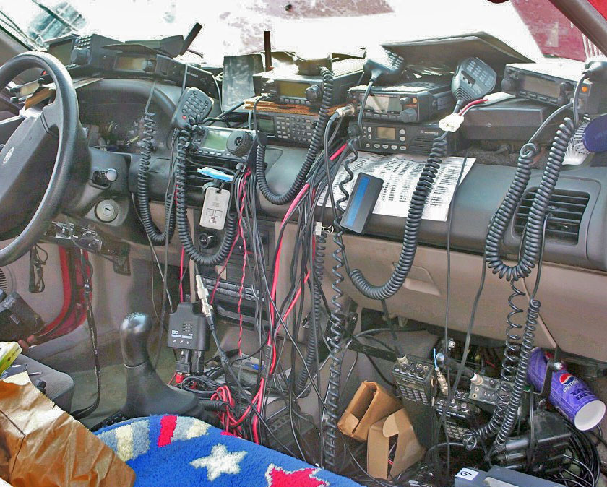
Public Safety Interoperability

Slide 5
U.S. Land Mobile Radio Landscape
Estimated ~$10B+ of capital invested in LMR in the United States
5+ different technologies
Including P25 (both conventional and trunked)
Legacy FM
Several proprietary types from multiple manufacturers
Thousands of different LMR networks
60,000+ public safety agencies
Each LMR network on separate and distinct procurement timeline
Networks typically are used for 15-20 years
Subscriber units typically used for 8-10 years

Slide 6
FirstNet Background
US Congress passes Middle Class Tax Relief and Job Creation Act of 2012
US Dept. of Commerce’s NTIA to establish First Responder Network Authority
FirstNet to establish a nationwide, LTE, public safety broadband network
Designation of $7 Billion USD towards the build out of the network
FirstNet intention to publish final Request for Proposal to build network end of 2015/early 2016
5-13* million public safety users in the US
Does not include vehicles and other machine type UEs (sensors)
* Dependent on interpretation of “public safety” by FirstNet

Slide 7
Standards Strategy
Mission Critical Voice
Two modes of operation acceptable
Push To Talk
Cellular Telephony
Direct Mode
Group Communications
Audio Quality
Speaker Identification
Emergency Alerting

Slide 8
Test and Evaluation
NIST Public Safety Research and Development Fund
Mission Critical Voice
Direct mode benchmarking
Push to talk evaluation
Audio quality testing
Land Mobile Radio to LTE integration
Integrated handset
System to system

Slide 9
Thank you! Questions?

