Slide 1
Document No: | GSC-19_023 (Rev.1)
Source: | ARIB
Contact: | Mr. Takehiro Nakamura, NTT DOCOMO (nakamurata@nttdocomo.com)
Agenda Item: | Agenda Item Number
Summary of IMT-2020/5G Strategic Session
Takehiro Nakamura
NTT DOCOMO, ARIB

Slide 2
Leadership of IMT-2020/5G Strategic Session
Chair: Takehiro Nakamura, ARIB
Vice Chair: Mark Lipford, ATIS
Vice Chair: Peter Ashwood Smith, ITU

Slide 3
Agenda
Approval of Agenda
Brief presentation on high level overviews of IMT-2020/5G (<15 minutes)
Session chair
ITU
Presentation from guest speakers of 5G related organizations (<10 minutes each)
3GPP: Mr. Erik Guttman, Chairman of 3GPP TSG-SA
4G Americas: Mr. Chris Pearson, President of 4G Americas
5G Forum: Prof. Youngnam Han, Chairman of Steering Committee, 5G Forum
5GMF: Dr. Akihiro Nakao, Chairman of Network Architecture Committee, 5GMF Mr. Takaharu Nakamura, Acting Chairman of Technical Committee, 5GMF
5GPPP: Dr. Werner Mohr, Chairman of the board of 5G Infrastructure Association
IMT-2020(5G) PG: Ms. Hu Jinling, CATT Delegate in IMT-2020(5G) PG
NGMN: Mr. Klaus Moschner, NGMN Office
ATIS (Oral presentation)
IEEE(Oral presentation)
TIA(Oral presentation)
Discussion on future collaboration among GSC members and 5G related organizations
Harmonization on study results of the organizations, e.g. use cases, requirements;
Harmonization on spectrum aspects;
Way forward for network aspects; and
Others.
Summary of the session

Slide 4
Summary of 5G Activities

Slide 5
Use cases
Variety of use cases have been proposed in the 5G related organizations and much commonalities can be seen
Major use cases are categorized to;
Enhanced Mobile Broadband
Massive machine type communications
Ultra reliable and low latency communications

Slide 6
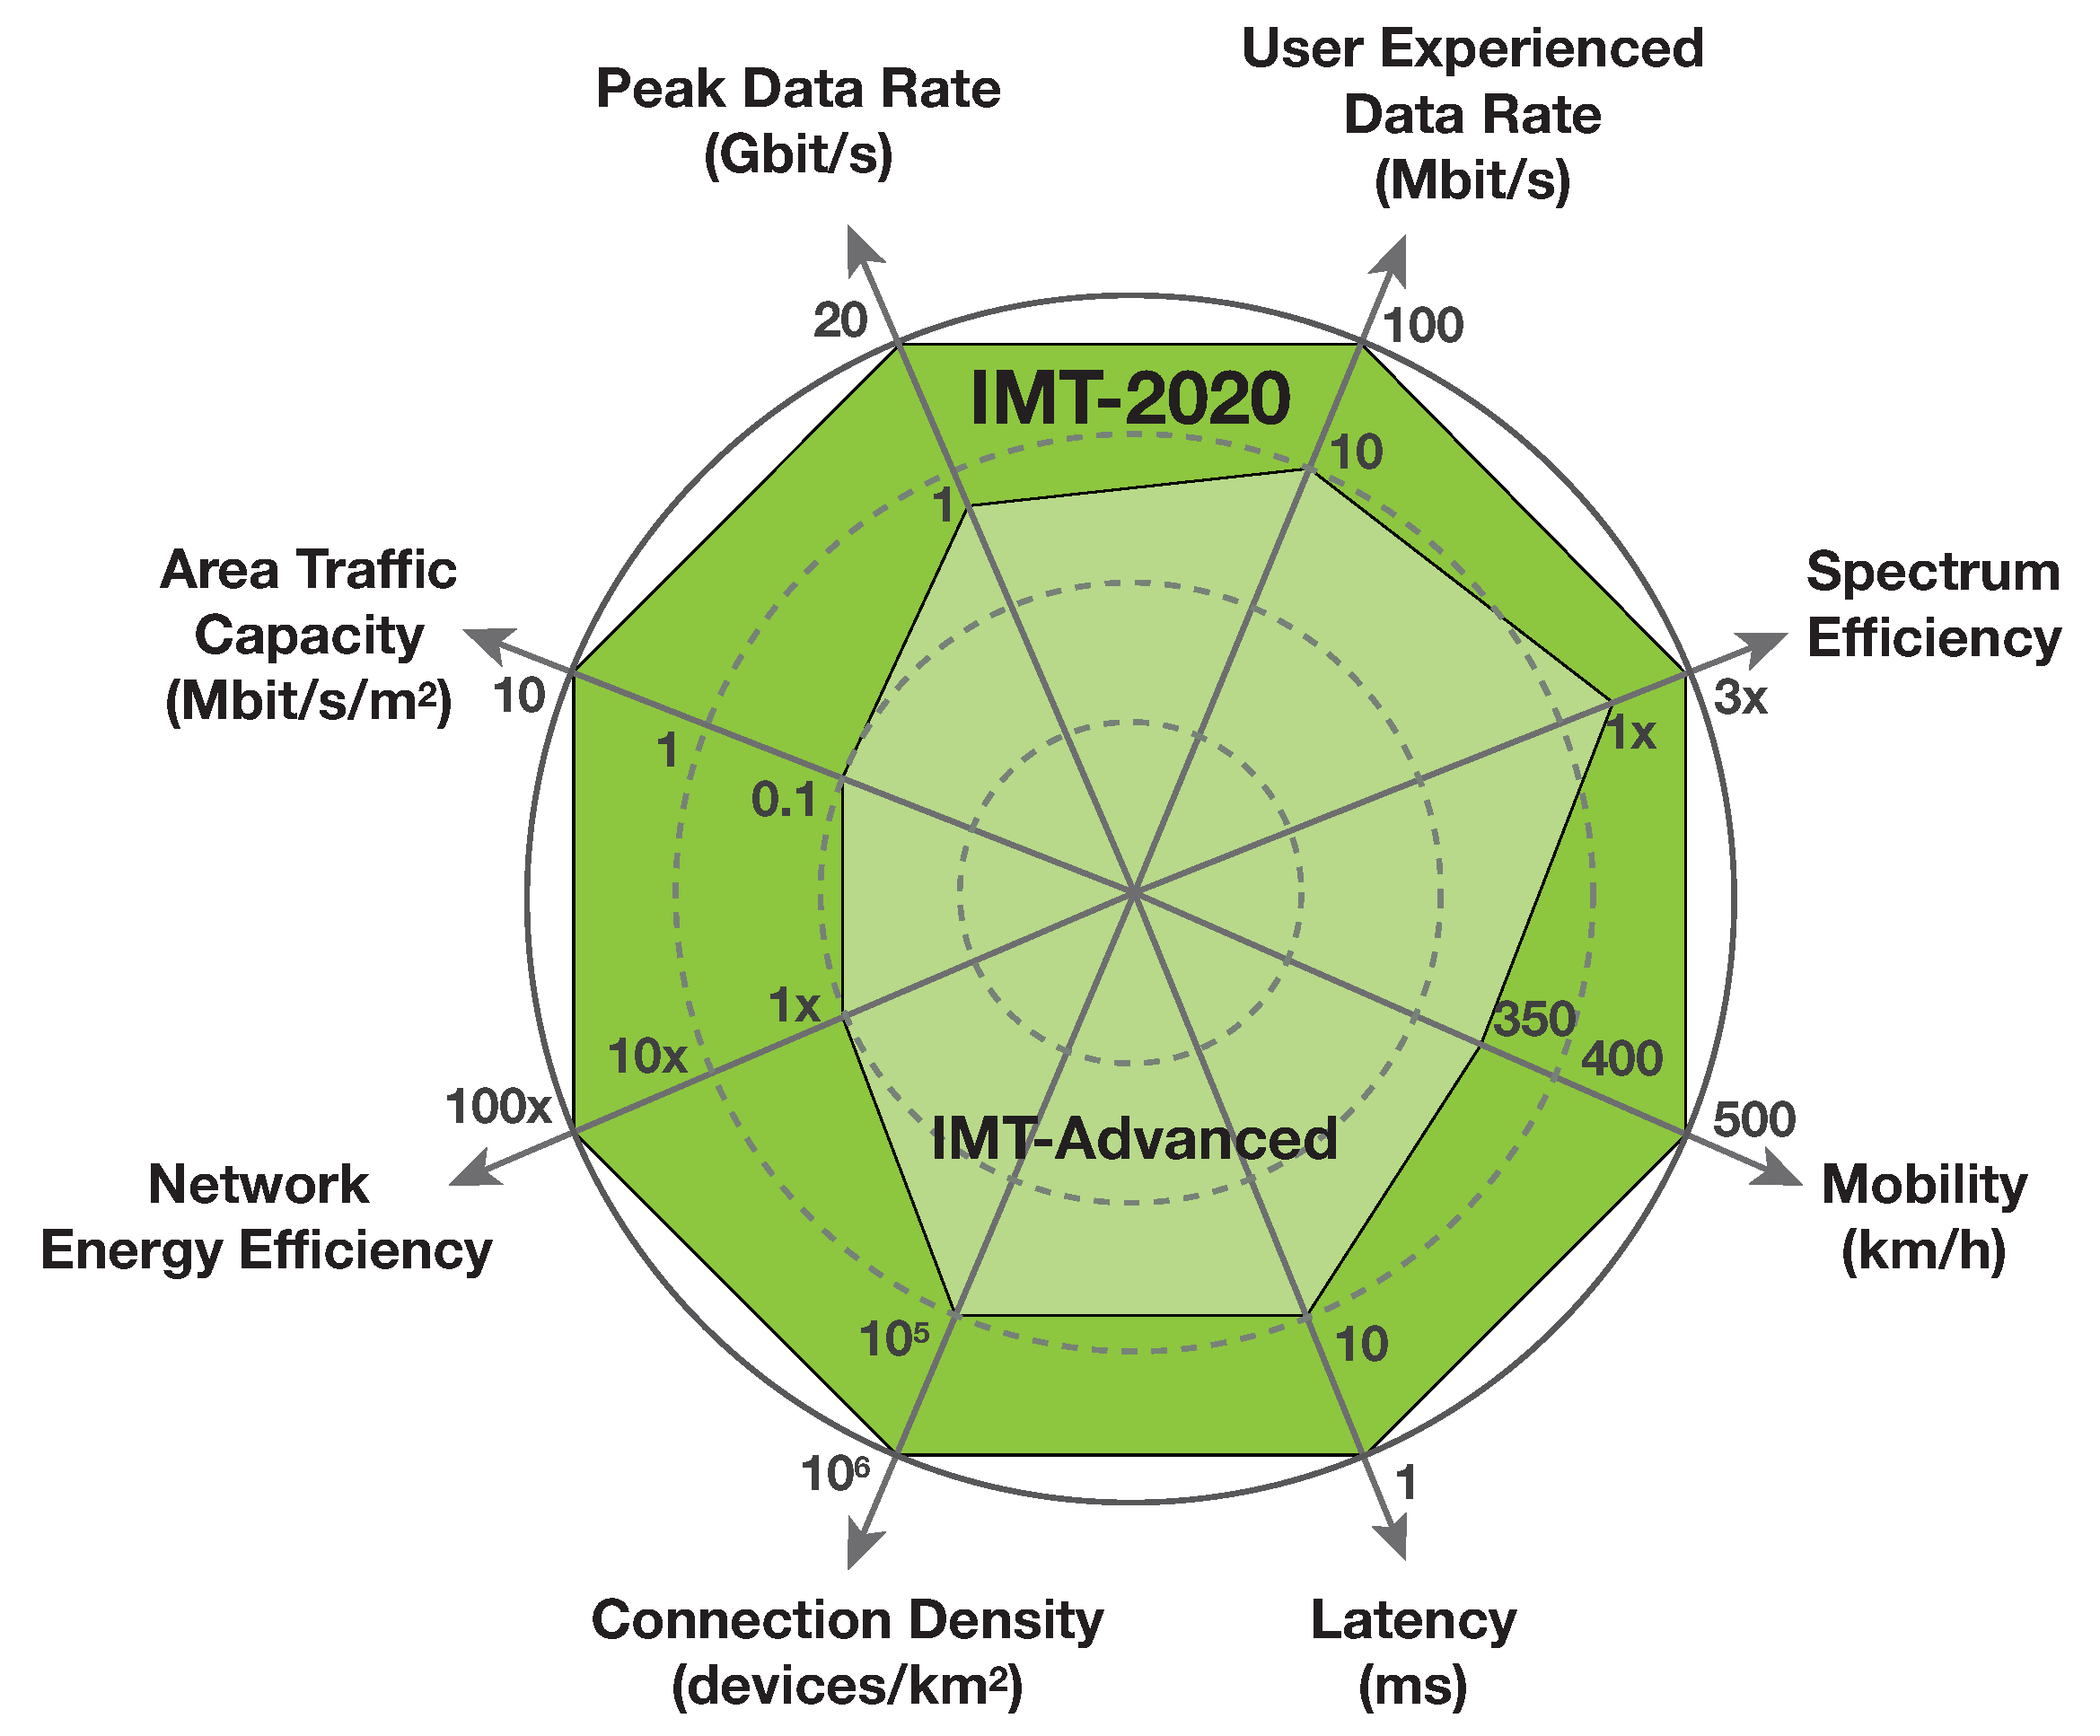
Requirements/capabilities
KPI and value are almost aligned among 5G related organizations
Detailed requirements and evaluation methodologies will be defined in ITU-R WP5D and 3GPP in 2016

Slide 7
Radio Technologies
Variety of technical proposals provided
Big interests in technologies on;
higher spectrum band, cm/mm wave, such as massive MIMO
New waveform
Heterogeneous multi-RAT interworking
Further enhancements from 4G technologies such as M2M, D2D
etc

Slide 8
Network Technologies
Variety of technical proposals provided
Big interests in technologies for;
SDN/NFV can be baseline for 5G network
Slicing
Mobile edge computing
Fronhaul/backhaul
Security
ICN/CCN
SDOs have already started some projects including gap analysis

Slide 9
Spectrum
Need new spectrum bands for 5G in WRC-19
Identification of new spectrum bands is under discussion
Some limited amount of spectrum may be available by refarming

Slide 10
Summary of Future Collaboration

Slide 11
Collaboration for harmonization on study results of the organizations
Use cases, requirements
Use cases, KPIs and values are almost aligned among the organizations
3GPP and ITU-R will start projects on them from beginning of 2016 in parallel
Technologies
So many proposals but almost common interests identified
Collaborations
To have opportunities for multilateral communication for e.g.
sharing study results of the organizations
Identification of potential 5G technologies and time schedule to facilitate discussion in 3GPP
Maintaining alignment between SDOs
Development of detailed requirements and evaluation methodologies

Slide 12
Collaboration for spectrum aspects
Need new spectrum bands for 5G in WRC-19
Identification of new spectrum bands is under discussion
Some limited amount of spectrum may be available by refarming
Collaborations
To have opportunities for multilateral communication to share the study results
Support national/regional activities for WRC-15/19
Provide common views, such as possible global harmonized bands and amount of spectrum, to regulators
Frequency sharing studies
Radio propagation measurements and channel modeling for > 6GHz to support ITU-R SG3 and 3GPP

Slide 13
Collaboration for network aspects
SDOs have already started some projects including gap analysis
Collaborations
To have opportunities for multilateral communication for network technologies
Support industry gap analysis sharing inputs from relevant SDOs, e.g. synchronization, X-haul, QoS consistency

